Slide 1

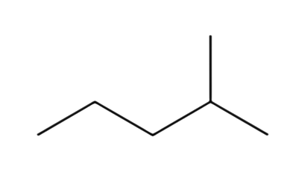
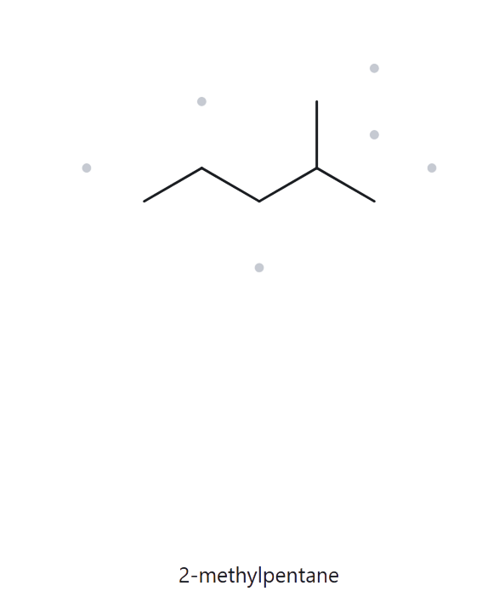


A01
Level: Foundation
Molecular Formula:
structure ➜ name
C6H14
  NUMBERED PARENT
  NAMING TRAIL
Parent: longest chain = 5 C → pentane.
Numbering: left → right gives 4
right → left gives 2
First point of difference: 2 < 4, so number from the right.
5
3
1
4
2
Substituents:
methyl on C2 → 2-methyl
  MY NAME
  ALKANE CHECK
2-methylpentane
match
longest chain
lowest locants
alphabetical order
punctuation
formula counted

Slide 2
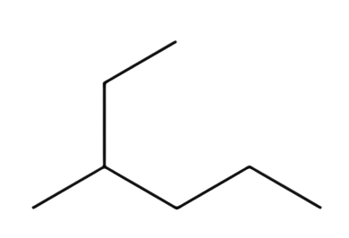
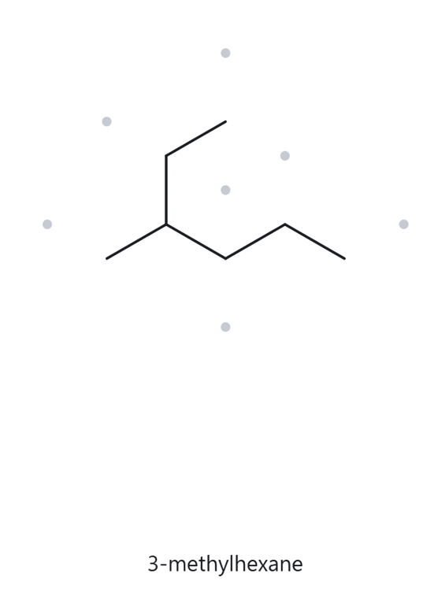
A02
Level: Foundation
Molecular Formula:
structure ➜ name
C7H16
  NUMBERED PARENT
  NAMING TRAIL
Parent: longest chain = 6 C → hexane
It runs up through the ethyl arm, which is not the horizontal path (that one is only 5 C).
1
2
Numbering: ethyl end → other end gives 3
other end → ethyl end gives 4
First point of difference: 3 < 4, so number from the ethyl end.
3
4
6
5
Substituents:
methyl on C3 → 3-methyl
  MY NAME
  ALKANE CHECK
3-methylhexane
match
longest chain
lowest locants
alphabetical order
punctuation
formula counted

Slide 3
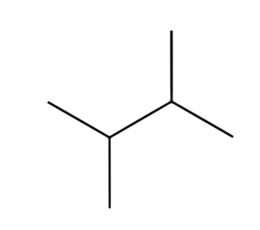
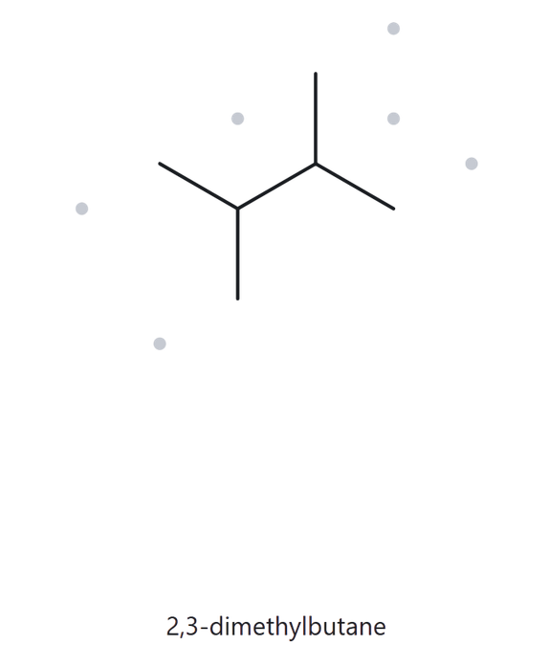
A03
Level: Foundation
Molecular Formula:
structure ➜ name
C6H14
  NUMBERED PARENT
  NAMING TRAIL
Parent: longest chain = 4 C → butane
Numbering: left → right gives 2,3
right → left gives 2,3
There is no point of difference, so the direction does not matter.
2
4
4
3
1
1
3
2
Substituents:
methyl on C2 and C3 → 2,3-dimethyl
  MY NAME
  ALKANE CHECK
2,3-dimethylbutane
match
longest chain
lowest locants
alphabetical order
punctuation
formula counted

Slide 4
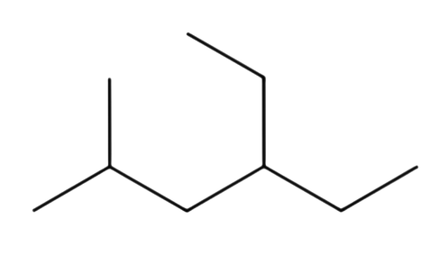
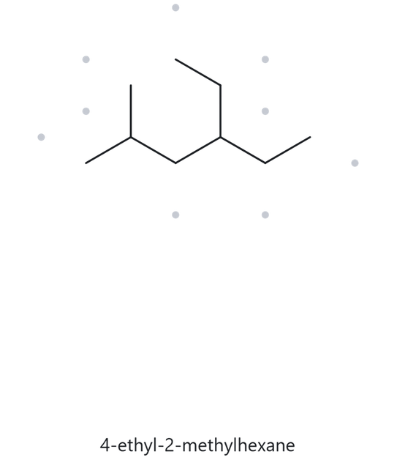
A04
Level: Developing
Molecular Formula:
structure ➜ name
C9H20
  NUMBERED PARENT
  NAMING TRAIL
Parent: longest chain = 6 C → hexane
Numbering: left → right gives 2,4
right → left gives 3,5
First point of difference: 2 < 3, so number from the left.
1
3
5
2
4
6
Substituents:
ethyl on C4, methyl on C2.
Ethyl is cited first alphabetically → 4-ethyl-2-methyl
  MY NAME
  ALKANE CHECK
4-ethyl-2-methylhexane
match
longest chain
lowest locants
alphabetical order
punctuation
formula counted

Slide 5
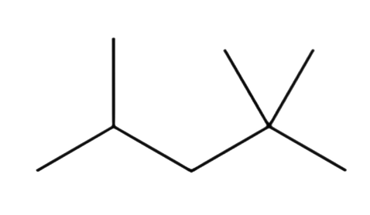
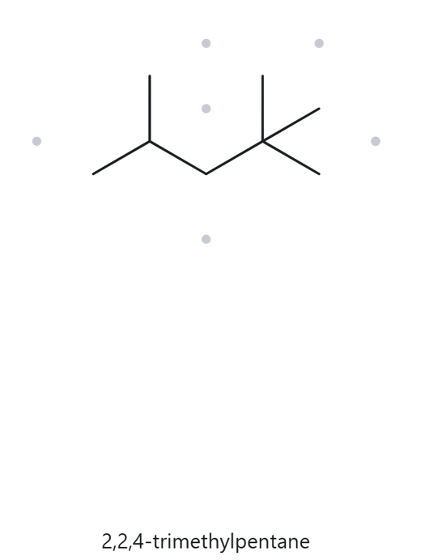
A05
Level: Developing
Molecular Formula:
structure ➜ name
C8H18
  NUMBERED PARENT
  NAMING TRAIL
Parent: longest chain = 5 C → pentane
Numbering: left → right gives 2,4,4
right → left gives 2,2,4
The first locants tie (2 and 2). The point of difference is the second locant: 2 < 4, so number from the right.
5
3
1
4
2
Substituents:
methyl on C2, C2 and C4 → 2,2,4-trimethyl
  MY NAME
  ALKANE CHECK
2,2,4-trimethylpentane
match
longest chain
lowest locants
alphabetical order
punctuation
formula counted

Slide 6
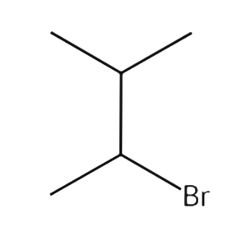
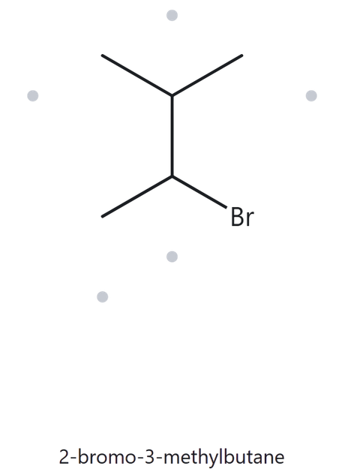
A06
Level: Developing
Molecular Formula:
structure ➜ name
C5H11Br
  NUMBERED PARENT
  NAMING TRAIL
Parent: longest chain = 4 C → butane
1
1
Numbering:
Both directions give locants 2 and 3.
Since the locant sets tie, use alphabetical order
Bromo comes before methyl, so bromo receives C2.
2
2
3
3
4
4
Substituents:
bromo on C2, methyl on C3 → 2-bromo-3-methyl
and two ways more
  MY NAME
  ALKANE CHECK
2-bromo-3-methylbutane
match
longest chain
lowest locants
alphabetical order
punctuation
formula counted

Slide 7
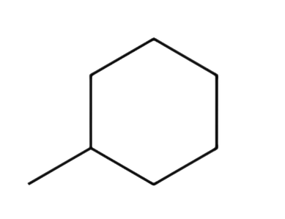
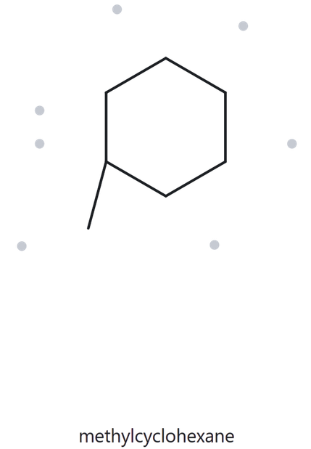
A07
Level: Developing
Molecular Formula:
structure ➜ name
C7H14
  NUMBERED PARENT
  NAMING TRAIL
Parent: the ring is the parent, 6 C → cyclohexane
3
Numbering: only one substituent, so there is no point of difference and no locant is needed
2
4
1
5
6
Substituents: methyl → methyl
The numbering is used only to count the parent ring carbons and identify the parent structure. It does not indicate a locant that needs to appear in the final name.
  MY NAME
  ALKANE CHECK
methylcyclohexane
match. The methyl bond angle differs, but the connectivity is the same (6-C ring, one methyl).
ring confirmed
lowest locants
alphabetical order
punctuation
formula counted

Slide 8
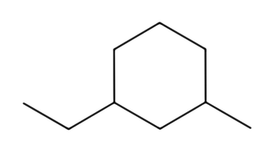
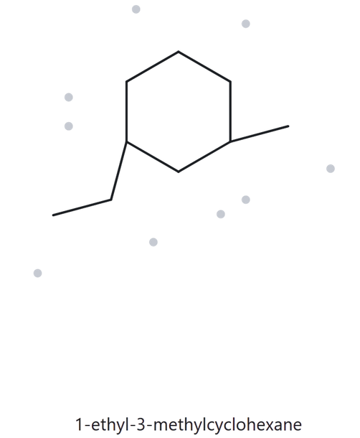
A08
Level: Challenge
Molecular Formula:
structure ➜ name
C9H18
  NUMBERED PARENT
  NAMING TRAIL
Parent: the ring is the parent, 6 C → cyclohexane
Numbering:
start at a substituent and go the shorter way round.
Ethyl C1 → methyl gives {1,3}; methyl C1 → ethyl gives {1,3}.
No point of difference, so the tie goes to alphabetical order: ethyl takes C1.
6
5
4
4
5
6
1
2
3
3
2
1
Substituents:
ethyl on C1, methyl on C3 → 1-ethyl-3-methyl
  MY NAME
  ALKANE CHECK
1-ethyl-3-methylcyclohexane
match. The bond angles and lengths differ, but the connectivity is the same: a 6-C ring, ethyl and methyl on carbons 1,3 apart.
ring confirmed
lowest locants
alphabetical order
punctuation
formula counted

Slide 9
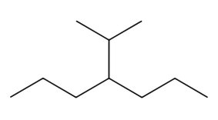
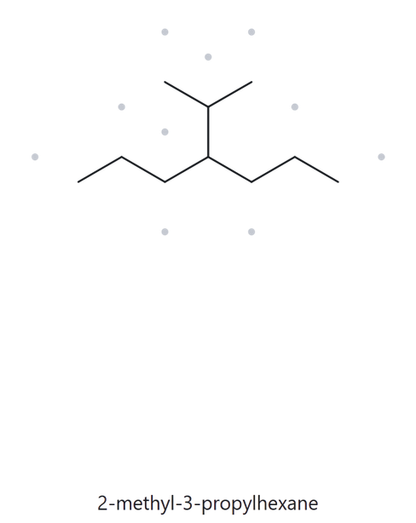

A09
Level: Challenge
Molecular Formula:
structure ➜ name
C10H22
  NUMBERED PARENT
  NAMING TRAIL
Parent: longest chain = 7 C → heptane
(the path through the branch is only 6 C)
Numbering: left → right gives 4; right → left gives 4. There is no point of difference, so the direction does not matter.
1
2
3
4
5
6
7
7
6
5
4
3
2
1
Substituents:
one 3-carbon branch attached through its middle carbon (isopropyl) on C4 → 4-(1-methylethyl)
  MY NAME
  ALKANE CHECK
4-(1-methylethyl)heptane
mismatch. Correct name: 4-(1-methylethyl)heptane. The parent is the longest continuous chain. The tool chose a 6-C chain (hexane), but a 7-C chain (heptane) exists.
also acceptable: 4-isopropylheptane or 4-(propan-2-yl)heptane
longest chain
lowest locants
alphabetical order
punctuation
formula counted

Slide 10
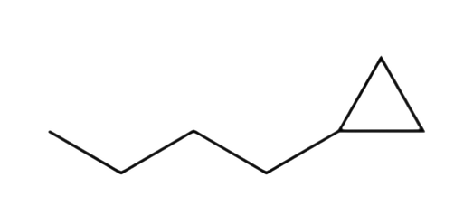
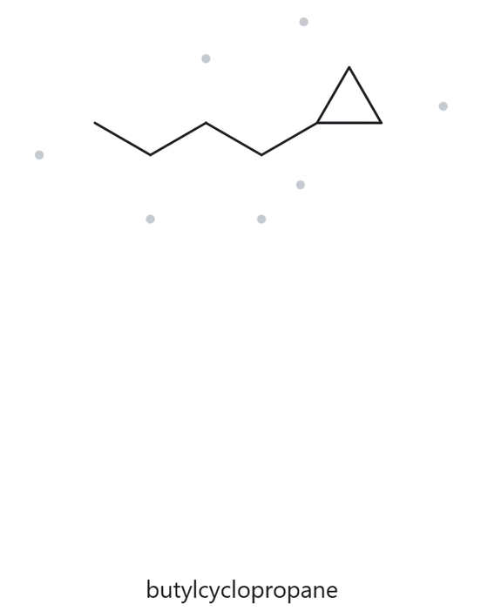
A10
Level: Challenge
Molecular Formula:
structure ➜ name
C7H14
  NUMBERED PARENT
  NAMING TRAIL
Parent: the ring (3C) is the parent (2013 rule), even though the chain is longer → cyclopropane
2
Numbering: only one substituent, so there is no point of difference and no locant is needed
1
3
Substituents:
4-carbon chain → butyl → butyl
The numbering is used only to count the parent ring carbons and identify the parent structure. It does not indicate a locant that needs to appear in the final name.
  MY NAME
  ALKANE CHECK
butylcyclopropane
match
ring confirmed
lowest locants
alphabetical order
punctuation
formula counted

Slide 11

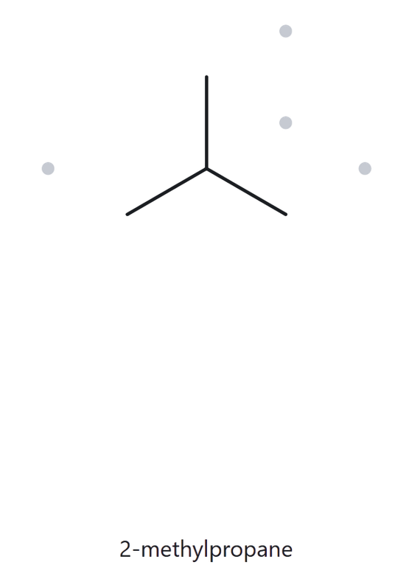
B01
Level: Foundation
GIVEN NAME:
structure ➜ name
2-methylpropane
  NAME DECODED
  BOND-LINE STRUCTURE (THE ALKANE)
Parent: propane → 3-C chain
Substituents: methyl on C2
Expected Formula (using the general formula):
Total carbon atoms = 3 + 1 = 4
open chain: CnH2n+2 = C4H2(4)+2 = C4H10
  FORMULA CHECK
  BACK-CHECK
Counted from the drawing:
C4H10
General Formula:
C4H10
Returned by The Alkane:
2-methylpropane
counted = general formula
same as the given name
parent length matches
substituent positions match
formula agrees
back-check recorded

Slide 12

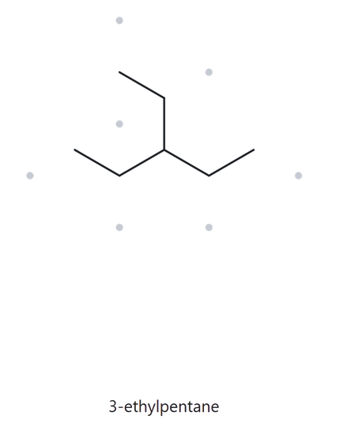
B02
Level: Foundation
GIVEN NAME:
structure ➜ name
3-ethylpentane
  NAME DECODED
  BOND-LINE STRUCTURE (THE ALKANE)
Parent: pentane → 5-C chain
Substituents: ethyl on C3
Expected Formula (using the general formula):
Total carbon atoms = 5 + 2 = 7
open chain: CnH2n+2 = C7H2(7)+2 = C7H16
  FORMULA CHECK
  BACK-CHECK
Counted from the drawing:
C7H16
General Formula:
C7H16
Returned by The Alkane:
3-ethylpentane
counted = general formula
same as the given name
parent length matches
substituent positions match
formula agrees
back-check recorded

Slide 13
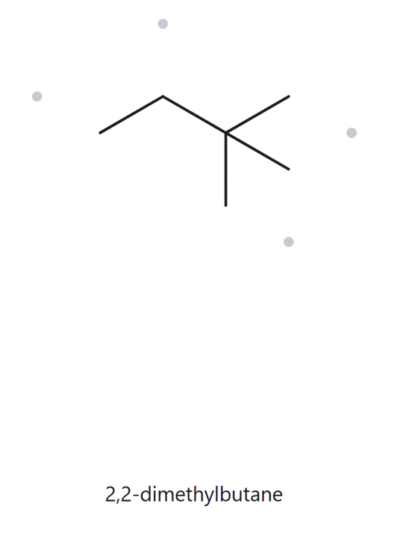
B03
Level: Foundation
GIVEN NAME:
structure ➜ name
2,2-dimethylbutane
  NAME DECODED
  BOND-LINE STRUCTURE (THE ALKANE)
Parent: butane → 4-C chain
Substituents: two methyls on C2
Expected Formula (using the general formula):
Total carbon atoms = 4 + 2 = 6
open chain: CnH2n+2 = C6H2(6)+2 = C6H14
  FORMULA CHECK
  BACK-CHECK
Counted from the drawing:
C6H14
General Formula:
C6H14
Returned by The Alkane:
2,2-dimethylbutane
counted = general formula
same as the given name
parent length matches
substituent positions match
formula agrees
back-check recorded

Slide 14
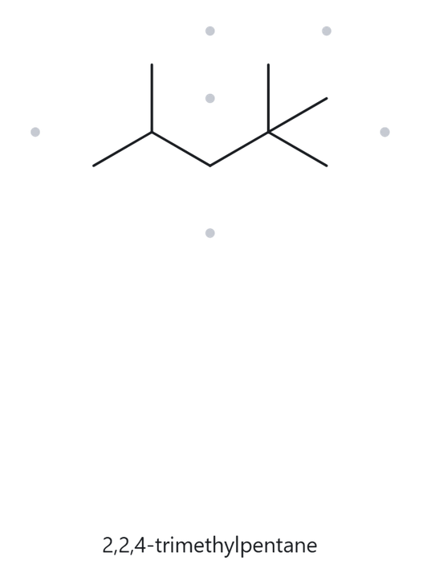
B04
Level: Developing
GIVEN NAME:
structure ➜ name
3-ethyl-2-methylpentane
  NAME DECODED
  BOND-LINE STRUCTURE (THE ALKANE)
Parent: pentane → 5-C chain
Substituents: methyl on C2, ethyl on C3
Expected Formula (using the general formula):
Total carbon atoms = 5 + 1 + 2= 8
open chain: CnH2n+2 = C8H2(8)+2 = C8H18
  FORMULA CHECK
  BACK-CHECK
Counted from the drawing:
C8H18
General Formula:
C8H18
Returned by The Alkane:
3-ethyl-2-methylpentane
counted = general formula
same as the given name
parent length matches
substituent positions match
formula agrees
back-check recorded

Slide 15
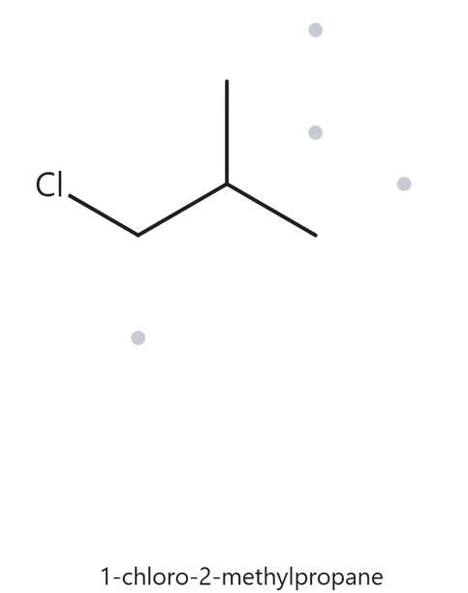
B05
Level: Developing
GIVEN NAME:
structure ➜ name
1-chloro-2-methylpropane
  NAME DECODED
  BOND-LINE STRUCTURE (THE ALKANE)
Parent: propane → 3-C chain
Substituents: chloro on C1, methyl on C2
Expected Formula (using the general formula):
Total carbon atoms = 3 + 1 = 4
open chain: CnH2n+2 = C4H2(4)+2 = C4H10
replaces one H → C₄H₉Cl
  FORMULA CHECK
  BACK-CHECK
Counted from the drawing:
C4H9Cl
General Formula:
C4H9Cl
Returned by The Alkane:
1-chloro-2-methylpropane
counted = general formula
same as the given name
parent length matches
substituent positions match
formula agrees
back-check recorded

Slide 16
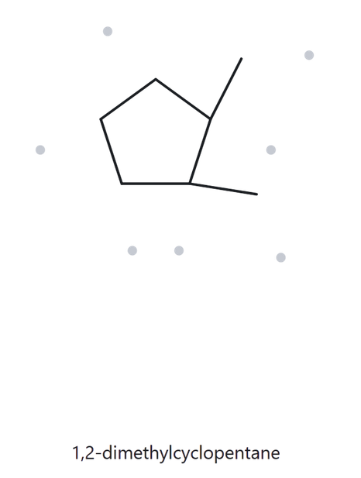
B06
Level: Developing
GIVEN NAME:
structure ➜ name
1,2-dimethylcyclopentane
  NAME DECODED
  BOND-LINE STRUCTURE (THE ALKANE)
Parent: cyclopentane → 5-C ring
Substituents:
methyl on C1 and C2 (adjacent carbons)
Expected Formula (using the general formula):
Total carbon atoms = 5 + 2 = 7
one ring: CnH2n = C4H2(4) = C7H14
  FORMULA CHECK
  BACK-CHECK
Counted from the drawing:
C7H14
General Formula:
C7H14
Returned by The Alkane:
1,2-dimethylcyclopentane
counted = general formula
same as the given name
parent length matches
substituent positions match
formula agrees
back-check recorded

Slide 17
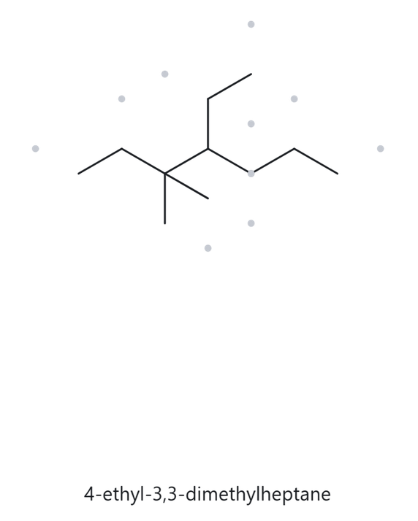
B07
Level: Developing
GIVEN NAME:
structure ➜ name
4-ethyl-3,3-dimethylheptane
  NAME DECODED
  BOND-LINE STRUCTURE (THE ALKANE)
Parent: heptane → 7-C chain
Substituents: two methyls on C3, ethyl on C4
Expected Formula (using the general formula):
Total carbon atoms = 7 + 2 + 2 = 11
open chain: CnH2n+2 = C11H2(11)+2 = C11H24
  FORMULA CHECK
  BACK-CHECK
Counted from the drawing:
C11H24
General Formula:
C11H24
Returned by The Alkane:
4-ethyl-3,3-dimethylheptane
counted = general formula
same as the given name
parent length matches
substituent positions match
formula agrees
back-check recorded

Slide 18
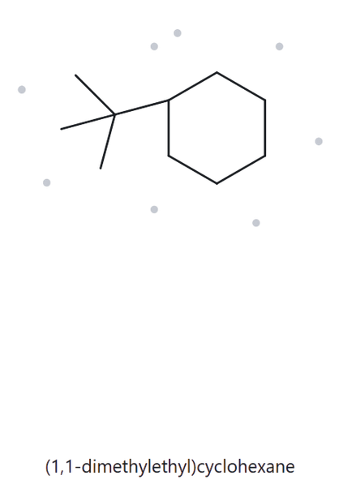
B08
Level: Challenge
GIVEN NAME:
structure ➜ name
tert-butylcyclohexane
  NAME DECODED
  BOND-LINE STRUCTURE (THE ALKANE)
Parent: cyclohexane → 6-C ring
Substituents:
tert-butyl, a carbon bearing three methyls,
–C(CH₃)₃ → 4 C
Expected Formula (using the general formula):
Total carbon atoms = 6 + 4 = 10
one ring: CnH2n = C10H2(10) = C10H20
  FORMULA CHECK
  BACK-CHECK
Counted from the drawing:
C10H20
General Formula:
C10H20
Returned by The Alkane:
(1,1-dimethylethyl)cyclohexane
Same compound as the given name. The Alkane writes tert-butyl as (1,1-dimethylethyl), the bracketed form of tert-butylcyclohexane.
counted = general formula
parent length matches
substituent positions match
formula agrees
back-check recorded

Slide 19
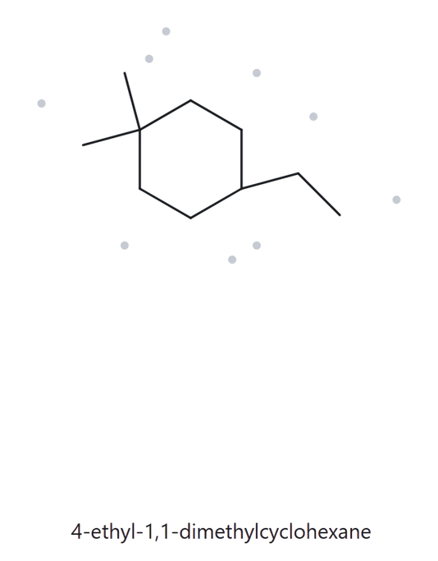
B09
Level: Challenge
GIVEN NAME:
structure ➜ name
3-ethyl-1,1-dimethylcyclohexane
  NAME DECODED
  BOND-LINE STRUCTURE (THE ALKANE)
Parent: cyclohexane → 6-C ring
Substituents: two methyls on C1, ethyl on C3
Expected Formula (using the general formula):
Total carbon atoms = 6 + 2 + 2 = 10
one ring: CnH2n = C10H2(10) = C10H20
  FORMULA CHECK
  BACK-CHECK
Counted from the drawing:
C10H20
General Formula:
C10H20
Returned by The Alkane:
3-ethyl-1,1-dimethylcyclohexane
counted = general formula
same as the given name
parent length matches
substituent positions match
formula agrees
back-check recorded

Slide 20
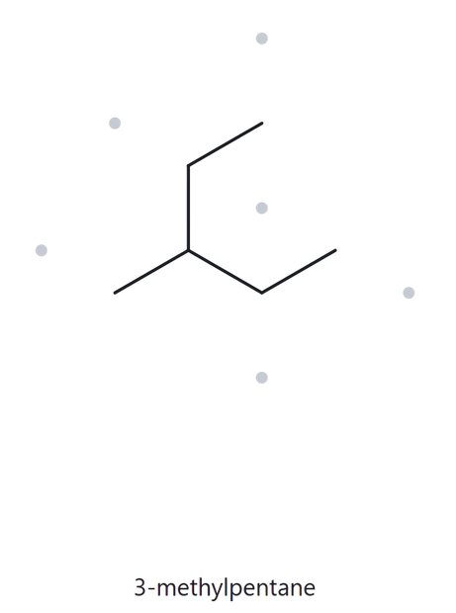
B10
Level: Challenge
GIVEN NAME:
structure ➜ name
2-ethylbutane
deliberately incorrect name
  NAME DECODED
  BOND-LINE STRUCTURE (THE ALKANE)
Parent: butane → 4-C chain
Substituents: ethyl on C2
Expected Formula (using the general formula):
Total carbon atoms = 4 + 2 = 6
open chain: CnH2n+2 = C6H2(6)+2 = C6H14
  FORMULA CHECK
  BACK-CHECK
Counted from the drawing:
C6H14
General Formula:
C6H14
Returned by The Alkane:
2-methylpropane
Not the same as the given name. The parent is the longest continuous chain. Through the ethyl group, there is a 5-C chain, so the parent is pentane with a methyl on C3.
counted = general formula
parent length matches
substituent positions match
formula agrees
back-check recorded

