Slide 1





four different chemical languages
IUPAC Name:
Propane
Propane is a liquefied petroleum gas that comes out of both oil and gas wells.
MOLECULAR FORMULA
LEWIS STRUCTRE
C₃H₈
H
H
H
H
C
C
C
H
H
H
H
CONDENSED STRUCTURAL FORMULA
BOND-LINE FORMULA
CH3CH2CH3
atom count
skeletal notation
connectivity consistent
valence
IUPAC name

Slide 2


four different chemical languages
IUPAC Name:
ethanol
Ethanol, also known as ethyl alcohol or simply alcohol, is a chemical compound that is both colorless and flammable.
MOLECULAR FORMULA
LEWIS STRUCTRE
C₂H₆O
H
H
..
H
C
C
O
H
..
H
H
CONDENSED STRUCTURAL FORMULA
BOND-LINE FORMULA
CH3CH2OH
atom count
skeletal notation
connectivity consistent
valence
IUPAC name

Slide 3

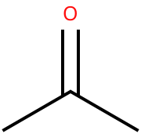
four different chemical languages
IUPAC Name: Propan-2-one
acetone
(Propan-2-one)
Acetone is a liquid solvent that can break down and dissolve other substances.
MOLECULAR FORMULA
LEWIS STRUCTRE
C₃H₆O
H
O
H
..
..
H
C
C
C
H
H
H
H
CONDENSED STRUCTURAL FORMULA
BOND-LINE FORMULA
CH3COCH3
atom count
skeletal notation
connectivity consistent
valence
IUPAC name

Slide 4

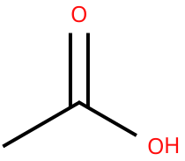
four different chemical languages
IUPAC Name: Ethanoic acid
acetic acid (ethanoic acid)
Acetic acid, also known as ethanoic acid, is a chemical compound found in many different products. It's perhaps most well-known as the main component of vinegar.
MOLECULAR FORMULA
LEWIS STRUCTRE
H
O
C₂H₄O₂
..
..
..
H
C
C
O
H
..
H
CONDENSED STRUCTURAL FORMULA
BOND-LINE FORMULA
CH3COOH
atom count
skeletal notation
connectivity consistent
valence
IUPAC name

Slide 5

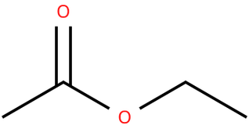
four different chemical languages
IUPAC Name: Ethyl ethanoate
Ethyl acetate
(ethyl ethanoate)
Ethyl Acetate is an organic ester compound that appears as a colorless liquid. It is highly miscible with all common organic solvents.
MOLECULAR FORMULA
LEWIS STRUCTRE
C₄H₈O₂
H
O
..
..
H
H
..
H
C
C
O
C
C
H
..
H
H
H
CONDENSED STRUCTURAL FORMULA
BOND-LINE FORMULA
CH3COOC2H5
atom count
skeletal notation
connectivity consistent
valence
IUPAC name

Slide 6


four different chemical languages
IUPAC Name:
Cyclohexane
Cyclohexane appears as a clear colorless liquid with a petroleum-like odor. Used to make nylon, as a solvent, paint remover, and to make other chemicals.
MOLECULAR FORMULA
LEWIS STRUCTRE
C₆H₁₂
H
H
H
C
H
H
C
C
H
H
C
C
H
C
H
H
H
H
CONDENSED STRUCTURAL FORMULA
BOND-LINE FORMULA
(CH2)6
atom count
skeletal notation
connectivity consistent
valence
IUPAC name

Slide 7

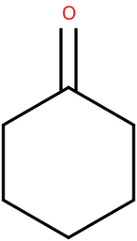
four different chemical languages
IUPAC Name:
Cyclohexanone
Cyclohexanone is an organic compound that is a colorless to pale yellow liquid with an odor similar to that of acetone that is very soluble in most organic solvents.
MOLECULAR FORMULA
LEWIS STRUCTRE
O
..
..
C₆H₁₀O
H
H
C
H
C
C
H
H
C
C
H
C
H
H
H
H
CONDENSED STRUCTURAL FORMULA
BOND-LINE FORMULA
(CH2)5CO
atom count
skeletal notation
connectivity consistent
valence
IUPAC name

Slide 8

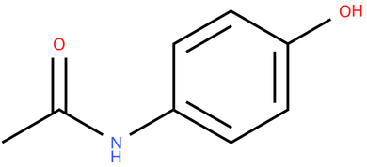
four different chemical languages
IUPAC Name: N-(4-hydroxyphenyl)acetamide
Acetaminophen
(paracetamol)
Acetaminophen (paracetamol), also commonly known as Tylenol, is the most commonly taken analgesic worldwide and is recommended as first-line therapy in pain conditions by the World Health Organization (WHO).
MOLECULAR FORMULA
LEWIS STRUCTRE
H
H
C₈H₉NO₂
C
O
H
..
H
..
O
..
C
C
..
H
C
C
..
C
C
N
C
H
H
H
H
CONDENSED STRUCTURAL FORMULA
BOND-LINE FORMULA
p-HOC6H4NHCOCH3
atom count
skeletal notation
connectivity consistent
valence
IUPAC name

Slide 9

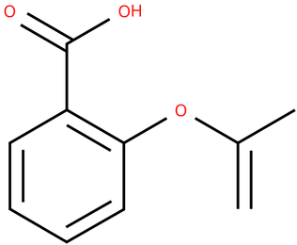
four different chemical languages
IUPAC Name: 2-(Acetyloxy)benzoic acid
Aspirin
(acetylsalicylic acid)
Aspirin (acetylsalicylic acid) is one of the oldest and most commonly used non-steroidal anti-inflammatory drugs (NSAIDs) for treating mild-to-moderate pain, fever, and inflammation from various causes.
MOLECULAR FORMULA
LEWIS STRUCTRE
H
C₉H₈O₄
..
O
..
O
..
..
C
H
C
..
O
..
C
H
H
C
C
C
H
C
C
H
O
..
H
C
..
H
CONDENSED STRUCTURAL FORMULA
BOND-LINE FORMULA
CH3COOC6H4COOH
atom count
skeletal notation
connectivity consistent
valence
IUPAC name

Slide 10

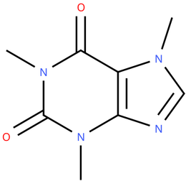
four different chemical languages
IUPAC Name: 1,3,7-Trimethylpurine-2,6-dione
caffeine
Caffeine is a drug of the methylxanthine class used for a variety of purposes, including certain respiratory conditions of the premature newborn, pain relief, and to combat drowsiness.
MOLECULAR FORMULA
LEWIS STRUCTRE
..
..
H
H
H
H
O
C
H
..
C
..
C₈H₁₀N₄O₂
H
C
N
C
N
..
C
H
..
C
..
C
N
O
N
..
C
H
H
H
CONDENSED STRUCTURAL FORMULA
BOND-LINE FORMULA
Caffeine does not have a simple, widely accepted condensed structural formula. Therefore, its structure may be represented using a structural diagram or SMILES notation. SMILES is a notation used to describe a molecule's structure and is not the same as a condensed structural formula.
SMIlLES Notation:
CN1C=NC2=C1C(=O)N(C(=O)N2C)C
atom count
skeletal notation
connectivity consistent
valence
IUPAC name

