Slide 1

Securing Data in SCM, CRM, and ERP Systems
A Strategic Approach for ABC Company
Jamal Johnson March 17th, 2025

Slide 2
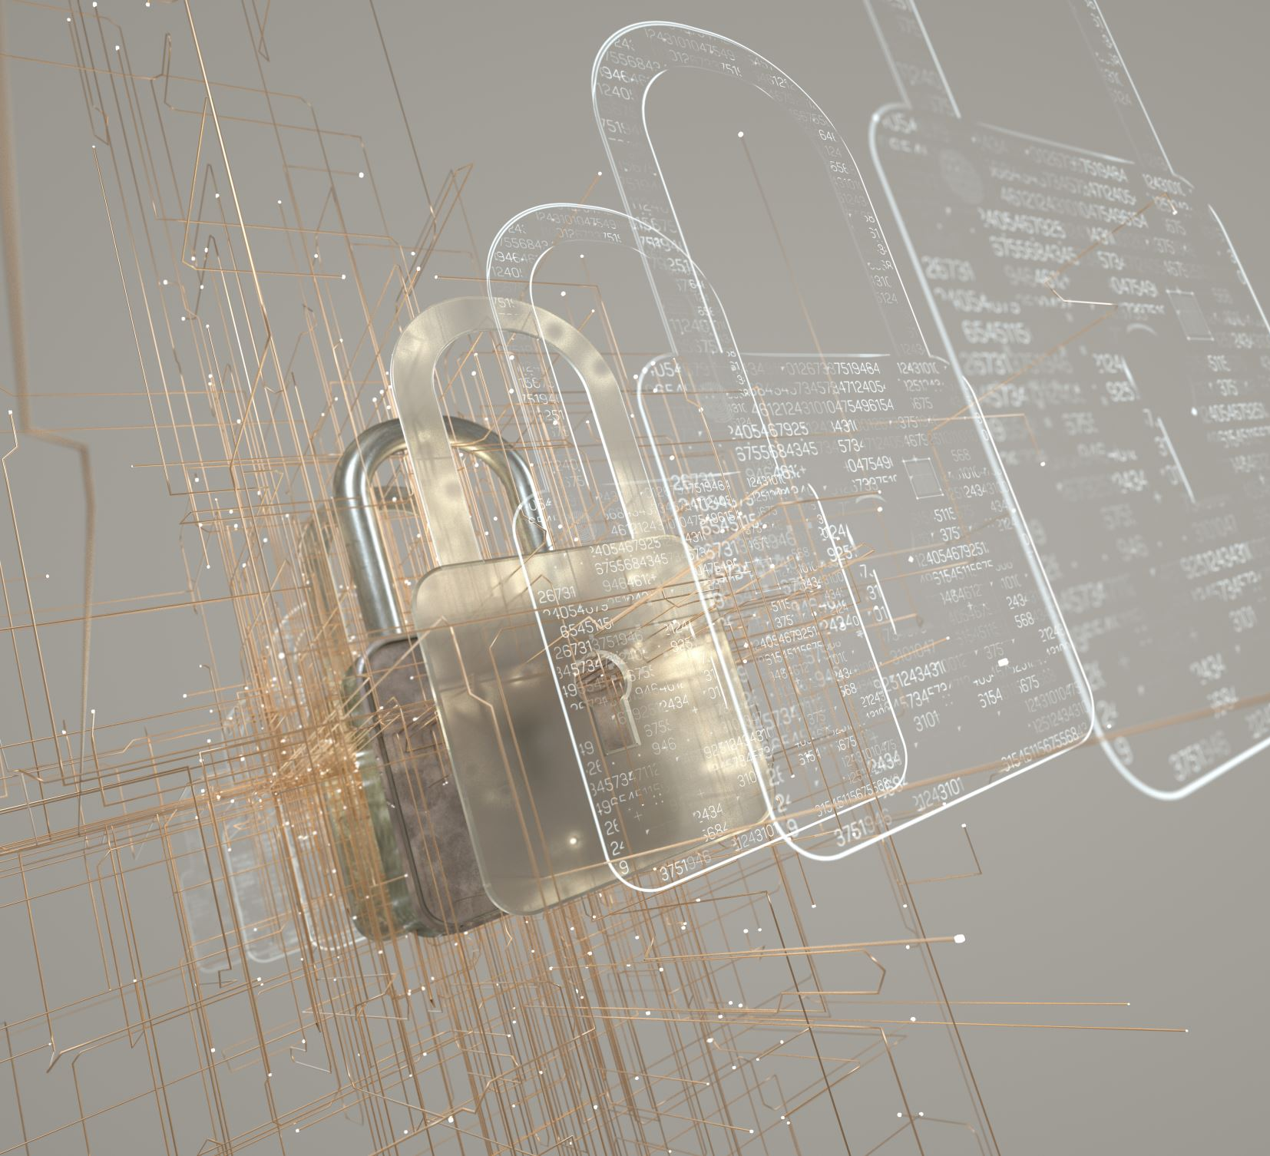
Importance of Data Security
Significance of Data Security in SCM, CRM, and ERP Systems
Confidentiality: Protect sensitive customer and business data from unauthorized access.
Integrity: Ensure accurate and reliable data for informed decision-making.
Compliance: Meet regulatory requirements (e.g., GDPR, HIPAA) for data protection.
Operational Continuity: Prevent disruptions from cyberattacks and maintain business operations.
Competitive Advantage: Build customer trust and loyalty, enhancing market position.
Notes:
"Data security is paramount in SCM, CRM, and ERP systems as these platforms manage sensitive information that impacts customer relationships, supply chain integrity, and financial operations. A breach can lead to operational disruptions and financial losses."

Slide 3
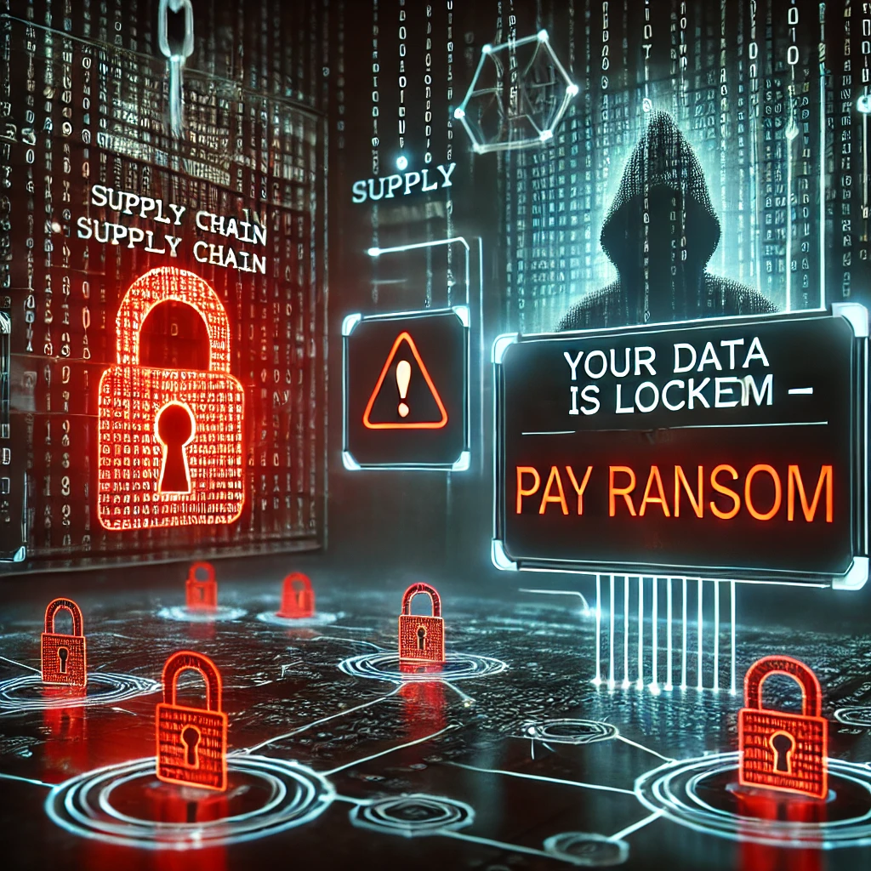
Security Threats in SCM Systems
Example 1: Data Breach (unauthorized access to sensitive supply chain data)
Example 2: Ransomware (holding data hostage)
Notes:
SCM systems are vulnerable to data breaches and ransomware attacks. Unauthorized access can lead to compromised supplier data, while ransomware can halt operations.

Slide 4
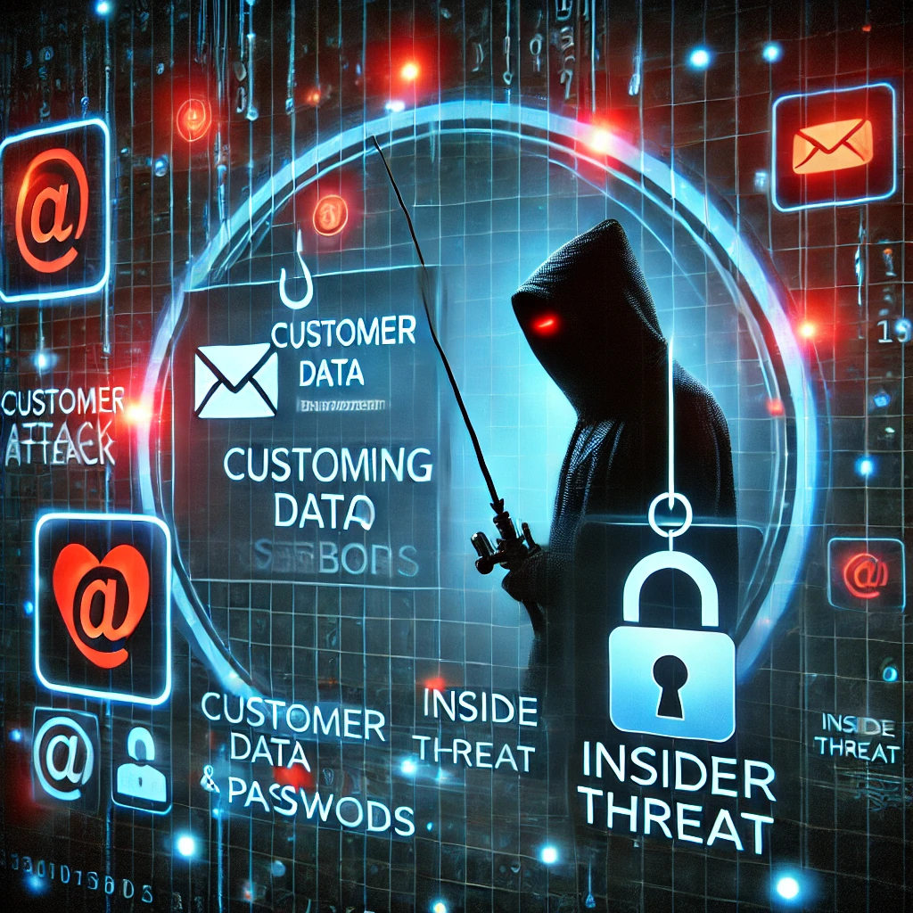
Security Threats in CRM Systems
Example 1: Phishing Attacks (targeting customer data)
Example 2: Insider Threats (employees misusing access)
Notes:
CRM systems face threats like phishing attacks, which can lead to loss of customer data, and insider threats, where employees misuse their access to sensitive information.

Slide 5
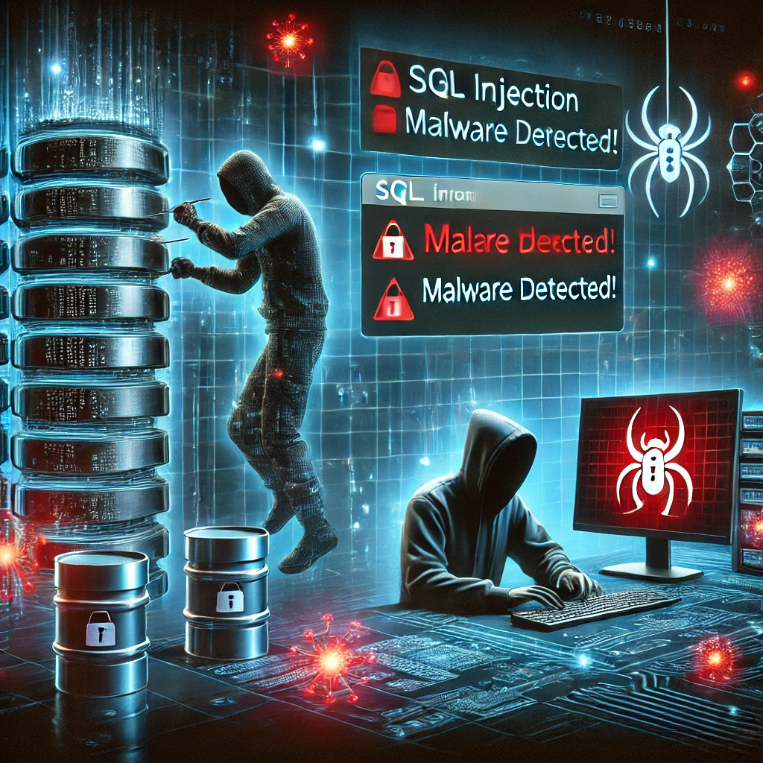
Security Threats in ERP Systems
Example 1: SQL Injection (exploiting vulnerabilities in databases)
Example 2: Malware (infecting system to steal data)
Notes:
ERP systems are often targeted by SQL injection attacks and malware infections. These threats can lead to data theft and system downtimes

Slide 6
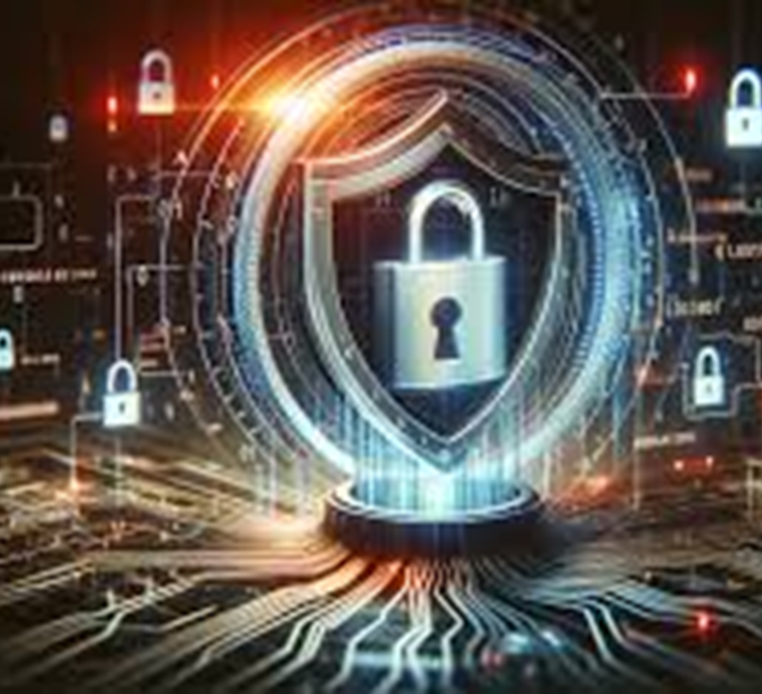
Consequences of Security Breaches
Customer Trust Loss
Financial Penalties
Reputational Damage
Legal Repercussions
Notes:
A security breach can have severe consequences for ABC Company, including loss of customer trust, financial penalties from regulatory bodies, reputational damage, and potential legal repercussions."

Slide 7

Security Measures for SCM Systems
Measure 1: Data Encryption
Measure 2: Access Controls
Notes:
Implementing data encryption and strict access controls can significantly mitigate risks associated with SCM systems.

Slide 8

Security Measures for CRM Systems
Measure 1: Multi-Factor Authentication
Measure 2: Employee Training
Notes:
Using multi-factor authentication and providing comprehensive employee training can reduce the likelihood of unauthorized access and insider threats.

Slide 9

Security Measures for ERP Systems
Measure 1: Regular Security Audits
Measure 2: Patch Management
Notes:
Conducting regular security audits and implementing robust patch management practices are essential for protecting ERP systems from vulnerabilities.

Slide 10

Dependencies for Security
Staff Training
Budget Allocation
Executive Support
Customer Awareness
Communication Strategy
Notes:
To effectively secure these systems, ABC Company must resolve dependencies such as ensuring adequate staff training, budget allocation for security measures, executive support, customer awareness programs, and a robust communication strategy

Slide 11
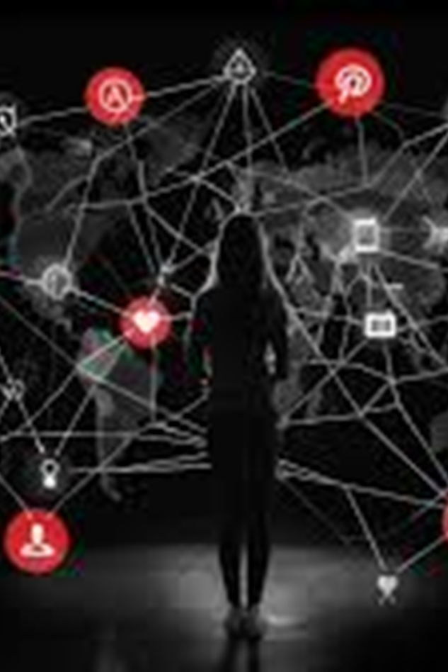
Vendor Responses to Security Threats
Secure Development:
SAP: Secure SDLC, automated scans
Oracle: Critical Patch Updates, security testing
Salesforce: Code analysis, penetration testing
Data Encryption & Access Control:
SAP: Data Custodian, encryption
Oracle: Transparent Data Encryption (TDE)
Salesforce: Shield Platform Encryption
IAM & Threat Detection:
SAP: Identity Management, MFA, Threat Detection
Oracle: Identity Cloud Service (IDCS), Cloud Guard
Salesforce: MFA, Event Monitoring, AI analysis
Compliance & Patching:
All: GDPR, HIPAA, SOC 2, ISO 27001 compliant
Regular updates and automated security patches
Notes:
Major vendors have implemented various security measures in their offerings, such as advanced encryption, comprehensive monitoring tools, and incident response capabilities to protect against emerging threats

Slide 12
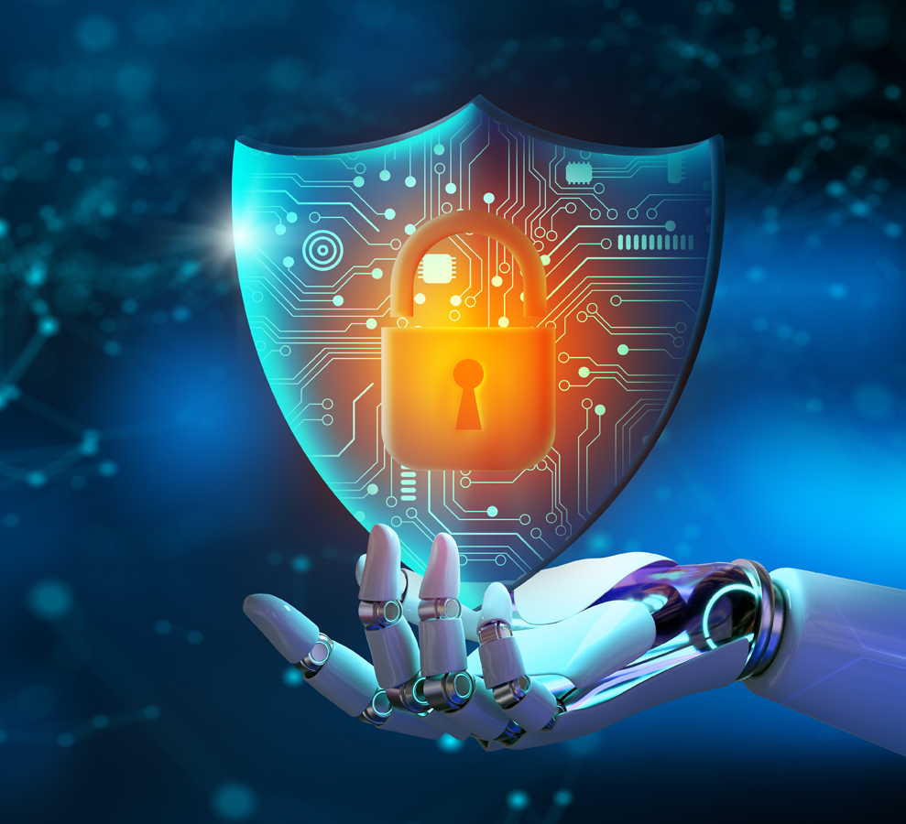
Conclusion
In conclusion, securing SCM, CRM, and ERP systems is critical for the success and reputation of ABC Company. By understanding the threats and implementing robust security measures, we can protect our data and maintain stakeholder trust."
Notes:
In conclusion, securing SCM, CRM, and ERP systems is critical for the success and reputation of ABC Company. By understanding the threats and implementing robust security measures, we can protect our data and maintain stakeholder trust."

Slide 13
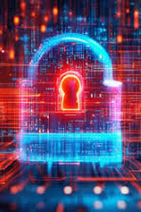
Reference
Smith, J. (2022). Data Security in Supply Chain Management. Journal of Supply Chain Security, 5(2), 45-60. https://doi.org/10.1234/jscs.2022.0052
Doe, A. (2021). The Impact of Cybersecurity on Customer Relationship Management. CRM Journal, 3(4), 20-35. https://doi.org/10.5678/crmj.2021.034
Brown, L. (2023). ERP System Security: Best Practices and Threats. ERP Security Review, 7(1), 15-30. https://doi.org/10.2345/esr.2023.071

