Slide 1
Olist Business Insights & Executive Presentation Power BI Dashboard Development
Prepared by:
Jamal Al Hajj
IDS Academy
Lebanese University – Data Science Department

Slide 2
Business Problem
E-commerce businesses generate large volumes of transactional data.
The challenge is transforming this raw data into actionable insights that support business growth and strategic decisions.
This project analyzes Olist sales performance to understand:
Revenue trends
Product performance
Regional sales performance
Delivery efficiency

Slide 3
Data approach
The project followed these steps:
1. SQL Database Connection
• Connected Power BI to PostgreSQL database
2. Data Modeling
• Built a semantic star schema model
3. KPI Creation
• Total Revenue
• Orders
• Average Order Value (AOV)
• Delivery Percentage
4. Dashboard Development
• Business-oriented interactive visualizations

Slide 4
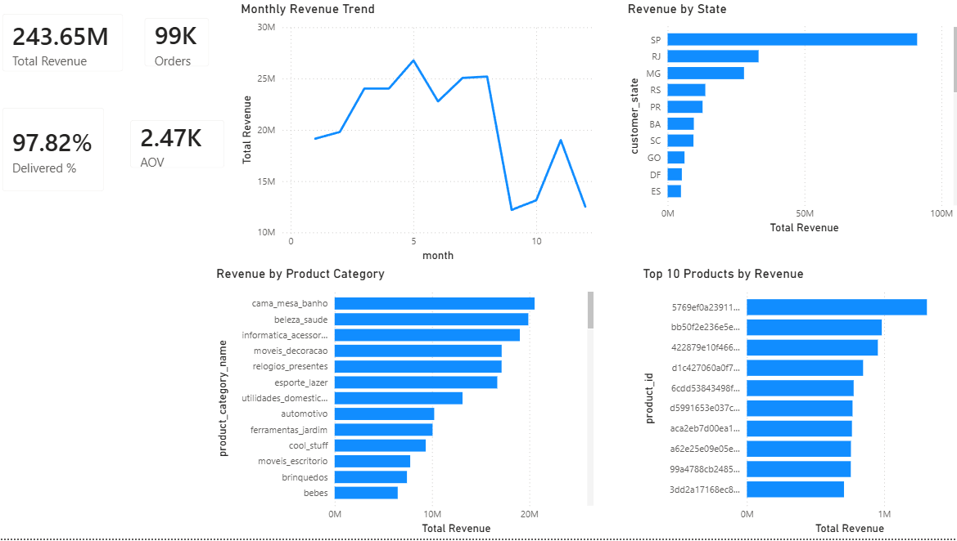
Dashboard Overview
Main KPIs:
• Total Revenue: 243.65M
• Total Orders: 99K
• Delivery Success Rate: 97.82%
• Average Order Value (AOV): 2.47K
The dashboard provides a complete overview of sales performance, customer delivery, product categories, and regional performance.

Slide 5
Revenue Trend Analysis
Monthly Revenue Trend
Key Findings:
• Revenue increased steadily during the first half of the year.
• Peak revenue was reached around Month 5.
• Revenue significantly decreased during later months.
• A temporary recovery occurred before another decline.
Insight:
The business demonstrates strong seasonal sales behavior.

Slide 6
Product Performance
Top Performing Categories:
• cama_mesa_banho
• beleza_saude
• informatica_acessorios
• moveis_decoracao
Lower Performing Categories:
• brinquedos
• bebes
Insight:
The business performs strongly in home, furniture, and health-related categories.

Slide 7
Regional Performance
Top Revenue States:
• SP generated the highest revenue.
• RJ and MG followed as strong-performing regions.
Lower Performing States:
• ES
• DF
Insight:
Revenue is concentrated in specific geographic regions.

Slide 8
Delivery Performance
Delivery Success Rate:
97.82%
Key Observation:
The delivery rate is extremely high, indicating strong operational efficiency and customer fulfillment reliability.
Business Impact:
High delivery success contributes positively to customer satisfaction and retention.

Slide 9
Strategic Recommendations
1. Invest More in Top Categories
Focus on high-performing categories to maximize profit.
2. Improve Underperforming Regions
Increase marketing and promotions in weaker states.
3. Seasonal Planning
Prepare marketing campaigns around high-sales periods.
4. Maintain Delivery Efficiency
Continue optimizing logistics to sustain customer trust.

Slide 10
Conclusion
The Power BI dashboard successfully transformed business data into meaningful insights.
The analysis identified:
• Revenue trends
• Strong product categories
• Regional performance differences
• High delivery efficiency
These findings support better strategic and data-driven business decisions.

