Slide 1
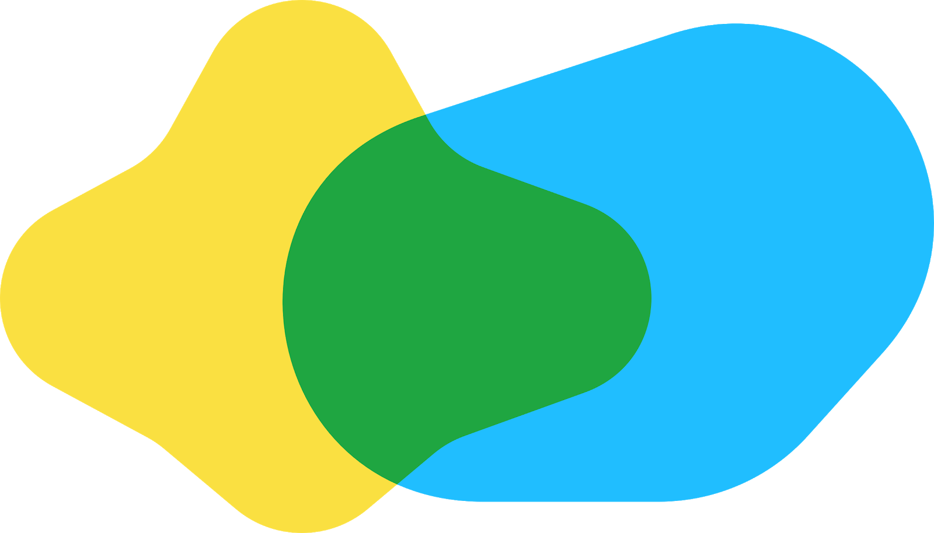


Biohub: Cell Tracking During Development
6th place solution · private 0.953
Jamal Saeedi
Researcher at IDSIA, Lugano · team Cyrus
Notes:
[about 30 seconds]
Hi everyone, and thanks to the organisers for having me. I'm Jamal Saeedi, a researcher at IDSIA in Lugano. I competed solo as team Cyrus, and this was my first cell-tracking project.
The solution finished sixth, with a private score of 0.953. It has three main pieces: a network that finds and links cells, a solver that builds consistent tracks, and a training loop that learns from those tracks.

Slide 2
Agenda
1
The task
2
Summary
3
Features & targets
4
Training methods
5
Inference: ILP & drift
6
Next steps
Notes:
[about 20 seconds]
I'll start with the task and the whole pipeline. Then we'll look inside the network, see how it learns from sparse labels, and turn its predictions into tracks. I'll finish with three things I'd try next. The appendix has extra detail for questions.

Slide 3
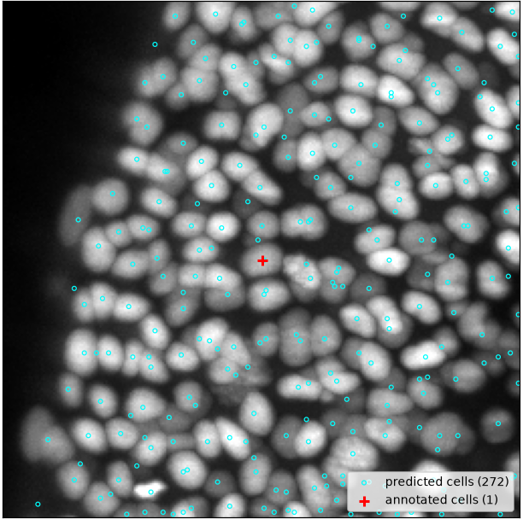
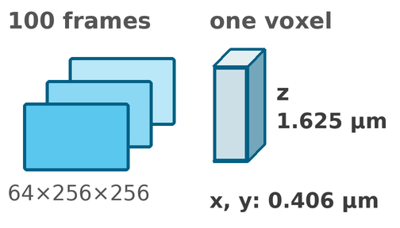
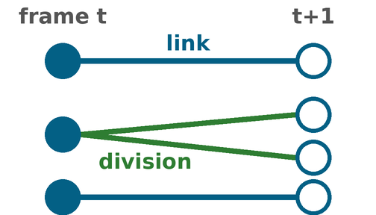
The task
Track every cell in 3D + time, with only 3 % of the cells annotated
Input
Output
Metric
link Jaccard
×
cell-count penalty
+
0.1 × division Jaccard
3D movies of embryos, up to ~400 cells per frame; z is 4 × coarser than x, y
a centre for every cell in every frame, and a link to its successor
per movie, then averaged; a division is a cell with two successors
J_adj = max(0, J_edge · (1 − 0.1 · (N_pred − N_est) / N_est)), N_est: the organisers' cell-count estimate
cyan: the 272 cells our pipeline finds; red +: the only annotated cell in this frame
199
training movies
133 k
annotated cells, ≈ 3 %
151
divisions in all
Biohub Cell Tracking · 6th place · J. Saeedi
Notes:
[about 35 seconds]
We need to find every cell in a 3D movie and follow it through time. A cell can continue, disappear, or divide into two. The score mainly measures correct connections, with a cell-count adjustment and a smaller division term.
The image on the left shows the challenge: 272 detected cells in cyan, but only one annotation, the red cross. Across the dataset, about 3 percent of cells are labelled. The training method has to make use of everything else.

Slide 4
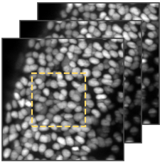
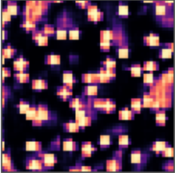
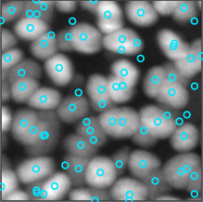
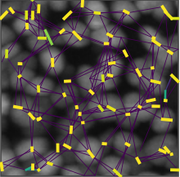
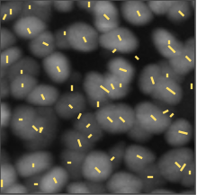
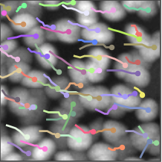
Summary
One network detects and links; a global solver decides; the pipeline teaches itself
1 Movie
2 6 networks
3 Heatmap
4 Shared cells
5 Links
6 Global ILP
7 Tracks
A
B
C
D
E
F
100 frames, 3-frame windows
detect + link, 2–4 rotated views each
centre logits, mean of six
peaks + sub-voxel offsets
parent, NEW, velocity; re-scored
prices from links, NEW, division
→ submission.csv
Methods
six 3D networks (2.5–5.7 M parameters), graph attention, LightGBM re-scorers, global ILP
Tools
PyTorch · LightGBM · HiGHS / SCIP · numba
Time
4–17 h per model on 1 GPU · about 10 h inference on 2 × T4
Biohub Cell Tracking · 6th place · J. Saeedi
Notes:
[about 35 seconds]
Here's the pipeline from left to right. Six networks look at three frames at a time, using rotated views. I average their centre maps to get one shared set of cells.
Each model scores the same possible connections. Its own boosted trees refine the probabilities, then I average the six results. The global solver chooses the tracks.
During training, those tracks become labels for the next networks. That loop helps us learn from the many cells nobody annotated.

Slide 5

Summary
Three jobs: the network proposes, the re-scorer re-ranks, the ILP decides
Illustrative numbers: cell X for the network and re-scorer, the toy cell d of the ILP slides.
Biohub Cell Tracking · 6th place · J. Saeedi
Notes:
[about 35 seconds]
This animation shows what each part contributes. The network gives X probabilities for parent A, parent B, or NEW, meaning no parent among the candidates.
The re-scorer adds information about movement and competition. In this example, B rises to 0.74, while NEW stays unchanged.
The solver considers the consequences across tracks. Starting d leaves C without a child, so connecting them is cheaper overall. These are toy examples; we'll look at the actual costs later.

Slide 6
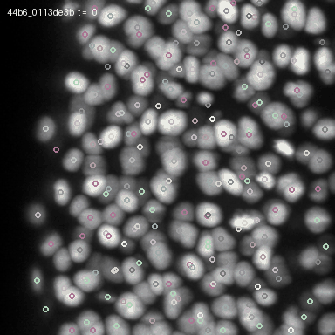
Summary
The output: predicted cell tracks through the movie, divisions included
every 2nd frame
of a public test movie, z projection; our predictions, not ground truth
one colour = one track
positions smoothed along the track
red ring = division
a cell with two successors
Biohub Cell Tracking · 6th place · J. Saeedi
Notes:
[about 20 seconds]
Here's the result on a public test movie. Each colour follows one track, and a red ring marks a predicted division. We're seeing every second frame, projected along depth.
These are predictions. Let's look at how the network learns to find and connect all those cells.

Slide 7
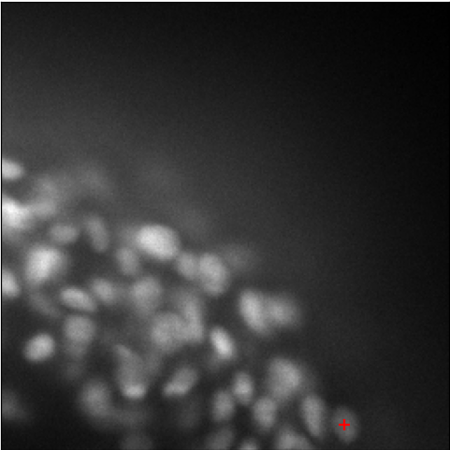
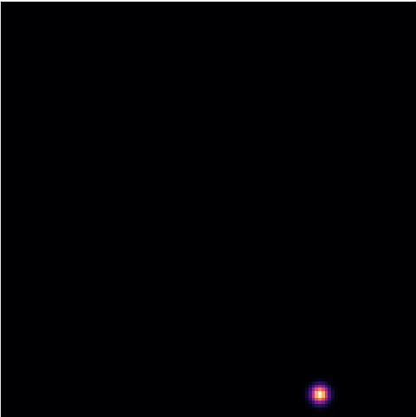
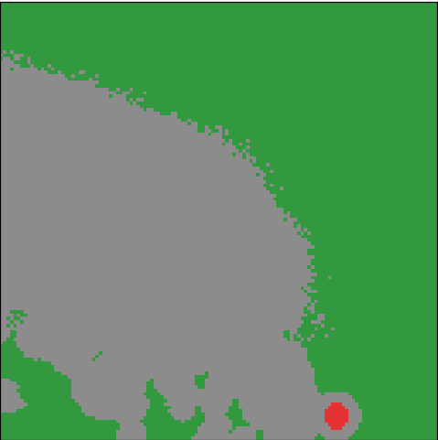
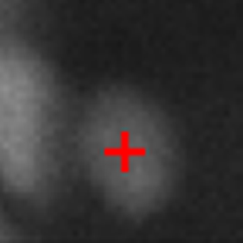
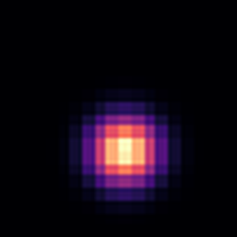

Features & targets
Only 3 % of cells are labelled, so centres and links are judged only where the answer is known
Centres · what we have
Centres · the target
Centres · where the loss judges
A real crop: one annotated cell (red +) among dozens of unlabelled ones
The target for that cell: a Gaussian blob, σ 1.5 µm
■ red: a cell, must fire
■ green: dark, > 6 µm from a label, quiet
■ grey: unknown, no loss
Link supervision: a cell is judged only where it and its parent are both annotated: pick the true parent among its candidates. Bright unlabelled peaks are decoys: a wrong parent, an unknown child. 15 % of true parents are hidden, so the cell must learn NEW.
Count prior, a safety net for centres: each window's total heat-map mass stays near the organisers' cell-count estimate, so the grey region cannot fill with false peaks.
Biohub Cell Tracking · 6th place · J. Saeedi
Notes:
[about 35 seconds]
With so few labels, treating every unmarked cell as background would teach the wrong lesson.
The top row shows the alternative. The annotated centre gets a Gaussian target. Red is supervised near the centre; green is likely background, based on darkness and distance; grey is unknown and gets no centre-detection loss.
For links, I supervise known parent relationships. Hiding some parents teaches the NEW option. The count prior at the bottom keeps the total heat-map mass near the organisers' estimated cell count.

Slide 8
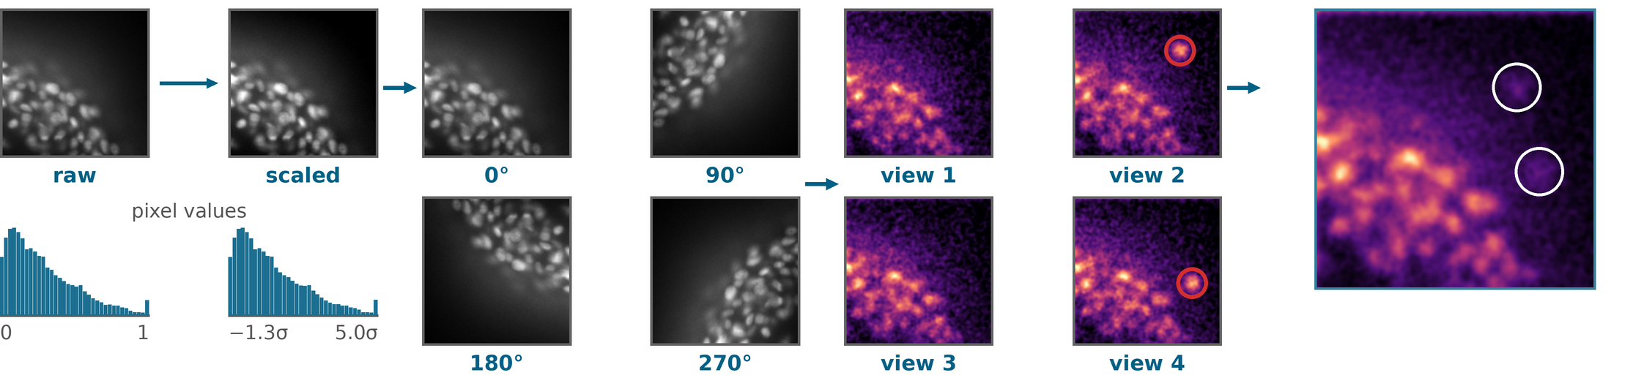
Features & targets
Scale each frame, look from four sides, average the predictions: +0.05 score from the four views
1
Scale each frame
2
Rotate in x–y
3
Predict on every view
4
Average
+0.05 score, 1 → 4 views
min–max to [0, 1], then z-score, frame by frame; no hand-made features
up to four views per model; z is never rotated, light fades with depth
the same network and weights; the maps are rotated back to the original frame
peaks every view agrees on stay; a false peak seen in one view fades to a quarter
Real crop; the heat maps are a toy. Red rings: a false peak that appears in one view only. +0.05: one early single model, validation.
Biohub Cell Tracking · 6th place · J. Saeedi
Notes:
[about 35 seconds]
Each frame is normalised separately. Then I run the same network on rotated views in x and y, keeping the depth axis fixed because brightness changes with depth.
Watch the red rings in this toy. A false peak appears in one view, then fades when the predictions are rotated back and averaged. Consistent peaks stay strong.
Going from one to four views added 0.05 on validation for an early single model. That was the largest measured gain in these experiments.

Slide 9
Features & targets
One network finds the cells and scores their links
1 Find the cells →
skip connections
t−1 · t · t+1
compare
3 frames
t−1, t, t+1; native 64×256×256
Encoder
each frame once, down to 3.25 µm cubes
Temporal fusion
guesses where each spot moved, then compares
Decoder
back to fine detail (64×128×128)
Heat map
where centres are
Cells
peaks + offsets
2 Link them: read right to left ←
Association head
P(parent) for each candidate, or NEW
division score
velocity ± uncertainty
Graph attention
3–4 blocks: cells at t and t+1 update each other
Candidates
4 nearest each way, within 20 µm
Cell fingerprint
features read at each cell centre
Two versions of this network: Isotropic (models A–C, 2.5–4.8 M parameters) and MultiScale (D–F, 5.7 M).
Biohub Cell Tracking · 6th place · J. Saeedi
Notes:
[about 35 seconds]
The top row finds cells. Each frame is encoded once. Temporal fusion learns where to look in neighbouring frames, then combines the useful information. The decoder produces a centre map and small position corrections.
The bottom row runs right to left. Each cell gets a learned description of its appearance, and we propose nearby connections. Graph attention lets connected candidates exchange information before they're scored.
The outputs are parent probabilities, including NEW, plus division and motion predictions.

Slide 10
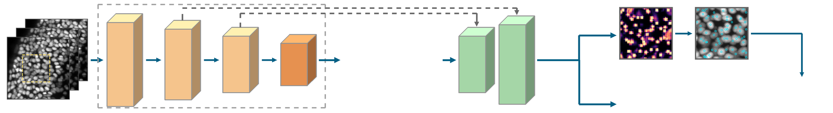
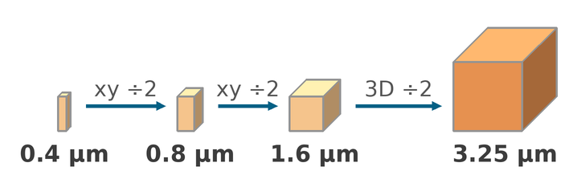
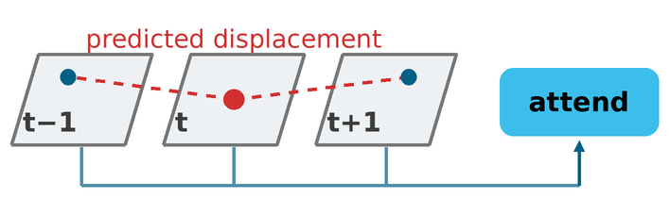
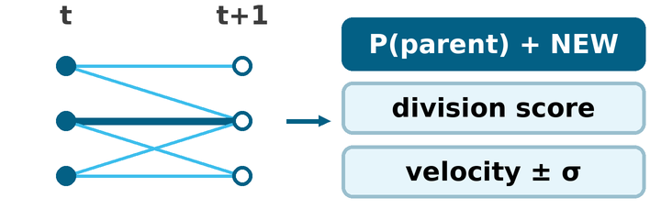
Features & targets
IsotropicLineageNet (models A–C): cubes first, align over time, then link
1
2
t−1 · t · t+1
3
heat map
cells + offsets
Association head · 0.90 M
3 frames
t−1, t, t+1
native resolution
Encoder, once per frame
stem → fine → isotropic → coarse
0.78 M
Temporal fusion
on the coarse grid
0.51 M
Decoder + heads
64×128×128, skips
0.28 M
1
Encoder: tall voxels become cubes
2
Temporal fusion: align, then compare
3
Association head: attention on links
z is 4× coarser than x–y, so two lateral-only strided convolutions come first, then one 3D step.
Each voxel predicts where it sits in t−1 and t+1 (≤ 6.5 µm per axis), samples there and attends.
Cells at t and t+1 update each other along candidate links, then score each one.
Model A shown, 2.47 M. B: 4.4 M, C: 4.8 M (wider; C has a 4th attention block).
Biohub Cell Tracking · 6th place · J. Saeedi
Notes:
[about 35 seconds; optional detail]
Models A, B and C use this architecture. The three cards explain its main choices.
First, depth is sampled four times more coarsely, so I reduce the lateral resolution first. Second, temporal fusion predicts where to sample neighbouring frames and how much weight to give them. Third, graph attention exchanges information along candidate links.
Each frame's encoded features are reused across windows. Model A has about 2.5 million parameters; B and C are wider, and C adds another attention block.

Slide 11

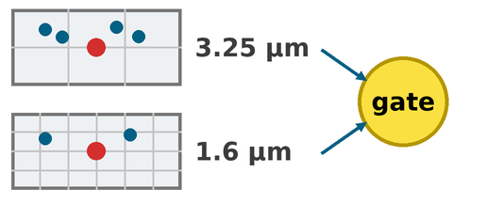
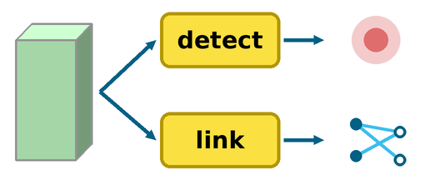
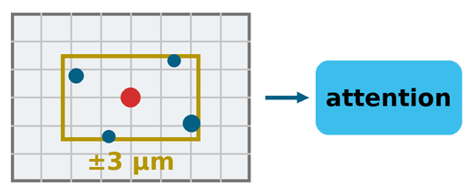
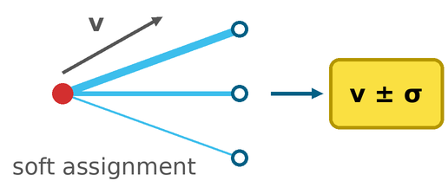
Features & targets
MultiScaleLineageNet (D–F): the linker trains on its own detections
Linker trains on: Isotropic (A–C) annotated cells + 0.5 µm jitter → MultiScale (D–F) 75 % of matched cells at detector positions
1
2
detect
coarse 3.25 µm
iso 1.6 µm
heat map
cells + offsets
Association head · 2.22 M
link
3
descriptor: + pooled samples
3 frames
t−1, t, t+1
native resolution
Encoder
same stages, + 1 residual block
1.61 M
Temporal fusion
two scales + gate
1.13 M
Decoder
+ adapters, heads
0.72 M
4
attention: + motion refinement
1
Fusion at two scales
2
Separate adapters
3
Pooled samples
4
Motion refinement
4 samples at 3.25 µm, 2 at 1.6 µm, per neighbour; per-voxel gate
Own residual block for detection and for linking, on the shared decoder
4 learned samples within ±3 µm of the centre, attention-pooled
After attention block 1, soft assignment refines v and σ
Biohub Cell Tracking · 6th place · J. Saeedi
Notes:
[about 35 seconds; optional detail]
Models D, E and F add the yellow parts. Fusion works at two scales, with a gate controlling how much neighbouring information to use. Separate adapters support detection and linking, extra samples describe each cell, and the graph refines its motion estimates.
The strip above is the training change: 75 percent of matched cells use detector positions. The linker gets to practise with the same kind of position errors it will encounter at inference.

Slide 12
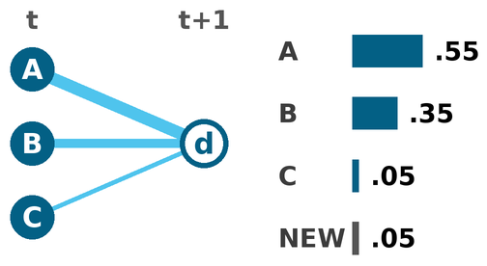
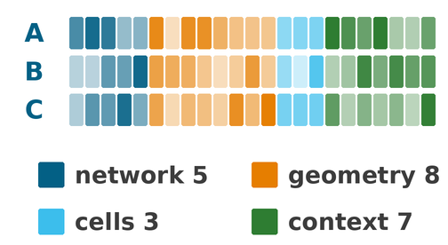
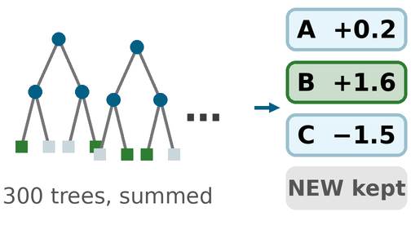
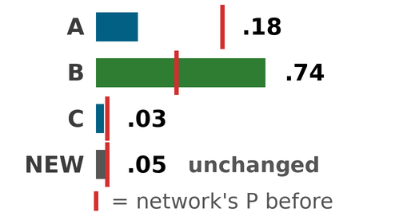
Features & targets
The re-scorer: boosted trees re-rank each cell's candidate parents, using the network's own outputs
1 Network output
2 23 features per link
3 300 trees
4 New probabilities
a probability per parent, plus NEW
from outputs and positions, not pixels
one yes/no score per parent; NEW is not scored
softmax of the scores × (1 − P(NEW)): B 0.35 → 0.74
Each model's trees learn on its own held-out movies
They see what the softmax does not
a rival cell wants this parent
+0.004…0.007
165 training movies
30
crowding around the cell
the network trains here
the stage shift
score per model, validation
the trees train here: binary log-loss, label 1 = the true parent
Biohub Cell Tracking · 6th place · J. Saeedi
Notes:
[about 35 seconds]
Over half the link errors were identity swaps between similar neighbours. The re-scorer gives the network's candidates a second assessment.
Each candidate parent becomes a row of 23 features: confidence, geometry, cell scores and competition. The trees learn whether that parent is correct. Their scores are converted into parent probabilities, preserving the network's NEW probability. Here, B rises from 0.35 to 0.74.
Each model has its own trees. Evaluated with folds separated by movie, they added 0.004 to 0.007 per model.

Slide 13
Features & targets
What the trees look at: 23 features in four families, and the ones they split on most
Network's view 5 features · 32% of splits
Its probability, rank and margin to the best rival: how one candidate sees the others. Plus the candidate count and the cell's P(NEW).
Geometry 8 features · 35% of splits
Distance and displacement, raw and after removing the frame's stage shift, z and lateral apart; mismatch to the parent's predicted velocity.
Cell scores 3 features · 17% of splits
Centre score of the parent and of the child (is it a real cell?), and the parent's division score.
Context 7 features · 16% of splits
Does another cell want this parent more? Plus crowding within 10 µm, depth and time.
Stage shift = per frame, the median displacement of links the network is ≥ 70 % sure of. Chart: the six shipped trees.
Biohub Cell Tracking · 6th place · J. Saeedi
Notes:
[about 35 seconds; optional detail]
The four groups on the right show what the trees can use. Confidence includes the margin over the best rival. Geometry includes drift-corrected distance. Cell scores describe the endpoints, and context includes competing children and crowding.
The chart highlights which features the trees use most. The rival margin stands out, followed by useful geometric clues. These are feature-importance statistics; they don't tell us how much score we'd gain from any one feature alone.

Slide 14
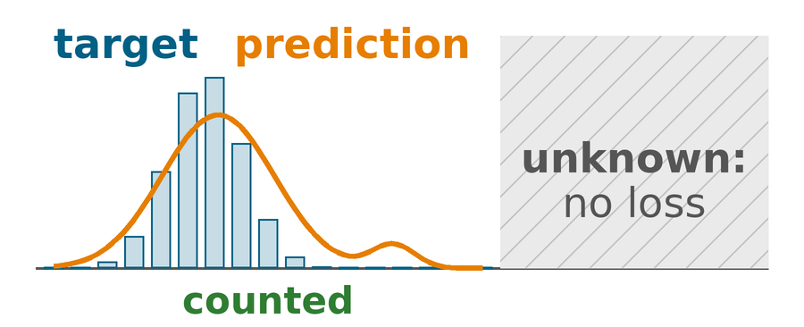
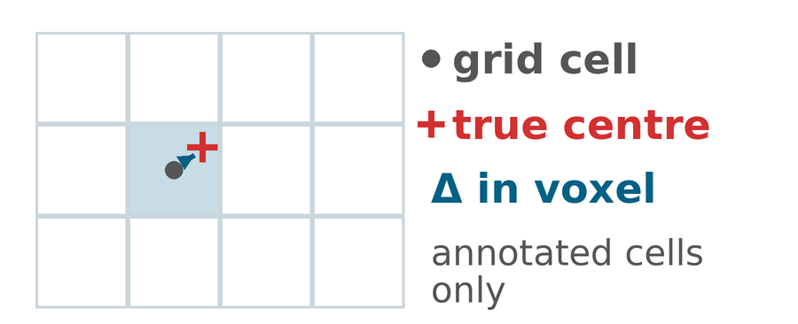
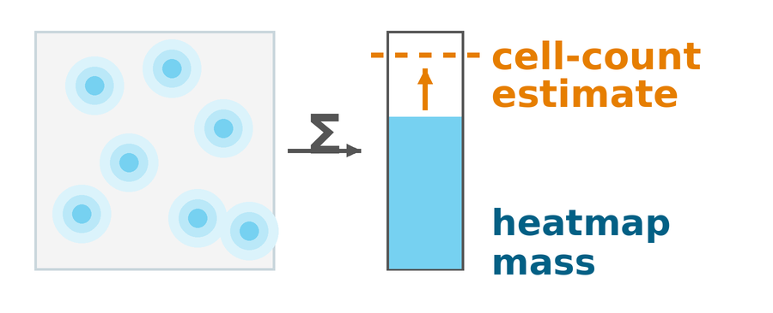
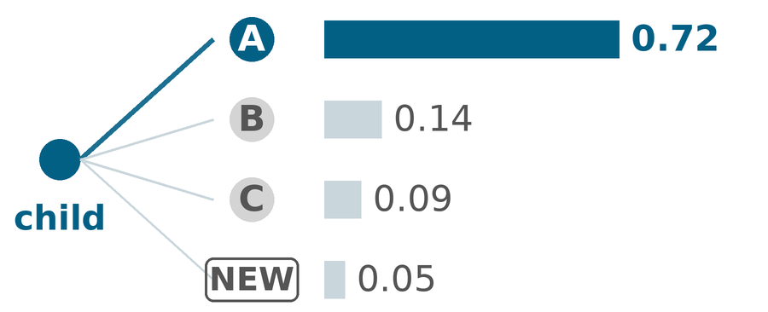
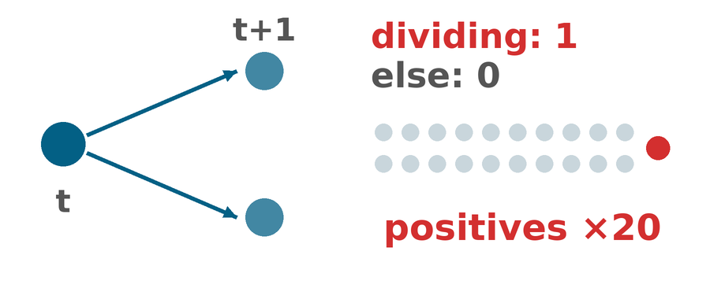
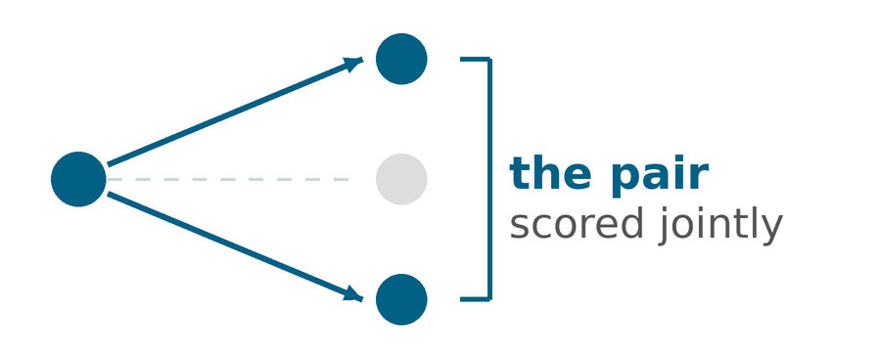
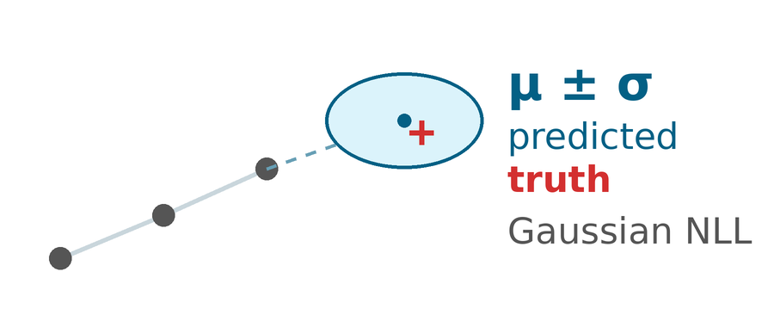
Training methods
Training recipe 1/2: seven loss terms, each teaching the network one thing
Total loss
L = L_GT + 0.5 · L_pseudo
Centre and parent losses are computed separately on ground truth (GT) and on pseudo-labels, so the 3 % GT is never drowned out.
Link losses start after 300 steps, then ramp in.
DETECT · weight 1 · GT+pseudo
Focal loss on centres
Match the Gaussian target; unknown voxels carry no loss
DETECT · weight 1 · GT only
Sub-voxel offset
Smooth L1 on the position inside the voxel
DETECT · weight 1 · cell count
Count prior
Keeps the heatmap mass near the cell count; stops over-firing
LINK · weight 1 · GT+pseudo
Parent cross-entropy
Choose the parent among the candidates, or NEW
LINK · weight 0.5 · GT only
Division BCE
Does this cell divide? Rare, so positives count ×20
LINK · weight 0.25 · GT only
Daughter-pair BCE
Which two children belong to the dividing parent?
LINK · weight 0.1 · GT only
Velocity Gaussian NLL
Next position, with an honest uncertainty
Biohub Cell Tracking · 6th place · J. Saeedi
Notes:
[about 35 seconds]
The seven cards show what training teaches. The top row covers centres, precise positions and cell count. The bottom row covers parents, divisions, daughter pairs and motion.
The yellow card is the important part: centre and parent losses are calculated separately for human labels and pseudo-labels, the tracks generated by the pipeline. Pseudo-label loss gets half the weight. The other supervised targets use human annotations.
Linking losses start after 300 steps, giving the detector time to get going.

Slide 15
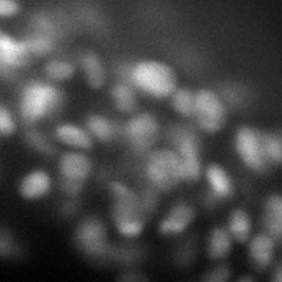
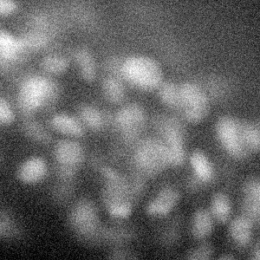
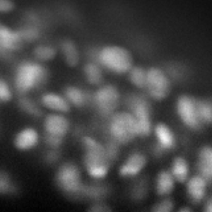
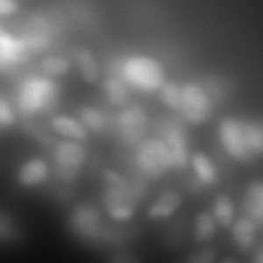
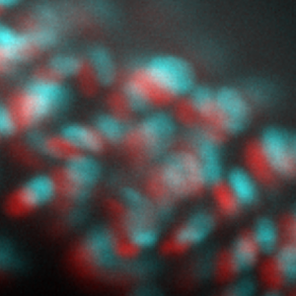
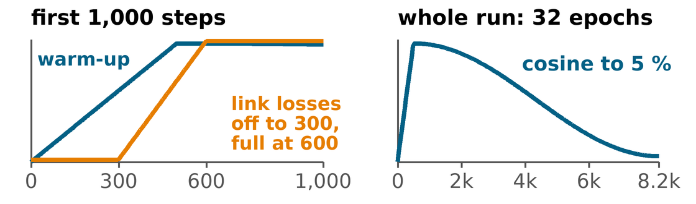
Training methods
Training recipe 2/2: which frames it sees, how they are corrupted, how the schedule runs
1 Pick a 3-frame window
2 Corrupt it, so the model survives real movies
3 consecutive frames of 64 × 256 × 256 voxels, the whole field of view
15
21
64
% of windows: anywhere · centred on a division · on an annotated cell
original
gamma
+ noise
depth gain
haze
+0.005
stage drift
≤ 6 µm / step
Linker: unlabelled bright peaks as distractors; 15 % of true parents hidden → NEW
Lateral flips and rotations only: z is never flipped, light fades with depth
AdamW, lr 1e-4 (3e-5 to fine-tune), clip 1, bf16
EMA of the weights (0.999): the averaged model is the one I ship
2,048 windows per epoch, batch 8; checkpoint on validation loss, models ranked end to end
Own split per model: 165 train, 30 validation movies
Biohub Cell Tracking · 6th place · J. Saeedi
Notes:
[about 35 seconds]
Every training example contains three whole frames. The bar shows the sampling mix: 15 percent random, 21 percent around divisions, and 64 percent around annotations.
The thumbnails show how I make the images harder: noise, depth gain, haze and simulated stage drift. Flips and rotations stay in x and y.
The schedule below warms up and then decays, with linking losses introduced gradually. For inference, I use an exponential moving average of the weights.

Slide 16
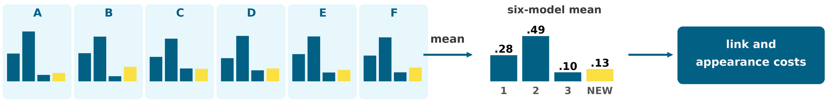
Training methods
Six models, one set of cells, six opinions about every link
1 Cells: average the six heat maps, extract the peaks once
the same cells for every model, so every link is scored on the same candidates
A
B
C
D
E
F
three Isotropic, three MultiScale; 2 to 4 rotated views each
mean heat map
one set of cells
2 Links: each model scores the same candidate parents; the six are averaged (toy numbers)
Equal weights
each member keeps its own trees
Different mistakes
own split per model, two architectures
Public score
1 model 0.954 → 3 models 0.959 → 6 models 0.961
Biohub Cell Tracking · 6th place · J. Saeedi
Notes:
[about 35 seconds]
The ensemble combines predictions in two stages. At the top, I average the six centre maps and detect cells once. Everyone then scores the same cells and candidate links.
At the bottom, each model applies its own linking head and re-scorer. I average those distributions equally, including NEW.
Different training splits and two architectures give us different errors to average out. The public score rose from 0.954 with one model to 0.959 with three and 0.961 with six.

Slide 17
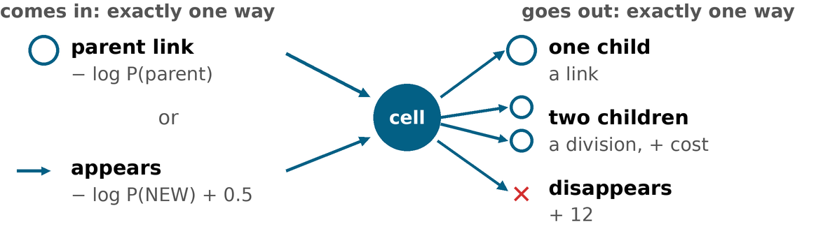
Inference: ILP · the model
The ILP turns probabilities into tracks: price every yes/no decision, then pick the cheapest whole that obeys the rules
1 Price every yes/no decision
2 One rule per cell
Cell exists − centre logit
centre head; zero at p = 0.5
Cell appears − log P(NEW) + 0.5
NEW class; the + 0.5 applies after the first frame
Cell disappears 12
tuned on validation: the network has no head for it
3 Minimise the total price
Cell divides max(0, − division logit)
division head: can veto a split, never pays for one
Switch each variable on (1) or off (0): the prices of everything on add up to the lowest total, and every cell obeys its rule.
A cell, a start or a link is only paid for if it is used. Every cell and every start has a price, so no dangling fragments and no repair rules.
Link − log P(parent) + 0.2 · drift µm
re-scored, averaged softmax (T = 0.9); drift-corrected
Why it has to be global: the toy on slide 5. Solver speed: appendix.
Biohub Cell Tracking · 6th place · J. Saeedi
Notes:
[about 40 seconds]
The ILP makes the final track decisions. Each card on the left has a cost: keep a cell, start or end a track, divide, or connect two cells. More likely links are cheaper; drift-corrected distance adds a penalty.
On the right are the rules. Every kept cell has a parent or starts a track, then continues, ends, or divides into two children.
The solver chooses the lowest total cost across the movie. That's why it can prefer the less likely link in our earlier toy: it also counts the track left behind.

Slide 18
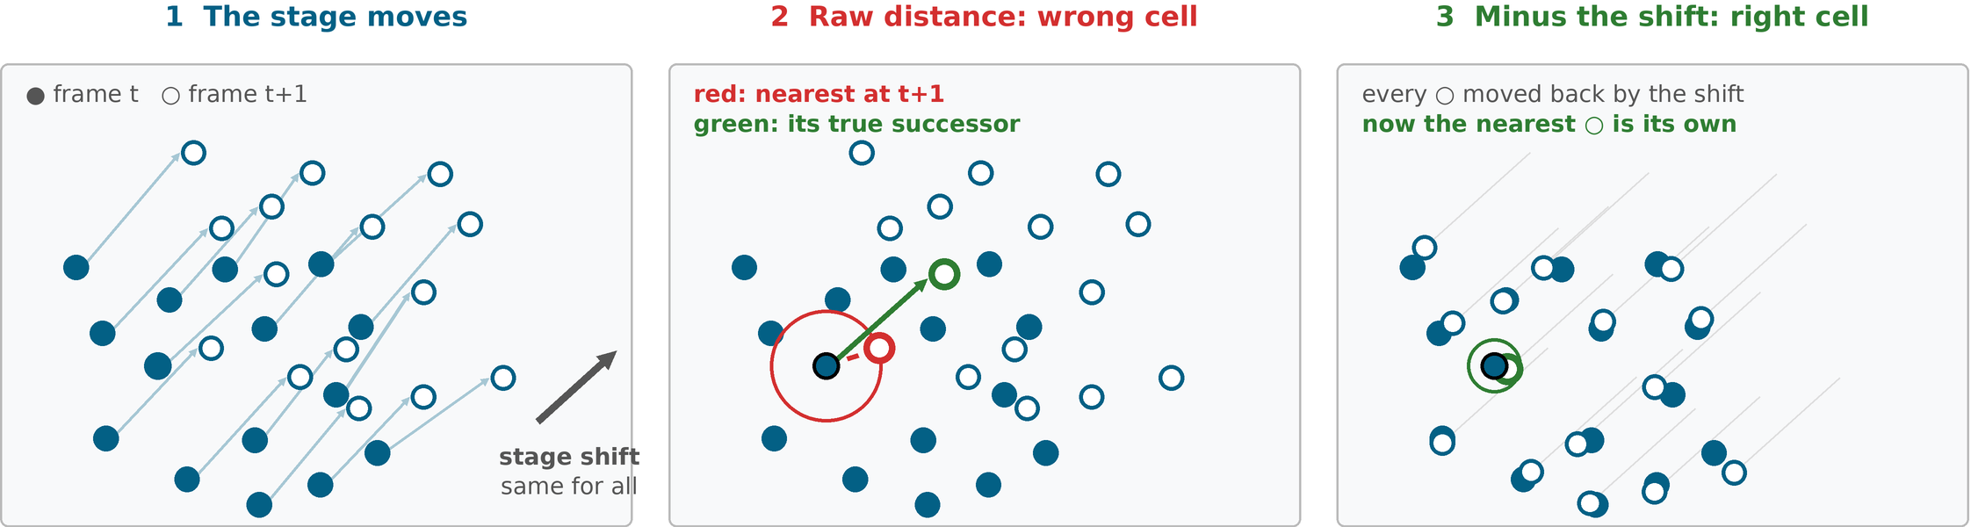
Inference: ILP & drift
Model the camera, not only the cells: when the stage moves, every cell moves by the same unknown shift
Toy field seen from above; the real shift is 3D. Distance linking fails once the shift exceeds the gap to a neighbour.
Why it matters
1.3 µm median shift, 7.3 µm at the 99th percentile (public test movies). Swaps concentrate there.
How it is estimated
Per frame pair: the median displacement of the links the network is at least 70 % sure about. No extra model, no ground truth.
Where it is used
Link cost: distance after the shift, +0.009 Smoothing: drift-free positions, +0.005 Training: synthetic drift, up to 6 µm per step
Biohub Cell Tracking · 6th place · J. Saeedi
Notes:
[about 35 seconds]
One part of that link cost needs special care: the microscope stage moves the whole field.
In the middle panel, raw distance picks a neighbour's successor. In the right panel, subtracting the shared shift makes the correct match closer.
I estimate the shift from the median displacement of links with at least 70 percent confidence. On the public movies, the median was 1.3 microns and the 99th percentile was 7.3. Correcting distance added 0.009 on validation. The same shift also helps with smoothing.

Slide 19
Next steps
Three directions I would try next, each with a cheap first test
1 Distil the ensemble into one model
2 Score daughter pairs inside the ILP
3 Measure the swap ceiling before more linker work
One model scores 0.954 public and six score 0.961, but six need about five times the GPU time.
The pipeline already writes pseudo-labels from the whole ensemble, so a single student can learn from them.
The daughter-pair head is trained, but the ILP never reads it: each child is judged alone, by its own parent probability.
The head already receives the ensemble-averaged features, so trying it needs no retraining.
Over half of the edge errors are swaps between neighbouring cells, and none of the fixes I tried removed them.
Many of these cells sit between two of my tracks in z, so the annotation itself may be ambiguous.
First test: train one model on the six-model tracks. Does it close the 0.007 gap on validation, with its own re-scorer?
First test: does the pair score rank true daughter pairs above the edge probability?
First test: inspect a sample of swap errors. How many are ambiguous even for a human?
More division labels would help most, but the whole corpus holds only 151 division events.
Biohub Cell Tracking · 6th place · J. Saeedi
Notes:
[about 35 seconds]
I'd try three things next. First, train one student on the six-model ensemble's tracks. One model already comes close, at roughly a fifth of the GPU time.
Second, test the daughter-pair head, which is trained but unused at inference. I'd check whether its scores identify true daughter pairs before adding them to the solver.
Third, inspect a sample of the remaining identity swaps. Some may be genuinely ambiguous in the images. Understanding those cases would help decide where further linker work is worthwhile.

Slide 20
Question and Answer
github.com/jamal-saeedi/biohub_cell_tracking_kaggle
code, trained models, notebook and write-up (MIT)
Notes:
[Q&A: read the opening, then answer as needed]
Thanks for listening. I'm happy to take questions. The repository on the slide links the code, trained models, notebook and write-up.
[Answer only the question asked.]
Why this architecture?
The linker uses image features to distinguish similar neighbours, and the solver makes the track choices consistent. Both good features and good candidate connections matter.
How reliable was the public ranking?
My highest-public-score submission reached about 0.948 privately, while FIN reached 0.953. The best-validation-checkpoint variant reached 0.955. Public ranking didn't reliably predict private ranking.
How did you handle divisions?
The network has division and daughter-pair heads, and the solver allows two children. The pair head is used only during training. With just 151 annotated divisions, I excluded the division metric from local model ranking because it was too noisy.
How can I reproduce it?
The repository has a recipe for each model, a script to run the training lineage, and links to the weights and inference notebook.

Slide 21
Notes:
[closing]
Thanks again to the organisers and everyone who joined. I hope the code and models are useful. Everything is linked from the repository on the Q&A slide.

Slide 22
Appendix
Notes:
[appendix divider]
[Open the slide relevant to a question.]
The appendix covers decoding, link probabilities, solver speed, model details, validation and runtime.

Slide 23
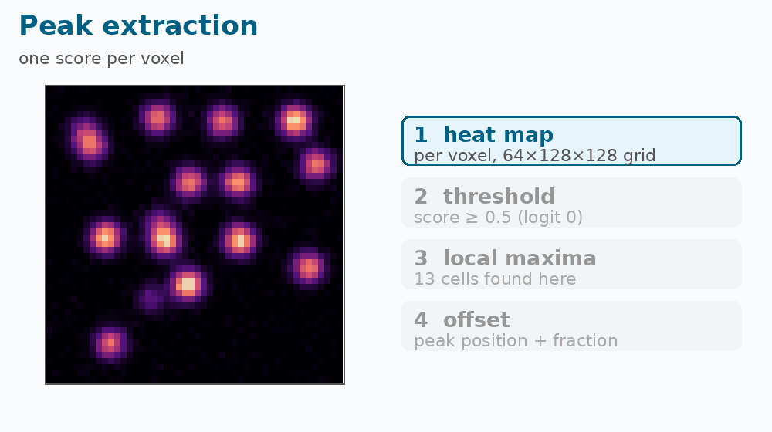
Appendix
Animation: from heat map to cells
1
Heat map
the network's score per voxel on the 64×128×128 grid
2
Threshold at 0.5
logit 0: where the ILP's cell cost breaks even
3
Keep local maxima
a voxel must beat its 3×3×3 neighbourhood: one cell per blob
4
Sub-voxel offset
a second head adds the fractional position, up to ± ½ voxel
Toy heat map
Biohub Cell Tracking · 6th place · J. Saeedi
Notes:
[appendix: use when relevant to a question]
The four steps turn a centre map into cells. I threshold at 0.5, keep local peaks in a three-by-three-by-three neighbourhood, then refine their positions with the offset head.
A probability of 0.5 corresponds to zero logit, where the solver's cell-existence cost breaks even. A surviving peak is still a candidate: the solver considers its connections and other costs before keeping it. This heat map is a toy.

Slide 24
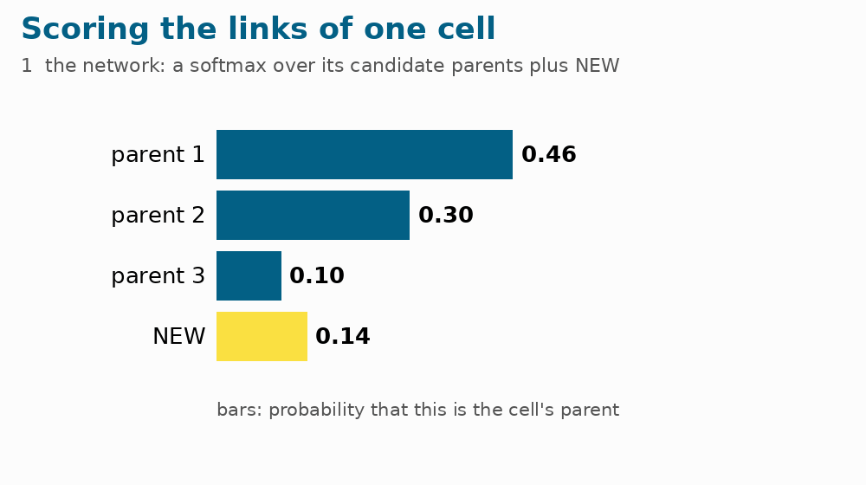
Appendix
Animation: how one cell's links get their probabilities
1
Network softmax
over the candidate parents plus the NEW class
2
LightGBM re-scorer
re-ranks the parents; NEW is left untouched
3
Six members
each with its own head and its own re-scorer
4
Average → P_T
link and appearance costs for the ILP
Toy numbers
Biohub Cell Tracking · 6th place · J. Saeedi
Notes:
[appendix: use when relevant to a question]
Start with the network's probabilities over candidate parents and NEW. The trees re-rank the real parents while preserving NEW.
Each of the six models does this with its own head and trees. I average their distributions and apply the solver's temperature adjustment. Parent probabilities become link costs; NEW contributes to the cost of starting a track. The animation uses toy numbers.

Slide 25
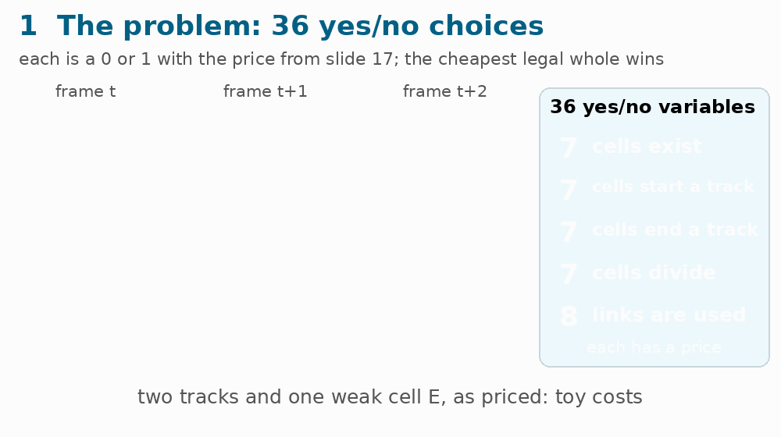
Appendix
Animation: how the ILP is solved fast: the easy LP first, lock what it decided, solve only the rest
1
The problem
36 yes/no variables, each with its price from slide 17
2
Relax to 0…1: the LP
HiGHS, fast; its cost is a floor nothing can beat
3
Lock what it decided
only variables not exactly 0 or 1 stay free
4
Solve the free part exactly
a small 0/1 problem instead of the whole movie
5
Check the gap to the floor
within 0.5 %: done; otherwise SCIP solves it all
Toy: 7 cells, 8 links; the LP and the optimum (−16.7) are real solves; the yellow box is a schematic. Real movies: 38–166× faster than SCIP alone.
Biohub Cell Tracking · 6th place · J. Saeedi
Notes:
[appendix: use when relevant to a question]
First, I solve a relaxed problem where decisions can take any value between zero and one. Its cost is a lower bound. If the answer is already binary, it's also optimal for the integer problem.
Otherwise, I fix the integral choices and solve a smaller problem around the fractional ones. I accept a gap within 0.5 percent of the bound; otherwise SCIP takes over. This was 38 to 166 times faster than SCIP alone, with that acceptance tolerance.

Slide 26
Appendix
Glossary 1: the data and the metric
Term | Meaning
Voxel | a 3D pixel; here 1.625 µm in z and 0.406 µm in x and y
Anisotropic | different spacing per axis: z is 4 × coarser than x / y
Cell centre (node) | the 3D point we predict for each cell in each frame
Link (edge) | a connection between a cell at t and its successor at t+1
Division | a cell with two successors (151 in the whole training set)
Track / lineage | a chain, or tree when cells divide, of linked cells over time
Edge Jaccard | correct links ÷ (predicted + true − correct)
Node-count penalty | score × (1 − 0.1 · (N_pred − N_est) / N_est): charges extra cells
Stage drift | the same offset for every cell in a frame, from the moving stage
Identity swap | two neighbouring cells exchange their track IDs
Ground truth | the human annotation: about 3 % of cells, whole lineages
Biohub Cell Tracking · 6th place · J. Saeedi
Notes:
[appendix: use when relevant to a question]
The table defines the data terms. A voxel is a 3D pixel; here, depth spacing is about four times coarser than lateral spacing. A node is a cell centre, an edge connects consecutive frames, and two children represent a division.
For the metric, link Jaccard is adjusted using the organisers' cell-count estimate. A 10 percent over-count reduces that link-score component by 1 percent. The division term is added separately.

Slide 27
Appendix
Glossary 2: models and algorithms
Term | Meaning
Encoder – decoder (U-Net) | shrinks the volume to features, then expands to a per-voxel output, with skips
GroupNorm, GELU | normalisation and a smooth activation inside every convolution block
Heatmap + peaks | a per-voxel cell-centre score; local maxima above 0.5 become cells
Graph attention | cells exchange messages along candidate links, weighted by learned relevance
Softmax with NEW | probabilities over a cell's candidate parents plus 'no parent'
Pseudo-label / noisy student | labels made by the pipeline; a student trained on them with extra noise
LightGBM re-scorer | boosted decision trees re-ranking each cell's candidate parents
ILP, LP relaxation, MILP | yes / no optimisation; solve it as a continuous LP, fix integral values, finish the rest
TTA | test-time augmentation: average predictions over rotated copies
Focal loss, EMA | loss that down-weights easy voxels; running average of the weights
fp16 vs bf16 | 16-bit float formats; the T4 has no native bf16, so fp16 is 3.5 × faster
Biohub Cell Tracking · 6th place · J. Saeedi
Notes:
[appendix: use when relevant to a question]
This is a reference for the method names. Graph attention exchanges information along candidate links. TTA averages rotated views; EMA averages model weights over training.
For the optimisation terms, the LP relaxation allows fractional decisions and gives a lower bound. A binary LP solution also solves the ILP. Otherwise, I use a smaller integer solve and check its gap to the bound.

Slide 28
Appendix
Glossary 3: the six things the network outputs
Output | Plain meaning | Used by
Centre heat map | how likely is a cell centre at each 3D location? | cell detection: peaks become cells
Position offset | a small shift of a centre, for a finer position | cell detection: final position
Parent probabilities | which candidate in the previous frame is the parent? | re-scorer, then the ILP link cost
NEW probability | chance the cell has no parent among the candidates | ILP: cost of starting a track
Division score | how likely the cell splits into two children? | ILP veto, and one re-scorer feature
Velocity and uncertainty | where the cell moves, and how sure the network is | after the network: re-scorer only (2 of 23 features)
The first two give the cells; the other four give the links. Parent probabilities and NEW sum to one per cell.
Biohub Cell Tracking · 6th place · J. Saeedi
Notes:
[appendix: use when relevant to a question]
The first two rows locate cells: the heat map gives candidate centres, and offsets refine their positions.
The remaining outputs support tracking. Parent probabilities and NEW sum to one for each cell. Division scores influence whether the solver allows a split. Velocity and uncertainty help judge movement inside the network; downstream, velocity-based features also go to the re-scorer. The ILP receives the resulting probabilities and costs, rather than velocity directly.

Slide 29
Appendix
Lineage of the six final models (A to F)
Ground truth
3 % of cells
W-link
Iso c48, GT only
P-l50
Iso c48
R2-ft24-noisy
Iso c48, noisy
A
R3-ft24-noisy-lc
Iso c48 + haze
NS1-ft24
Iso c48, split B
CX-deep-lc
Iso c48, L4
all 195 movies
BX-wide-lc
Iso c64
v10 teacher (whole pipeline)
v11 teacher (whole pipeline)
A
BX best-e23
CX best-e20
A
BX
CX
B2-v10
Iso c64
DX-widedeep
Iso c64, L4
B
C
D
E
F
B3-v11-ft32
Iso c64
D2-v11-ft32
Iso c64, L4
EX-ms-lc
MultiScale
FX-ms-lc
MultiScale
GX-ms-lc
MultiScale
solid arrow: trained on the (pseudo-)labels of · dashed: initialised from · red circle: member of the final ensemble
Biohub Cell Tracking · 6th place · J. Saeedi
Notes:
[appendix: use when relevant to a question]
Start at the grey ground-truth box and follow the teacher-student chain. Red circles mark the final six models. Dark blue is Isotropic, light blue is MultiScale, and the yellow boxes are ensemble teachers that generated new labels.
Solid arrows show where labels came from; dashed arrows show where model weights came from. Each named model has a recipe in the repository, so the diagram also helps navigate the reproduction steps.

Slide 30
Appendix
The six models of the ensemble
 | Model | Architecture | Channels / linker | Params | Training | Views
A | R3-ft24-noisy-lc-s1 | Isotropic | 48 / 192 × 3 | 2.5 M | third teacher → student round | 4
B | B3-v11-ft32-noisy-lc-s31 | Isotropic, wide | 64 / 256 × 3 | 4.4 M | fine-tuned twice on ensemble labels | 4
C | D2-v11-ft32-noisy-lc-s33 | Isotropic, wide + deep | 64 / 256 × 4 | 4.8 M | v10 labels, fine-tuned on v11 | 4
D | EX-ms-lc-s5 | MultiScale | 64 / 256 × 4 | 5.7 M | from scratch on ensemble labels | 3
E | FX-ms-lc-s6 | MultiScale | 64 / 256 × 4 | 5.7 M | from scratch on ensemble labels | 2
F | GX-ms-lc-s7 | MultiScale | 64 / 256 × 4 | 5.7 M | from scratch on ensemble labels | 2
Compute: one RTX 3090 / 4090 per run, 4–10 h per Isotropic and about 17 h per MultiScale run; the whole lineage (14 models, 7 label sets, re-scorers) is about a week of single-GPU time. Every model has its own random movie-disjoint split (165 train / 30 validation).
Biohub Cell Tracking · 6th place · J. Saeedi
Notes:
[appendix: use when relevant to a question]
A, B and C are Isotropic models with different widths and depths. D, E and F use MultiScale. The table gives their sizes, training histories and rotated views.
Each model has its own movie-disjoint training split. The full lineage took roughly a week of single-GPU time. FIN and BEST differ in checkpoint and re-scorer choices; their private scores were 0.953 and 0.955.

Slide 31
Appendix
What I learned, what helped most, what was fun
Key insights
Biggest advantage
Most fun
Unlabelled is not background: supervise what is known and mask the rest
Output probabilities a solver can price, with an explicit NEW class
Model the camera: stage drift in cost, smoother and augmentation
A pipeline that teaches itself: its ILP tracks become pseudo-labels
Exact comparisons: results are bit-identical per GPU type, ranked end to end on the score
An engineered time budget: fp16, encoder cache, two-GPU sharding
Kaggle itself: two months, solo, from the first look at the data to a six-model ensemble
Publishing everything: code, models and write-up are open (MIT)
Biohub Cell Tracking · 6th place · J. Saeedi
Notes:
[appendix: use when relevant to a question]
The left column holds the modelling lessons: supervise what is known, predict NEW explicitly, and account for stage movement.
The middle is what helped me iterate: using tracks as labels, making runs reproducible, and spending the compute budget carefully.
On the right is what I enjoyed: taking a new problem from the first look at the data to a working ensemble, then releasing the code, models and write-up.

Slide 32
Appendix
The two architectures side by side
IsotropicLineageNet models A, B, C · 2.5 to 4.8 M parameters
3 frames
t−1, t, t+1
Encoder
stem → fine → isotropic → coarse; 3.25 µm grid
Temporal fusion
1 learned sample per neighbour, coarse grid
Decoder
one feature map for detection and linking
Heads
centre heat map + sub-voxel offset
Descriptor
centre sample + local mean
Association head
graph attention × 3–4
MultiScaleLineageNet models D, E, F · 5.7 M parameters
3 frames
t−1, t, t+1
Encoder
same stages, one more residual block
Temporal fusion
two scales (coarse + isotropic), 2–4 samples, gated
Decoder
separate detection and linking adapters
Heads
centre heat map + sub-voxel offset
Descriptor
+ attention-pooled samples within 3 µm
Association head
+ motion refinement after block 1
Yellow: what MultiScale adds. Both read 3 frames at native resolution, encode each frame once, and end in P(parent), NEW, division score and velocity. MultiScale also trains its linker on 75 % of matched annotated cells at detector positions instead of jittered annotations.
Biohub Cell Tracking · 6th place · J. Saeedi
Notes:
[appendix: use when relevant to a question]
Both architectures read three frames and use image features for detection and linking. The yellow boxes show MultiScale's additions: gated fusion at two scales, separate task adapters, extra descriptor samples and motion refinement.
There's also a training difference: 75 percent of matched cells use detector positions in MultiScale. That exposes the linker to realistic localisation errors. This slide brings the two designs together for comparison.

Slide 33
Appendix
What each stage saw: how far the validation numbers can be trusted
Stage | Data it saw | What that means
Each student network | 165 training and 30 validation movies, its own random split; ground truth plus pseudo-labels | validation is movie-disjoint for that network
Teachers (earlier rounds) | other splits, so a teacher may have trained on a student's validation movies; labels cover all 195 | a student's validation movies are not independent of its teachers
Re-scorers | trained on their own model's validation movies; gains scored by cross-validation over those movies | still development data
Tuning and ranking | model A's 30 validation movies rank every change; a small solver grid per model | mild optimism is likely in every local gain
4 public test movies | held out from every model; never pseudo-labelled; used as a check | a small, independent check
Private leaderboard | hidden movies, scored once at the end | the strongest held-out evidence
A qualification to keep in mind, not a finding of leakage.
Biohub Cell Tracking · 6th place · J. Saeedi
Notes:
[appendix: use when relevant to a question]
Each network has a movie-disjoint split, but its teacher may have trained on some of its validation movies. Re-scorers also use development movies, with movie-level cross-validation for evaluation. I repeatedly used model A's validation set to rank changes.
Local gains may therefore be optimistic. The four public movies were excluded from training and pseudo-labelling, but their results were visible during development. The hidden private leaderboard gives the strongest held-out evidence.

Slide 34
Appendix
Finishing in 12 hours on two T4s: queue, fp16, graded fallbacks
Shared queue
T4 worker 0
six models loaded once · fp16
Every movie gets a prediction
a worker claims a movie by atomically renaming its file; a deadline guard picks the richest setting that fits
movie
movie
movie
movie
T4 worker 1
six models loaded once · fp16
Deadline guard and fallbacks, from richest to cheapest
All views
75 % of views
50 % of views
One view
Primary model alone
DoG tracker, no model
Placeholder
time ladder: chosen before each movie from recent speed
failure ladder: a failed movie steps down
3.5 ×
faster prediction with fp16 than emulated bf16
~7 min
per movie per T4, six models
~10 h
for the hidden set (limit 12 h)
Biohub Cell Tracking · 6th place · J. Saeedi
Notes:
[appendix: use when relevant to a question]
Each T4 loads the models once and claims movies from a shared queue. Before each movie, recent timings determine how many views will fit the deadline.
If processing fails, retries use cheaper settings: fewer views, one model, a model-free tracker and, as a last resort, a placeholder.
Switching inference to fp16 made prediction 3.5 times faster. The hidden set finished in about ten hours, within the twelve-hour limit.

Slide 35
Appendix
Code, models and references
Resource | Where
Code (MIT) | github.com/jamal-saeedi/biohub_cell_tracking_kaggle
Models (Kaggle Models) | kaggle.com/models/jamalsaeedi/biohub-cell-tracking
Inference notebook | kaggle.com/code/jamalsaeedi/biohub-cell-tracking-inference
Write-up | docs/SOLUTION.md in the repository
Slides, with speaker notes | docs/Biohub_Winner_Presentation.pptx in the repository
References
The 25 works the solution builds on are on the next slide; the numbers match docs/SOLUTION.md.
Biohub Cell Tracking · 6th place · J. Saeedi
Notes:
[appendix: use when relevant to a question]
Everything is linked here: code and training recipes on GitHub, weights on Kaggle Models, the inference notebook, the full write-up, and these slides.
The references credit the methods behind the main pieces, including image-based linking and conservation tracking. For a first run, I'd start with single-model inference, then explore the recipes for training and the ensemble.

Slide 36
Appendix
References
[1] Biohub. Cell Tracking During Development. Kaggle competition, 2026.
[2] Maška et al. The Cell Tracking Challenge: 10 years of objective benchmarking. Nature Methods 2023.
[3] Ronneberger, Fischer, Brox. U-Net: Convolutional Networks for Biomedical Image Segmentation. MICCAI 2015.
[4] Çiçek et al. 3D U-Net: Learning Dense Volumetric Segmentation from Sparse Annotation. MICCAI 2016.
[5] Wu, He. Group Normalization. ECCV 2018.
[6] Hendrycks, Gimpel. Gaussian Error Linear Units (GELUs). arXiv:1606.08415, 2016.
[7] Veličković et al. Graph Attention Networks. ICLR 2018.
[8] Vaswani et al. Attention Is All You Need. NeurIPS 2017.
[9] Gallusser, Weigert. Trackastra: Transformer-based cell tracking for live-cell microscopy. ECCV 2024.
[10] Dai et al. Deformable Convolutional Networks. ICCV 2017.
[11] Law, Deng. CornerNet: Detecting Objects as Paired Keypoints. ECCV 2018.
[12] Zhou, Wang, Krähenbühl. Objects as Points. arXiv:1904.07850, 2019.
[13] Xie et al. Self-training with Noisy Student improves ImageNet classification. CVPR 2020.
[14] Loshchilov, Hutter. Decoupled Weight Decay Regularization. ICLR 2019.
[15] Loshchilov, Hutter. SGDR: Stochastic Gradient Descent with Warm Restarts. ICLR 2017.
[16] Polyak, Juditsky. Acceleration of Stochastic Approximation by Averaging. SIAM J. Control Optim. 1992.
[17] Micikevicius et al. Mixed Precision Training. ICLR 2018.
[18] Lee. Pseudo-Label: The Simple and Efficient Semi-Supervised Learning Method. ICML Workshop 2013.
[19] Ke et al. LightGBM: A Highly Efficient Gradient Boosting Decision Tree. NeurIPS 2017.
[20] Lam, Pitrou, Seibert. Numba: A LLVM-based Python JIT Compiler. LLVM-HPC 2015.
[21] Kausler et al. A Discrete Chain Graph Model for 3d+t Cell Tracking with High Misdetection Robustness. ECCV 2012.
[22] Schiegg et al. Conservation Tracking. ICCV 2013.
[23] Huangfu, Hall. Parallelizing the dual revised simplex method (HiGHS). Math. Prog. Comp. 2018.
[24] Bolusani et al. The SCIP Optimization Suite 9.0. arXiv:2402.17702, 2024.
[25] Lowe. Distinctive Image Features from Scale-Invariant Keypoints. IJCV 2004.
Numbers match docs/SOLUTION.md#references in the code repository.
Biohub Cell Tracking · 6th place · J. Saeedi
Notes:
[appendix; use only if relevant to a question]
The full reference list, with the same numbers as the write-up in the repository. The ones the talk leans on most are Trackastra for the link scoring, conservation tracking for the ILP, graph attention for the association head, Noisy Student for the teacher and student rounds, LightGBM for the re-scorer, and HiGHS and SCIP for the solver.

