Slide 1
Physical Storage Organization

Slide 2
Outline
Where and How data are stored?
physical level
logical level

Slide 3
Building a Database: High-Level
Design conceptual schema using a data model, e.g. ER, UML, etc.
stid
student
1:N
takes
0:N
course
name

Slide 4
Building a Database: Logical-Level
Design logical schema, e.g. relational, network, hierarchical, object-relational, XML, etc schemas
Data Definition Language (DDL)
CREATE TABLE student
(cid char(8) primary key,name varchar(32))
student
cid | name
Notes:
show example in psql
\d
\d student

Slide 5
Populating a Database
Data Manipulation Language (DML)
INSERT INTO student VALUES (‘00112233’, ‘Paul’)
student
cid | name
00112233 | Paul

Slide 6
Transaction operations
Transaction: a collection of operations performing a single logical function
A failure during a transaction can leave system in an inconsistent state, e.g. transfers between bank accounts.
BEGIN TRANSACTION transfer UPDATE bank-account SET balance = balance - 100 WHERE account=1 UPDATE bank-account SET balance = balance + 100 WHERE account=2 COMMIT TRANSACTION transfer

Slide 7
Where and How all this information is stored?
Metadata: tables, attributes, data types, constraints, etc
Data: records
Transaction logs, indices, etc

Slide 8
Where: In Main Memory?
Fast!
But:
Too small
Too expensive
Volatile

Slide 9
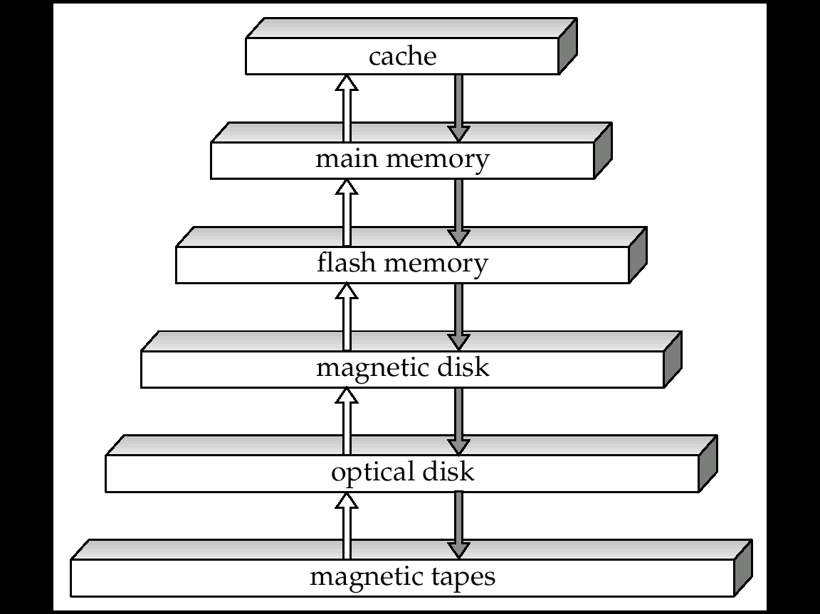
Physical Storage Media
Primary Storage
Cache
Main memory
Secondary Storage
Flash memory
Magnetic disk
Offline Storage
Optical disk
Magnetic tape
Notes:
- the higher the faster and more expensive

Slide 10
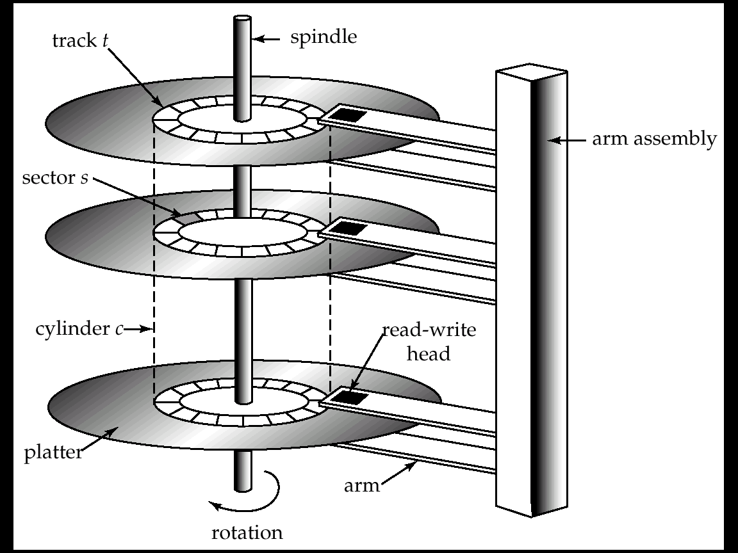
Magnetic Disks
Random Access
Inexpensive
Non-volatile

Slide 11
How do disks work?
Platter: covered with magnetic recording material
Track: logical division of platter surface
Sector: hardware division of tracks
Block: OS division of tracks
Typical block sizes:
512 B, 2KB, 4KB
Read/write head

Slide 12
Disk I/O
Disk I/O := block I/O
Hardware address is converted to Cylinder, Surface and Sector number
Modern disks: Logical Sector Address 0…n
Access time: time from read/write request to when data transfer begins
Seek time: the head reaches correct track
Average seek time 5-10 msec
Rotation latency time: correct block rotated
under head
5400 RPM, 15K RPM
On average 4-11 msec
Block Transfer Time

Slide 13
Optimize I/O
Database system performance I/O bound
Improve the speed of access to disk:
Scheduling algorithms (elevator algorithm)
File Organization (heap, index, hash)
Introduce disk redundancy
Redundant Array of Independent Disks (RAID)
Reduce number of I/Os
Query optimization, indexes
Notes:
elevator scheduling algorithm
Keep logical close blocks physically close

Slide 14
Where and How all this information is stored?
Metadata: tables, attributes, data types, constraints, etc
Data: records
Transaction logs, indices, etc
A collection of files (or tables)
Physically partitioned into pages or data blocks
Logically partitioned into records
Notes:
Example in postgres in iBook

Slide 15
Storage Access
A collection of files
Physically partitioned into pages
Typical database page sizes: 2KB, 4KB, 8KB
Reduce number of block I/Os := reduce number of page I/Os
How?
Buffer Manager
Notes:
Before we introduce buffer management, an exercise

Slide 16
Buffer Management (1/2)
Buffer: storing a page copy
Buffer manager: manages a pool of buffers
Requested page in pool: hit!
Requested page in disk:
Allocate page frame
Read page and pin
Problems?
Page request
Page request
disk
buffer pool

Slide 17
Buffer Management (2/2)
What if no empty page frame exists:
Select victim page
Each page associated with dirty flag
If page selected dirty, then write it back to disk
Which page to select?
Replacement policies (LRU, MRU)
Page request
disk
buffer pool
Notes:
Replacement policies similar to OS page replacement policies, eg:
Least Recently Used pages
Most Recently Used
Could have a short exercise

Slide 18
Disk Arrays
Single disk becomes bottleneck
Disk arrays
instead of single large disk
many small parallel disks
read N blocks in a single access time
concurrent queries
tables spanning among disks
Redundant Arrays of Independent Disks (RAID)
7 levels (0-6)
reliability
redundancy
parallelism

Slide 19
RAID Technology
A natural solution is a large array of small independent disks acting as a single higher-performance logical disk.
A concept called data striping is used, which utilizes parallelism to improve disk performance.
Data striping distributes data transparently over multiple disks to make them appear as a single large, fast disk.

Slide 20
RAID Technology (cont.)
Different raid organizations were defined based on different combinations of the two factors of granularity of data interleaving (striping) and pattern used to compute redundant information.
Raid level 0 (striping) has no redundant data and hence has the best write performance at the risk of data loss
Raid level 1 uses mirrored disks.
Raid level 2 uses memory-style redundancy by using Hamming codes, which contain parity bits for distinct overlapping subsets of components. Level 2 includes both error detection and correction.
Raid level 3 uses a single parity disk relying on the disk controller to figure out which disk has failed.
Raid Levels 4 and 5 use block-level data striping, with level 5 distributing data and parity information across all disks.
Raid level 6 applies the so-called P + Q (two parity) redundancy scheme using Reed-Solomon codes to protect against up to two disk failures by using just two redundant disks.

Slide 21
RAID level 0
Block level striping
No redundancy
maximum bandwidth
automatic load balancing
best write performance
but, no reliability
0
1
2
3
4
5
disk 1
disk 2
disk 3
disk 4

Slide 22
Raid level 1
Mirroring
Two identical copies stored in two different disks
Parallel reads
Sequential writes
transfer rate comparable to single disk rate
most expensive solution
0
0
2
2
1
1
disk 1
disk 2
mirror of disk 1
disk 3
disk 4
mirror of disk 3

Slide 23
RAID levels 2 and 3
bit level striping (next bit on a separate disk)
error detection and correction
RAID 2
ECC error correction codes (Hamming code)
Bit level striping, several parity bits
RAID 3
Byte level striping, single parity bit
error detection by disk controllers (hardware)
RAID 4
- Block level striping, single parity bit

Slide 24
RAID level 4
block level striping
parity block for each block in data disks
P1 = B0 XOR B1 XOR B2
B2 = B0 XOR B1 XOR P1
an update:
P1’ = B0’ XOR B0 XOR P1 (every update -> must write parity disk)
B0
B1
B2
P1
disk 1
disk 2
disk 3
disk 4

Slide 25
RAID level 5 and 6
subsumes RAID 4
parity disk not a bottleneck
parity blocks distributed on all disks
RAID 6
tolerates two disk failures
P+Q redundancy scheme
2 bits of redundant data for each 4 bits of data
more expensive writes
BM
B1
B0
PX’
B2
P1
PN
BY’
PX
BY
disk 1
disk 2
disk 3
disk 4

Slide 26
What pages contain logically?
Files:
Physically partitioned into pages (or blocks)
Logically partitioned into records
Each file is a sequence of records
Each record is a sequence of fields
student
cid | name
00112233 | Paul
student record:
00112233
Paul
8 + 4 = 12 Bytes

Slide 27
Page Organization
Student record size: 12 Bytes
Typical page size: 2 KB
Record identifiers: <Page identifier, offset>
How records are distributed into pages:
Unspanned organization
Blocking factor =
Spanned organization
Page i
Page i+1
Page i
Page i+1
unspanned
spanned
Notes:
q1: what if large records (over a single page)?
Q2: what if large records, BLOBs (over multiple pages)?

Slide 28
Blocking
Blocking:
Refers to storing a number of records in one block on the disk.
Blocking factor (bf) refers to the number of records per block.
There may be empty space in a block if an integral number of records do not fit in one block.
File records can be unspanned or spanned
Unspanned: no record can span two blocks
Spanned: a record can be stored in more than one block
The physical disk blocks that are allocated to hold the records of a file can be contiguous, linked, or indexed.

Slide 29
What if a record is deleted?
Depending on the type of records:
Fixed-length records
Variable-length records
Notes:
Which is the easiest one and why?

Slide 30
Fixed-length record files
Upon record deletion:
Packed page scheme
Bitmap
Slot 1
Slot 1
Slot 2
Slot 2
...
...
...
Slot N
Slot N
...
Free Space
Slot M
Page header
N
1
N-1
1
...
...
0
0
1
N
M
N
2
1
Packed
Bitmap
Notes:
Problem with packed scheme, RID do not change
But you can’t store a sorted file on bitmap

Slide 31
Variable-length record files
When do we have a file with variable-length records?
Column datatype: variable length
create table t (field1 int, field2 varchar2(n))
Problems:
Holes created upon deletion have variable size
Find large enough free space for new record
Could use previous approaches: maximum record size
a lot of space wasted
Use slotted page structure
Slot directory
Each slot storing offset, size of record
Record IDs: page number, slot number
...
32
...
N
16
38
N
2
1
Notes:
So in this case record IDs are still valid when record’s moved
Slots are not removed, but scanned

Slide 32
Record Organization
Fixed-length record formats
Fields stored consecutively
Variable-length record formats
Array of offsets
NULL values when start offset = end offset
f1
f2
f3
f4
Base address (B)
L1
L2
L3
L4
f3 Address = B+L1+L2
f1
f2
f3
f4
Base address (B)
Notes:
Where are the number of fields and data types stored?
Record that grows moves subsequent fields

Slide 33
Operation on Files
Typical file operations include:
OPEN: Prepares the file for access and associates a pointer that will refer to a current file record at each point in time.
FIND: Searches for the first file record that satisfies a certain condition and makes it the current file record.
FINDNEXT: Searches for the next file record (from the current record) that satisfies a certain condition and makes it the current file record.
READ: Reads the current file record into a program variable.
INSERT: Inserts a new record into the file & makes it the current file record.
DELETE: Removes the current file record from the file, usually by marking the record to indicate that it is no longer valid.
MODIFY: Changes the values of some fields of the current file record.
CLOSE: Terminates access to the file.
REORGANIZE: Reorganizes the file records.
For example, the records marked deleted are physically removed from the file or a new organization of the file records is created.
READ_ORDERED: Read the file blocks in order of a specific field of the file.

Slide 34
File Organization (later we study it in a more detailed way)
Heap files: unordered records
Sorted files: ordered records
Hashed files: records partitioned into buckets
34
Notes:
34

Slide 35
Heap Files
file
header
35
Simplest file structure
Efficient insert
Slow search and delete
Equality search: half pages fetched on average
Range search: all pages must be fetched
Notes:
35

Slide 36
Sorted (Ordered) files
start of file
Page 1
Page 2
insert
start of file
Page 1
Page 2
36
Sorted records based on ordering field
If ordering field same as key field, ordering key field
Slow inserts and deletes
Fast logarithmic search
Notes:
36

Slide 37
Sorted (Ordered) Files
Also called a sequential file.
File records are kept sorted by the values of an ordering field.
Insertion is expensive: records must be inserted in the correct order.
It is common to keep a separate unordered overflow (or transaction) file for new records to improve insertion efficiency; this is periodically merged with the main ordered file.
A binary search can be used to search for a record on its ordering field value.
This requires reading and searching log₂ of the file blocks on the average, an improvement over linear search.
Reading the records in order of the ordering field is quite efficient.

Slide 38
Hashed Files
null
null
hash field
h
Overflow page
…
38
Hash function h on hash field distributes pages into buckets
Efficient equality searches, inserts and deletes
No support for range searches
Notes:
38

Slide 39
Hashed Files
Hashing for disk files is called External Hashing
The file blocks are divided into M equal-sized buckets, numbered bucket₀, bucket₁, ..., bucket_{M-1}.
Typically, a bucket corresponds to one (or a fixed number of) disk block.
One of the file fields is designated to be the hash key of the file.
The record with hash key value K is stored in bucket i, where i=h(K), and h is the hashing function.
Search is very efficient on the hash key.
Collisions occur when a new record hashes to a bucket that is already full.
An overflow file is kept for storing such records.
Overflow records that hash to each bucket can be linked together.

Slide 40
Hashed Files

Slide 41
Summary (1/2)
Why Physical Storage Organization?
understanding low-level details which affect data access
make data access more efficient
Primary Storage, Secondary Storage
memory fast
disk slow but non-volatile
Data stored in files
partitioned into pages physically
partitioned into records logically
Optimize I/Os
scheduling algorithms
RAID
page replacement strategies

Slide 42
Summary (2/2)
File Organization
how each file type performs
Page Organization
strategies for record deletion
Record Organization

