Slide 1



A
SQL-Driven Ad-hoc Business Insights

Slide 2
PROBLEM STATEMENT:
AtliQ Hardwares, one of the leading computer hardware producers in India with a strong presence in other countries, has been experiencing impressive business growth.
However, the management team has noticed a gap — they do not have sufficient data-driven insights to make quick and smart business decisions. To overcome this challenge, AtliQ Hardwares is expanding its data analytics team by hiring junior data analysts.
Tony Sharma, the Director of Data Analytics, has designed a SQL challenge to evaluate applicants’ ability to solve real-world business problems. This challenge will test both technical expertise (SQL, data analysis) and soft skills (storytelling, communication, presentation).
Task Assigned to Me:
As an applicant for the Junior Data Analyst role at AtliQ Hardwares, I have been assigned the following task:
Review the company’s 10 ad-hoc business requests provided in ad-hoc-requests.pdf.
Write and execute SQL queries to answer each of these requests.
Analyze the query results and translate them into clear, actionable business insights.
Prepare a presentation (slides) that summarizes these insights for top-level management.
Include charts, graphs, and dashboards to visualize the findings.
Keep the presentation concise, strategic, and executive-friendly.

Slide 3
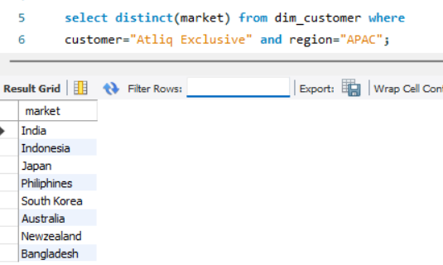
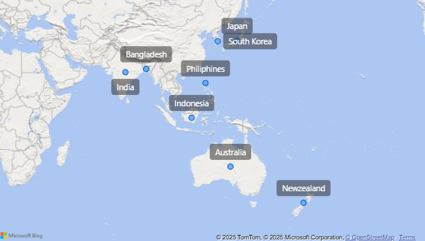
AD-HOC REQUEST 1: Provide the list of markets in which customer “AtliQ Exclusive” operates its business in the “APAC region”.
QUERY & OUTPUT:
Key Insights & Recommendation
Provides leadership a clear view of AtliQ Exclusive’s APAC footprint and whitespace opportunities for expansion.

Slide 4
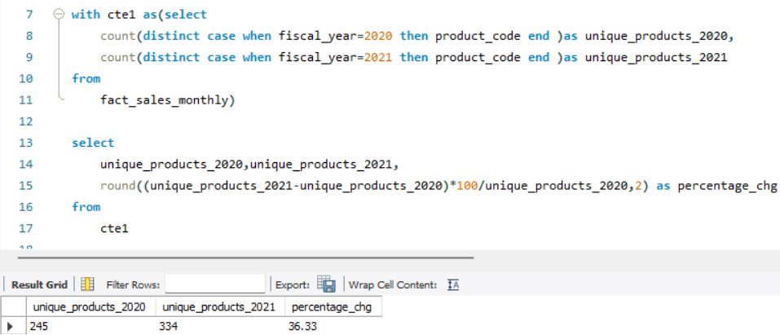
AD-HOC REQUEST 2: What is the percentage of unique product increase in 2021 vs. 2020? The final output contains these fields, unique_products_2020, unique_products_2021 percentage_chg.
QUERY & OUTPUT:
Key Insights & Recommendation
The number of unique products grew from 245 in 2020 to 334 in 2021, adding 89 new products (+36% YoY growth), showing strong expansion and diversification of the portfolio.
Portfolio expansion reflects SKU diversification and innovation — strong sign of market competitiveness.

Slide 5
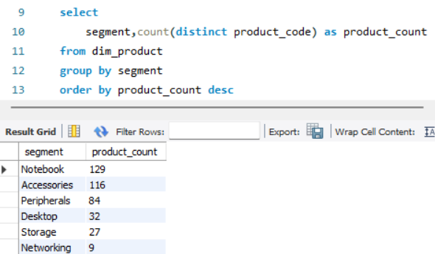
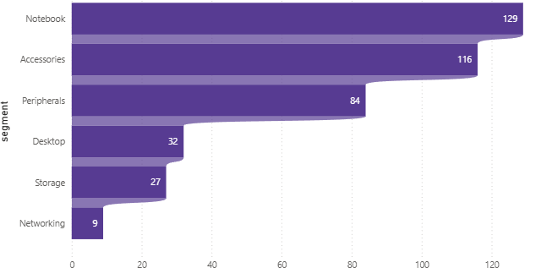
AD-HOC REQUEST 3: Provide a report with all the unique product counts for each segment and sort them in descending order of product counts. The final output contains 2 fields: segment, product count.
QUERY & OUTPUT:
Key Insights & Recommendation
Notebooks, Accessories, and Peripherals are the top-performing categories.
Networking is explicitly the lowest segment in product count.
Networking represents a portfolio gap to address.

Slide 6
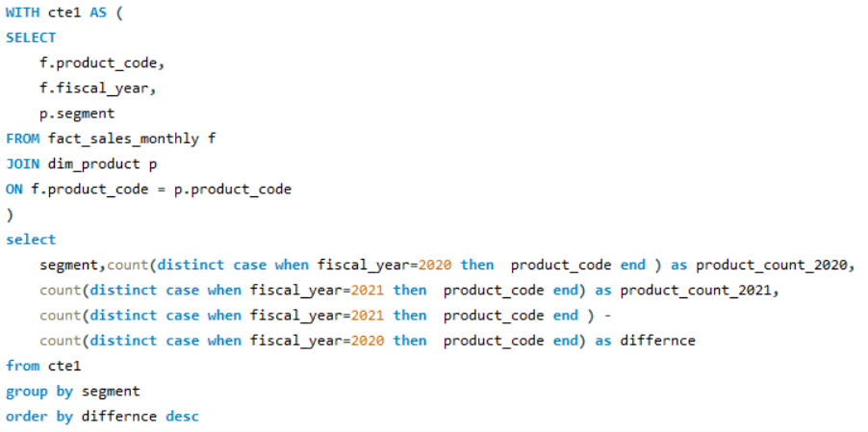
AD-HOC REQUEST 4: Which segment had the most increase in unique products in 2021 vs 2020? The final output contains these fields: segment, product_count_2020 product_count_2021, difference.
QUERY:

Slide 7
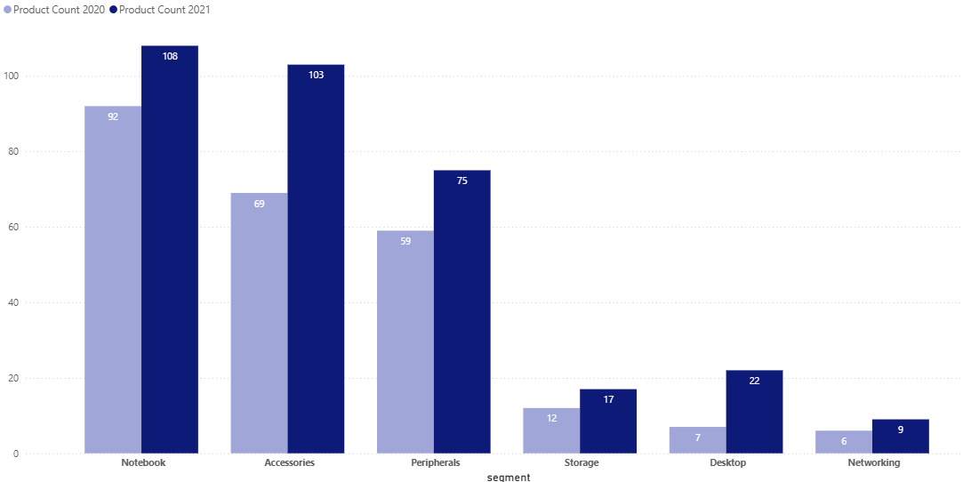
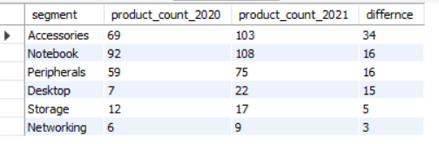
OUTPUT:
Key Insights & Recommendations
Networking grew by only 3 products (+50%), signaling the need to rethink strategy in this segment.
Accessories added 34 products (+41%), emerging as the fastest-growing and high-priority area for marketing.
Notebooks and Peripherals each expanded by 16 products (~14–23% growth), showing steady, reliable performance.
Desktop (+6 products, +23%) and Storage (+14 products, +108%) remain niche segments with potential for targeted development.
Accessories is the scale driver (highest absolute growth), while Networking grew fastest in % terms but added only 3 products — small base.

Slide 8
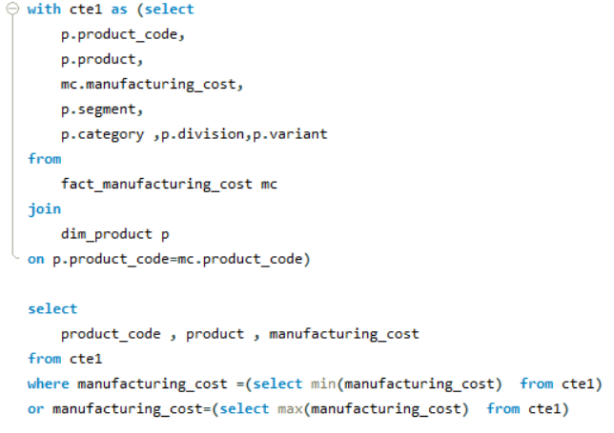

AD-HOC REQUEST 5: Get the products that have the highest and lowest manufacturing costs. The final output should contain these fields: product_code, product, manufacturing_cost
QUERY & OUTPUT:
Key Insights & Recommendation
The most expensive product to manufacture is AQ HOME Allin1 Gen 2 at $240.54, while the least expensive is AQ Master wired x1 Ms at $0.89 — a cost gap of $239.65 (≈27,000%) between premium and entry-level products.
Focusing on premium products can drive higher margins, while optimizing costs for entry-level products is key to maintaining profitability.
Gap highlights margin strategy: focus premium SKUs for profitability, optimize entry-level SKUs for efficiency.

Slide 9
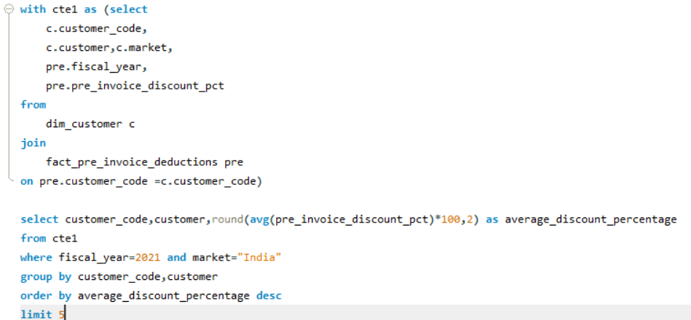
AD-HOC REQUEST 6: Generate a report which contains the top 5 customers who received an average high pre_invoice_discount_pct for the fiscal year 2021 and in the Indian market. The final output contains these fields, customer_code customer average_discount_percentage
QUERY:

Slide 10
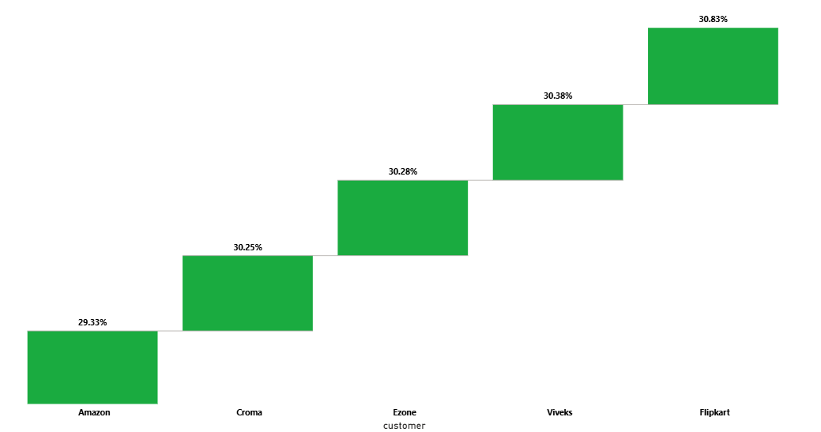
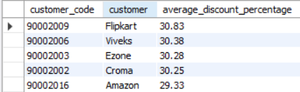
OUTPUT:
Key Insights & Recommendation
Flipkart, Viveks, Ezone, Croma, and Amazon received the highest average discounts in FY 2021 (29–31%), indicating they are strategic partners and high-volume buyers.
Maintaining strong relationships with these customers through tailored promotions is critical, while reviewing discount strategies will help balance profitability and partner support.
High discounts create margin erosion risk — leadership must balance partner loyalty with sustainable margins

Slide 11
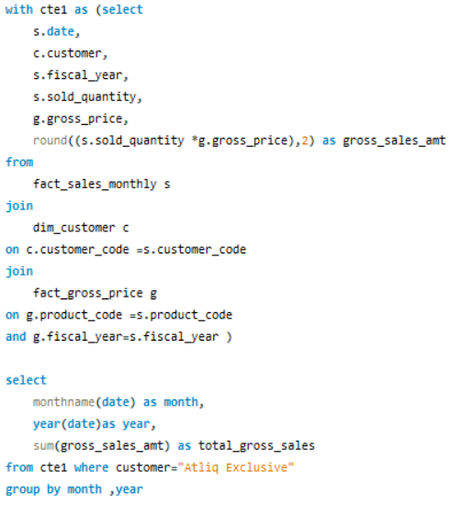
AD-HOC REQUEST 7: Get the complete report of the Gross sales amount for the customer “Atliq Exclusive” for each month . This analysis helps to get an idea of low and high-performing months and take strategic decisions. The final report contains these columns: Month Year Gross sales Amount
QUERY:

Slide 12
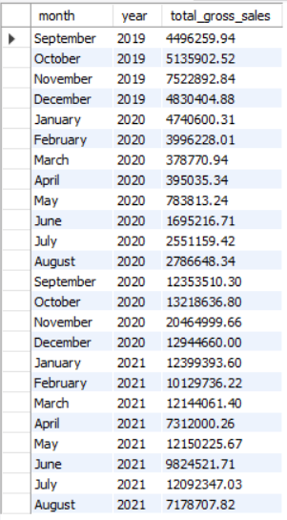
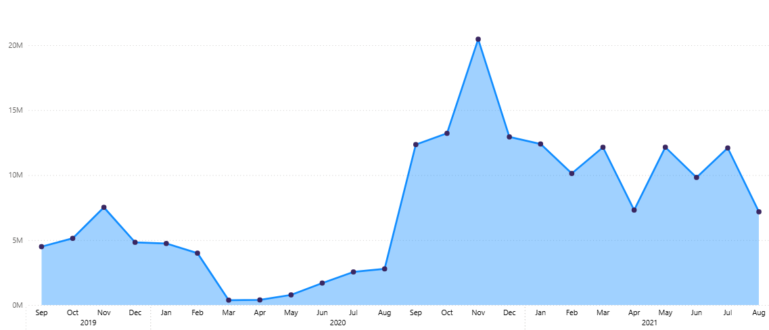
OUTPUT:
Note: fiscal year runs Sep–Aug.
Key Insights & Recommendations
Sales were steady in late 2019 but dropped sharply in early 2020, bottoming out in March (~$2M) due to COVID-19 disruptions.
A strong rebound followed, with sales peaking in November 2020 at $20M+.
In 2021, sales stabilized between $7M–$12M, reflecting resilience post-crisis.
Leverage Q4 seasonal peaks, counter Q1 slumps with targeted initiatives, and replicate strategies from the November 2020 surge to sustain growth.
Q1 (Sep–Nov) is a recurring sales peak and Q3/Q4 need resilience strategies.

Slide 13
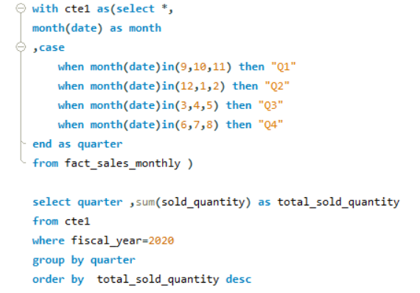
AD-HOC REQUEST 8: In which quarter of 2020, got the maximum total_sold_quantity? The final output contains these fields sorted by the total_sold_quantity, Quarter total_sold_quantity
QUERY:

Slide 14
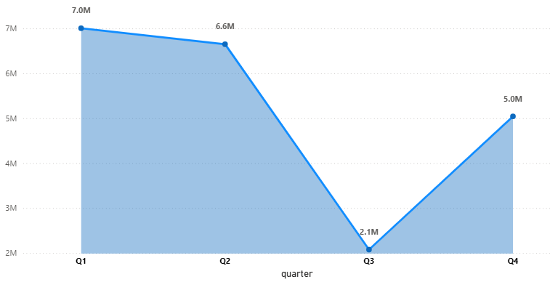
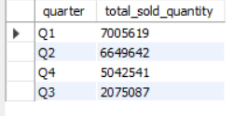
OUTPUT:
Key Insights & Recommendations
Q1 leads with ~7M units, followed by Q2 with ~6.6M (strong first half).
Q3 is weakest at ~2.1M units, a 71% drop vs Q1.
Q4 is moderate at ~5M units, below the first-half levels.
Action: Sustain Q1–Q2 momentum, investigate Q3 slump, and run targeted campaigns in Q4 to lift performance.(Q1 shows strongest demand, Q3 weakest — requires demand stimulation initiatives)

Slide 15
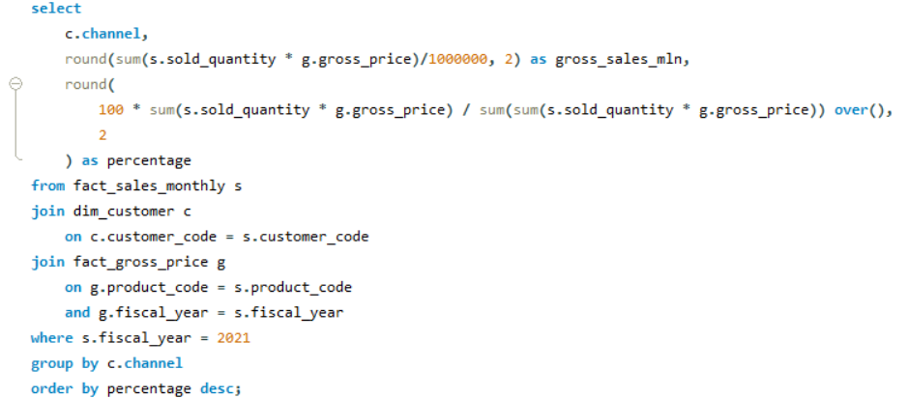
AD-HOC REQUEST 9: Which channel helped to bring more gross sales in the fiscal year 2021 and the percentage of contribution? The final output contains these fields, channel gross_sales_mln percentage
QUERY:

Slide 16
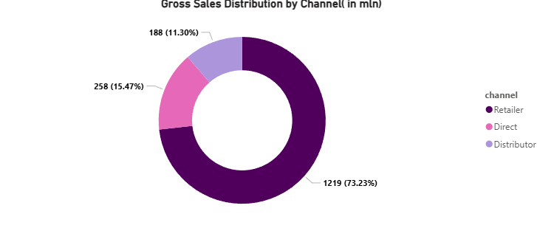

OUTPUT:
Key Insights & Recommendations
Retail partners (e.g., Flipkart, Amazon) dominate with 73% of sales (~$1.2B).
Direct channel contributes 15% (~$258M) — a clear opportunity to boost margins and customer relationships.
Distributors hold 11% (~$188M), the smallest share.
Leverage retailer strength, scale direct-to-customer initiatives, and optimize distributor efficiency to balance the channel mix.
Retail dependency is high (73%), Direct channel growth can improve margins and reduce concentration risk.

Slide 17
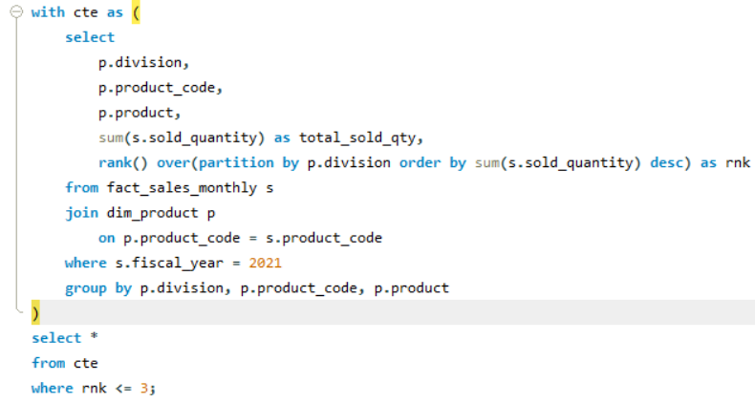
AD-HOC REQUEST 10: Get the Top 3 products in each division that have a high total_sold_quantity in the fiscal_year 2021? The final output contains these fields, division, product_code, product, total_sold_quantity, rank_order.
QUERY:

Slide 18

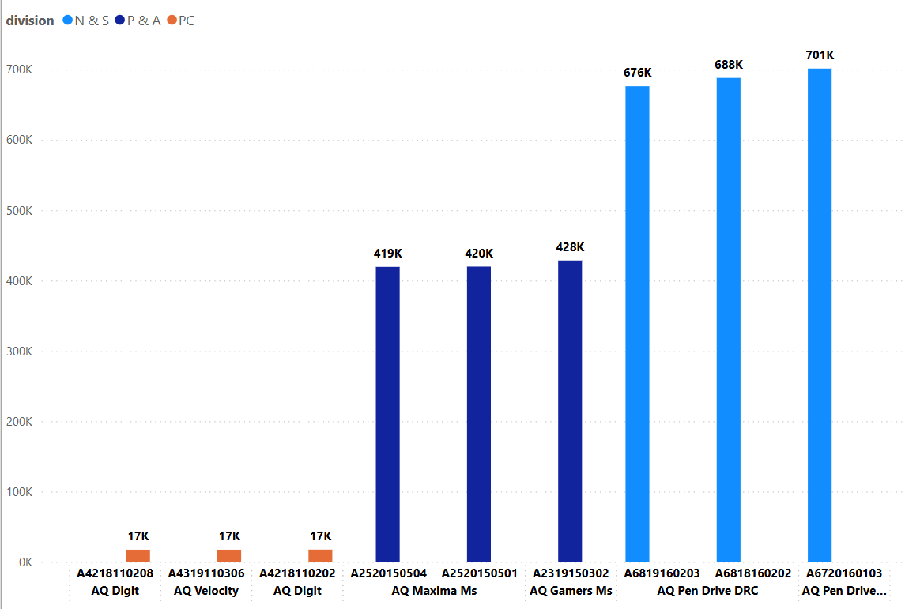
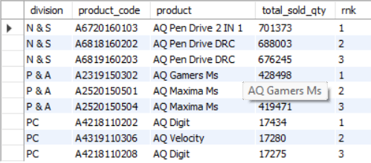
OUTPUT:
Key Insights & Recommendations
Pen Drives dominate in the N & S division, with 2M+ units sold across the top 3 models.
Accessories (P & A division) are gaining traction, led by Gamers Ms and Maxima Ms.
PC division is underperforming, moving only ~17K units.
Invest in Pen Drives, scale up Accessories, and reassess the PC division to optimize the overall product strategy.
Sales heavily concentrated in Pen Drives — concentration risk. PC division underperforms and requires strategy reset.

