Slide 1
Online Video Streaming Service

Slide 2

Prepared by
1505091 Rituparna Datta
1505092 Jamalia Sultana Jisha
1505118 Afsara Benazir
Submitted to
Dr. Tanzima Hashem
Mahjabin Nahar
Nafis Irtiza Tripto
CSE 326 : Information System Design Sessional
Department Of Computer Science And Engineering, BUET

Slide 3
Project Background

Slide 4
Purpose
Creating a unique and engaging video sharing platform to let users connect with people on an emotional level

Slide 5
Impact
Revolutionize entertainment and education
Help People Get Discovered
Gain real time feedback on your content

Slide 6
Requirements Analysis

Slide 7
What the Users can do
Search video
Upload video
Watch video (can perform action without signing in)
Download video
Interact with uploaders content
like, share, comment, subscribe
Has to be signed in to perform this action

Slide 8
What the Users can do
See video analytics
See notifications
Individual and group messaging options
Create customised playlist
Add to watch later

Slide 9
Scopes for development
Get recommended videos
Detect spam and take appropriate actions
Include live streaming options
Auto generate report on site statistics
Sync account with facebook,google,twitter etc
Advanced search options

Slide 10
Workflow diagram

Slide 11
Workflow Diagram
Create Account
Login
Upload Videos
Viewer
Watch Video
Download
Watch Videos
Interact
Admin
Verify Report
Take
Actions
Report

Slide 12
Use Case Diagram
User Functionalities
Report Handling Use case

Slide 13
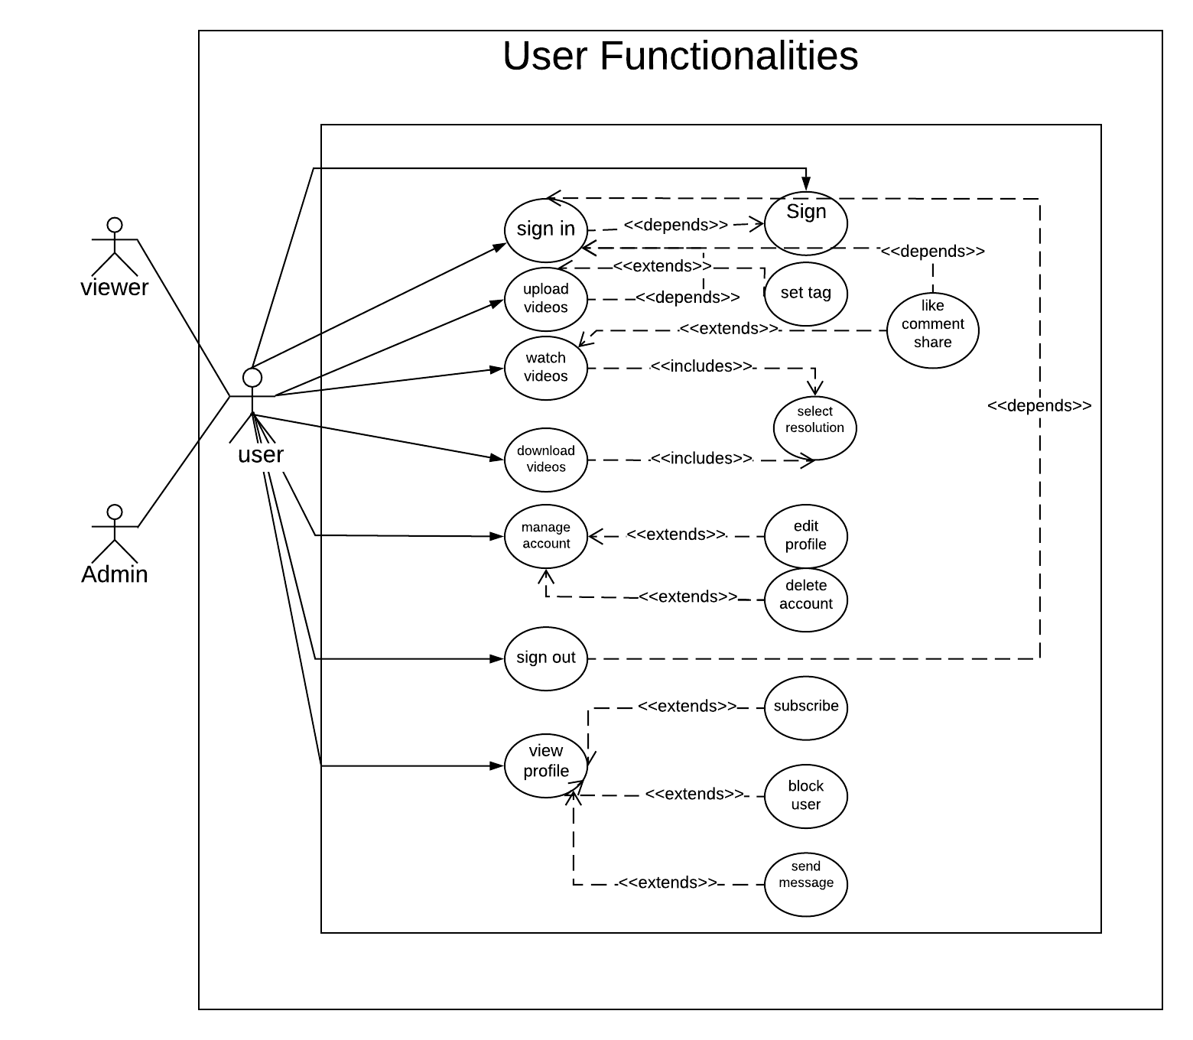

Slide 14
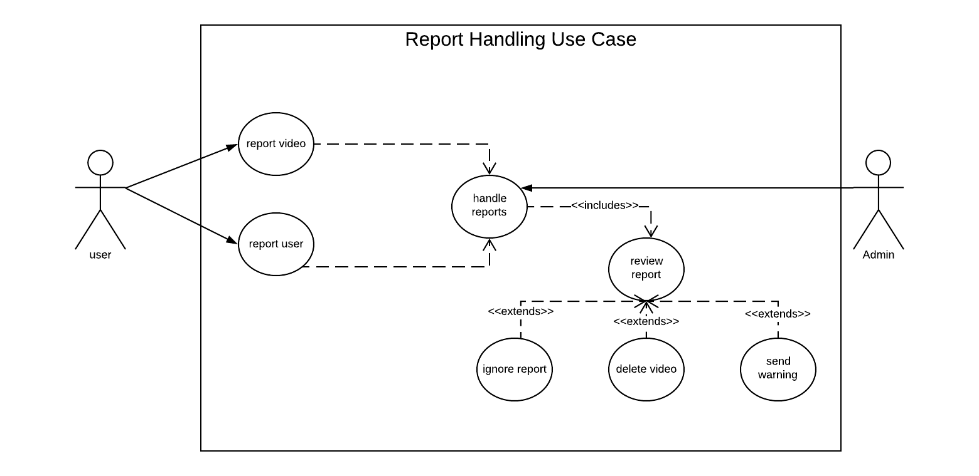

Slide 15

THANK YOU!

