Slide 1
Dow Theory
by Charles Dow

Slide 2
The Dow Theory is one of the most popularly used concepts of charting & Technical Analysis. It happens to be one of the oldest technical analysis tools as well. Dow Theory days back to as early as 1900 to 1902 when Charles Dow laid the basic principles. The Theory named after him as Dow Theory. It helps investors in the stock market to understand the health of the trade condition. The father of Dow Theory, Mr Charles Dow died in 1902 but after his death work of Dow Theory was continued by William Hamilton.
The Dow Theory helps investors to know how the stock market used to understand the business environment’s health. It was the first theory of technical analysis that explains the trends of market moves.

Slide 3
HISTORY REPEATS EVERYTHING
MARKET DISCOUNT EVERYTHING
A TREND IS SAID TO BE CONTINUOUS UNTIL A REVERSAL IS CONFIRMED

Slide 4
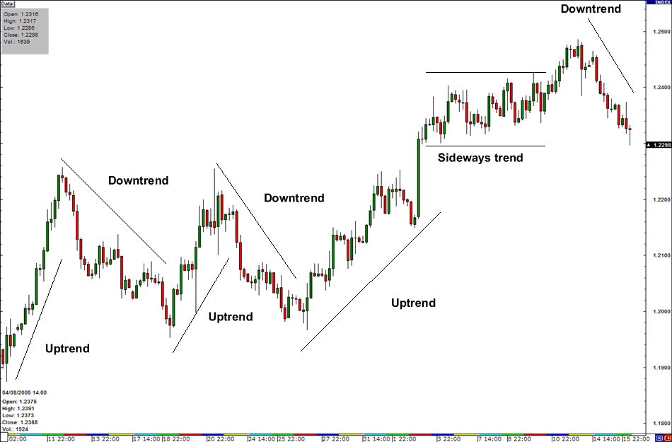
AUGUST 21, 2019

Slide 5
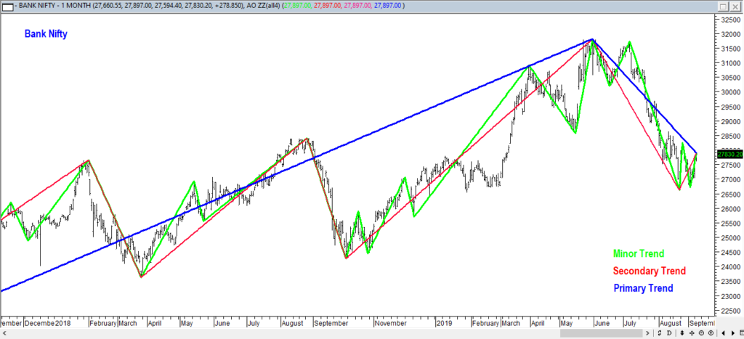
Market Trends are of three types

Slide 6
The primary, secondary and minor trends that affect the stock market
Primary Trend: The primary trend is one of the major trends for the market, which indicates how the market moves in the long-term. It can occur in both rising and falling market.
Secondary Trend: It is considered for correction to a primary trend. It’s an opposite action to the primary trend. This secondary trend has a range of 10 days to three months.
Minor Trend: In this trend, the market movement fluctuated on a daily basis. And these trends last usually less than three weeks. Minor trends are short term trends.

Slide 7
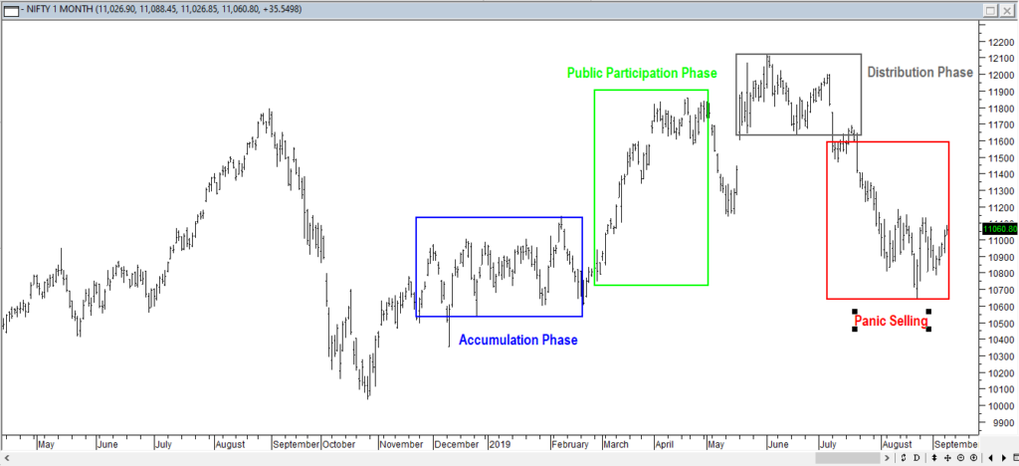
The market has three phases
These three phases in the market are accumulation, public participation, and distribution or panic phase.
I

Slide 8
In bullish markets, the phases described as below
Accumulation Phase: The accumulation market phase is when investors feel the change in the current market direction when they are entering the market.
Public Participation Phase: In this phase, investors enter the market just when the condition of the market improves and positive sentiments become noticeable.
Distribution or Panic Phase: This phase begins when the entire bullish news headline is carried by media, there is buying on huge volume which is base on speculation. During the distribution phase, the trade news is bullish than ever, business value begins to advance quickly, & the community flock to the market in expectation of catching the movements.

Slide 9
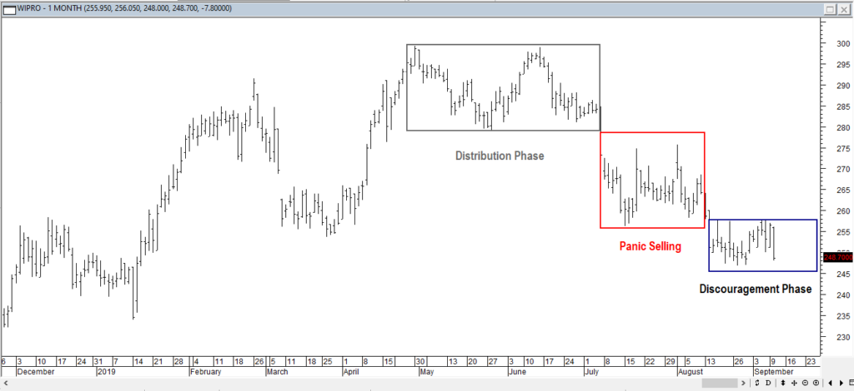
Now talk about the bear market phases:

Slide 10
Distribution Phase: Usually the bear market starts when the bull market going to end.
Panic selling phase is: According to the name – best described by panic & fear. As a market price begins to failure and buyers become limited, people want to leave the market urgently when the very sharp drop occurs in the price of the market.
Discouragement phase: It occurs when the sharpest failures are finish. Stock investors thought that the market would improve, sell their portfolios which discouraged by the condition. This phase may follow through a lengthy horizontal range, but after some time (sooner or later) things start to look positive and a new accumulation phase occurs in the market.

