Slide 1

Exploring
#5 Looping

Slide 2
Looping Statements
What ?
Javascript feature that help deal with repeat same / identical work .
Why ?
We don't want to type too much code.

Slide 3
While Loop
var angka = 1;
while(angka <=10){
console.log(angka);
angka++;
}

Slide 4
Do While Loop
var angka = 1;
do{
console.log(angka);
angka++;
} while(angka <=10) ;

Slide 5
var x;
for(x=1; x<=10; x++){
console.log(x);
}
For Loop

Slide 6
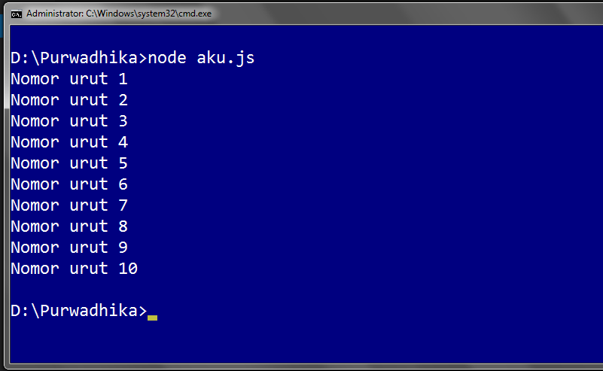
Solve It!

Slide 7
Solved!
var y = 'Nomor urut '; for(let x=1; x<=10; x++){
console.log(y + x);
}

Slide 8
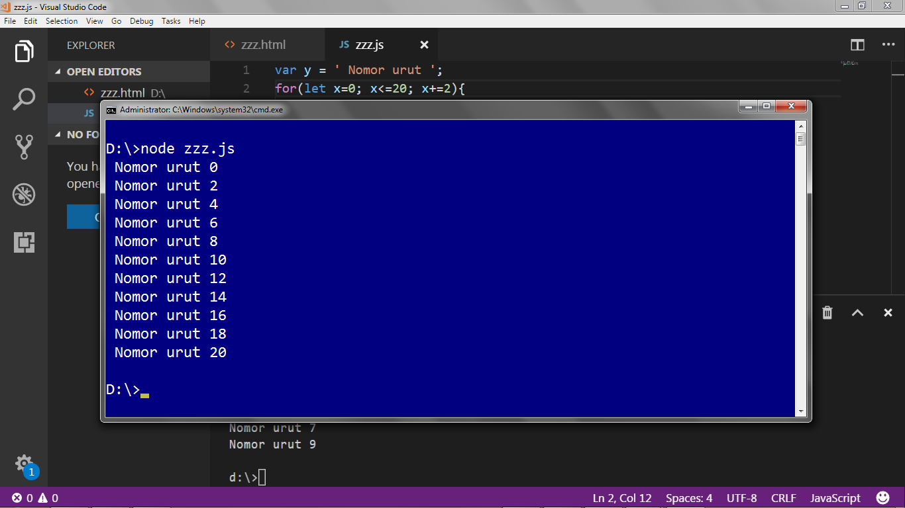
Solve It! #13

Slide 9
Solved!
var y = ' Nomor urut ';
for(let x=0; x<=20; x+=2){
console.log(y + x);
}

Slide 10
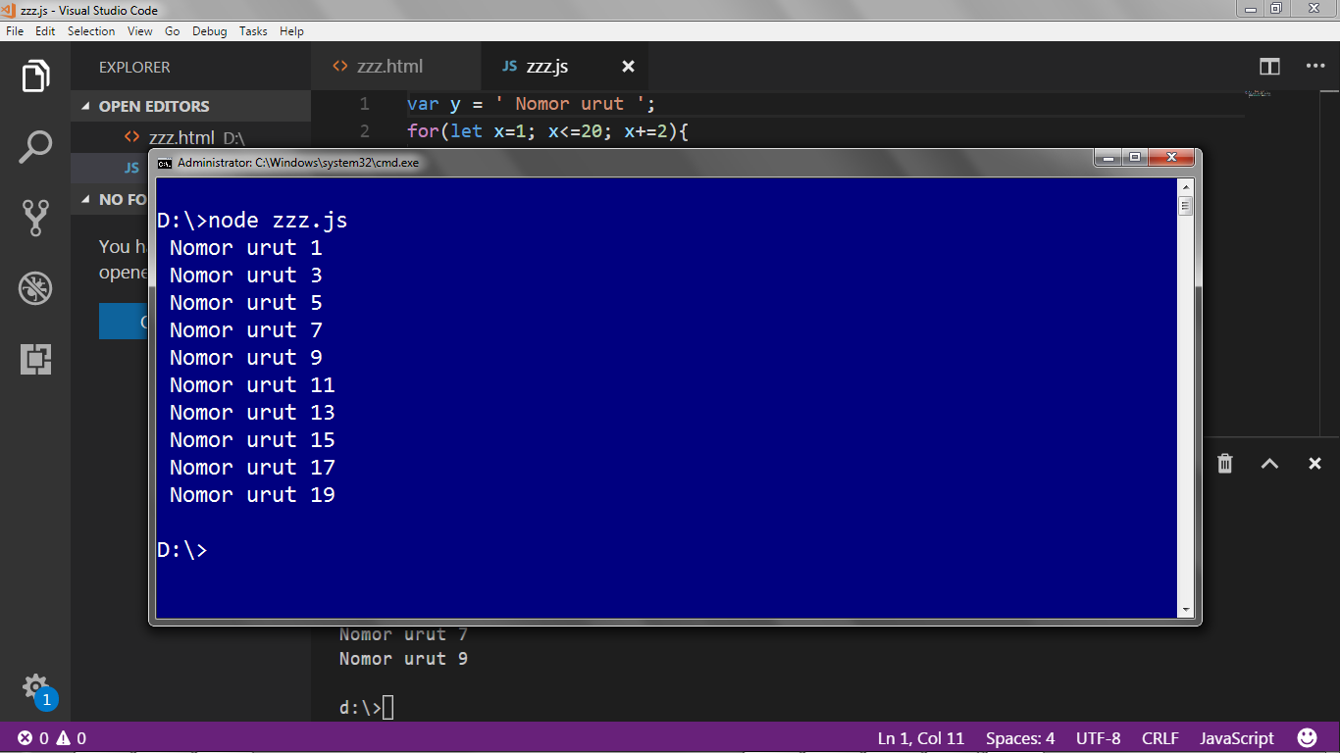
Solve It! #14

Slide 11
Solved!
var y = ' Nomor urut ';
for(let x=1; x<=20; x+=2){
console.log(y + x);
}

Slide 12
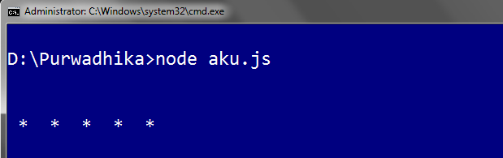
for Loop Drawing
let z='';
for (let i=0;i<5;i++){
z += ' * '
}
console.log(z)

Slide 13
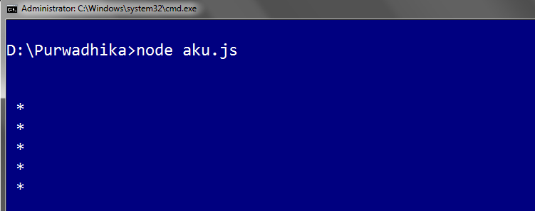
for Loop Drawing
let z=''; for (let i=0;i<5;i++){
z += ' * ' + '\n'
} console.log(z)

Slide 14
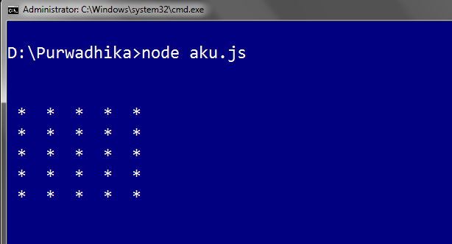
Solve It! #15

Slide 15
for Loop Drawing
let z='';
for (let i=0; i<5; i++){
for (let j=0; j<5 ;j++){
z += ' * '
}
z += '\n'
}
console.log(z)

Slide 16
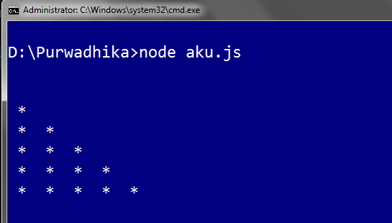
Solve It! #16

Slide 17

Solve It! #17

Slide 18
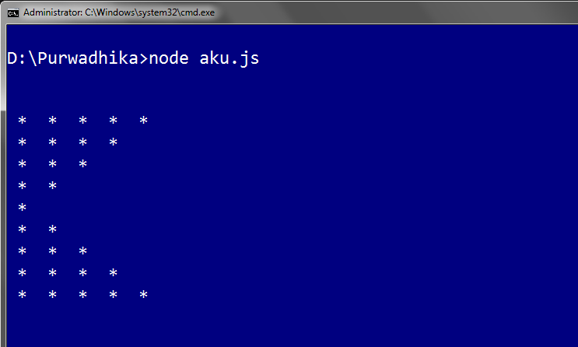
Solve It! #18

Slide 19
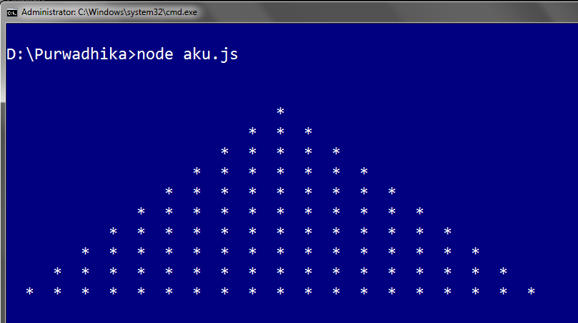
Solve It! #19

Slide 20
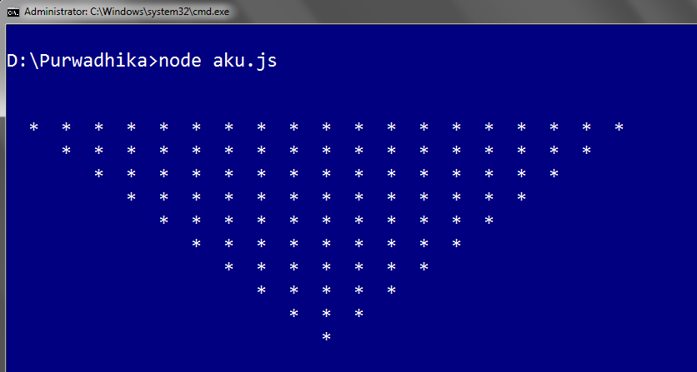
Solve It! #20

Slide 21
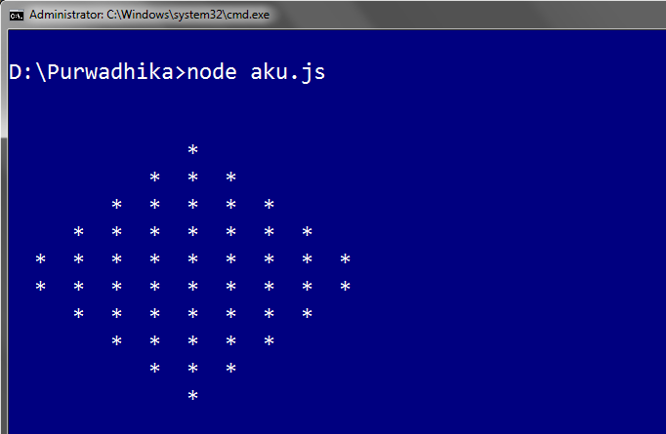
Solve It! #21

Slide 22
Exploring
#5 Looping

