Slide 1

Exploring
#5 Function

Slide 2
Function
What ?
One block code that can called at many place and reuseable .
Why ?
We need simple way for maintaining code that will appear at many different place.

Slide 3
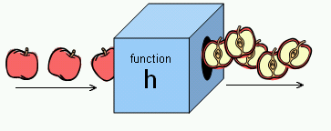
Function
Functions are blocks of code that can be named and reused.

Slide 4
Function Statement
function contoh() {
console.log('Halo Dunia!');
}
contoh();
/*
function namafunc(param) {prog}
*/

Slide 5
Function Expression
var contoh = function () {
console.log('Halo Dunia!');
}
contoh();
/*
var namafunc = function (param) {prog}
*/

Slide 6
Function
let x = 10
let y = 50
function contoh() {
console.log(x+y)
}
contoh();

Slide 7
Function with a Parameter
function namaku(nama) {
console.log (nama+' Susilo');
}
namaku('Adi');
namaku('Budi');
namaku('Caca');
namaku('Dedi');

Slide 8
Function with 2 Parameters
function data(x,y) {
console.log (x+' Lahir th '+y);
}
data('Adi','1990');
data('Budi','1991');
data('Caca','1992');
data('Dedi','1993');

Slide 9
Return Function
function total(x,y) {
z = x + y
return z
} console.log(total(4,5))
console.log(z)
/*
- z adalah local variabel dalam func total, tidak dapat
dipanggil di luar func tsb.
- jika z tidak di-return maka total(4,5) = undefined
*/

Slide 10
Return Function
function total(x,y) {
z = x + y
}
console.log(total(4,5))
/*
- z adalah local variabel dalam func total, tidak dapat
dipanggil di luar func tsb.
- jika z tidak di-return maka total(4,5) = undefined
*/

Slide 11
Return Function
function total(x,y) {
z = x + y
console.log(z)
}
console.log(total(4,5))
/*
- z adalah local variabel dalam func total, tidak dapat
dipanggil di luar func tsb.
- jika z tidak di-return maka total(4,5) = undefined
*/

Slide 12
Recursive Function
function Pangkat(x,y){
if (y == 1) {
return x;
}
else {
return x=x*Pangkat(x,y-1);
}
}
console.log(Pangkat(7,2))

Slide 13
Fn inside Fn
function kali(x) {
if (x < 2) {return 1;}
else {return (x * tiga());}
}
function tiga(){
return 3;
}
console.log(kali(5))

Slide 14
setTimeout
setTimeout(waktu, 3000);
function waktu() {
console.log('Halo');
}
console.log('Yuk');
3000 ms (3 detik) setelah program running, output ‘Halo’ muncul. Output ‘Yuk’ muncul lebih dahulu, tanpa menunggu baris kode di atasnya (‘Halo’) selesai.

Slide 15
clearTimeout
var x = setTimeout(waktu, 3000);
function waktu() {
console.log('Halo');
}
clearTimeout(x)
console.log('Yuk');
Baris setTimeout tidak diproses, lantaran dibatalkan seketika oleh clearTimeout.

Slide 16
setInterval
setInterval(waktu, 1500);
function waktu() {
console.log('Halo');
}
Output ‘Halo’ akan muncul tiap 1500 ms (1.5 detik).
Untuk stop proses di cmd, tekan CTRL + C.

Slide 17
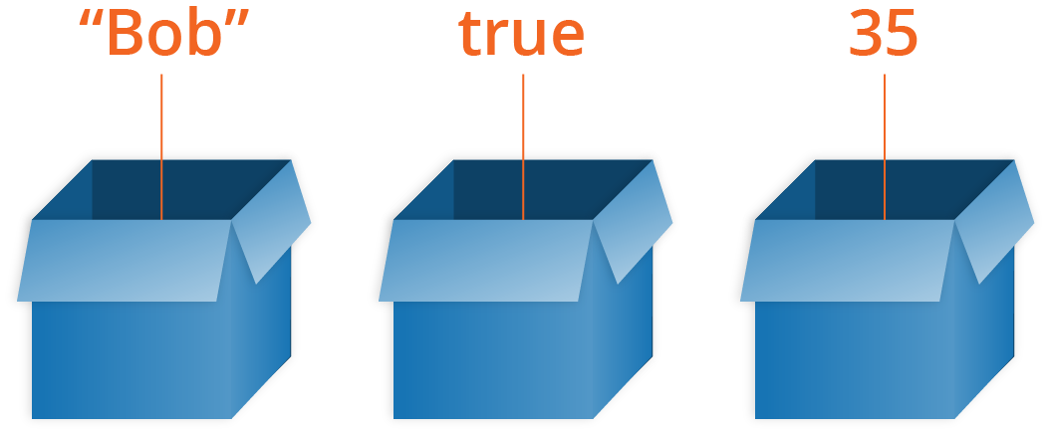

Array
Arrays are container-like values that can hold other values. The values inside an array are called elements.

Slide 18
Array
let mobil1 = 'Alya';
let mobil2 = 'Xenia';
let mobil3 = 'Avanza';
=============================
let mobil = ['Alya','Xenia','Avanza'];
let mobil = [
'Alya',
'Xenia',
'Avanza'
];

Slide 19
Array
let mobil = ['Alya','Xenia','Avanza'];
console.log(mobil)
console.log(mobil.toString())
console.log(mobil.join(' * '))

Slide 20
Array Elements
let mobil = ['Alya','Xenia','Avanza'];
console.log(mobil[0])
console.log(mobil[1])
console.log(mobil[2])
console.log(mobil[3])

Slide 21
Array Elements
let buah, bPjg, i;
buah = ['Jeruk', 'Nanas', 'Apel'];
bPjg = buah.length;
for (i = 0; i < bPjg; i++) {
console.log(buah[i]);
}

Slide 22
Array Properties & Methods
< length, sort, reverse & indexOf >
let mobil = ['Alya','Xenia','Avanza'];
let w = mobil.length;
let x = mobil.sort();
//let y = mobil.reverse();
let z = mobil.indexOf('Avanza');
console.log(w)
console.log(x)
// console.log(y)
console.log(z)

Slide 23
pop & push
let buah = ['Jeruk','Nanas','Apel'];
buah.pop();
console.log(buah)
buah.push('Kiwi');
console.log(buah)

Slide 24
shift & unshift
let buah = ['Jeruk','Nanas','Apel'];
buah.shift();
console.log(buah)
buah.unshift('Lemon');
console.log(buah)

Slide 25
delete & splice
let buah = ['Jeruk','Nanas','Apel'];
buah.splice(2, 0, 'Lemon', 'Kiwi');
console.log(buah)
buah.splice(0, 1);
console.log(buah)
delete buah[0];
console.log(buah)

Slide 26
slice
let buah = ['Banana', 'Orange',
'Lemon', 'Apple', 'Mango'];
let buah2 = buah.slice(1);
console.log(buah2)
let buah4 = buah.slice(1,4);
console.log(buah4)

Slide 27
Adding Array Elements
let buah = ['Jeruk','Nanas','Apel'];
buah.push('Duku');
console.log(buah)
buah[buah.length] = 'Pisang';
console.log(buah)
buah[6] = 'Mangga';
console.log(buah)

Slide 28
Merging (Concatenating)
2 Arrays
let nama1 = ['Andi','Budi'];
let nama2 = ['Caca','Dede','Euis'];
let nama3 = nama1.concat(nama2);
let nama4 = nama2.concat(nama1);
console.log(nama3)
console.log(nama4)

Slide 29
Merging (Concatenating)
3 Arrays
let nama1 = ['Andi','Budi'];
let nama2 = ['Caca','Dede','Euis'];
let nama3 = ['Faza','Gilang'];
let x = nama1.concat(nama2,nama3);
console.log(nama1)
console.log(nama2)
console.log(nama3)
console.log(x)

Slide 30
Solve It!
Buatlah algoritma untuk mengurutkan elemen array berikut:
x = [40, 100, 1, 5, 25, 10]

Slide 31
Numeric Sorting Ascending
Function comparison
let x = [40, 100, 1, 5, 25, 10];
console.log(x)
console.log(x.sort())
x.sort(function(a,b){
return a-b
});
console.log(x)

Slide 32
Numeric Sorting Descending
Function comparison
let x = [40, 100, 1, 5, 25, 10];
console.log(x)
console.log(x.sort())
x.sort(function(a,b){
return b-a
});
console.log(x)

Slide 33
Solve It!
Buatlah algoritma untuk menentukan elemen tertinggi & terendah,
dari array berikut:
x = [40, 100, 1, 5, 25, 10]

Slide 34
Lowest & Highest Element #1
let x = [40, 100, 1, 5, 25, 10];
x.sort(function(a,b){
return a-b
});
console.log(x[0])
console.log(x[x.length-1])

Slide 35
Lowest & Highest Element #2
let x = [40, 100, 1, 5, 25, 10];
function nilaiMin(a) {
return Math.min.apply(null, a);
}
function nilaiMax(a) {
return Math.max.apply(null, a);
}
console.log(nilaiMin(x))
console.log(nilaiMax(x))

Slide 36
Array of Arrays
var arrayKu = [
['Andi',24,'PNS'],
['Budi',28,'Pengacara'],
['Caca',21,'Siswa'],
]
console.log(arrayKu[0])
console.log(arrayKu[0][0])
console.log(arrayKu[1][1])
console.log(arrayKu[2][2])

Slide 37
Sorting Array of Arrays
var arrayKu = [
['Andi',24,'PNS'],
['Budi',28,'Pengacara'],
['Caca',21,'Siswa'],
]
arrayKu[0].sort()
arrayKu[1].reverse()
console.log(arrayKu[0])
console.log(arrayKu[1])

Slide 38
Exploring
#6 Function & Array

