Slide 1
Linking Clara and Moodle
Connecting to Clara
Using Moodle's external enrolments plugin
Dawson's custom plugins
Using PHP, query Clara and insert rows into tables that are similar to the following

Slide 2
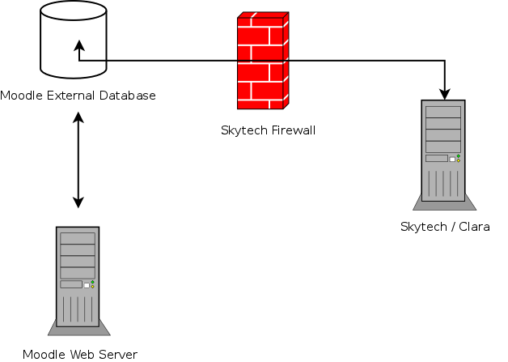
Connecting to Clara

Slide 3
Connecting to Clara
What you need
  FreeTDS and PHP compiled from source
    See https://github.com/jamaur/moodle2/blob/master/docs/freetds.detailed.instructions.txt for the gruesome details.
    The instructions were made for CentOS 5. They should also work with CentOS 6 with little to no modifications.

Slide 4
Connecting to Clara
What you need from Skytech
  Connectivity! Skytech needs to open their firewall to allow your database server to connect to Clara on port 1433.
  Easiest way to test: run “telnet clara_hostname 1433” from the command-line. If it hangs, there's a firewall issue. If it says “connected”, then you're good to go.
  A username and password for an account that can SELECT from the tables you want.

Slide 5
Using Moodle's external enrolments plugin
See https://github.com/jcharaoui/moodle-cegep/blob/master/lib_maisonneuve.php for some useful SQL statements.
See https://github.com/jcharaoui/moodle-cegep/blob/master/sisdb/sisdb.php for and idea of how to “massage” the data.
Map the table fields with Moodle fields in the configuration page.
Using PHP, query Clara, massage the data, and insert rows into tables that are similar to the following (there is no code to share for this because we use our in-house framework accomplish this step):

Slide 6
Moodle External Database Structure
The “course” table
Column | Type | Description
id | int | Unique identifier, auto-incremented.
coursenumber | varchar | 8 character course code. E.g., “101202DW”
session | int | Numerical session code. E.g., “20131” for Winter 2013.
section | varchar | The section number.
fullname | varchar | Full English-readable name of the course.
shortname | varchar | Used for Moodle's shortname. Should be unique.
idnumber | varchar | Used for Moodle's course idnumber. We use <coursenumber>-<section>-<session>.
category | int | The course category ID from the Moodle tables.
edit_time | timestamp | When the row was last edited.

Slide 7
Moodle External Database Structure
The “enrolment” table
Column | Type | Description
id | int | Unique identifier, auto-incremented.
userno | varchar | This field should be equal to Moodle's “idnumber” field for this user.
firstname | varchar | The user's first name.
lastname | varchar | The user's last name.
course | varchar | Equal to the “idnumber” field from the “course” table.
role | varchar | The Moodle role to assign for the course. E.g., “student”, “editingteacher”.
session | int | The session that the user is enrolled in.
section | varchar | The section the user is enrolled in.
custom | tinyint | 1 if the row is considered “custom”, 0 otherwise.
edit_time | timestamp | When the row was last edited.

Slide 8
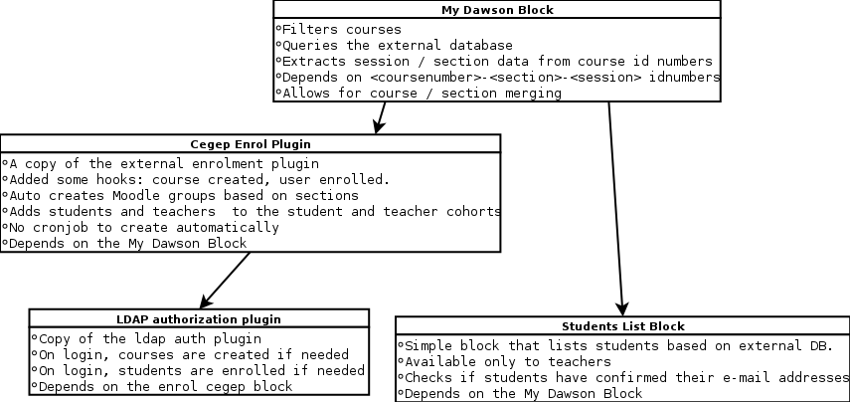
Dawson's Custom Plugins

Slide 9
Shortcomings
Language: some stuff is hard-coded in there.
URLs: again, hard-coded (albeit relative).
Not terribly up-to-date (I don't merge changes to the enrol/external plugin into the enrol/cegep plugin)
Couple Moodle core hacks: filtering the courses in the Navigation bar, and triggering the cegep enrol / ldapdawson auth stuff when admins “login as”.

Slide 10
Getting the code
The code for our custom plugins, this presentation, and other goodies is available on github:
  git clone git@github.com:jamaur/moodle2.git
  or https://github.com/jamaur/moodle2/archive/master.zip

