Slide 1
HOPS MONDAY.COM | Workflow SOP
August 2025

Slide 2
Workflow Overview
This Monday.com workflow serves as a collaborative project management suite allowing users to create and track projects across multiple companies and teams.
Projects
Monday.com hosts projects and corresponding information, created and managed by users
Voting
Integrates pre-filled google forms with Monday.com formula columns to allow project-specific voting with API connections
Visibility
Allows a top-down view of all projects and their progression to improve time management and remove confusion
Visualization
Utilizes Gantt Charts, custom plots, and status boards for progress tracking and discussion

Slide 3
SOP Usage cases
Click usage case box to move to procedure
Users
Administrators

Slide 4
USER STANDARD OPERATING PROCEDURE
Monday.com Interface
Poker-Style Voting

Slide 5
USER SOP - The Monday.com Interface
Boards
Status Flow
Dashboards

Slide 6
Monday.com Interface: boards - Overview
Boards are where projects are stored. They allow for separation between projects at different stages of development.
Drafts
For project entries still being prepared
Ready for
Voting
For project entries recently added, allows for communal voting through google forms
Ready for Review
For project entries with completed voting rounds, ready for in-meeting discussion
Approved / In Progress
Contains projects already passed through review (Approved)
and projects currently being worked on (In Progress)
Completed / Closed
For discontinued or completed projects

Slide 7
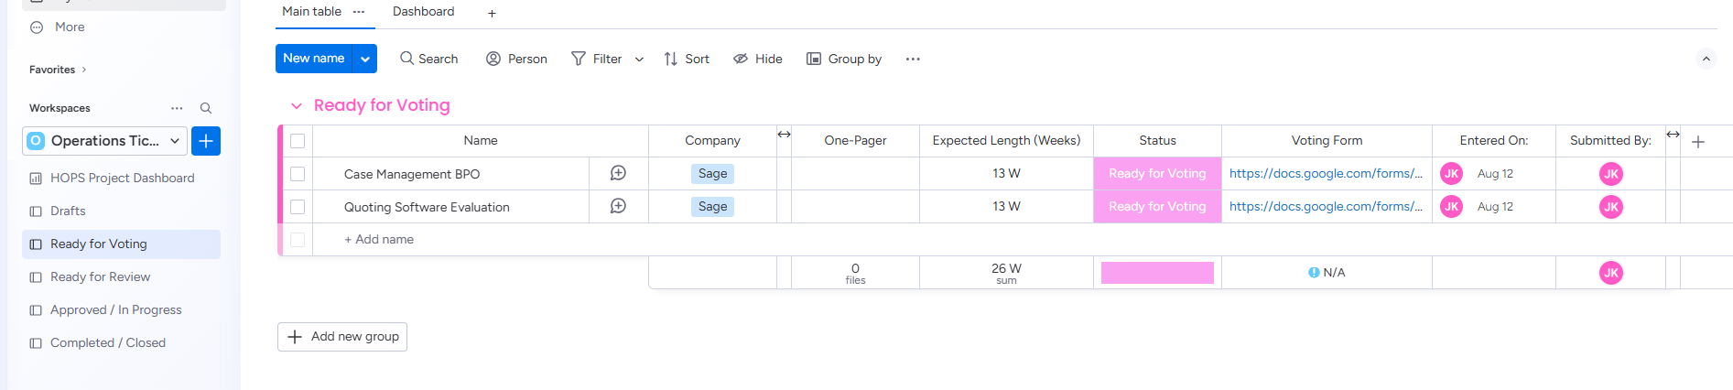
Monday.com Interface: boards - Navigation
Navigating through boards can be done on the far-left side of the Monday.com interface, in the workspaces section.
Projects move through the boards via status column changes. For more, refer to the Status Flow section.
More information can be input the deeper into the workflow projects progress. A project’s columns allow users to type, upload, choose, or interact to add data

Slide 8
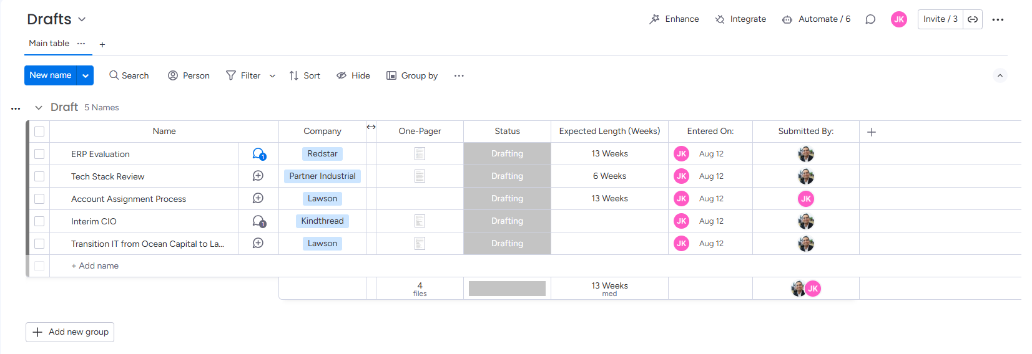
Monday.com Interface: boards - Drafts
The drafts board is where developing projects will be submitted and edited.
Projects can be added by simply clicking the add name option under all of the projects, then filling in the following columns. For example, the company option allows you to select from a dropdown list of portfolio companies or add one that doesn’t exist yet, and the One-Pager column allows you to upload a file and add comments on it.
Projects can be moved between boards when drafting is complete by changing the Status column.

Slide 9
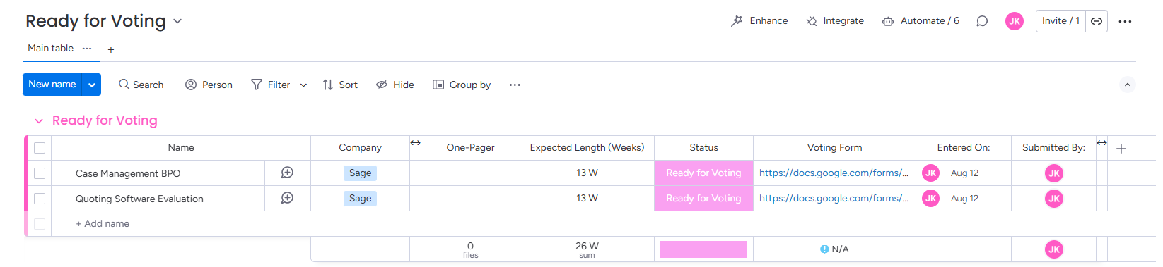
Monday.com Interface: boards – Ready for Voting
The Ready for Voting board is where projects will collect after they are finished being drafted and before users vote on them for meetings.
There are no new columns in need of input on this board, but a project-specific google form link will auto-generate as soon as a project is moved here. This form can be voted on by simply clicking the link in the ‘Voting Form’ column.
After votes have been collected and prior to a meeting, these projects will be moved to the Ready for Review board via the status column.

Slide 10
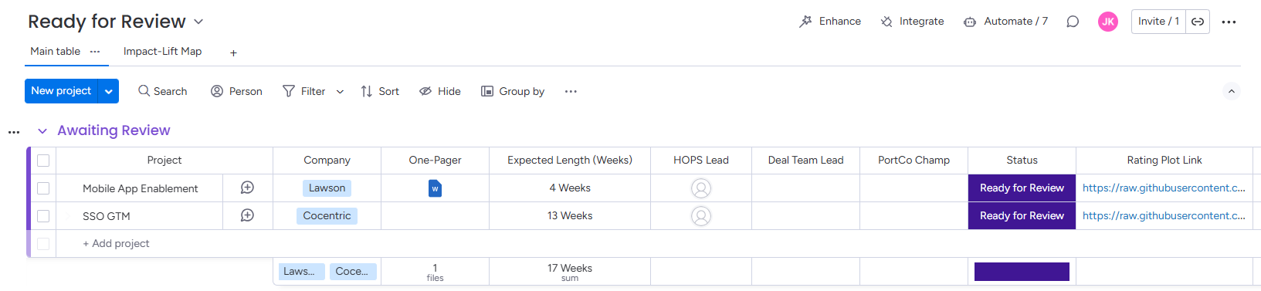
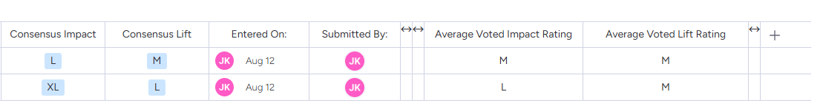
Monday.com Interface: boards – Ready for Review
The Ready for Review board is where projects are stored after voting has been completed and before/during the discussion meeting.
Prior to the meeting, the administrator will run a script to upload the average votes as well as make plots of how people responded.
During the meeting, the group can use the plot linked in the Rating Plot Link column to understand the group’s thoughts on the project. The group will arrive at a consensus impact and lift score as well as decide who from HOPS, the deal team, and the portfolio company will spearhead the project.
The administrator’s script will also enable a consensus-score plot for all projects, viewable in the Impact-Lift Map tab under the board title

Slide 11
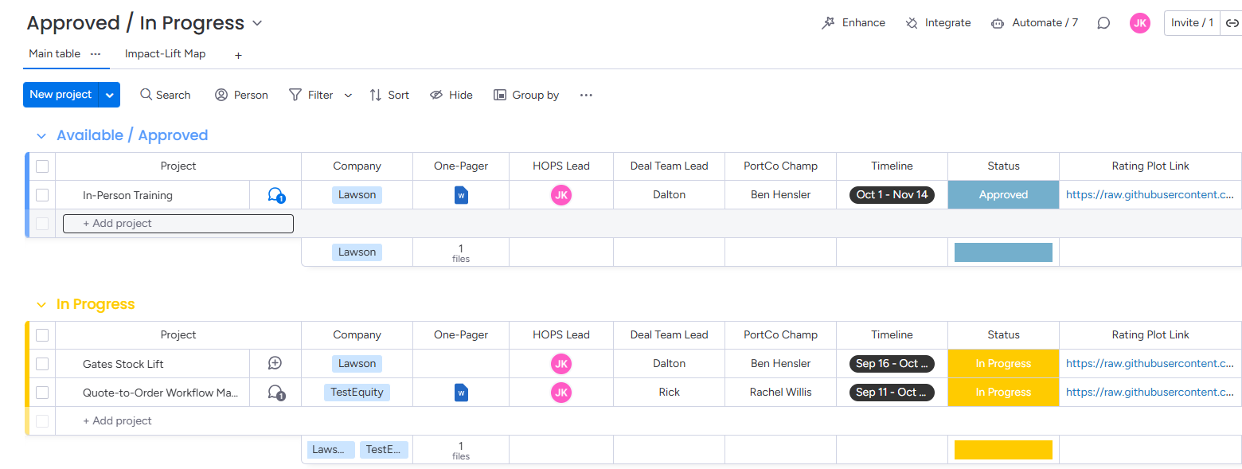
Monday.com Interface: boards – Approved / In Progress
The Approved / In Progress board is where projects that have already been discussed at meetings are housed. This includes both projects that are available as well as in progress.
This board allows the entry of the timeline column, which will flow into the Gantt chart dashboard. The rating plot link and consensus scores are still viewable.
Once a project is started, the user can move it from the Available / Approved group to the In Progress group via the status column.
When a project has been completed or is stopped, the status column can be changed to ‘Completed’ or ‘Closed’ to move the project to the Completed / Closed board.

Slide 12
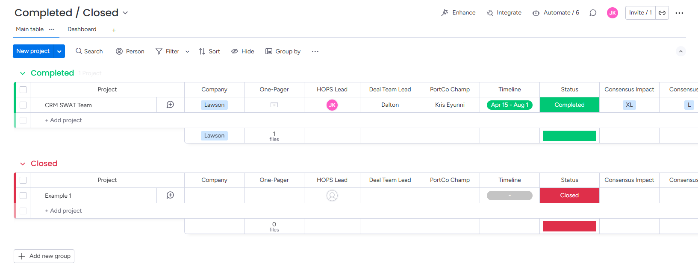
Monday.com Interface: boards – Completed / Closed
The Completed / Closed board houses a log of all previous projects, finished or stopped.

Slide 13
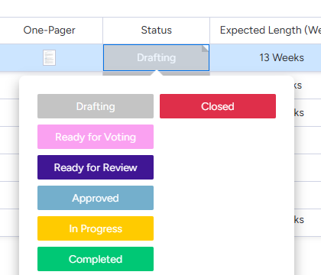
Monday.com Interface: Status flow
Projects move through the boards through changes in the ‘Status’ column
To change a project’s status, click on the status box, then select the corresponding dropdown box.
For example, when a drafting project has all items uploaded, and it is ready for people to begin voting, change the status to ‘Ready for Voting’.
This will automatically move the project into the ‘Ready for Voting’ board.

Slide 14
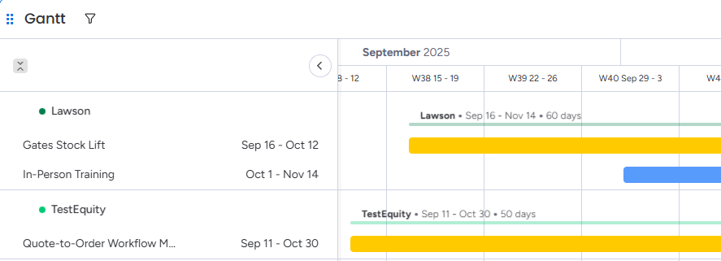
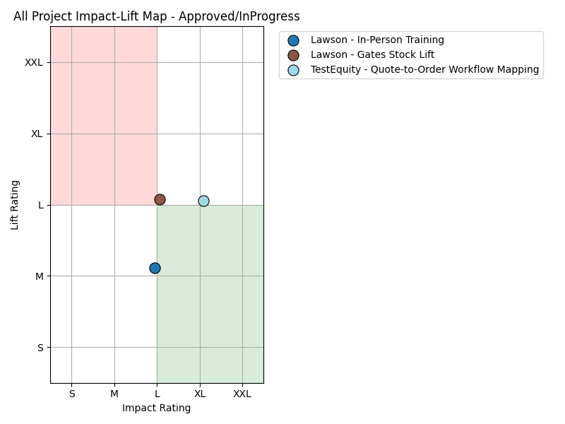
Monday.com Interface: Dashboards
Two types of dashboard
View all available and in progress projects’ timelines
Found in the HOPS Project Dashboard tab right above the Drafts board on the board selection workspace
Gantt
View the consensus impact and lift scores for all projects on a board
Found within the Ready for Review¹ and Approved / In Progress boards, in the ‘Impact-Lift Map’ tab under the board title
Impact – Lift Map
1. Ready for Review board’s Impact-Lift Map will only become updated and accurate once ‘Consensus’ scores have been input during quarterly meetings and the administrator has run the voting script

Slide 15
USER SOP – Poker-Style Voting
Google Form
Viewing Votes

Slide 16
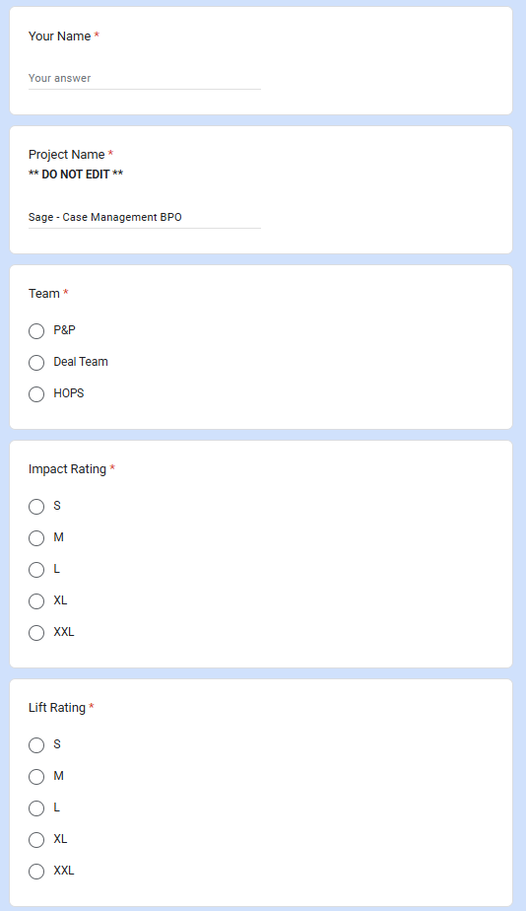
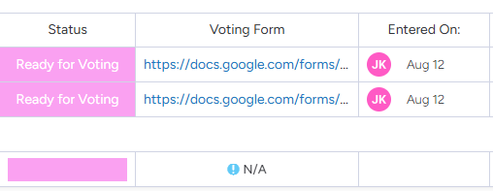
Poker-Style Voting: Google Form
Once projects move from ‘Drafts’ to ‘Ready for Voting’, a google form link will generate with the project name pre-filled. This will be found in the ‘Voting Form’ column
Voters input their name, team, and votes for the project. Votes and averages will be viewable on a project-by-project basis

Slide 17
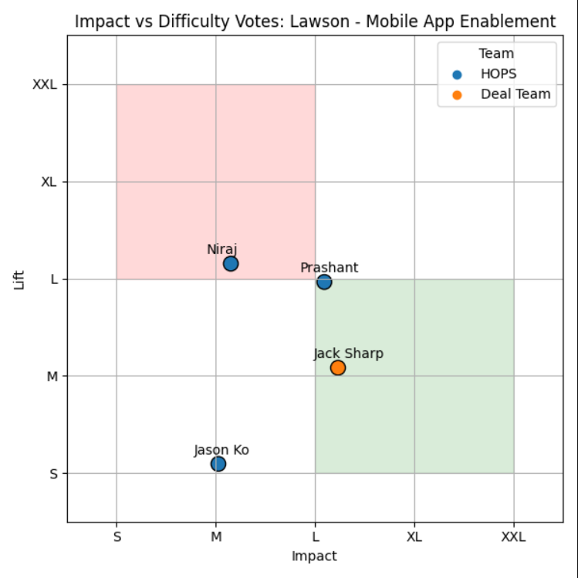
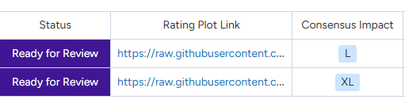
Poker-Style Voting: Viewing Votes
In the ‘Rating Plot Link’ column of the Ready for Review board, an Impact-Lift Map is available to show individual users’ votes.¹
This is helpful for group discussions to establish a consensus score.
1. The plots will only show votes captured before the administrator last ran the voting script

Slide 18
ADMINISTRATOR STANDARD OPERATING PROCEDURE
Monday.com ADMIN Interface
Poker-Style Voting Script
Meeting Use

Slide 19
ADMIN SOP - The Monday.com ADMIN Interface
Automation
Columns
Dashboards &
Plots

Slide 20
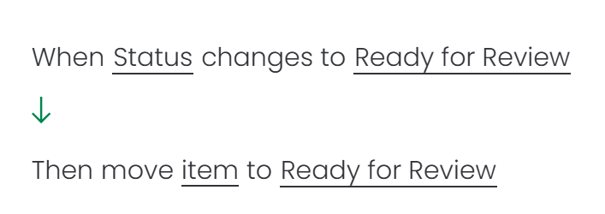
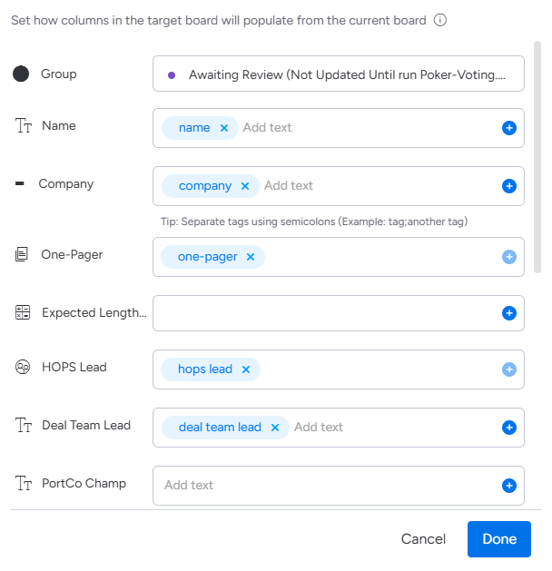
Monday.com Interface: Automation
Monday allows many in-house ‘automations’, but only status change automations are used in this project. Each automation is individually set for each board.
In a simple when X, do Y format, building automations
is easy, yet linking projects (called items in the Monday.com
system) can be time consuming.
Ensure that the columns of target board are set to
populate from the correct columns of the initial board.¹
1. Changing the names of columns will not affect the automations, but adding new, deleting, or changing column type will necessitate a relinking. Columns can only link to columns of the same type.

Slide 21
Monday.com Interface: Columns
Common Column Types
Text
Allows manual text entry
Dropdown
Allows users to select from a set list of options, or add their own to the list
Contact
Allows users to select from a list of all people in the company with access to Monday.com
Formula
Allows combinations and concatenations of other columns, text strings, numbers, etc¹
Timeline
Allows users to input start and end dates
1. Formula columns are often hidden from view, but are still functional in combining things like project title and company, recording numerical vote averages, and hosting string & float values for the voting script’s API scraping

Slide 22
Monday.com Interface: Dashboards & Plots
Created solely through in-house Monday.com features. It simply pulls the timelines from the Approved / In Progress tabs into the HOPS Project Dashboard
Gantt
Maintained through scraping project column entries with the Monday.com & Google Client APIs, plotting with Matplotlib, and hosting the images in a GitHub repository, which is linked in a text embed in the Impact-Lift Map tab under the Ready for Review and Approved / In Progress boards. See the Voting Script section for more detail.
This will not be updated for the Ready for Review section until there are consensus scores entered.
Impact – Lift Map

Slide 23
ADMIN SOP - The Poker-Style Voting Script
General Function
Execution
Notes

Slide 24
The POKER-Style Voting Script: General Function
Install & Import Python Packages
Push data to Monday.com
Scrape project data from Monday.com
Import votes from google sheet
Upload plots to GitHub
Make Impact-Lift maps from consensus
Make voting plot from votes
Compute project voted averages
Upload plots to GitHub
For more specific detail and source code, please refer to the text-based light walkthrough in the embedded .pdf file

Slide 25
The POKER-Style Voting Script: Execution
To run the script, I would recommend using windows PowerShell, Anaconda Prompt, or a similar terminal system. Make sure to keep the application open until the execution success printout appears.
If the current python file name is Poker-VotingV4_8.19.25, run the below command in your terminal system. Be sure that both the python file and the
hops-project-tickets-a9ec8e365472.json file are in the same directory location
python Poker-Votingv4_8.19.25.py
The first time this script is run, you will need to install python on your machine. You can do this through the Microsoft store. Python version 3.13 is ideal as of 8.2025.
Often on the first time executing, there will likely be issues with importing the base python packages needed for the script.
You can import each package individually by running the below code directly in the terminal system. If the failed packages are called IPython¹ and gspread, run the below.
pip install IPython
pip install gspread
1. The IPython package is used for displaying buffered (stored) image files within the code, and I have no idea why it almost never correctly imports within the script on the first try.

Slide 26
The POKER-Style Voting Script: Notes
Monday.com Columns
Changing Monday.com column names will not affect the script’s function but changing the
column type or deleting and/or replacing the column will.
API Keys
API keys should be treated as sensitive information, as with an API key, anyone can
pull or push data to/from the Monday.com/Google Sheets/GitHub account the key belongs to.
The same goes for .json files, although not nearly as serious
Google API is done through sharing the targeted documents with google services account, so
the google sheet that collects votes from the google form is shared with:
hops-ticket-tracker@hops-project-tickets.iam.gserviceaccount.com
The API keys, tokens, client ID’s, and other information should be in the hands of the administrator, not public
Google API
Plot Pop-ups
While running the script, two plots will appear as HTML file viewers. Each will pause the code until the image
is closed. This functions to bypass Monday.com’s loading time for viewing linked plots for in-meeting discussion
GitHub
The images are all hosted on my personal GitHub account, in the LKCM plots repository. Here you can find
every project that has been voted on, although duplicates replace if the code was run multiple times in
one voting cycle: https://github.com/jamburs/LKCM_HOPS_Plots/tree/main/plots
For any issues with the script, APIs or anything else, feel free to reach out to Jack Sharp: sharpj@uchicago.edu | jack.a.sharp2@gmail.com

Slide 27
ADMIN SOP – Meeting Use
Pre-Script Checkup
When to Run the Script
Meeting Functionality

Slide 28
Meeting Use: Pre-Script Checkup
Ensure voting has occurred
Move projects from Ready for Voting to Ready for Review before running
Clear google form of old projects (not necessary, but speeds up script)

Slide 29
Meeting Use: When to Run the Script
The script should be run once before the meeting to populate the fields and graphs, and once again after projects’ consensus scores are entered.
Please see the script execution section for instructions.

Slide 30
Meeting Use: Meeting Functionality
The Impact-Lift Maps given for both voting and all projects are available in the project ‘Rating Plot Link’ columns and the secondary board tabs of Ready for Review and Approved/In Progress, respectively
Graphs
The average score from voting is shown in the project columns, but a consensus score should be added after discussion about the project’s impact and lift. This will allow the project to be viewed in the dashboard graphs.
Consensus Scores

