Slide 1

TIER 0
Business Critical
Data, Privileged Identities
& Intellectual Property
TIER 1
Important but not business critical
TIER 2
Standard Users, Low sensitivity data, Public Information

Slide 2
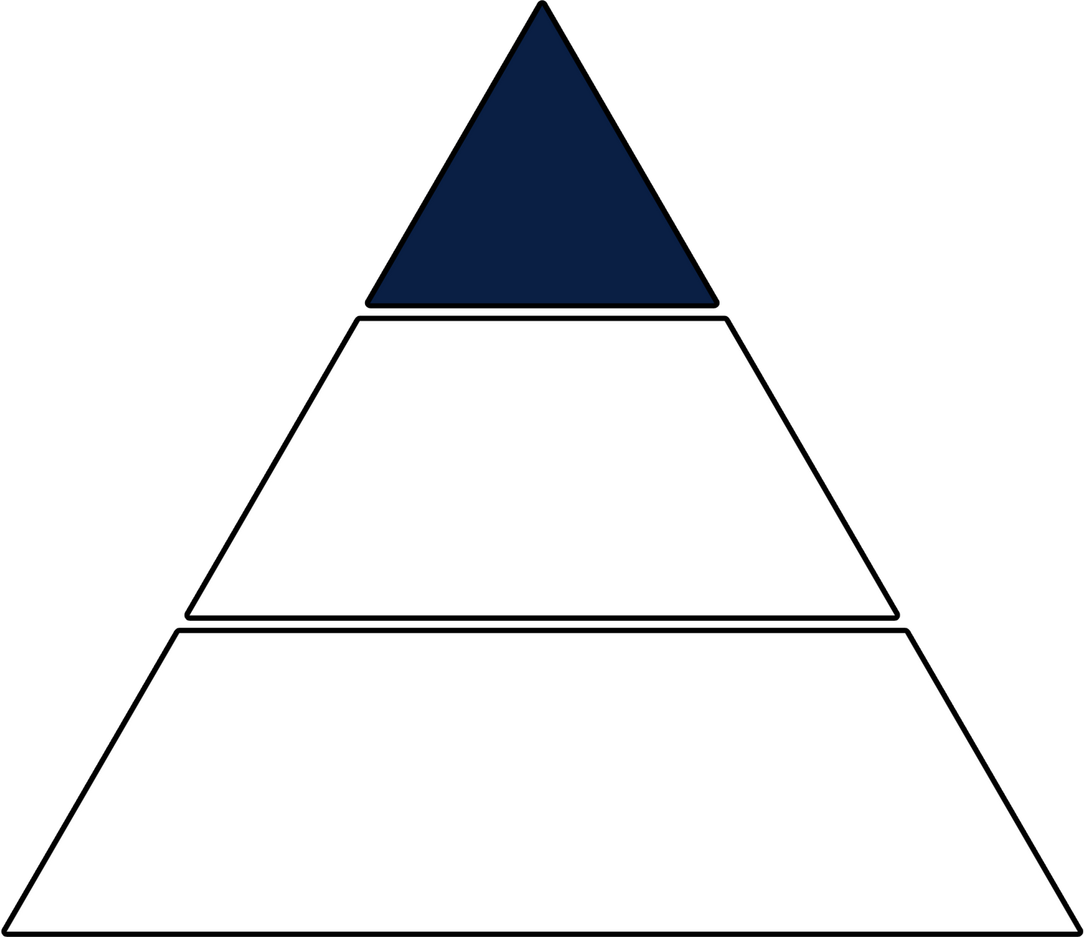

TIER 0
TIER 1
important but not
business critical
TIER 2
User / Public Information

Slide 3

TIER 0
TIER 1
important but not
business critical
TIER 2
User / Public Information

Slide 4

TIER 0
TIER 1
important but not
business critical
TIER 2
User / Public Information

Slide 5
Deepfake Defense Hierarchy
Crown Jewels Approach to Executive Protection
TIER 0
Business Critical Executives
C-Suite & Board Members
TIER 1
Important but not business critical
Senior Management & Department Heads
TIER 2
Standard Users & Public Communications
General Staff & External Facing
TIER 0 Protection
⚖️ TIER 1 Protection
👥 TIER 2 Protection
Maximum Security:
Enhanced Security:
Standard Security:
• Multi-factor voice verification
• Streamlined verification
• Basic detection tools
• AI-powered detection
• Department-level protocols
• Awareness training
• Immediate response protocols
• Regular training updates
• Standard verification
• Weekly rotating auth phrases
• Escalation pathways
• Incident reporting
Examples: CEO, CFO, COO whose
Examples: VPs, Directors with significant
Examples: General staff, customer
compromise triggers million-dollar losses
authority but contained risk
service with manageable exposure
Implementation: Tier 0 (30 days) → Tier 1 (90 days) → Tier 2 (180 days) | 78% attack reduction → 94% full protection
© 2025 James Cameron | Big Rock Intelligence | Deepfake Defense Series

Slide 6
Deepfake Defense Hierarchy
Crown Jewels Approach to Executive Protection
TIER 0
Business Critical Executives
C-Suite & Board Members
TIER 1
Important but not business critical
Senior Management & Department Heads
TIER 2
Standard Users & Public Communications
General Staff & External Facing
TIER 0 Protection
⚖️ TIER 1 Protection
👥 TIER 2 Protection
Maximum Security:
Enhanced Security:
Standard Security:
• Multi-factor voice verification
• Streamlined verification
• Basic detection tools
• AI-powered detection
• Department-level protocols
• Awareness training
• Immediate response protocols
• Regular training updates
• Standard verification
• Weekly rotating auth phrases
• Escalation pathways
• Incident reporting
Examples: CEO, CFO, COO whose
Examples: VPs, Directors with significant
Examples: General staff, customer
compromise triggers million-dollar losses
authority but contained risk
service with manageable exposure
Implementation: Tier 0 (30 days) → Tier 1 (90 days) → Tier 2 (180 days) | 78% attack reduction → 94% full protection
© 2025 James Cameron | Big Rock Intelligence | Deepfake Defense Series

