Slide 1
Thermal Estimation of Power Electronic Converters
ECE 592 Final Project by Zack Miller, John McDonald and Elijah Bouma-Sims
Notes:
Elijah
Hey everyone. Thanks for viewing our presentation. This is our final project for ECE 592, Data Science on thermal estimation for power electronic converters.

Slide 2
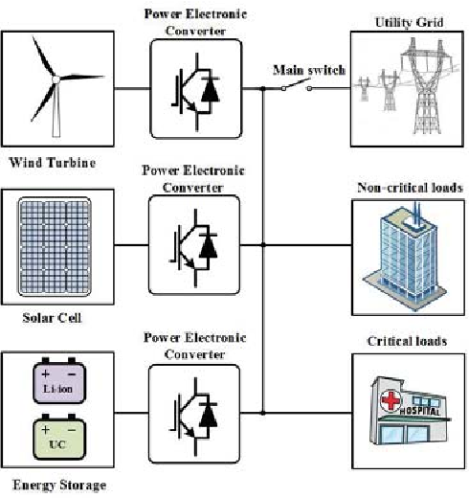
Background and Motivating Problem
Power Electronic Converters (PECs) are an integral part of the power grid
Also a large source of downtime/associated cost
Reliability of switching components is often dependent on thermal stress.
Goal: Efficiently estimate mean/delta junction temperature of a PEC system using machine learning to create device control algorithms which maximize reliability.
Extend prior work by looking at more models and comparing computational complexity and accuracy.
Test on real data with Rainflow analysis
Notes:
Elijah
To start, some background. Power Electronic Converters or PECs are an integral part of the power grid as they convert one form of electrical power to other form. This includes converting between AC and DC or changing the magnitude and phase of voltage and current or frequency or combination of these. They provide flexibility and controbility to the grid. Unfortunately, PECs are also a large source of downtime and the associated costs in the power grid. Modern research in this domain been pushed in the direction of Design-for-Reliability (DfR) that focuses on the underlying physics of failure behind these devices, finding that thermal stressing and cycling is a very important part of device reliability. To the end of providing device control algorithms which maximize reliability, we replicate and extend prior work by looking at efficient ways to estimate the mean and delta junction temperature of PECs based on several parameters. We look at several different machine learning models discussed in the course and compare their accuracy and efficiency. When then test our model on real data from the Aalborg Denmark, using ambient temperature and solar irradiance to estimate solar power output and junction temperature. Rainflow analysis is then used to count the number of thermal cycles which each model predicts.
So with that, let’s get into looking at our data.

Slide 3
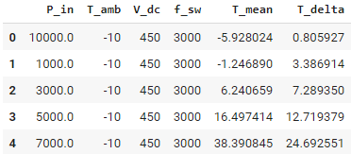
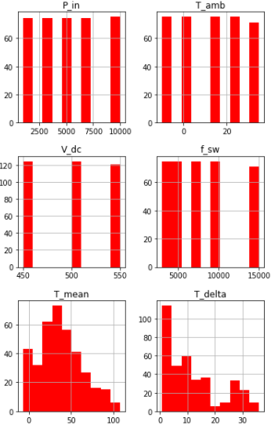
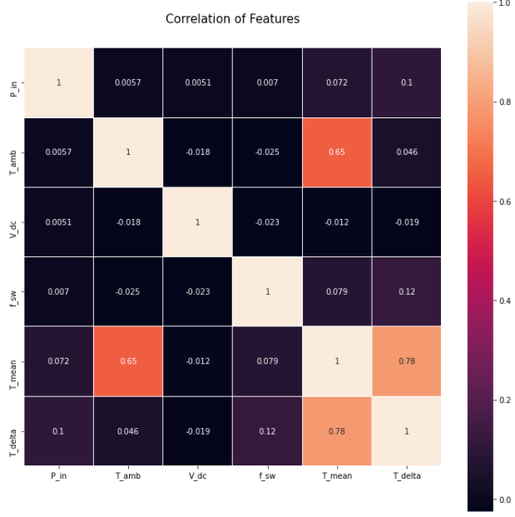
Describe the Data
Predicting T_mean & T_delta
Mean junction temperature
Change in junction temperature
We observe:
Monotonic data
Small amount of data
More observations than predictors
Shape:
Discrete predictors, continuous resp.
Notes:
John

Slide 4
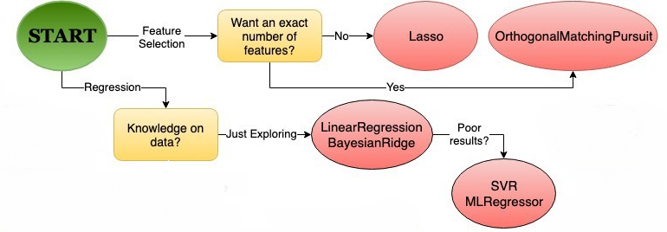
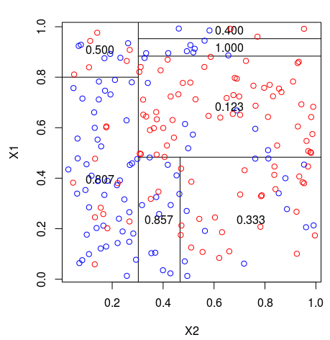
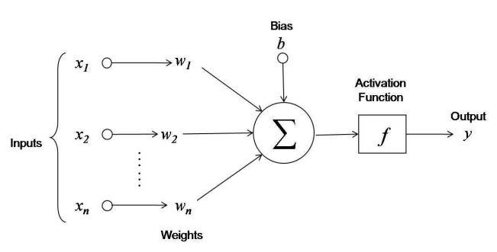
Methods of Analysis
Choosing model based on data set Feature selection / dimension reduction not necessary Just exploring data set
Linear regression
Bayesian Ridge
SVM (better performance?)
Decision tree
Artificial Neural Network
Referenced images: https://gdcoder.com/decision-tree-regressor-explained-in-depth/ https://towardsdatascience.com/choosing-a-scikit-learn-linear-regression-algorithm-dd96b48105f5 https://medium.com/@rajatgupta310198/getting-started-with-neural-network-for-regression-and-tensorflow-58ad3bd75223
Notes:
John

Slide 5
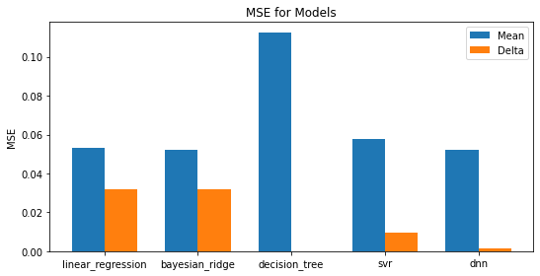
Model Performance Comparison
Decision tree lowest T_delta MSE. NN close second lowest
Decision tree very poor for T_mean MSE, others perform similarly with bayesian ridge being best
Concerns:
Potential overfitting
Notes:
Elijah
Our performance for mean standard error is graphed on the graph on the top right. As you can see, decision tree provided the lowest MSE for temperature delta with the neural net providing nearly identical, low MSE. On the other hand, decision tree was extremely poor for MSE for estimating the mean temperature. Bayesian ridge was the best, but all other models performed comparably. Overall performance is okay, although we have some concern about overfitting for the decision_tree model. As we will discuss later, it has poor results for the rainflow estimation and its results with 0 MSE for temperature delta are not possible in the real world.

Slide 6
Computational Complexity
Computational complexity for running the model is a particularly important consideration
We need control decisions to be made quickly; prediction complexity is key
n the number of training sample
p the number of features
ntrees the number of trees (for methods based on various trees)
nsv, the number of support vectors
nli the number of neurons at layer i in a neural network
Model | Training | Prediction
Linear Regression | O(p^2*n+p^3) | O(p)
Bayesian Ridge |  | O(p)
Decision Tree | O(n^2*p) | O(p)
SVM | O(n^2*p+n^3) | O(nsv*p)
Neural Network | Varies | O(p*nl1+nl1nl2+...)
Notes:
Zack

Slide 7
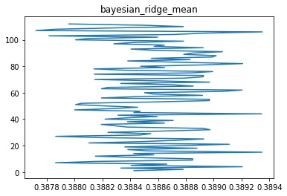
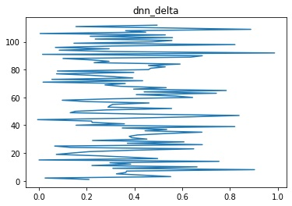
Rainflow Analysis
Counting Algorithm that reduces a wide spectrum of data into equivalent cycle/half-cycles
Enables a reasonable measure of fatigue or stress based on temperature variance
Algorithm is initially applied to test data before mission profile data
Notes:
Zack

Slide 8
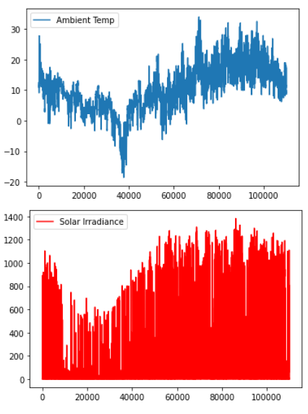
Mission Profile Data
Mission Profile defines the operating conditions a renewable system (such as a PV Plant) might experience in a given year
Weather data sampled in 5 minute intervals from Aalborg, Denmark was used to approximate the mean number of cycles estimated with Rainflow Analysis

Slide 9
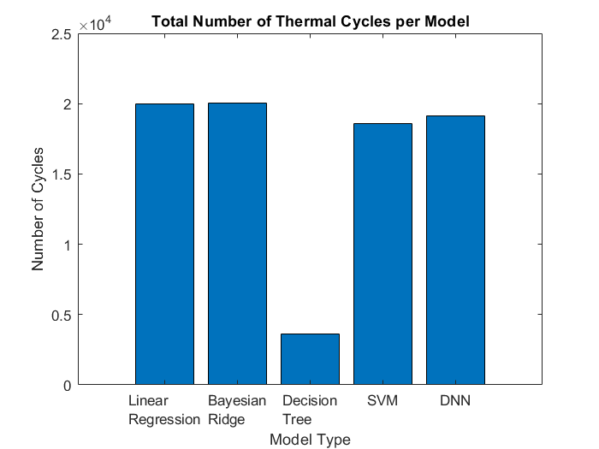
Thermal Cycling
Analysis applied assuming fixed voltage and switching frequency
Models performed roughly the same
Decision Tree resulted in the worst performance
Linear Regression | 19964.5
Bayesian Ridge | 20041.5
Decision Tree | 3639.0
SVM | 18552.5
DNN | 19156.5

Slide 10
References
[1]J . Zhang, “Power electronics in future electrical power grids,” in 2013 4th IEEE International Symposium on Power Electronics for Distributed Generation Systems (PEDG), pp. 1–3, 2013
[2] H. Wang, M. Liserre, F. Blaabjerg, P. de Place Rimmen, J. B. Jacobsen, T. Kvisgaard, and J. Landkildehus, “Transitioning to physics-of-failure as a reliability driver in power electronics,” IEEE Journal of Emerging and Selected Topics in Power Electronics, vol. 2, no. 1, pp. 97–114, 2014.
[3] H. Lu, C. Bailey, and C. Yin, “Design for reliability of power electronics modules,” Microelectronics Reliability, vol. 49, no. 9, pp. 1250 – 1255, 2009. 20th European Symposium on the Reliability of Electron Devices, Failure Physics and Analysis.
[4] T. Dragičević, P. Wheeler, and F. Blaabjerg, “Artificial intelligence aided automated design for reliability of power electronic systems,” IEEE Transactions on Power Electronics, vol. 34, no. 8, pp. 7161–7171, 2019

