Slide 1
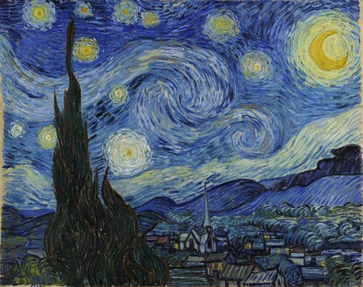
JamCoders: Week 1
Lecture 2B:
For loops
Range
Lists

Slide 2
Loops

Slide 3
Repetition
> Hello World
> Hello World
> Hello World
So far, how have we gotten our program to do something over and over?
print("Hello world")
print("Hello world") print("Hello world")
print("Hello world") print("Hello world") print("Hello world")
If only there was a better way…

Slide 4
For Loop
Variable name that gets assigned values from the sequence
Sequence that is read one item at a time
for var_name in [sequence]: execute_code1() ...
Codeblock to be repeated
Control structure that runs block of code repeatedly by iterating over elements in sequence.
We call this iterating over a sequence.

Slide 5
Sequences

Slide 6
Sequence
For loops need a sequence to iterate over.
This is so common, Python gives us a handy function to create a sequence of numbers...
range(start, end, step_size)
The range function creates a sequence of numbers that you can iterate through

Slide 7
Sequence
The range function can take 1, 2, or 3 arguments:

Slide 8
Sequence
The range function can take 1, 2, or 3 arguments:
1 argument
Counts up starting from 0 to end (exclusive) by 1s
Example:
range(end)
range(6) # == [0,1,2,3,4,5] range(2) # == [0,1] range(1) # == [0]

Slide 9
Sequence
The range function can take 1, 2, or 3 arguments:
2 arguments
Counts up starting from start (inclusive) to end (exclusive) by 1s
Example:
range(start, end)
range(0, 6) # == [0,1,2,3,4,5] range(2, 6) # == [2,3,4,5] range(5, 10) # == [5,6,7,8,9]

Slide 10
Sequence
The range function can take 1, 2, or 3 arguments:
3 arguments
Creates a sequence, starting from start, going up to end, in increments of step_size.
Example:
range(start, end, step_size)
range(0, 6, 1) # == [0,1,2,3,4,5] range(2, 6, 1) # == [2,3,4,5] range(0, 10, 2) # == [0,2,4,6,8] range(0, 10, 2) # == [0,2,4,6,8] range(5, 0, -1) # == [5,4,3,2,1]

Slide 11
Range
Let’s see it in action...
for i in range(5): print(i)

Slide 12
Range
> 0
[0, 1, 2, 3, 4]
i
for i in range(5): print(i)

Slide 13
Range
> 0
> 1
[0, 1, 2, 3, 4]
i
for i in range(5): print(i)

Slide 14
Range
> 0
> 1
> 2
[0, 1, 2, 3, 4]
i
for i in range(5): print(i)

Slide 15
Range
> 0
> 1
> 2
> 3
[0, 1, 2, 3, 4]
i
for i in range(5): print(i)

Slide 16
Range
> 0
> 1
> 2
> 3
> 4
[0, 1, 2, 3, 4]
i
for i in range(5): print(i)

Slide 17
Range
Let’s see it in action...side by side
(range(3) == [0,1,2])
print("Hello world") print("Hello world") print("Hello world")
for i in range(3): print("Hello world")
Notice: you don’t have to use the variable if you don’t need it! You can use the range to control how many times the body is executed.

Slide 18
Sequence
`range`s are not the only kind of sequence...
Where else have you heard “sequence” before in this class?

Slide 19
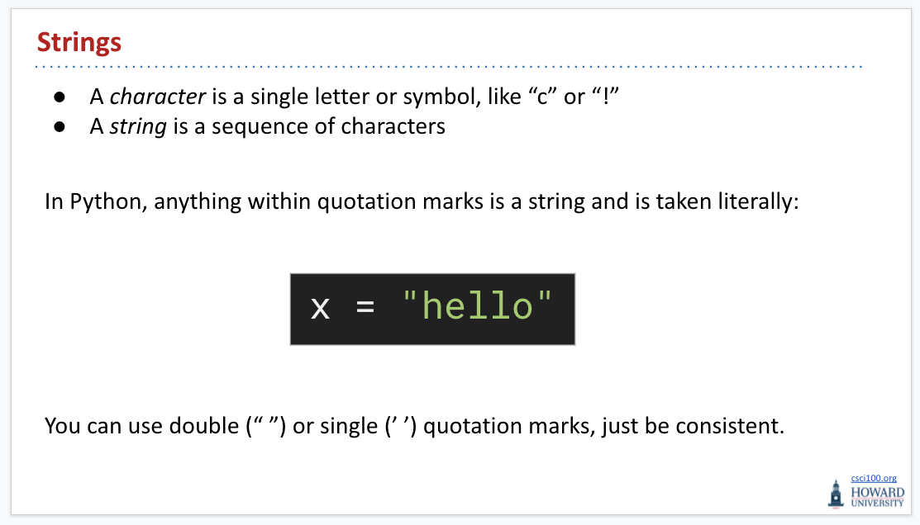
Sequence
Where else have you heard “sequence” before in this class?

Slide 20
Sequence
> H
> o
> w
> a
> r
> d
Strings are a sequence of characters!
for char in "Howard": print(char)

Slide 21
More Loop Details
Python has 2 special statements you can use inside of loops for finer control.

Slide 22
Break
> Num is 0
> Num is 1
> Num is 2
> La commedia e finita!
The `break` statement tells Python to “break” the loop, and continue on past the for loop body.
for i in range(6): if i == 3: break print("Num is", i) print("La commedia e finita!")

Slide 23
Continue
> Num is 0
> Num is 1
> Num is 2
> Num is 4
> Num is 5
> La commedia e finita!
The `continue` statement tells Python to end just the current iteration of the loop, and move on to the next value in the sequence.
for i in range(6): if i == 3: continue print("Num is", i) print("La commedia e finita!")

Slide 24
Live Coding Demo

Slide 25
Lists

Slide 26
Lists
Range() gives you a sequence of numbes…
A string is a sequence of characters…
What if you wanted a custom sequence of your own data?
…Lists.
This is a new type! Booleans, Integers, Floats, Strings, + Lists
(Technically, this is your first “data structure”: a way of organizing data. )

Slide 27
Motivation
Let’s say we want to store a user’s top 10 favorite soccer players
player1 = "Ronaldo" player2 = "Messi" player3 = "Drogba" ...
Each player requires its own variable. This gets more and more cumbersome the more data we have. It’s also hard to answer basic questions, like how many players we have, the first player alphabetically, etc...

Slide 28

Creating a List
A list is an ordered collection of items of any type.
Create a new list using brackets, with a comma-separated list of values.
players = ["Ronaldo", "Messi", "Drogba"]

Slide 29
Creating a List
To make an empty list, use just empty brackets.
players = []

Slide 30

Accessing a List
We use brackets to access a List’s values.
Look familiar? Think back to strings! A list is a type of sequence, just like a string.
players = ["Ronaldo", "Messi", "Drogba", "Casillas"] print(players[0]) # prints "Ronaldo" print(players[1]) # prints "Messi" print(players[-1]) # prints "Casillas"

Slide 31
Printing Lists
You can use print just as you’re used to with lists to print out their content.
players = ["Ronaldo", "Messi", "Drogba"] print(players) # prints ["Ronaldo", "Messi", "Drogba"] print(players[1:]) # prints ["Messi", "Drogba"]

Slide 32
Iterating over Lists
You can use the same `for x in sequence:` syntax we learned earlier, because lists are a type of sequence just like strings and range.
Prints each player’s name on a new line
players = ["Ronaldo", "Messi", "Drogba", "Casillas"] for name in players: print(name)

Slide 33
List Functions

Slide 34
List Appending, Inserting, and Length
Use list_name.append(element) to append to the end of the list.
Use list_name.insert(index, element) to insert at a specific index.
Use len(list_name) to to get the length of the list.
items = [] items.append(7) items.append("Dindu") items.insert(0, True) print(items) # [True, 7, 'Dindu'] print("There are", len(items), "items in the list.")

Slide 35
Removing from a List
To remove an element from the list…
Use list_name.remove(item) to remove a specific item
Use list_name.pop(index) to remove an item at a specific index
items = [7, "Dindu", True] items.pop(1) # Removes and return "Dindu" print(items) # Prints [7, True] items.remove(7) print(items) # Prints [True]

Slide 36
List Contains
To know whether a list contains a particular item, use the `in` keyword
ta_list = ["Deontae", "Jonathan", "Dindu", "Bradon"] dindu_is_ta = "Dindu" in ta_list # True vijay_is_ta = "Vijay" in ta_list # False

Slide 37
List Slicing
Slicing works for lists just like for strings (because lists and strings are both types of sequences, and slicing works for all sequences)!
Slicing makes a (shallow) copy of the array.
tas = ["Deontae", "Jonathan", "Dindu", "Bradon"] all_but_one_tas = tas[1:] print(all_but_one_tas) # ['Jonathan', 'Dindu', 'Bradon']

Slide 38
Rapid Fire List Functions
numbers = [5, 6, 12, 9, 4] # Find largest number in list max_num = max(numbers) # == 12 # Find smallest number in list min_num = min(numbers) # == 4 # Find the sum of numbers in list total = sum(numbers) # == 36 fruits = ["apple", "banana", "orange"] # Find the index of a specific value banana_index = fruits.index("banana") # == 1

Slide 39
Coding Demo

