Slide 1

JamCoders: Week 1
Lecture 3A:
While loops

Slide 2
While Loops

Slide 3
While Loops
Let’s make a word guessing game...
secret_word = "bears" for i in range(5): ____________________ ____________________ ____________________
secret_word = "bears" for i in range(5): guess = input("Enter a word guess: ") if guess.lower() == secret_word: print("You got it!") break else: print("That's not right. Try again")

Slide 4
While Loops
What if 5 guesses isn’t enough?
secret_word = "bears" for i in range(5): guess = input("Enter a word guess: ") if guess.lower() == secret_word: print("You got it!") break else: print("That's not right. Try again")

Slide 5
While Loops
What if 5 guesses isn’t enough?
Make it 10!
secret_word = "bears" for i in range(10): guess = input("Enter a word guess: ") if guess.lower() == secret_word: print("You got it!") break else: print("That's not right. Try again")

Slide 6
While Loops
What if 10 guesses isn’t enough?
Make it 20!
secret_word = "bears" for i in range(20): guess = input("Enter a word guess: ") if guess.lower() == secret_word: print("You got it!") break else: print("That's not right. Try again")

Slide 7
While Loops
We never know how many guessing will be enough…really, what we want to do is keep repeating until the user guesses correctly.
Or in other words, keep repeating while the answer is incorrect...

Slide 8
While Loops
A while loop continues to repeat indefinitely as long as the condition expression evaluates to `True`.
This expression gets re-evaluated after each iteration
while expression: execute_code() ...

Slide 9
While Loops
Back to the game...keep taking guesses until the guess is correct
While loops let us repeat based on some condition
secret_word = "bears" guess = input("Enter a word guess: ") while guess.lower() != secret_word: print("That's not right. Try again..") guess = input("Enter a word guess: ") print("You got it!")

Slide 10
While Loops
You can also use a while loop with the True condition, called an infinite loop, along with Break, to solve this problem.
Break and continue work in both while and for loops.
secret_word = "bears" while True: guess = input("Enter a word guess: ") if guess.lower() == secret_word: print("You got it!") break else: print("That's not right. Try again..")

Slide 11
While Loops
Infinite loops are useful for when you want to take input indefinitely with no stopping condition

Slide 12
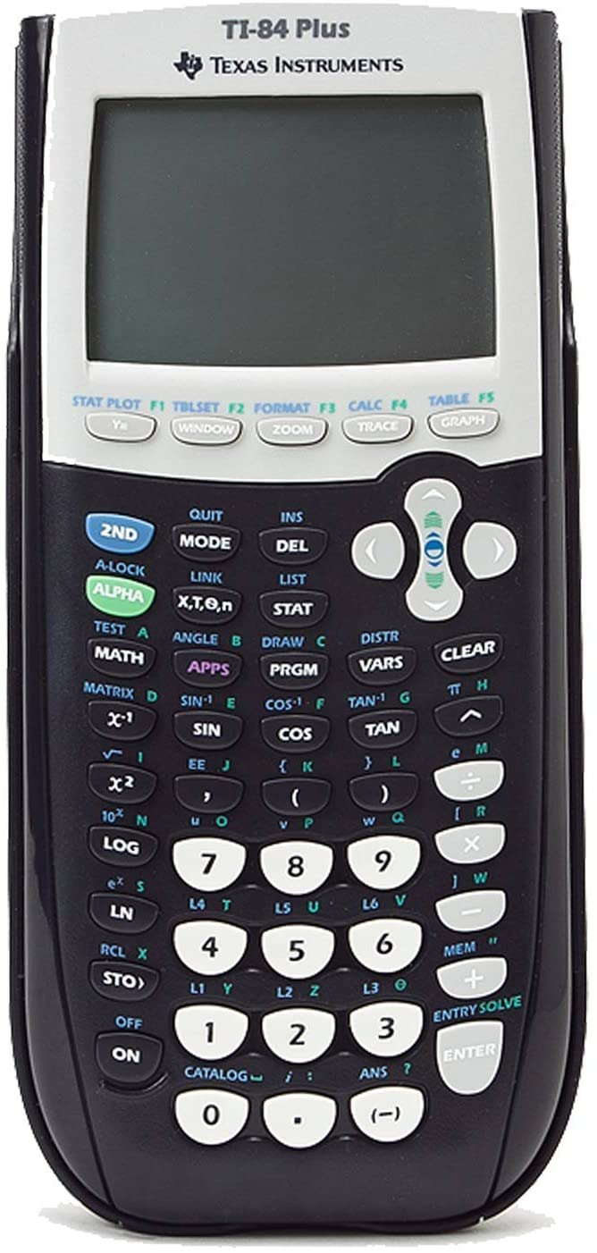
Repetition
Using a calculator

Slide 13
Repetition
Using a calculator
12 + 7
12 + 7
19
12 + 7
19
8 + 2
12 + 7
19
8 + 2
10
12 + 7
19
8 + 2
10
...

Slide 14
Repetition
A calculator keeps asking for more input forever.
Perfect use for a while loop
12 + 7
19
8 + 2
10
...

Slide 15
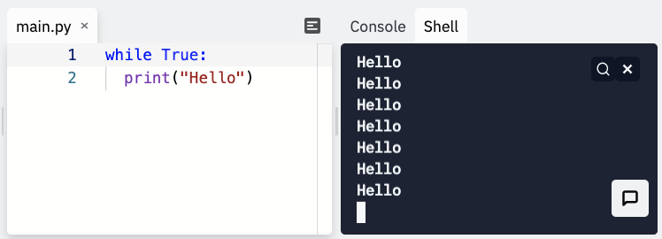
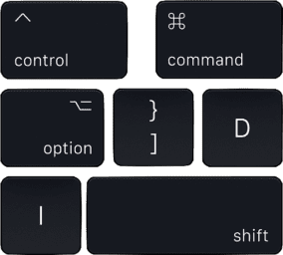
Help, I’m Stuck in an Infinite Loop!
If you’re running Python code in the terminal and you get stuck in an infinite loop...
Press + on Mac to stop execution (Ctrl + Z on Windows)
c

Slide 16
For vs While
Forloops While Loops
…
…
When you have a particular sequence you know you want to iterate over ahead of time:
A particular range
If you don’t know ahead of time how many times to iterate, or over what elements.

