Slide 1

JamCoders: Week 1
Lecture 3B:
Functions
Print vs Return
None

Slide 2
Lecture Objective
Learn what a function is and why we use them
Recognize common functions we’ve already been using
Get comfortable with defining and calling basic functions
Next lecture we’ll learn more details about functions. Today we’ll focus on the core details.

Slide 3
Routine
What do you do when you get up in the morning? What is your morning routine?
Check my phone
Brush my teeth
Shower
Get dressed
Make my bed
Eat breakfast
Notes:
Wash your face
Brush your teeth
Make the bed
Get dressed
Eat breakfast

Slide 4
Encapsulation
Encapsulation is how we (humans) deal with complexity.
Parent tells you to “brush your teeth”, rather than “pick up the tooth brush, put toothpaste on it, put it in your mouth, move it around for 120 seconds, …”
Parent can do that because at some point in the past, we all learned that “brush your teeth” means doing all of those other steps.

Slide 5
Functions

Slide 6
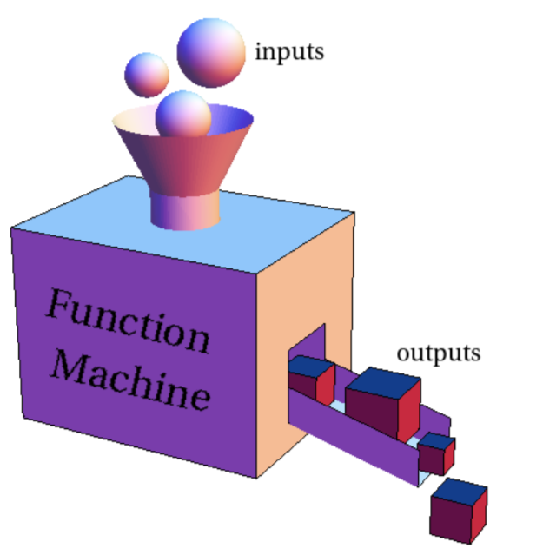
Functions
Functions are a way of encapsulating some code to use it elsewhere in our program.
This allows us to accomplish two things at once:
Write repeatable code: We can write a function once, then use it anywhere.
Write readable code: it is clear at a glance what each part of the code is responsible for.

Slide 7
Calling Functions

Slide 8
Functions
You’ve already been using functions all along, you just didn’t know it.
int("8") input("Name?") str(100) print("Hello")
Notes:
All of these have been functions.

Slide 9
Using Functions
To use a function, we call the function...
Argument(s)
Function Name
func_name(argument1, argument2)
Parentheses

Slide 10
Calling a function
A function call is another kind of expression, just like `a + b` or `is_raining and is_cloudy`, and therefore gets evaluated.
A function call evaluates to the return value of the function

Slide 11
Calling a function
We say `input` is a function that returns a string, because the function call evaluates to a string.
name = input("What is your name? ")

Slide 12
Calling a function
We say `int` is a function that returns an integer, because the function call evaluates to an integer.
number = int("8")

Slide 13
Calling a function
So...what does print return? What does it evaluate to?
print("Hello world")
Nothing! Functions don’t have to return something, they can just do something.
Notes:
Here, “doing something” means changing pixels on your computer screen from black to white.

Slide 14
Calling a function
`round` is an example of a function that takes multiple arguments, separated by commas.
The number of arguments that a function takes is specified in the function definition.
rounded = round(2.5662, 2)
Notes:
Here, “doing something” means changing pixels on your computer screen from black to white.

Slide 15
Defining Functions

Slide 16
Defining Functions
We know how to use existing functions that Python provides us...how about making our own?
Called defining a function.

Slide 17
Functions
A function is a named block of code that can take some input, performs some routine, and can return some output.
The technical definition...

Slide 18
Functions
A function is a named block of code that can take some input, performs some routine, and can return some output.
1
3
2
4

Slide 19
Functions
1
2
A function is a named block of code...that performs some routine

Slide 20
Functions
1
2
(def stands for “define”)
A function is a named block of code...that performs some routine
function name
def
(keyword)
parentheses
def func_name(): statement1 statement2 ...
Indented lines define the “body” of the function, which is the routine.

Slide 21
Functions
1
2
For example, making this block of code into a function...
A function is a named block of code...that performs some routine
def absolute_value(): num = -12 if num >= 0: print(num) else: print(-num) absolute_value()
num = -12 if num >= 0: print(num) else: print(-num)

Slide 22
Functions
3
Functions are powerful because they can take some input to use in the routine.

Slide 23
Functions
3
Functions are powerful because they can take some input to use in the routine.
Zero or more parameters, which are given separated by commas in the parentheses. These are then variables that can be used only within the function.
def func_name(param1, param2): statement1 statement2 ...

Slide 24
Functions
3
Functions are powerful because they can take some input to use in the routine.
Now, this routine will work for any given number, not just -12.
def absolute_value(): num = -12 if num >= 0: print(num) else: print(-num) absolute_value()
def absolute_value(num): if num >= 0: print(num) else: print(-num) absolute_value(-12)

Slide 25
Functions
4
A function...can return some output
def func_name(param1, param2): x = param1 + param2 return x
`return` is a reserved keyword used to return output from a function.
It can only be used within a function.
Function execution stops as soon as soon as return line is reached.
Notes:
Class problem: write a function that prints a tree to the screen
Then take input from the user to print out x trees?

Slide 26
Function Anatomy
function name
def greater(a, b):
if a > b:
return a
return b
def
(keyword)
parentheses
colon
body
(indented)
parameters
(optional)
return
(optional)

Slide 27
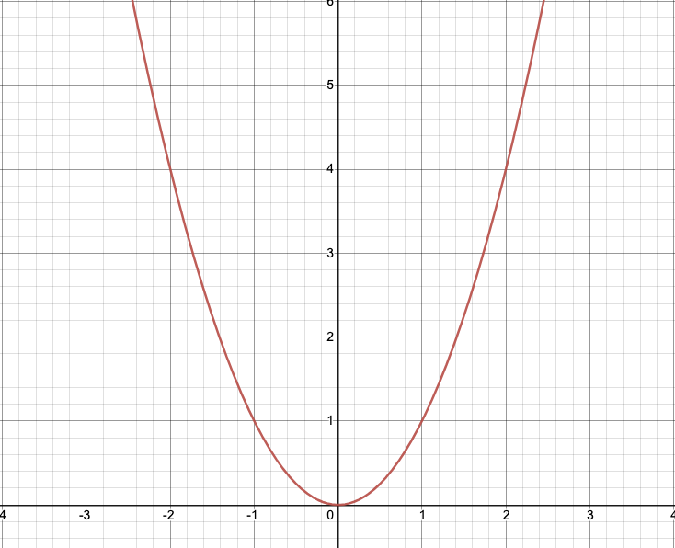
Functions
Another perspective...similar to “functions” in math.
f(x) = x²

Slide 28
Functions
Another perspective...similar to “functions” in math.
Input: 1
“Call” the function: f(1)
Output: 1
f(x) = x²

Slide 29
Functions
Another perspective...similar to “functions” in math.
Input: 2
“Call” the function: f(2)
Output: 4
f(x) = x²

Slide 30
Functions
Another perspective...similar to “functions” in math.
Input: 2
“Call” the function: f(2)
Output: 4
x² is the body
x is the parameter
2 is the argument
4 is the return value f(x) = x²

Slide 31
Functions
f(x) = x²
def parabola(x): return x * x print("f(1) ==", parabola(1)) # == 1 print("f(2) ==", parabola(2)) # == 4

Slide 32
Function Examples

Slide 33
Function Examples
Write a function to introduce a person with their name and age.
def introduction(name, age): age_string = str(age) + " years old" print("Hi this is " + name + ". They are " + age_string) introduction("Sonya", 41) introduction("James", 19) introduction("Greg", 28) introduction("Alexandria", 76)
Notes:
Class problem: write a function that prints a tree to the screen
Then take input from the user to print out x trees?

Slide 34
Function Practice
Write a function that takes a string as a parameter and returns the word repeated twice.
Sample input: “hello”
Sample output: “hellohello”

Slide 35
Quick Takeaways
Think of a function as a (sub)routine.
As soon as you see yourself doing the same sort of thing in different places, think function.
Use functions to make your code more readable via “encapsulation”
Vocab:
Using a function is called calling or executing the function
Function calls are expressions that need to be evaluated
The input values given in the function call are called arguments
Creating a new function is called defining it
The input variables in the definition are called parameters
We can return a value for the function to evaluate to

Slide 36
Live Coding Demo

Slide 37
Print vs Return

Slide 38
Print vs Return
Common question…what’s the difference between print and return?

Slide 39
Print vs Return
Print Return

Slide 40

Print vs Return
Print Return
def print_hello(): print("Hello World") value = print_hello() print("Return value:", value)
`print` is a function that gives output from your entire program to the computer to print to the terminal.
Can be called from anywhere
Function doesn’t return any value
Communicates outside of the program (to the terminal)

Slide 41

Print vs Return
Print Return
def return_hello(): return "Hello World" value = return_hello() print("Return value:", value) length = len(value) if length > 5: print(value)
def print_hello(): print("Hello World") value = print_hello() print("Return value:", value)
`print` is a function that gives output from your entire program to the computer to print to the terminal.
Can be called from anywhere
Function doesn’t return any value
Communicates outside of the program (to the terminal)
`return` is a statement that specifies the value that the function will evaluate to when called.
Can only be used within a function
Does not print anything to the screen, only specifies value that the function call evaluates to
Someone else can print the return value if they want to.

Slide 42
None

Slide 43
None
What happens when a function doesn’t return anything? What does it evaluate to?
None is a special value, used for when there is no value to set. Most commonly, you’ll see this when a function doesn’t return anything.
It is of type “NoneType”, a new type that can only have one value, None.
def print_hello(): print("Hello World") value = print_hello() print("Return value:", value)
What is this?

Slide 44
None
You can manually set a value to None.
ta_name = None if ta_name == None: ta_name = input("Enter your TA's name: ") print(ta_name)

