Slide 1

JamCoders: Week 1
Lecture 4A:
More Functions
Scope

Slide 2
Scope

Slide 3
Scope
Variable Scope refers to the “visibility” of variables.
It answers the question “can I reference this variable here”

Slide 4
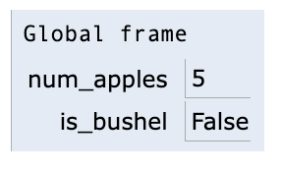
Scope
All of the code we have written before has always written to and read from the global frame.
Therefore, we only had one frame to look at.
num_apples = 5 is_bushel = num_apples > 10 if is_bushel: print("That's a bushel!") else: print("That's a handful...")
visualizer link

Slide 5
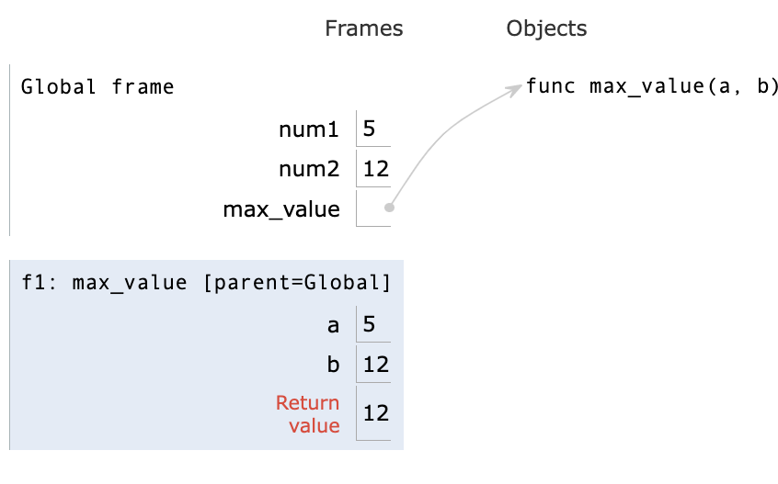
Scope
However, when a function is executed, the function gets a new frame for each time it is executed, called the local frame.
Any variable assignments in the function gets made in the local frame. Referencing a variable always looks for a match first in the local frame, and only then in the parent Global frame.
num1 = 5 num2 = 12 def max_value(a, b): if a > b: return a return b print(max_value(num1, num2))
visualizer link

Slide 6
Scope
Tricky case:
num1 = 5 num2 = 12 def max_value(num1, num2): if num1 > num2: return num1 return num2 print(max_value(45, 32))
Think through what happens when this code is executed? Which values are used for num1 and num2 in the function body?
visualizer link

Slide 7
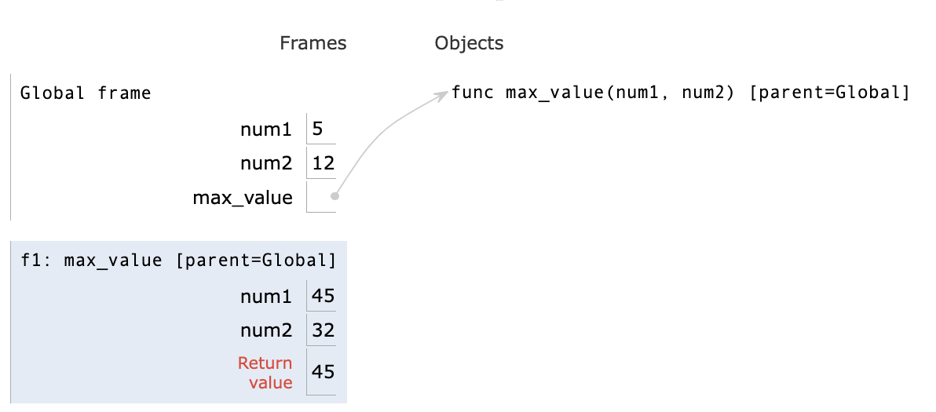
Scope
Tricky case:
num1 = 5 num2 = 12 def max_value(num1, num2): if num1 > num2: return num1 return num2 print(max_value(45, 32))
visualizer link

Slide 8
Scope
Another tricky case:
def add_up(a, b, c): total = a + b + c add_up(10, 5, 6) print(total)
Think through what happens when this code is executed? Which values are used for num1 and num2 in the function body?
visualizer link

Slide 9
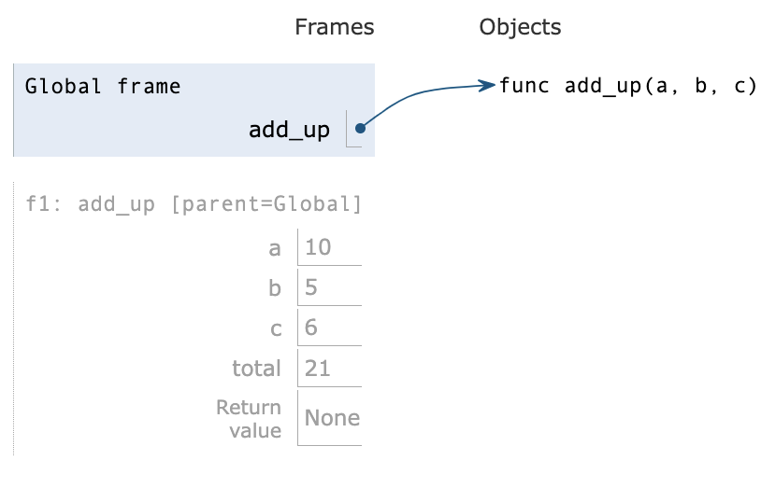
Scope
Another tricky case:
def add_up(a, b, c): total = a + b + c add_up(10, 5, 6) print(total)
visualizer link

Slide 10
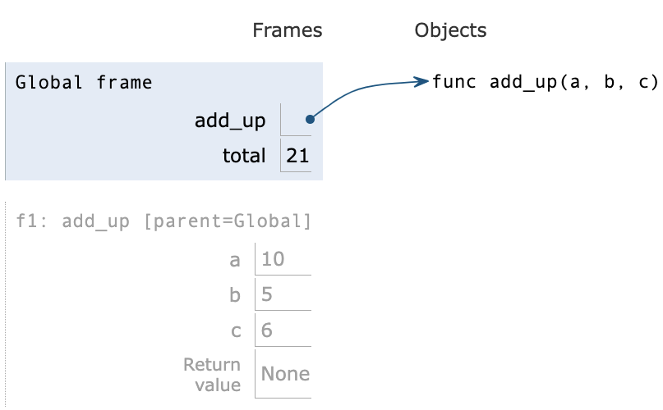
Scope
Use the `global` keyword inside of your function to specify which variables should be written to the global frame.
No error when we go to print `total` because it is written to the global frame!
def add_up(a, b, c): global total total = a + b + c add_up(10, 5, 6) print(total)
visualizer link

Slide 11
Local Frames
One last detail…
Local frames get discarded after the function is done running and a value is returned. So anything you assign in just a local frame disappears after the function is done running unless you return it or you write to a global variable.

Slide 12
Live Coding Demo

