Slide 1
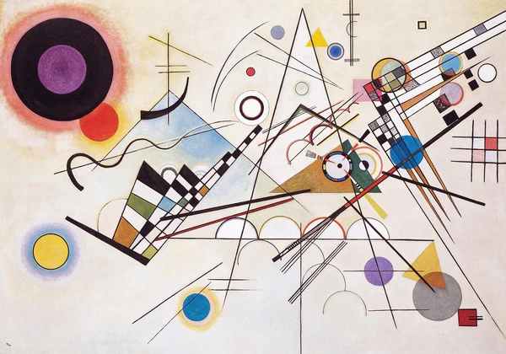
JamCoders: Week 1
Lecture 4B:
Mutability
More Lists

Slide 2
List Recap

Slide 3
List Slicing
Slicing works for lists just like for strings (because lists and strings are both types of sequences, and slicing works for all sequences)!
Slicing makes a new list.
ta_list = ["Lydia", "Joy", "Hanna", "Zaria"] all_but_one_tas = tas[1:] print(all_but_one_tas) # ['Joy', 'Hanna', 'Zaria']

Slide 4

List Indexing
We use brackets to access a List’s values.
players = ["Ronaldo", "Messi", "Drogba", "Casillas"] print(players[0]) # prints "Ronaldo" print(players[1]) # prints "Messi" print(players[-1]) # prints "Casillas"

Slide 5
List Contains
To know whether a list contains a particular item, use the `in` keyword
ta_list = ["Lydia", "Joy", "Hanna", "Zaria"] zaria_is_ta = "Zaria" in ta_list # True manolis_is_ta = "Manolis" in ta_list # False

Slide 6
Rapid Fire List Functions
numbers = [5, 6, 12, 9, 4] # Find largest number in list max_num = max(numbers) # == 12 # Find smallest number in list min_num = min(numbers) # == 4 # Find the sum of numbers in list total = sum(numbers) # == 36 fruits = ["apple", "banana", "orange"]

Slide 7
Mutability

Slide 8
Mutability
Mutate means to change. So mutable means able to change.
Mutable
Mut-able
Mutate-able
Able to Mutate

Slide 9
Mutability
The first four datatypes we learned were immutable. You couldn’t change the value, you could only replace the value…
Integers
Floats
Booleans
Strings

Slide 10
Immutability
Common confusion: but wasn’t this an example of mutating an integer?
score = 2 event = input("Enter an event: ") if event == "touchdown": score = score + 7 print(score)

Slide 11
Immutability
Common confusion: but wasn’t this an example of mutating an integer?
Answer: No! In score = score + 7, we first evaluate the expression `score + 7` and created a new integer (in this case 9), and then replace the previous value via assignment.
score = 2 event = input("Enter an event: ") if event == "touchdown": score = score + 7 print(score)

Slide 12
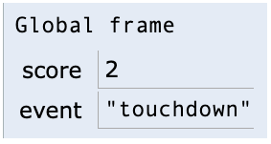
Immutability
Common confusion: but wasn’t this an example of mutating an integer?
Answer: No! In score = score + 7, we first evaluate the expression `score + 7` and created a new integer (in this case 9), and then replace the previous value via assignment.
score = 2 event = input("Enter an event: ") if event == "touchdown": score = score + 7 print(score)
X 9

Slide 13
Mutability
But some objects in Python are mutable; their value can be modified after creation without replacing the whole object.
Lists are the first mutable type you’re learning!

Slide 14
Mutability
To update a single value in a list, you assign to the indexed value.
grades = [95, 70, 92] print(grades) # prints "[95, 70, 92]" grades[1] = 90 print(grades) # prints "[95, 90, 92]"

Slide 15
Mutability
To update a single value in a list, you assign to the indexed value.
To update multiple values at once, you can assign to the sliced value.
grades = [95, 70, 92] print(grades) # prints "[95, 70, 92]" grades[1] = 90 print(grades) # prints "[95, 90, 92]"
grades = [95, 70, 92] print(grades) # prints "[95, 70, 92]" grades[1:] = [90, 100] print(grades) # prints "[95, 90, 100]"

Slide 16
Coding Demo

Slide 17
Lists in the Frame

Slide 18
Lists in the Frame
Why am I showing you this?
Show you how PythonTutor represents Lists
Hint to you what’s actually going on deep down, which will help you solve problems and understand your code more easily.
Everything that PythonTutor shows is real and there for a reason. I won’t focus on them heavily now, but these details will come back in later CS classes.

Slide 19
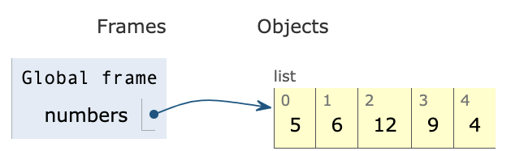
Lists in the Frame
Lists are a more complicated type of object that the other types we’ve seen, so they’re written down separately, and the variable “points” us to the list.
numbers = [5, 6, 12, 9, 4]
Notes:
Think of this as the list itself being written down in a special page that has much more room

Slide 20
Lists in the Frame
Lists are a more complicated type of object that the other types we’ve seen, so they’re written down separately, and the variable “points” us to the list.
Think of this as the list itself being written down on a separate special piece of paper that is just for complicated types.
numbers = [5, 6, 12, 9, 4]
Notes:
Think of this as the list itself being written down in a special page that has much more room

Slide 21
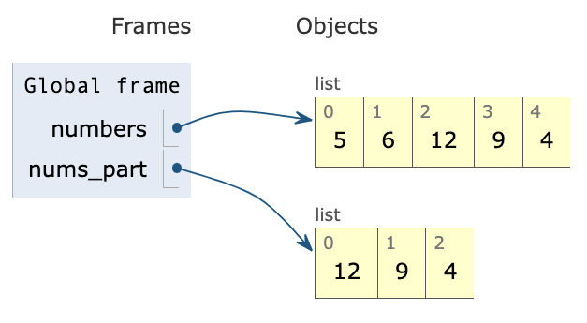
Lists in the Frame
When you make a copy of a list (like by slicing), it makes a new list.
numbers = [5, 6, 12, 9, 4] nums_part = numbers[2:]

Slide 22
Lists in the Frame
When you pass a list into a function as an argument, you point to the same list in the local frame as in the global frame. This means you can mutate the given list within a function.
number_list = [4, 2, 7] def add_number(nums, x): nums.append(x) add_number(number_list, 12) print(number_list)

Slide 23
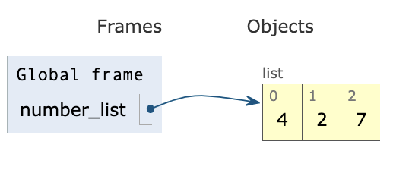
Lists in the Frame
When you pass a list into a function as an argument, you point to the same list in the local frame as in the global frame. This means you can mutate the given list within a function.
number_list = [4, 2, 7] def add_number(nums, x): nums.append(x) add_number(number_list, 12) print(number_list)

Slide 24
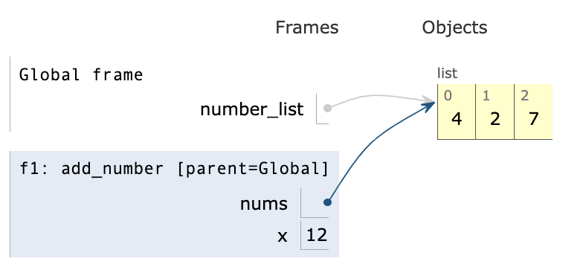
Lists in the Frame
When you pass a list into a function as an argument, you point to the same list in the local frame as in the global frame. This means you can mutate the given list within a function.
number_list = [4, 2, 7] def add_number(nums, x): nums.append(x) add_number(number_list, 12) print(number_list)

Slide 25
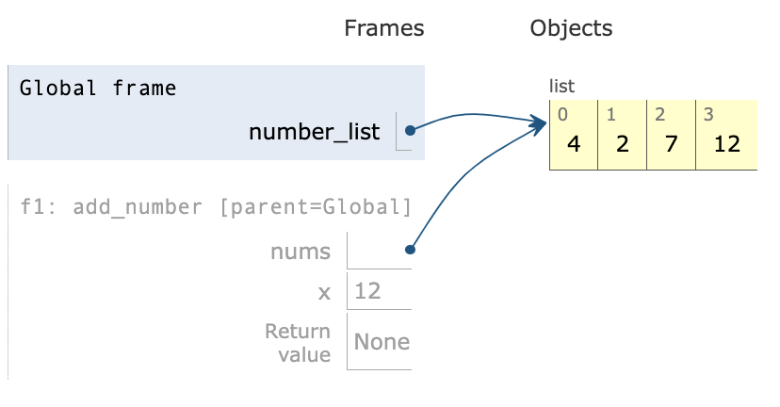
Lists in the Frame
When you pass a list into a function as an argument, you point to the same list in the local frame as in the global frame. This means you can mutate the given list within a function.
number_list = [4, 2, 7] def add_number(nums, x): nums.append(x) add_number(number_list, 12) print(number_list)

Slide 26

Lists in the Frame
When you pass a list into a function as an argument, you point to the same list in the local frame as in the global frame. This means you can mutate the given list within a function.
number_list = [4, 2, 7] def add_number(nums, x): nums.append(x) add_number(number_list, 12) print(number_list)

