Slide 1

JamCoders: Week 1
Lecture 5A:
Nested Lists
Nested Loops
Modules & Imports

Slide 2
Nested Lists

Slide 3
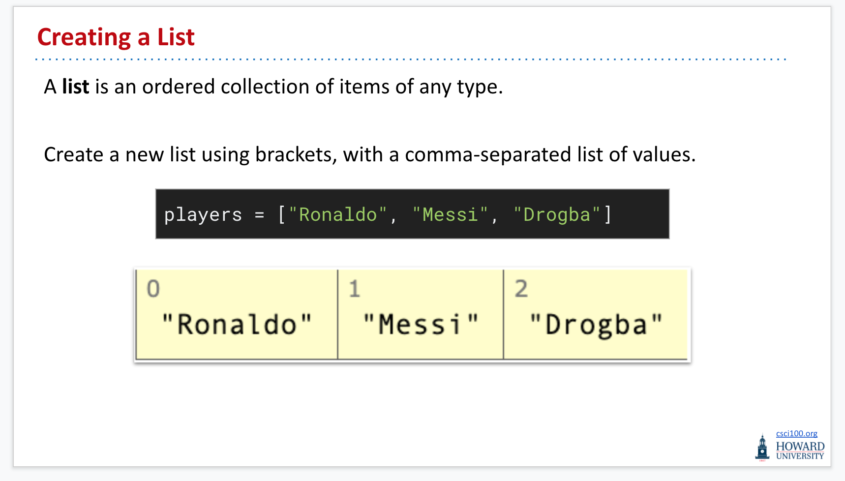
2-Dimensional Lists
We learned about lists as an ordered collection of items of any type.

Slide 4
2-Dimensional Lists
We learned about lists as an ordered collection of items of any type.

Slide 5
2-Dimensional Lists
When you have a list that holds other lists, we call this a “2 dimensional list”

Slide 6
2-Dimensional Lists
When you have a list that holds other lists, we call this a “2 dimensional list”
seating = [ ['Anton', 'Jordan', 'Joy'], ['Ibrahim', 'Sam', 'Pooja'], ['Okoro', 'Nathan', 'Mira'] ]

Slide 7

2-Dimensional Lists
It’s useful to think of them as representing some sort of grid.
seating = [ ['Anton', 'Jordan', 'Joy'], ['Ibrahim', 'Sam', 'Pooja'], ['Okoro', 'Nathan', 'Mira'] ]

Slide 8
2-Dimensional Lists
It’s useful to think of them as representing some sort of grid.
seating = [ ['Anton', 'Jordan', 'Joy'], ['Ibrahim', 'Sam', 'Pooja'], ['Okoro', 'Nathan', 'Mira'] ] print(seating[0])
,
,
> ['Anton', 'Jordan', 'Joy']

Slide 9
2-Dimensional Lists
It’s useful to think of them as representing some sort of grid.
seating = [ ['Anton', 'Jordan', 'Joy'], ['Ibrahim', 'Sam', 'Pooja'], ['Okoro', 'Nathan', 'Mira'] ] print(seating[1])
,
,
> ['Ibrahim', 'Sam', 'Pooja']

Slide 10
2-Dimensional Lists
It’s useful to think of them as representing some sort of grid.
seating = [ ['Anton', 'Jordan', 'Joy'], ['Ibrahim', 'Sam', 'Pooja'], ['Okoro', 'Nathan', 'Mira'] ] print(seating[2])
> ['Okoro', 'Nathan', 'Mira']
,
,

Slide 11
2-Dimensional Lists
To get a particular item in an inner list, we first index into the list to get the correct “row”, then index into that “row” to get the
item we want.
seating = [ ['Anton', 'Jordan', 'Joy'], ['Ibrahim', 'Sam', 'Pooja'], ['Okoro', 'Nathan', 'Mira'] ] print(seating[0][1])
> Jordan

Slide 12
2-Dimensional Lists
Indexing into a list is an expression. So the outer index is applied to the value that the inner index returns.
seating[0][1]

Slide 13
2-Dimensional Lists
seating[1][0]

Slide 14
2-Dimensional Lists
seating[2][1]

Slide 15
2-Dimensional Lists
seating[2][2]

Slide 16
Nested Loops

Slide 17
2D List Iterating
What if we want iterate over all of the seats?
seating = [ ['Anton', 'Jordan', 'Joy'], ['Ibrahim', 'Sam', 'Pooja'], ['Okoro', 'Nathan', 'Mira'] ] ????
> Anton
> Jordan
> Joy
> Ibrahim
> Sam
> Pooja
> Okoro
> Nathan
> Mira

Slide 18
Nested For Loops
For each row, we will for each name in that row print it to the screen.

Slide 19
Nested For Loops
For each row, we will for each name in that row print it to the screen.
???

Slide 20
Nested For Loops
For each row, we will for each name in that row print it to the screen.
# For each row index for row in range(3): # For this particular row, # print each entry ???

Slide 21
Nested For Loops
For each row, we will for each name in that row print it to the screen.
# For each row index for row in range(3): # For each column index for col in range(3): print(seats[row][col])
See it in action on PythonTutor

Slide 22
2D List Iterating
The other way to see this…
This is how we get all of the names:
seating[0][0]
seating[0][1]
seating[0][2]
seating[1][0]
seating[1][1]
seating[1][2]
seating[2][0]
seating[2][1]
seating[2][2]

Slide 23
2D List Iterating
Notice the pattern. Repeating [0,1,2] outside
seating[0][0]
seating[0][1]
seating[0][2]
seating[1][0]
seating[1][1]
seating[1][2]
seating[2][0]
seating[2][1]
seating[2][2]

Slide 24
2D List Iterating
Notice the pattern. Each repeated [0,1,2] is matched up with one digit (the row)
seating[0][0]
seating[0][1]
seating[0][2]
seating[1][0]
seating[1][1]
seating[1][2]
seating[2][0]
seating[2][1]
seating[2][2]

Slide 25
2D List Iterating
Notice the pattern. Each repeated [0,1,2] is matched up with one digit (the row)
This is the code that would generate all of these pairs of numbers together.
seating[0][0]
seating[0][1]
# For each row index for row in range(3): # For each column index for col in range(3): print(row, col)
seating[0][2]
seating[1][0]
seating[1][1]
seating[1][2]
seating[2][0]
seating[2][1]
seating[2][2]

Slide 26
Modules & Imports

Slide 27
Modules and Imports
Just like we use functions to organize our code, we can use modules to organize larger codebases and import code that others have written.
YouTube is not written all in one big file called youtube.py. Different functionality is split across different modules, which different people own.

Slide 28
Modules and Imports
module: a file containing Python definitions and statements, written and shared by another programmer.
import statement: loads module into program to make its functions available

Slide 29
Modules and Imports
A “module” is just a Python file containing definitions and statements. You can make your own!
If it’s in the same folder (file.py), import it with `import file`, then use functions with `file.function_name()`
helper.py
main.py
def pretty_print(string): print("-----------------") print(string) print("-----------------") def max_val(a, b): if a > b: return a return b
import helper val = helper.max_val(15, 12) helper.pretty_print("Value is " + str(val))

Slide 30
Modules and Imports
Let’s learn our first module: random

Slide 31
Modules and Imports
Let’s learn our first module: random
import random rand_int = random.randrange(0, 10) print(rand_int)

Slide 32
Modules and Imports
Let’s learn our first module: random
The randrange(start, end) function of the random module a random integer from the range [start, end) where end is exclusive (just like regular range)
import random rand_int = random.randrange(0, 10) print(rand_int)
How did I know this?

Slide 33
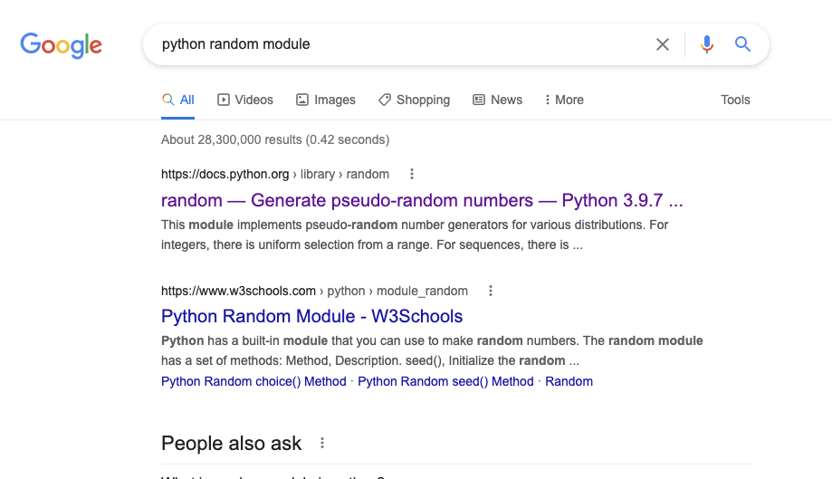
Modules and Imports
Documentation: description of the functions a programmer writes.
https://docs.python.org/3/library/random.html

Slide 34
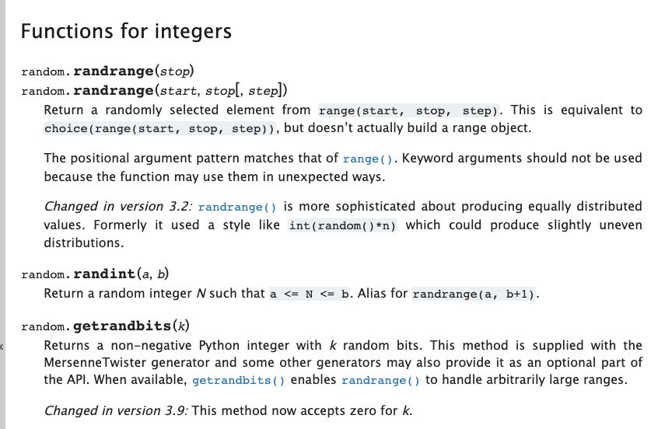
Random Module
Important skill: learn to find and read documentation online.
When you don’t know how to do something, search for the documentation.

