Slide 1

SCHOOL OF COMPUTER SCIENCES
RESEARCH PROPOSAL [SEMESTER 2 2025/2026]
Enhanced Drug-Target Interaction Prediction Through Hybrid Deep Learning Approaches
PRESENTER: Jamila Abdul-Hadi
MATRIC NUMBER: 24100625
SUPERVISOR:
Assoc. Prof. Dr. Nurul Hashimah Ahamed Hassain Malim
PROGRAM: PhD

Slide 2



Presentation Outline
📚
💊
Introduction & Background
5
Overview of Literature Review
5
1
⚠️
🏗️
2
Problem Statement
6
Methodology, Timeline & Milestones
2
6
🎯
✨
3
Objectives
7
Expected Outcomes
3
7
📚
4
Scope
8
References
4
8

Slide 3
Introduction & Background
Drug–Target Interactions (DTIs)
Limitations of Biological experimental Drugs discovery and repurposing
Computational DTI Prediction use Biological data
Need for computational approaches
  Identifying drug target interactions between drugs is a fundamental step in drug discovery and repurposing.
  Time-consuming
  Expensive
  Safety concerns
  Biological data are diverse and heterogeneous in nature
Computational approaches enable fast, cost-effective analysis of complex data.

Slide 4



Problem Statement
🧩Weak Feature Integration
Shallow or static fusion of heterogeneous representations prevents meaningful cross-modal interaction
Therefore, enhanced computational-based DTI models are needed to improve cross-modal feature integration, enhance cold-start generalization, increase interpretability, and effectively handle data imbalance.
❄️Cold-Start Failure
Poor generalization on unseen drugs or targets due to data sparsity and biased training datasets.
⬛“Black Box” Models
Lack of interpretability hinders rational drug design and limits transparency in medicinal chemistry.

Slide 5

Research Questions
Q2
Q1
Q1
Q3
  How can a Gated Cross-Attention fusion mechanism effectively integrate GNN-based drug and RNN-based protein representations to improve DTI prediction over static concatenation methods?
  To what extent can pre-trained molecular and protein language embeddings, combined with imbalance-aware learning, improve generalization to unseen drugs, targets, and cross-dataset scenarios?
  Can an attention-enhanced hybrid model provide interpretable, biologically meaningful insights by identifying key binding residues and pharmacophoric features?

Slide 6

Research Objectives
Design a hybrid GNN + RNN model with dynamic cross-modal fusion to improve DTI prediction accuracy, generalization, and interpretability.
Main Aim
Main aim
To develop a CNN-based predictive models that integrates heterogeneous biological data to enhance DTI prediction accuracy.
Objectives
To design a novel CNN architecture capable of learning and integrating heterogeneous biological datasets.
To develop and train the proposed model on benchmark DTI datasets.
To evaluate and compare the proposed model’s performance with existing state-of-the-art DTI prediction models.

Slide 7

Scope of the Study
Scope of the Research
The proposed research focuses on developing advanced deep learning model for predicting DTIs by integrating heterogeneous biological data sources using CNNs.
Notes:
This study is significant because it aims to develop an advanced deep learning model using CNNs to better predict drug–target interactions by integrating heterogamous biological data. By addressing current limitations in data integration, our approach can lead to more accurate and generalizable predictions—ultimately accelerating drug discovery and repurposing efforts in a more efficient and cost-effective way.

Slide 8
Overview of Literature Review
Computational Methods for DTI Prediction
Molecular docking
Ligand-based approaches
Machine Learning and Deep Learning
Heterogeneous Biological Data Sources
Integrating multiple data types:
  Drug structures (SMILES)
  Protein sequences (FASTA)
  Pathways, gene expression
Challenges of the Data Sources
  Format incompatibility, noise, and data sparsity
Notes:
The literature highlights several computational methods for DTI prediction, including molecular docking, ligand-based techniques, and machine learning—especially deep learning models. A key trend is the integration of heterogeneous biological data like drug structures (SMILES), protein sequences (FASTA), pathways, and gene expression. However, combining these diverse sources poses major challenges due to format incompatibility, noise, and data sparsity. These issues underscore the need for models that can effectively learn from and unify complex biological data

Slide 9
Overview of Literature Review
CNNs in Biological Data Processing
CNNs extract hierarchical features from sequences and structures
Can manage 1D (sequence), 2D (images), and graph-like inputs
Enable end-to-end learning from raw input to interaction prediction
CNN-Based DTI Models
DeepDTA: SMILES & protein sequences processed by CNNs
DeepConv-DTI: Raw sequences + dense layers
Achieved strong results in drug repurposing (e.g., COVID-19)
Notes:
Convolutional Neural Networks (CNNs) are widely used in biological data processing because they can automatically extract meaningful features from sequences and structures. They handle various data formats like 1D sequences, 2D images, and even graph-like structures, enabling end-to-end learning from raw input to DTI prediction. Notably, models like DeepDTA and DeepConv-DTI have used CNNs to process drug SMILES and protein sequences, achieving promising results in drug repurposing tasks, including COVID-19 applications.

Slide 10

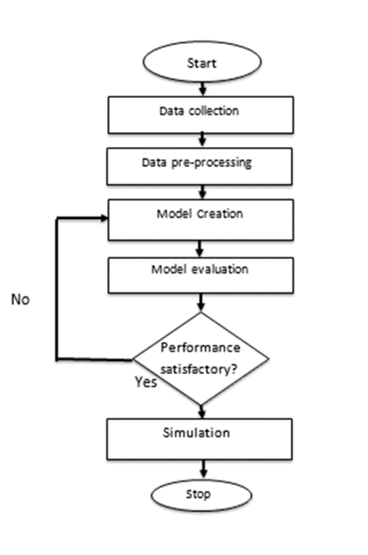
Methodology, Timeline & Milestones
Research Design
Data Collection
DrugBank, ChEMBL, and PubChem.
Data Preprocessing
Tokenization, encoding, normalization,
Padding, and reshaping
Flow chart of the proposed research
Notes:
Our propose research design begins with data collection from well-established sources like DrugBank, ChEMBL, and PubChem, which provide drug and target information. The raw data is then preprocessed through steps such as tokenization, encoding, normalization, padding, and reshaping. These steps ensure that the diverse biological inputs are in the right format for the CNN model to learn effectively from them.

Slide 11
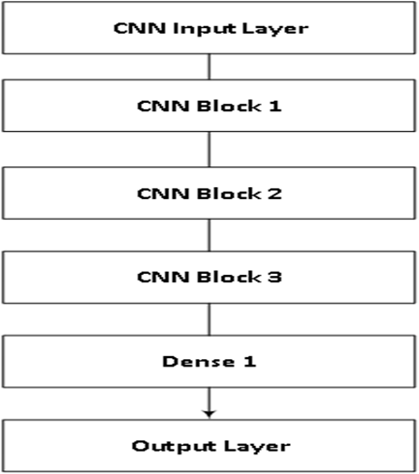
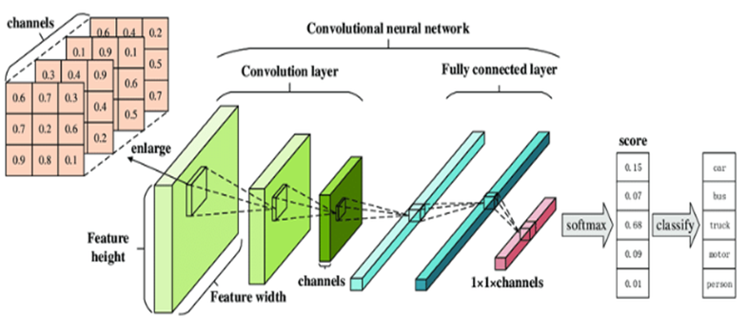
Methodology, Timeline & Milestones
CNN Architecture Design
  3 convolutional blocks + 2 dense layers
  Handles both drug and protein representations
Block diagram of Convolutional Neural Network
CNN Architecture
Notes:
Our CNN architecture is designed with three convolutional blocks followed by two dense layers. This structure allows the model to effectively capture local and hierarchical patterns in both drug and protein representations. By processing SMILES strings and protein sequences in parallel, the model can learn complex interaction features critical for accurate DTI prediction

Slide 12
Methodology, Timeline & Milestones
Experimental Setup
  Python with TensorFlow/Keras in Anaconda environment
Evaluation Metrics
  Accuracy, Precision, Recall, F1-Score
Notes:
For the experimental setup, we will use Python with TensorFlow and Keras within the Anaconda environment to build and train our CNN model. To evaluate its performance, we apply standard classification metrics such as: accuracy, precision, recall, and F1-score—providing a comprehensive view of the model’s effectiveness in predicting drug–target interactions.

Slide 13
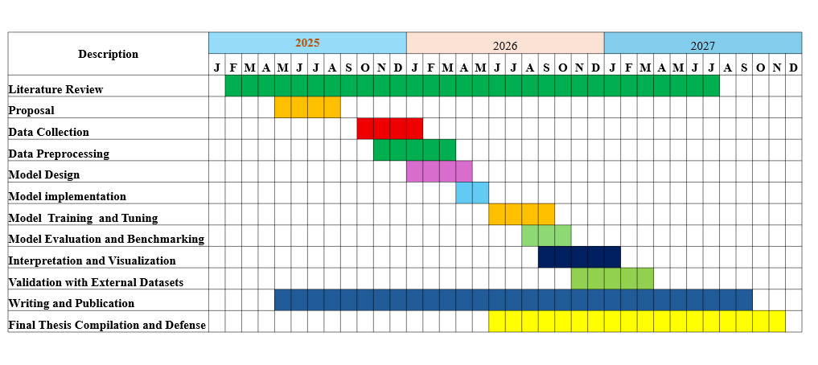
Timeline & Milestones

Slide 14
Expected Outcomes
A deep learning model based on CNN that effectively integrates diverse biological data types for DTI prediction.
Enhanced performance of the proposed model over the baseline DTI datasets.
Insights into which data types and features contribute most to DTI prediction accuracy.
Notes:
We expect to develop a CNN-based deep learning framework that effectively integrates diverse biological data types for DTI prediction. The proposed model aims to outperform baseline methods on benchmark datasets. Additionally, our analysis will provide insights into which data types and features contribute most to prediction accuracy—guiding future improvements in computational drug discovery

Slide 15
References
Azlim Khan, A. K., & Ahamed Hassain Malim, N. H. (2023). Comparative Studies on Resampling Techniques in ML and DL for DTI. Molecules, 28(4), 1663.
Seo, S. et al. (2024). Pseq2Sites: Deep CNN + attention for ligand-binding prediction. Engineering Applications of AI, 127, 107257.
Lee, J. et al. (2024). DLM-DTI: A dual-language model for drug-target interaction. Journal of Cheminformatics, 16(1).
Dai, W., Wang, Y., Yan, S., Yu, Q., & Cheng, X. (2025).Hete rogeneous network drug-target interaction prediction model based on graph wavelet transform and multi-level contrastive learning (No. arXiv:2504.20103). arXiv. https://doi.org/10.48550/arXiv.2504.20103.
Hua, Y., Feng, Z., Song, X., Wu, X. J., & Kittler, J. (2025). MMDG-DTI: Drug–target interaction prediction via multimodal feature fusion and domain generalization. Pattern Recognition, 157. https://doi.org/10.1016/j.patcog.2024.110887
Luo, Y. et al. (2024). DTKGIN: Predicting DTI with knowledge graphs. Methods, 226, 21–27.
Zhao, W. et al. (2024). MSI-DTI: DTI prediction using multi-source information and self-attention. Briefings in Bioinformatics, 25(3).

Slide 16


