Slide 1


DATA STRATEGY
CONSULTATION
R. JAMAL DUBEY

Slide 2
DATA STRATEGY CONSULTATION | CONTENTS
1
DATA REPOSITORY OPTIONS
DATALAKES VS. DATAWAREHOUSES
“SERVERLESS” VS. INFRASTRUCTURE
2
CUSTOMER DATA PROJECT
DATA ARCHITECTURE
ML-OPS PILOT

Slide 3
DATA
REPOSITORY
OPTIONS
DATALAKE VS DATAWAREHOUSE
SERVERLESS VS INFRASTRUCTURE
CUSTOMER
DATA
PROJECT
DATA
ARCHITECTURE
ML-OPS

Slide 4
DATA REPOSITORY OPTIONS | DATALAKES VS. DATAWAREHOUSES
THE TWO MAJOR TYPES OF BUSINESS DATA REPOSITORIES DIFFER WITH REGARDS TO DATA INGESTION, USERSHIP, PRO’S & CON’S
DATALAKES
DATA INGESTION:
UNSTRUCTURED, SEMI-STRUCTURED, AND STRUCTURED DATA
USERSHIP:
DATA SCIENTISTS, SMALL SPECIALIZED OR NICHE AUDIENCES
PRO’s & CON’s:
DATA DISCOVERY – SINGLE LANDING POINT FOR MULTIPLE DATA SOURCES
UNWIELDLINESS – ONLY USABLE BY SPECIALIZED PERSONNEL
FROM LAKES TO THE WAREHOUSE:
DATA ENGINEERS, DATA ARCHITECTS, AND MLOPS TEAMS, WORKING IN CONCERT WITH BUSINESS STAKEHOLDERS, CAN BUILD PROCESSES FOR STRUCTURING AND STANDARDIZING DATA, THEREBY MAXIMIZING THE READINESS OF DATA FOR BROADER DISTRIBUTION AND DECISION-MAKING
DATA
WAREHOUSES
DATA INGESTION:
HIGHLY STRUCTURED DATA
USERSHIP:
DBA’s, BI ANALYSTS
PRO’s & CON’s:
QUERYABLE CONSUMPTION AT SCALE; RELATIONAL
LIMITED AND MORE RESTRICTIVE DATA INGESTION
Notes:
DATA LIFE-CYCLE
CREATION / ACTIVE UTILIZATION / ARCHIVE
HOW BOTH REPOSITORY TYPES ARE USED IN DATA LIFE-CYCLE
DATALAKE
PRO: DATA DISCOVERY
NEW DATA CAN ENTER IN REGARDLESS OF STRUCTURE ACROSS DATASETS OR ORDERLINESS
BRINGS DATA FROM DISPARATE SOURCES INTO A CENTRAL LOCATION UNTIL IT CAN BE USED
ADDRESSES DATA LOCALITY AND FORMATTING PROBLEMS
UNSTRUCTURED, SEMI-STRUCTURED, AND STRUCTURED DATA
CON: DATA NOT READY FOR DECISION-MAKING, REQUIRES FURTHER INTEGRATION AND CORRELATION EFFORTS
DATA SCIENTISTS, SMALL SPECIALIZED AUDIENCES OF BI TOOLS
LINK
ENTRY POINT FOR DATA,
DATA ENGINEERS, DATA ARCHITECTS, ML OPS
DATAWAREHOUSE
ORDERLY INGESTION OF STRUCTURED AND UNIFORM DIMENSIONS AND MEASURES
PRO
ALL CATEGORIES OF BUSINESS DATA FOR A VARIETY OF DATA DISTRIBUTION USE CASES
POTENTIATES ORDERLY DISTRIBUTION OF BUSINESS DATA FOR REPORTING NEEDS
RELATIONAL STRUCTURES POTENTIATE EASY JOINS
CONSITENT QUERYABLE DATA THAT CAN BE CONSUMED AT SCALE AND IN AN EASILY INTERPRETABLE, SCHEDULED, OR EVEN AUTOMATED MANNER
DATA BASE ADMINISTRATORS, BI ANALYSTS

Slide 5
DATA
REPOSITORY
OPTIONS
DATALAKE VS DATAWAREHOUSE
SERVERLESS VS INFRASTRUCTURE
CUSTOMER
DATA
PROJECT
DATA
ARCHITECTURE
ML-OPS

Slide 6
DATA REPOSITORY OPTIONS | SERVERLESS VS. TRADITIONAL
MODERN SERVERLESS ARCHITECTURES, RELATIVE TO TRADITIONAL ARCHITECTURES, PROVIDE BUSINESSES A FLEXIBLE, LOW-COST COMPUTE OPTION
SERVERLESS
DESCRIPTION:
ARCHITECTURE WHEREBY BUSINESS RESPONSIBILITY FOR APPLICATION FUNCTIONALITY IS REDUCIBLE TO DEFINING AND IMPLEMENTING BUSINESS LOGICS AS STATELESS FUNCTIONS IN EVENT-DRIVEN WORKFLOWS
EXAMPLE PROVIDERS:
MICROSOFT AZURE, GOOGLE CLOUD, AMAZON WEB SERVICES
PRO’s:
LOWER COSTS FOR SHORT DURATION TASKS, PATCHES/FIXES NOT INTERNAL CONCERNS
AUTOMATIC SCALING WITH TRAFFIC VOLUMES
CON’s:
VENDOR LOCK-IN/DEPENDENCY
TASKS HEAVY IN COMPUTE TIME ARE EXPENSIVE (CONTRARIWISE TO SHORT TASKS)
COMPLEXITY/LEARNING CURVE
TRADITIONAL
DESCRIPTION:
ARCHITECTURES WHEREBY COMPUTING RELIES UPON PHYSICAL ON-PREMISE SERVERS
EXAMPLE PROVIDERS:
ORACLE, SAP
PRO’s:
POTENTIALLY LOW NETWORK LATENCY
COMPLETE CONTROL OVER HARDWARE AND SOFTWARE USED, GOVERNANCE
CON’s:
ORGANIZATION RESPONSIBE FOR ADMINISTRATION, MAINTENANCE, AND REPAIRS
LONG, CAPEX-INTENSIVE IMPLEMENTATIONS AND SCALING

Slide 7
DATA
REPOSITORY
OPTIONS
DATALAKE VS DATAWAREHOUSE
SERVERLESS VS INFRASTRUCTURE
CUSTOMER
DATA
PROJECT
DATA
ARCHITECTURE
ML-OPS

Slide 8
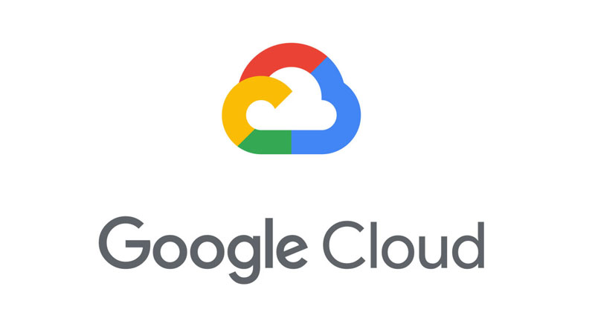



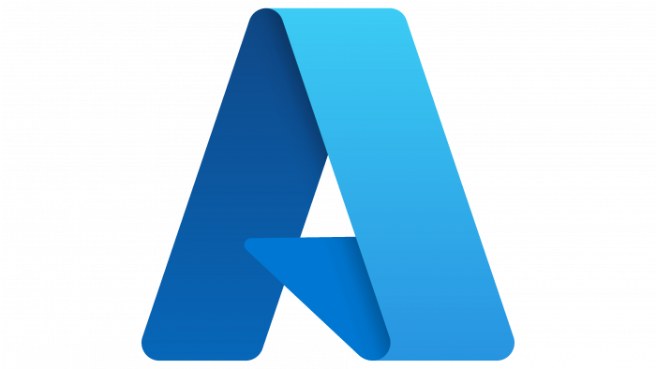
DATA ARCHITECTURE | NEEDS & OPTIONS – CLOUD SOLUTIONS
CLOUD SOLUTION CHOICE INFORMED BY CLIENT USE-CASES: DIVERSITY REPORTING AND GEOREFERENCING
CUSTOMER
DIVERSITY
OBJECTIVE:
DETERMINE IF CORPORATE DIVERSITY AND INCLUSION INITIATIVES ARE RESULTING IN DESIRED GENDER DIVERSITY OF CUSTOMER BASE
DESIRED SOLUTION:
AUTOMATE THE CREATION OF A SUMMARY DATASET APPRISING BUSINESS OF CUSTOMER COUNT BY GENDER, AND CONNECT THE DATASET TO POWERBI FOR REGULAR REPORTING
CUSTOMER GEOGRAPHY
OBJECTIVE:
DETERMINE POTENTIAL LOCATIONS FOR PRODUCT WAREHOUSES, BASED OFF CUSTOMER IP ADDRESSES
DESIRED SOLUTION:
AUTOMATE JOINING OF GEOGRAPHIC DATA (ADMNISTRATIVE DIVISION AND POINT COORDINATES) AGAINST CUSTOMER DATA, IN A MANNER THAT WORKS WELL BOTH FOR GIS ANALYSTS AND BUSINESS ANALYSTS
Notes:
START WITH ALL USE CASES, DIVERSITY AND GEOGRAPHY
REFINE EACH
OVERVIEW OF ALL PROVIDERS WHOSE CLOUD INFRASTRUCTURE WILL FACILITATE THIS
WHICHWILL BEST OPTIMIZE COSTS?
MINIMIZE CAPEX FOR DEVELOPMENT
OPEX ASSOCIATED WITH BAU JOB RUNS FOR THE DATABASE
OF ALL POTENTIAL PROVIDERS, AWS BEST ACCOMPLISHES AFORESAID OBJECTIVES, FOCUS OF SUBSEQUENT SLIDES
WHAT STRATEGY WILL WORK BEST TO SATISFY NEEDS OF DIFFERENT CONSUMERS OF TRANSFORMED DATA
GEOGRAPHICAL DATA FROM 3rd Party ML Use-Case
RETAIN CUSTOMER ID TO ENSURE RELATIONAL INTEGRITY OF RETURNED DATA
AGGREGATION ON GENDER FOR SALES TEAM REPORTING
ENSURE COMPLIANCE WITH CUSTOMER DIVERSITY OBJECTIVES
WHAT STRATEGY WILL BEST OPTIMIZE COSTS
MINIMIZE CAPEX FOR DEVELOPMENT
OPEX ASSOCIATED WITH BAU JOB RUNS FOR THE DATABASE
OF ALL POTENTIAL PROVIDERS, AWS BEST ACCOMPLISHES AFORESAID OBJECTIVES, FOCUS OF SUBSEQUENT SLIDES

Slide 9









DATA ARCHITECTURE | DESIGN
CRAWLERS & PYTHON ETL’S IN AWS SERVERLESS ARCHITECTURE BEST ACCOMPLISH DIVERSITY AND GEOGRAPHY CLIENT USE CASES
DIVERSITY AGGREGATION TABLE:
“RAW” DATA FROM THE CUSTOMER INFORMATION TABLE IS THEN AGGREGATED ON DISTINCT GENDERS (“sfl.sales_diversity”) VIA GLUE ETL
THEREBY ENSURING DATA ARRIVES IN THE FORM REPORTING/VISUALIZATIONS REQUIRE
“RAW” CUSTOMER DATA TABLE:
CUSTOMER DATA FILE HITS S3 BUCKET
REGULARLY SCHEDULED GLUE CRAWLER AUTOMATICALLY ADDS NEW DATA TO TABLE “sfl.sfl_17” IN ATHENA’S SFL DATABASE
AD-HOC CREATION OF GEO-REFERENCES:
“RAW” IP-ADDRESS DATA FROM THE CUSTOMER INFORMATION TABLE IS ENRICHED, VIA 3rd PARTY API, WITH ADMINISTRATIVE DIVISIONS AND COORDINATES, THEREBY ENSURING DATA ARRIVES IN THE FORM WAREHOUSE/FACILITIES PLANNING REQUIRES
GEO-REFERENCE CSV THEN WRITTEN TO S3 FROM SAGEMAKER, WHERUPON GLUE ETL CREATES GEOGRAPHIC REFERENCE TABLE IN ATHENA (“sfl.geo_ref”) FOR FUTURE USE

Slide 10
DATA
REPOSITORY
OPTIONS
DATALAKE VS DATAWAREHOUSE
SERVERLESS VS INFRASTRUCTURE
CUSTOMER
DATA
PROJECT
DATA
ARCHITECTURE
ML-OPS

Slide 11
ML-OPS PILOT | BEST PRACTICES
SFL RECOMMENDS OPERATIONALIZATION, MAINTENANCE AND DEPLOYMENT OF ML MODELS BE IN KEEPING WITH BEST PRACTICES
MODERN
ML-OPS
FLOW:
OPERATIONALIZING THE MACHINE LEARNING LIFE-CYCLE ON THE RIGHT PLATFORM FACILITATES THE WORK OF DATA SCIENTISTS AND ENGINEERS
WELL STRUCTURED OBJECT-INHERITANCE, AND DATA-CENTRIC RATHER THAN MODEL-CENTRIC APPROACHES YIELD BEST RESULTS
STEPS:
EXPLORATORY DATA ANALYSIS
DATA PREP AND FEATURE ENGINEERING
MODEL TRAINING AND TUNING
MODEL REVIEW AND GOVERNANCE
MODEL DEPLOYMENT
MODEL RETRAINING AUTOMATION
POTENTIAL TOOLS:
AWS SAGEMAKER, CLOUDERA, DATABRICKS, H2O
Design
Development
Operations
SAGEMAKER
(AWS)
RECOMMENDATION:
SFL RECOMMENDS USAGE OF SAGEMAKER WITHIN AWS TO POTENTIATE RUNNING LARGE-SCALE EXPERIMENTS ACROSS MULTIPLE DATA SCIENCE TEAMS
CI/CD:
EASIER MAINTENANCE OF PARITY BETWEEN DEV/PROD ENVIRONMENTS
ARTIFACT TRACEABILITY
VERSION CONTROL
E2E AUTOMATION
SAGEMAKER PIPELINES:
AUTOMATION OF ML WORKFLOWS
JOB ORCHESTRATION
MODEL MONITOR & SAGEMAKER CLARIFY:
TRACK AND ADDRESS MODEL & CONCEPT DRIFT
EASIER DISCOVEY OF MODEL BIAS

Slide 12
ANNEX

Slide 13
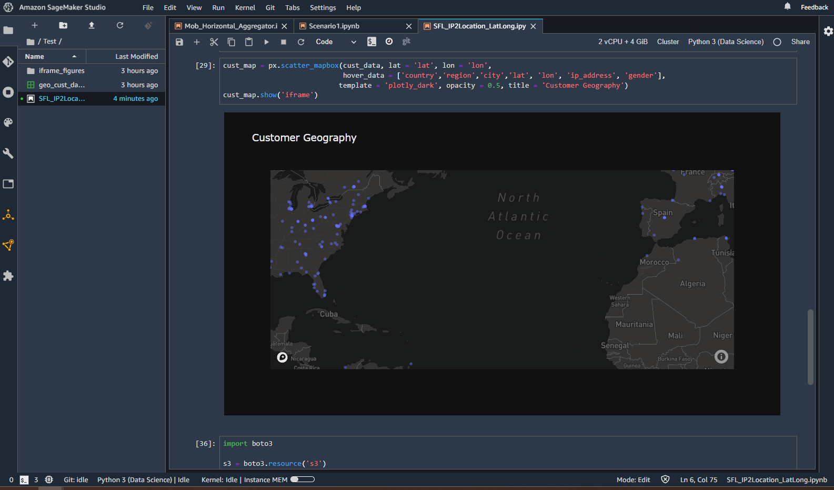
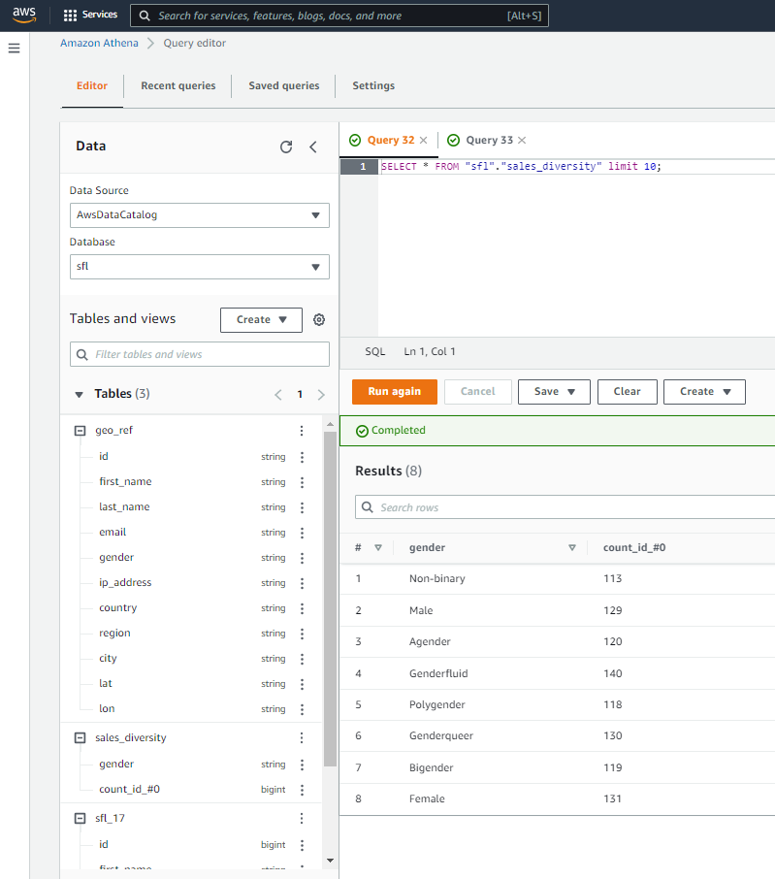
CUSTOMER DATA PROJECT | OUTPUTS

