Slide 1

Twitter Television Ratings
Dat-DC-9 : James Duvall : December 3, 2015

Slide 2
The Goal
Can the Nielsen household rating be predicted from tweets by Twitter users?

Slide 3

Why do we care?

Slide 4
But really…
Ratings are how broadcast shows get paid
The need to find an alternative ratings measure as the Nielsen household ratings continue their decline
Advertisers need to be able to capitalize on this alternative

Slide 5
The Data
Nielsen household 18–49 live + same day ratings
Web scraping
Twitter: millions of tweets
Twitter’s Stream API

Slide 6
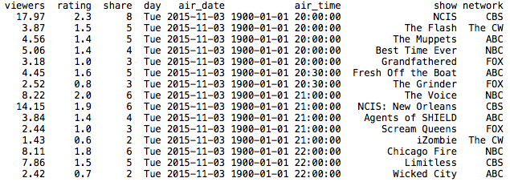
Nielsen Data (What it Looks Like)
Key takeaway: advertisers don’t care about viewers aged 49+

Slide 7
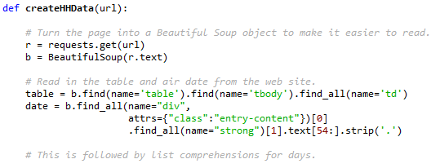
Nielsen Data (How I Grabbed It)

Slide 8

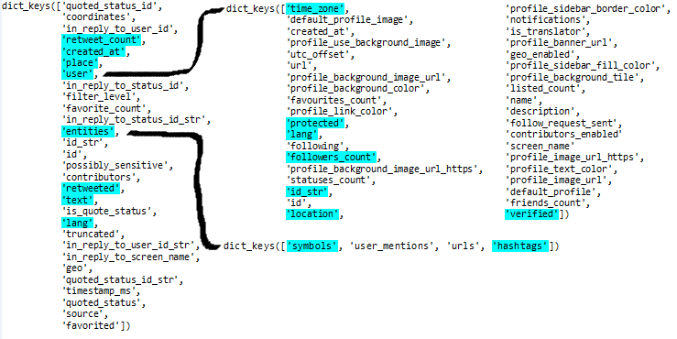

Twitter Data (Elements of a Tweet)

Slide 9
Twitter Data (Reading in the Data)
I began with a giant folder full of tweets
Each tweet is stored as a JSON [simple enough with json.loads()]
Some of the tweets were “bad” – usage of Try/Except
Pulled them into a list of dictionaries
Pulled out individual elements of tweets to add to DataFrame
Requirements: the tweet must be in English, it must correspond to a U.S. time zone, and the tweet must occur between 7 p.m. and 6 a.m. EST
Filter down to a set of “unique user tweets” by the user id string

Slide 10
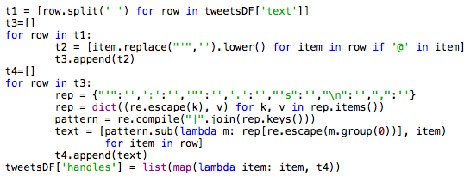
Twitter Data (Useful Tools)
Getting the twitter handles and the power of regular expressions [import re]
MAGIC

Slide 11
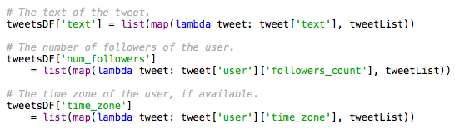
Twitter Data (Useful Tools)
Mapping and lambda functions
Lambda defines the function
Map applies that function to each iterable
Not very pythonic? Haters gonna hate!

Slide 12

Problems with Twitter data
Space!
One folder (representing a day) at a time
Clearly missing tweets (no Empire!)
Non-network trending hashtags, hard to capture
Worthless tweets:
A new limitless pill takes internet by storm!

Slide 13
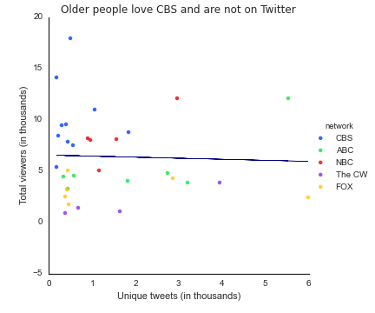
Analyzing the Data
While not significant in the least, we observe an expected negative coefficient between total viewers and unique tweets

Slide 14
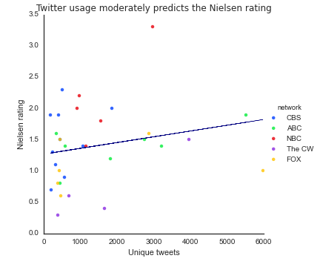
Analyzing the Data
By itself, unique tweets have almost no relationship with the Nielsen rating; however, this changes when both the networks and days are controlled.
The Voice
NCIS
OUaT
Arrow
Scream Queens
The R² jumps from 0.05 to 0.68 when adding the control variables.

Slide 15
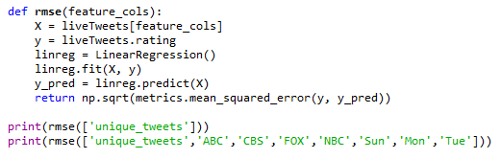
Analyzing the Data
The RMSE dramatically improves when adding the control variables, from 0.60 to 0.35.

Slide 16
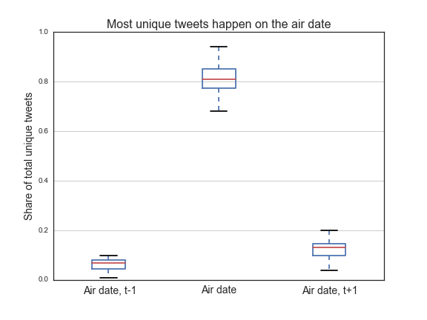
Analyzing the Data

Slide 17
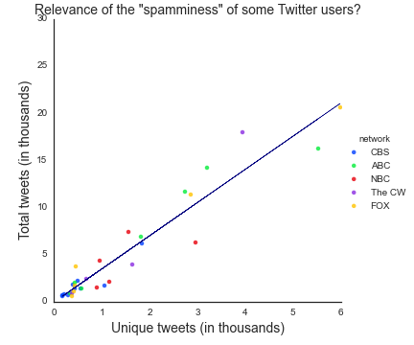
Spamminess

Slide 18
Insights
Analytically:
When controlling for the day of the week and the program’s network, simply having the number of unique tweets is a relatively solid indicator for the Nielsen rating
Computationally:
RAM is exceptionally valuable
UNIX solves a lot of problems
WTB: Apache Spark

Slide 19
The Future
With more data, I could more effectively control for reality programming.
Could I predict someone’s age group based on the “spamminess” of their tweets? This would help advertisers.
Can I predict either a drop or rise in each week’s Nielsen rating based on the sentiment of their tweet? This could encourage quality.

Slide 20
Thank you for listening!
Any questions?

