Slide 2


Hudson – The Little Heart for Big Enterprises
Winston Prakash, Duncan Mills Hudson Development Team

Slide 3

Program Agenda
Hudson in a Nutshell
Hudson in the Enterprise
Understanding Team Concept

Slide 4
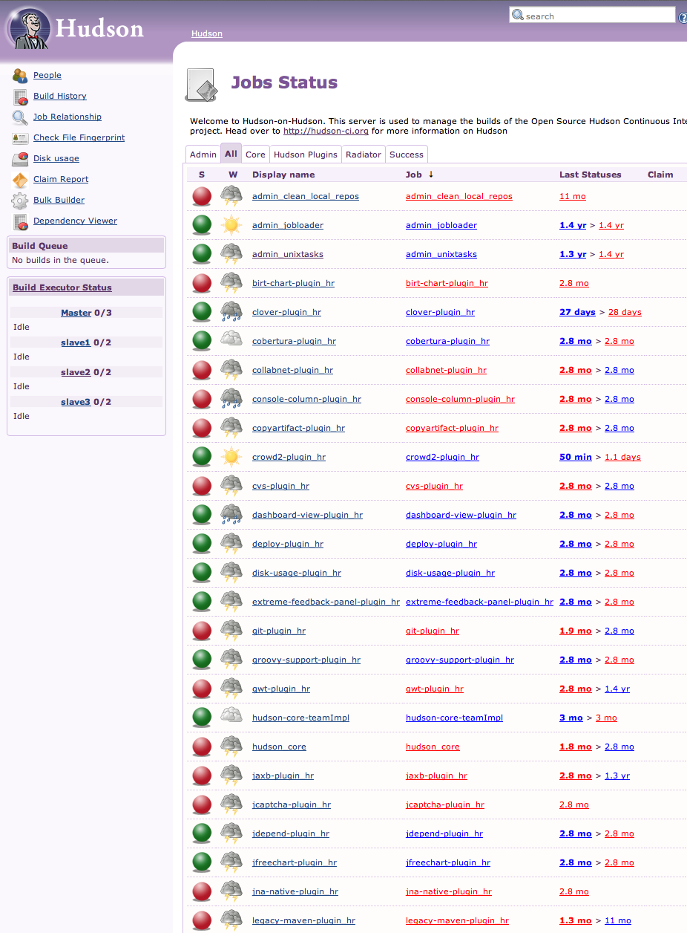
Hudson in a Nutshell

Slide 5
Hudson in a Nutshell
Check-in
Build
Test
Deploy
Report
Continuous Integration Server
Manage the essential flow of a modern development env.
Heterogeneous technologies and operating systems
Extensible

Slide 6
Hudson in a Nutshell
The Project
Mature Technology Project at the Eclipse Foundation www.eclipse.org/hudson || www.hudson-ci-org
Hudson Core is EPL licensed
Plug-ins mixed licenses; usually MIT
Current release 3.1.0
Project plan available @ Eclipse
http://projects.eclipse.org/projects/technology.hudson
Open (non-Eclipse) plug-in community, GitHub, java.net etc.

Slide 7
Hudson in a Nutshell
Has all the Right Bits for Continuous Integration
Runs automatically
SCM: GIT, SVN, CVS, Perforce…
Builds: Maven, Ant, scripts…
Testing: Junit, Selenium, Abbot…
Deployment: app servers, web…
Feedback
Email, IM, RSS, Lava Lamp…
Analysis
Clover, Sonar, PMD…

Slide 8

But it's More than Continuous Integration
CI is but the First Step
Continuous Delivery
A set of practices and principles aimed at building, testing and releasing software faster and frequently
Produce a deployable-to-production build regularly, probably on each commit.
Every build is a potential release.

Slide 9

Continuous Delivery with Hudson
A
Continuous
Integration
Manual
Testing
Continuous
Integration
Continuous
Testing
Manual
Delivery
Continuous
Delivery
Automated Tests
Source
Repository
Automated Deployment
Source
Repository
Acceptance Test
Deploy-QA
Dev
Functional Test
Dev
Deploy-production
QA
Operations
Build and Unit Test
Build and Unit Test
Integration Test
Deploy-performance
Package
Repository
Acceptance Test
Deploy-QA
Functional Test
Deploy-production
Package
Repository
Resources
Repository
Integration Test
Deploy-performance

Slide 10
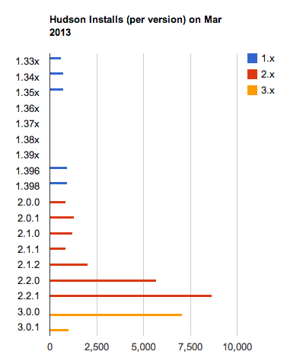
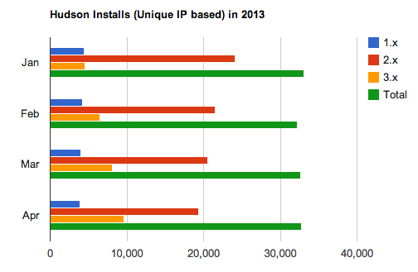
Hudson in the Wild
Usage

Slide 11
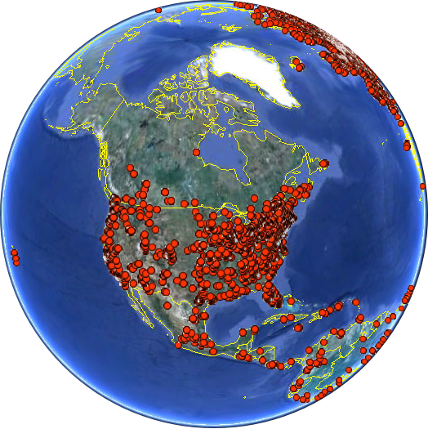
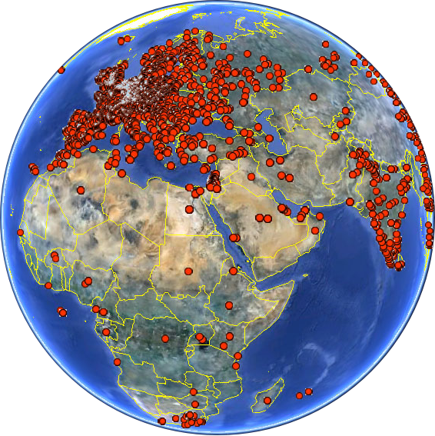
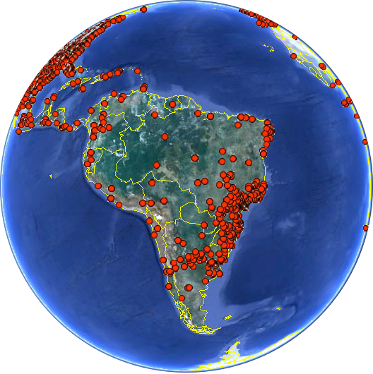
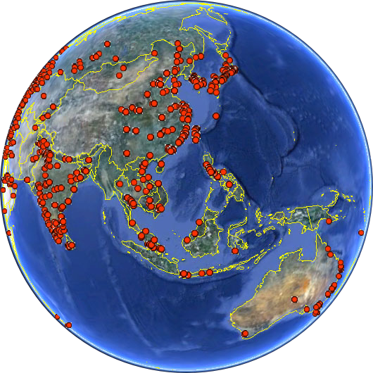
Hudson in the Wild
Installed Around the World…

Slide 12
Hudson in the Enterprise

Slide 13
From CI for an Individual / Small Team
What Matters?
Saving Time
Agility
Flexibility

Slide 14
To CD in the Enterprise
What Matters?
Manageability
Security
Performance and Scalability
Visibility
Legal / IP
Developer Needs
Management Needs

Slide 15
Hudson – Redressing the Balance
Core Theme to make Hudson more Enterprise Friendly
IP – Hudson 3.0.0 cleaned up and documented all deps.
109 libraries reduced to 85
LGPL and unprovenanced libraries removed / replaced
Plug-in management
Switchable Update Centers and initial setup capabilities
More complex pipelines
Cascading templates introduced in 2.2.0

Slide 16
Hudson – Redressing the Balance
Hudson 3.1 – Yet More…
Big memory optimization exercise
Can reduce required heap by between 50-75% for the same set of jobs
The more builds the bigger the savings
Team Concept
More to come in the next release
Hot loading of plug-ins
Restart in place

Slide 17
Hudson Memory Usage Improvements
A Major internal Re-work
Older versions hold much too much in memory
Jobs ,builds for a job, console output etc.
Change to a smart cache model
Manages lightweight object proxies on a LRU and timed basis
Proxies abstract the object and prevent the pinning of the whole graph
Some work still to do
A badly written plugin could mess it all up
Fixing this could break one-source Hudson / Jenkins plugins
Guidance for plug-in writers to be released

Slide 18
Hudson Memory Usage Improvements
Testing from hudson-ci sandbox
40 Jobs
Running @ 15mins intervals
Total number of builds so far: 62,000
Other trials on large build farms have show similar or larger savings
Hudson 3.0
1024
360
Hudson 3.1
512
118
54
62,000
52
0
Max Heap
Used Heap
Used Permgen
Builds in memory

Slide 19
Team Concept in Hudson 3.1

Slide 20
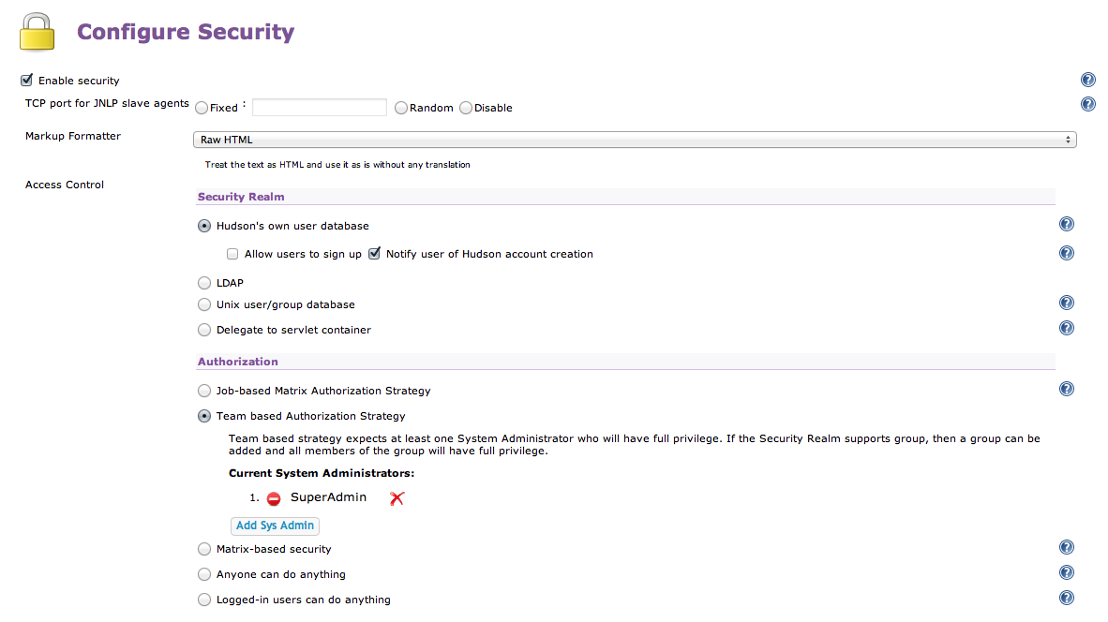
Hudson Teams
Enabled from Manage Security
Maps onto chosen security realm (e.g. Hudson's own, LDAP, your SSO etc.)
Teams can map to existing groups

Slide 21
Hudson Teams
System Admin
Winston
Team Admin
Bob
Geoff
Geoff Team Admin
ALL_QA_STAFF
Duncan
Team Structure
*
*
* A single user or group can be present in more than one team with different rights in each case

Slide 22
Hudson Teams
Roles
Super Admin
Can create non-team PUBLIC jobs ("public" is a predefined reserved team)
Creates teams and appoints initial team admin
Can move jobs between teams
Team Admin
Manages the users, groups within a team
Can control visibility of a job
Team Member
May have rights to configure, create, delete and run jobs
Member may also be a Team Admin

Slide 23
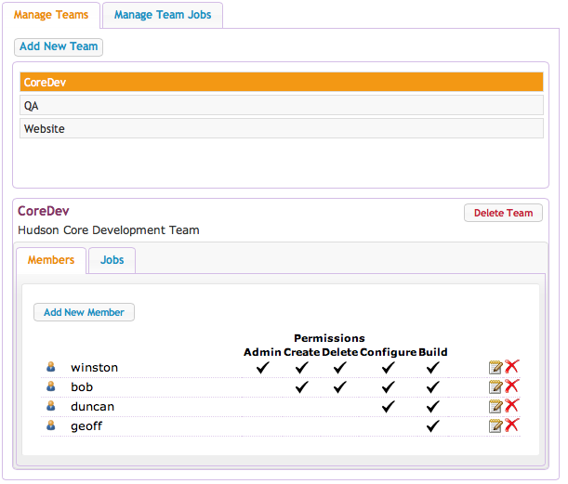
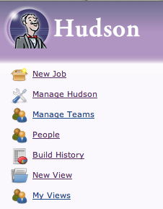
Hudson Teams
Demo
Management

Slide 24
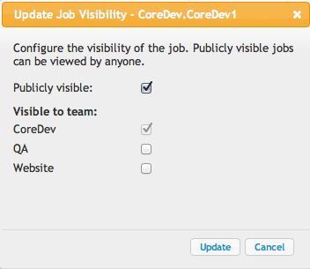
Hudson Teams
Job Types
Public jobs
Owned by the special public team
Existed before Team support enabled or created by super-admin
Referenced with just the job name – no prefix
Read-only to all except Super Admin
Team Jobs visible to public
Referenced with team-name prefix
E.g. CoreDevTeam.HudsonNightlyBuild
Granted to public by team admin
View only by public

Slide 25
Hudson Teams
Job Types
Team Jobs
Referenced with team-name prefix
E.g. CoreDevTeam.HudsonNightlyBuild
3 subtypes
Private, visible to owning team only
Public - read-only to all
Visible to nominated other team(s) but not public

Slide 26
Hudson Teams
Stuff You Might Need to Know?
Enabling Team support
Creates /team folder in Hudson Home
Sub-folders created (by default) for each team. (Super Admin can designate a custom location if required)
Team Jobs stored in those folders
Team defined through simple team.xml file in $HUDSON_HOME/teams
Job management execution through the API as usual
Use the fully qualified name
Command line support for management of teams and jobs

Slide 27
Hudson Teams
Demo
Management From the Command Line
All the functions you'd expect
Create and list teams
Manage jobs using team prefixes, including copying jobs from one team to another
Using hudson-cli.jar
$ java -jar hudson-cli.jar list-teams --username duncan --password secret
CoreDev Admin Build Configure Create Delete ExtendedRead Read WipeOut Workspace
public Read

Slide 28
What's Next for Hudson
3.1.1 and Beyond
More memory work
Particularly plugins
Warm restart of plugins and server
UI Cleanup
General improvements and accessibility
Complex build and delivery pipelines
Management and visualization

Slide 29
What Something Else?
Get Involved…
Join the Developer list
Join the project bi-weekly phone call
Add your ideas to the wiki
Log enhancements in Bugzilla
Write a plug-in
http://www.eclipse.org/hudson/

Slide 30
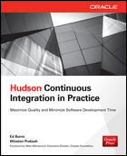
New Hudson Book just Released
Hudson Continuous Integration in Practice
By Winston Prakash and Ed Burns
Available from Oracle Press

Slide 31

Graphic Section Divider

