Slide 1








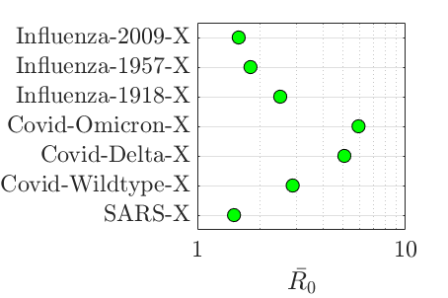
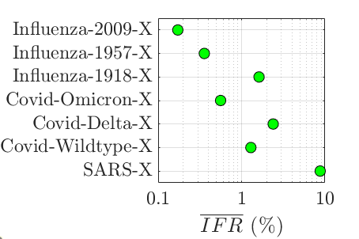


















Income Group
Demography
Economy
Mixing
Workplace*
Retired-Age
Working-Age
Sector 1
Sector 5
School*
…
Other*
Working-Age
Non-
Working
Sector 2
Sector k
Household
School-Age
Sector 3
…
.....
.....
`
Preschool-Age
Sector 4
Sector 45
.....
.....
`
Life-Expectancy
Y₀ = Σ y_{j}N_{j}
Population
* = Closure-Dependent
Disease
Transmissibility
Delays
Severity
β
εβ
1 - p^{Is}
p^{Is}
Time
Mitigation
Measures
I_{j}^{ai}
Unvaccinated
Distancing
Surveillance
I_{j}ª
I_{j}^{ai}
Vaccinated
Response Time
Transmission Multiplier Intercept
Transmission Multiplier Death-Sensitivity
Transmission Multiplier Time-Decay
Testing Start-Time
Testing Rate
S_{j}
E_{j}
R_{j}
D_{j}
I_{j}^{s}
I_{j}ª
R_{j}
S_{j}
E_{j}
H_{j}
D_{j}
Vaccination
I_{j}^{s}
H_{j}
Healthcare
Administration Start-Time
Administration Rate
Coverage
S_{j}^{c}
I_{j}^{si}
Spare Hospital Capacity
I_{j}^{si}
Closure Strategy
No Closures
Reactive/Sustained-School Closures
Reactive/Reactive-School Closures
Elimination
Response
Time?
Distancing
Response
Time?
Distancing
Response
Time?
Distancing
Response
Time?
Heavy Economic
Closures
Schools Closed
Distancing
Heavy Economic
Closures
Schools Closed
Hospital Occupancy > 95% of Capacity?
Heavy Economic
Closures
Schools Closed
Hospital Occupancy > 95% of Capacity?
Light Economic
Closures
Schools Reopen
R_{t} < 1?
Hospital Occupancy < 25% of Capacity?
Light Economic
Closures
Schools Remain
Closed
Hospital Occupancy < 25% of Capacity?
Light Economic
Closures
Schools Reopen
R_{t} > 1.2?
Heavy Economic
Closures
Schools Closed
Socioeconomic Loss
Health Loss
Economic Loss
Educational Loss
Deaths
Remaining
Life-Expectancy
Value of
Life-Year
(VLY)
Economic Closures
Labour Supply Shock
Pre-Pandemic
GDP
School
Closures
Student Absences
Value of
School-Year
(VSY)
= Value of Life-Years Lost (VLYL)
= GDP Loss (GDPL)
= Value of School-Years Lost (VSYL)
Notes:
To Export:
Print to PDF
Page Layout: Tick High-Quality
Advanced Printer Settings: A3 size

