Slide 1








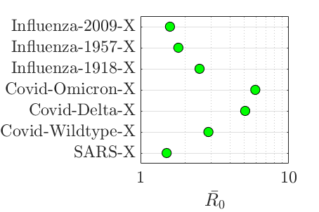
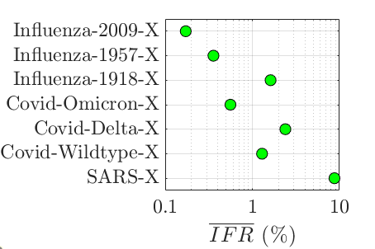


















Income Group
Demography
Economy
Mixing
Workplace*
Retired-Age
Working-Age
Sector 1
Sector 5
School*
…
Other*
Working-Age
Not
Working
Sector 2
Sector k
Household
School-Age
Sector 3
…
.....
.....
`
Preschool-Age
Sector 4
Sector 45
.....
.....
`
Life Expectancy
Y₀ = Σ GVA_{k}W_{k}
Population
* = Closure-Dependent
Disease
Transmissibility
Delays
Severity
β
rβ
1 - p_{s}
p_{s}
Time
Mitigation
Measures
I_{j}^{ai}
Unvaccinated
Distancing
Surveillance
I_{j}ª
I_{j}^{ai}
Vaccinated
Response Time
Transmission Multiplier Intercept
Transmission Multiplier Death-Sensitivity
Transmission Multiplier Time-Decay
Testing Start-Time
Testing Rate
S_{j}
E_{j}
R_{j}
D_{j}
I_{j}^{s}
I_{j}ª
R_{j}
S_{j}
E_{j}
H_{j}
Vaccination
I_{j}^{s}
H_{j}
Healthcare
Administration Start-Time
Administration Rate
Coverage
S_{j}^{c}
I_{j}^{si}
Spare Hospital Capacity
I_{j}^{si}
Closure Strategy
No Closures
School Closures
Economic Closures
Elimination
Response
Time?
Distancing
Response
Time?
Distancing
Response
Time?
Distancing
Response
Time?
Heavy Economic
Closures
Schools Closed
Distancing
Heavy Economic
Closures
Schools Closed
Hospital Occupancy > 95% of Capacity?
Heavy Economic
Closures
Schools Closed
Hospital Occupancy > 95% of Capacity?
Light Economic
Closures
Schools Reopen
R_{t} < 1?
Hospital Occupancy < 25% of Capacity?
Light Economic
Closures
Schools Remain
Closed
Hospital Occupancy < 25% of Capacity?
Light Economic
Closures
Schools Reopen
R_{t} > 1.2?
Heavy Economic
Closures
Schools Closed
Societal Loss
Health Loss
Economic Loss
Educational Loss
Deaths
Remaining
Life Expectancy
Value of
Life-Year
(VLY)
Economic Closures
Labour Supply Shock
Pre-Pandemic
GDP
School
Closures
Student Absences
Value of
School-Year
(VSY)
= Value of Life-Years Lost (VLYL)
= GDP Loss (GDPL)
= Value of School-Years Lost (VSYL)

