Slide 1
miscarriage
Presenter :
Jawaher Aljulaify
Jamila Alharbi
Instructor:
Dr. Mejdal Alqahtani

Slide 2
TABLE OF CONTENTS
01
03
02
04
INTRODUCTION
MODELS
PREPROCESSING
CONCLUSION

Slide 3
INTRODUCTION
There are many pregnant women who suddenly miscarry, which affects their psychological state, so we will build a model capable of predicting the miscarriage or not.

Slide 4
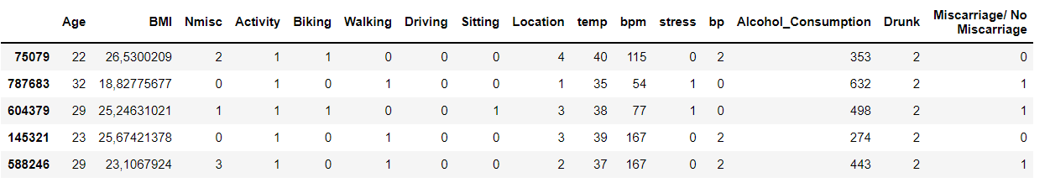
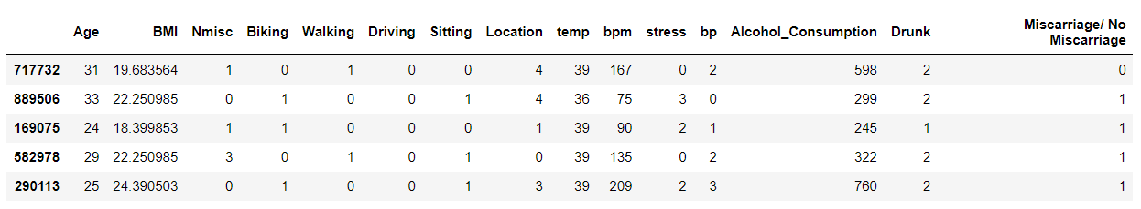
PREPROCESSING

Slide 5
PREPROCESSING
01
02
03
BEFORE CLEANING
AFTER CLEANING
AFTER SPLIT
In train We have
799940 rows
15 feature
In test We have
199986 rows
15 feature
We have
1000000 rows
16 feature
We have
999926 rows
15 feature

Slide 6
MODELS
Logistic Regression
Decision Tree
Random Forest
KNN
xgboost
SVM
Accuracy = 59%
Accuracy = 80%
Accuracy = 80%
GaussianNB
Accuracy = 60%
Accuracy = 80%
Accuracy = 58%
Accuracy = 65%

Slide 7
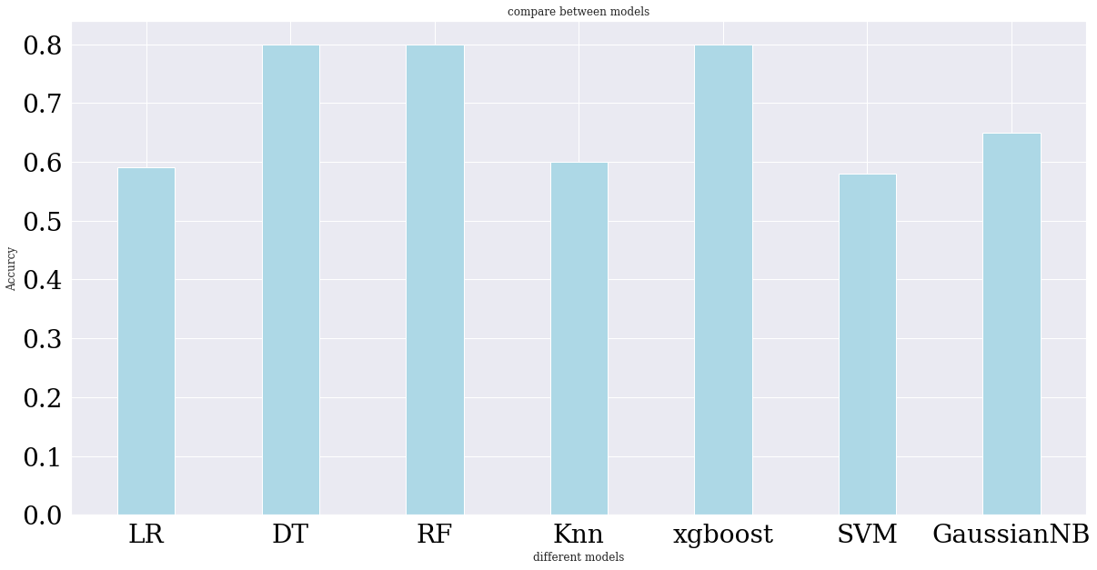
MODELS
compare between models

Slide 8
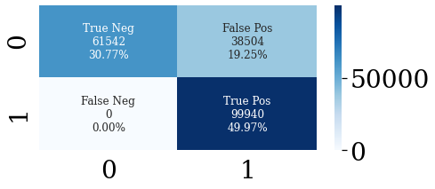
RESULTS
Accuracy = 0.80
F1 = 83
Recall = 1
Precision = 0.72

Slide 9
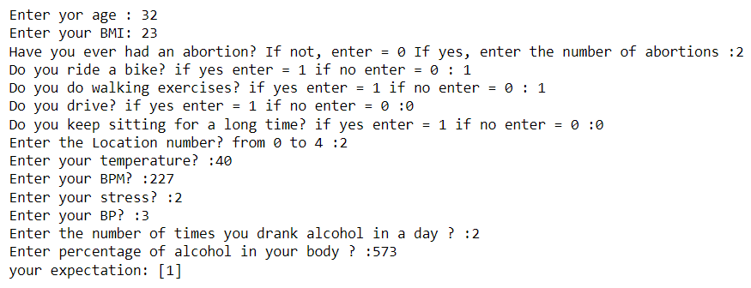
RESULTS
Simple program

Slide 10

CONCLUSION
We've been able to make a model that can predict a miscarriage by 80%.
We hope to work on data from a Saudi government hospital
Please keep this slide for attribution

Slide 11
THANKS
Please keep this slide for attribution

