Slide 1
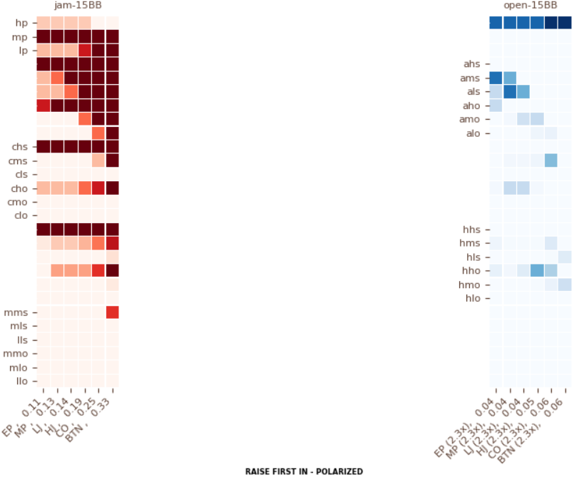
Notes:
What are the hand classes and worst hands within those classes that should defend versus the above jamming composition?
vs EP: 77+, AJs+, AQo+
vs MP: 77+, ATs+, AJo+
vs LJ: 77+, ATs+, AJo+
vs HJ: 55+, A9s+, AT+
vs CO: 44+, A8s+, A9+, KQs
vs BTN: 44+, A5s+, A7+, KTs

Slide 2
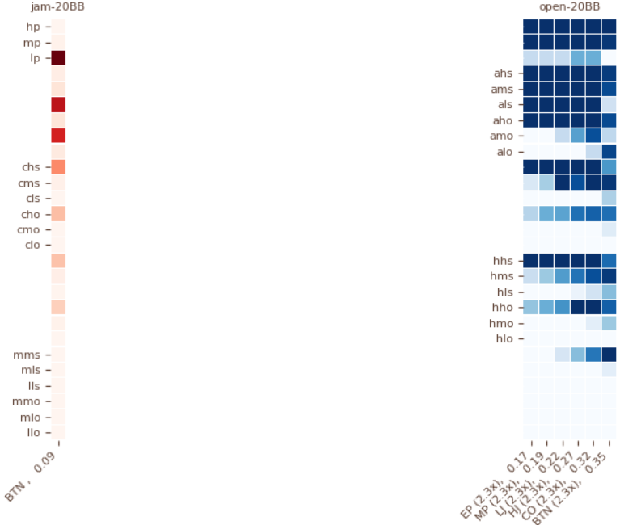
Notes:
What are the hand classes and worst hands within those classes that should defend versus the above jamming composition?
vs BTN: 33+, A8s+, A8o+

Slide 3
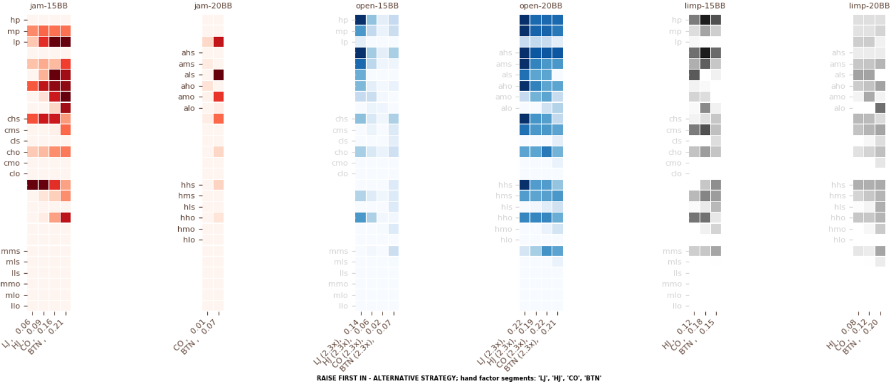
Notes:
MESOANALYSIS
How do the RFI polar and RFI alternative strategies at 15BB (jams) compare?
The jam-15BB alternative composition is a subset (or 60%) of the jam-15BB polarized composition
How do the RFI linear and RFI alternative strategies at 20BB (jams) compare?
Virtually identical
Comparative Analysis: RFI linear (20BB opens) vs RFI alternative (20BB opens):
The open-20BB alternative composition is a subset (or 65%) of the open-20BB linear composition
Comparative Analysis: RFI linear (20BB) vs RFI alt (20BB) vs RFI alt (15BB):
The open-20BB alternative composition is a subset (or 65%) of the open-20BB linear composition
The open-15BB alternative composition is a subset (or 15%) of the open-20BB linear composition
Comparative Analysis: RFI linear (20BB opens) vs RFI alt (15BB limps) vs RFI alt (20BB limps):
The limp-15BB alternative composition is a subset (or 50%) of the open-20BB linear composition
The limp-20BB alternative composition is a subset (or 25%) of the open-20BB linear composition
MACROANALYSIS
How does random number generation map to the frequency of each action?
15BB: jam 40% (1 – 24s), open 20% (25-36s), limp 40% (37 – 00s)
20BB: open 60% (01-36s), limp 40% (37 – 00s)
What is a good heuristic to play this strategy exploitatively?
If all the opponents are weaker in the SB and BB, then limp the BTN at both stack depths 100% of the time
If all the opponents are weaker in the BTN, SB, and BB, limp, then limp the CO and BTN at both stack depths 100% of the time
If all the opponents are weaker in the CO, BTN, SB, and BB, then limp the HJ, CO, and BTN at both stack depths 100% of the time

Slide 4
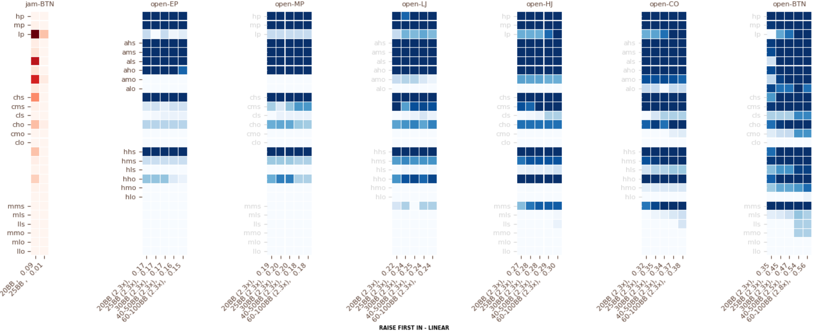

Slide 5
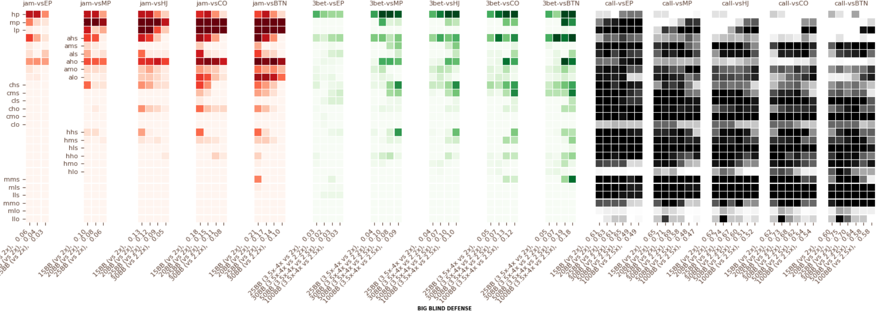

Slide 6
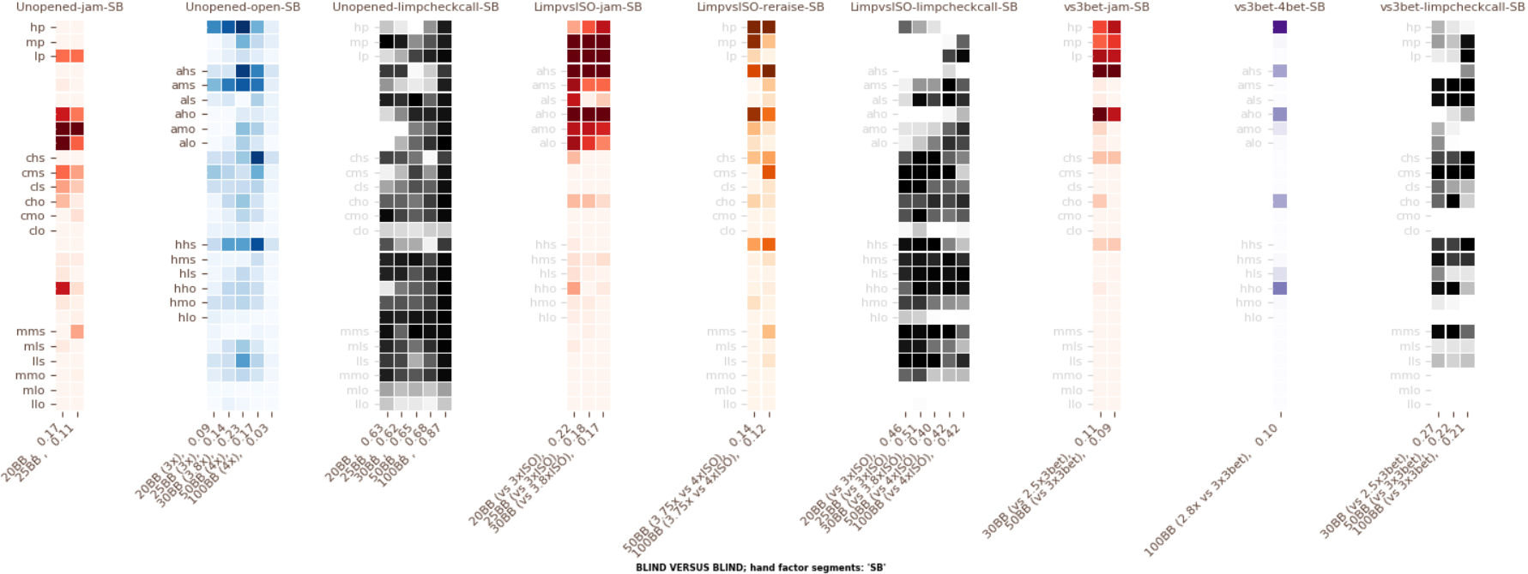

Slide 7
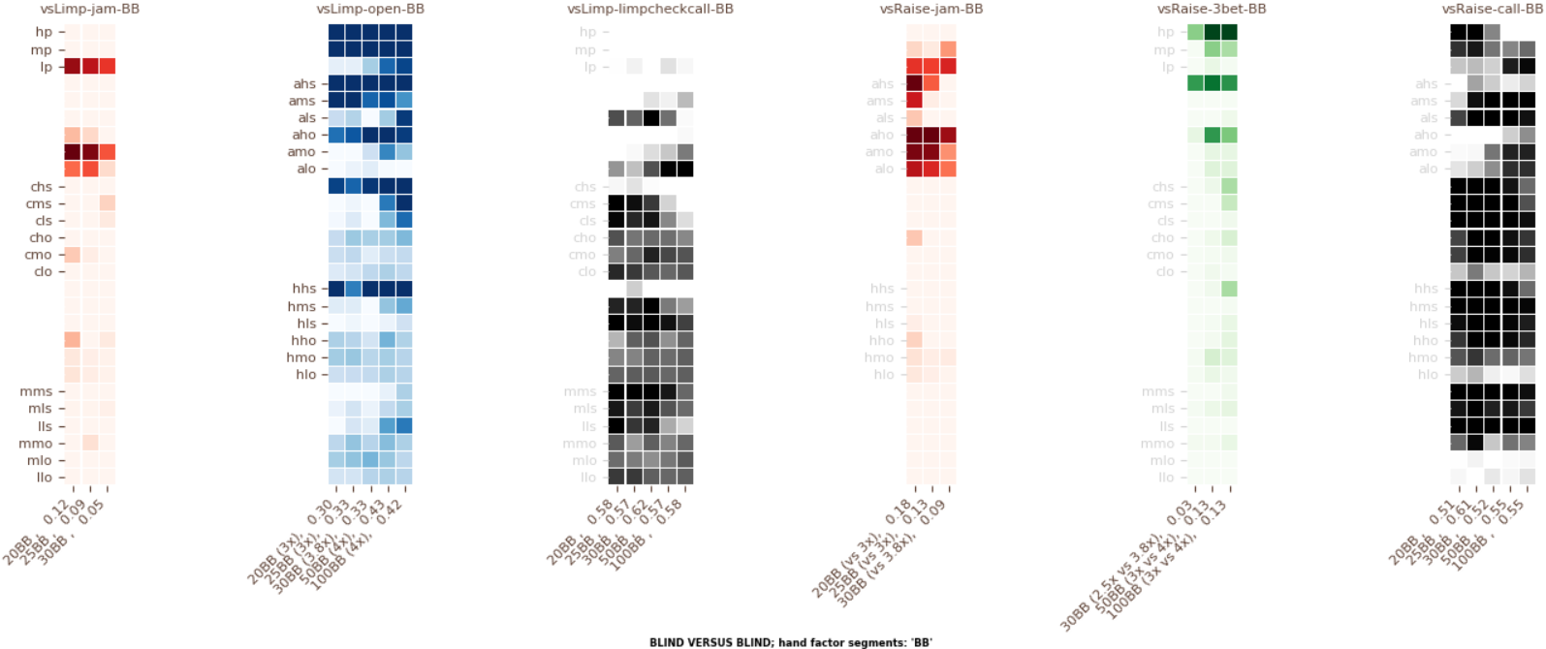

Slide 8
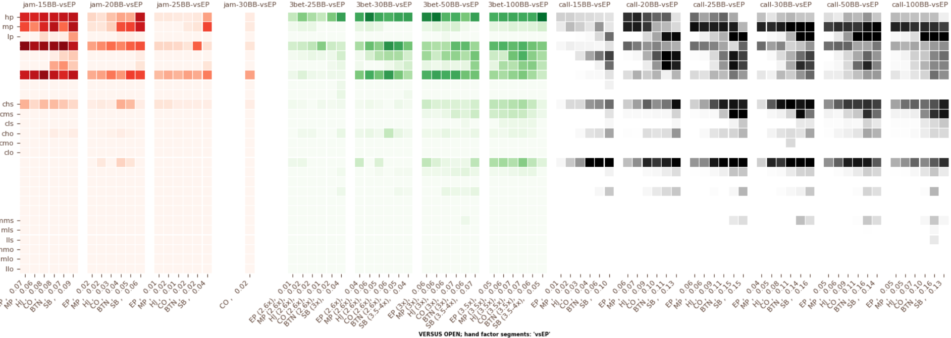

Slide 9
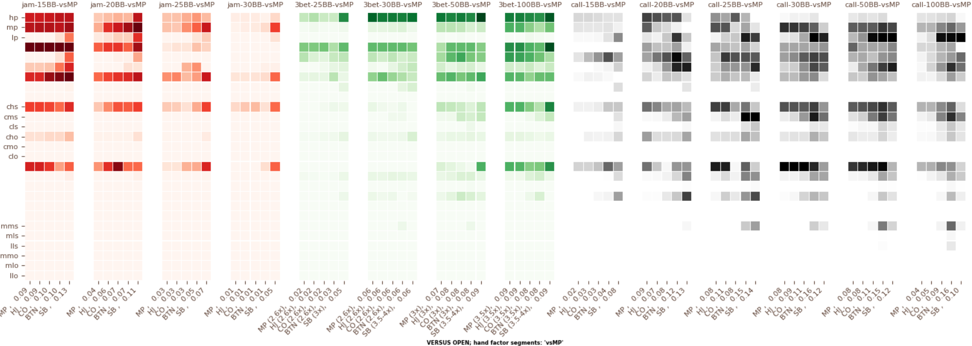

Slide 10
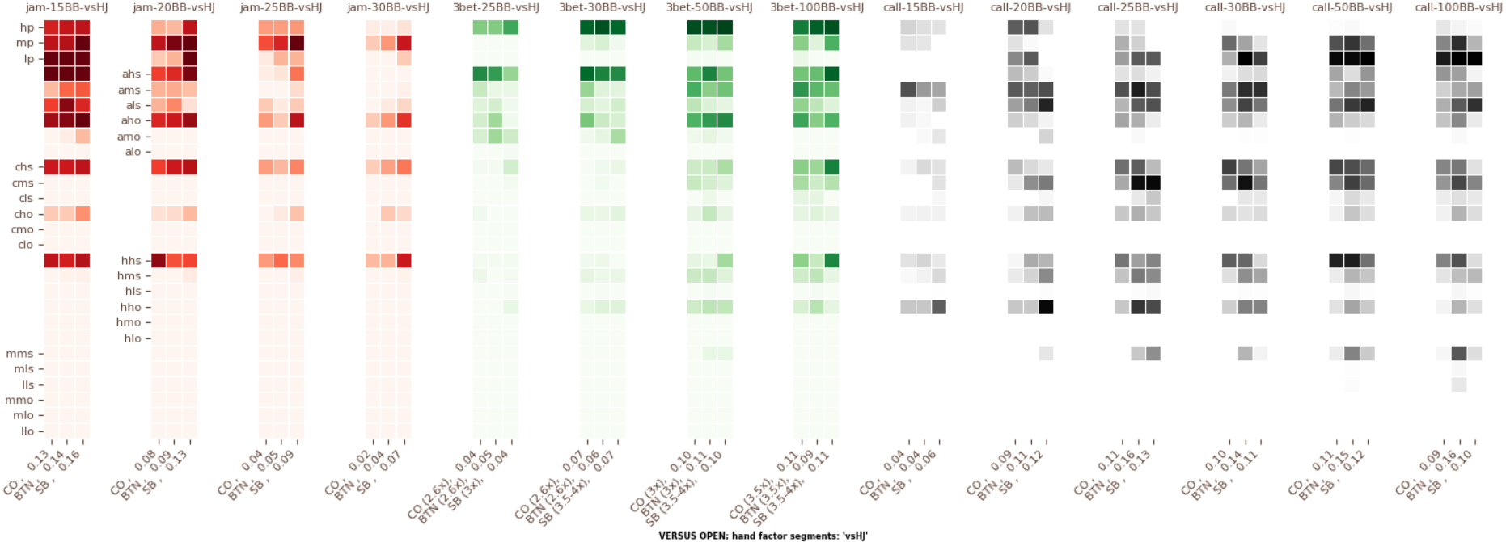

Slide 11
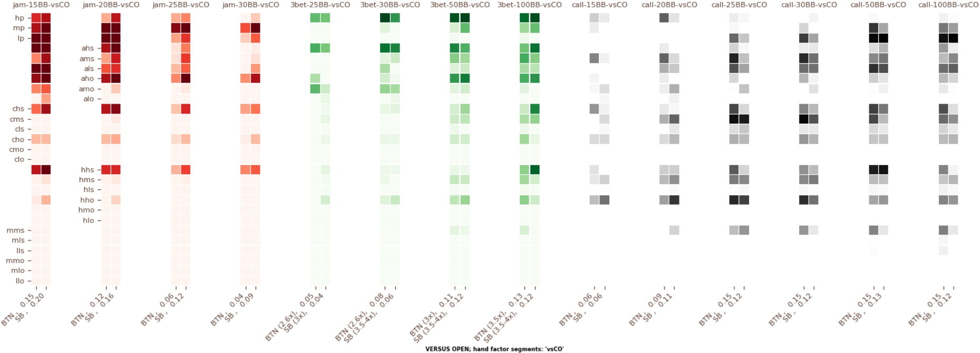

Slide 12
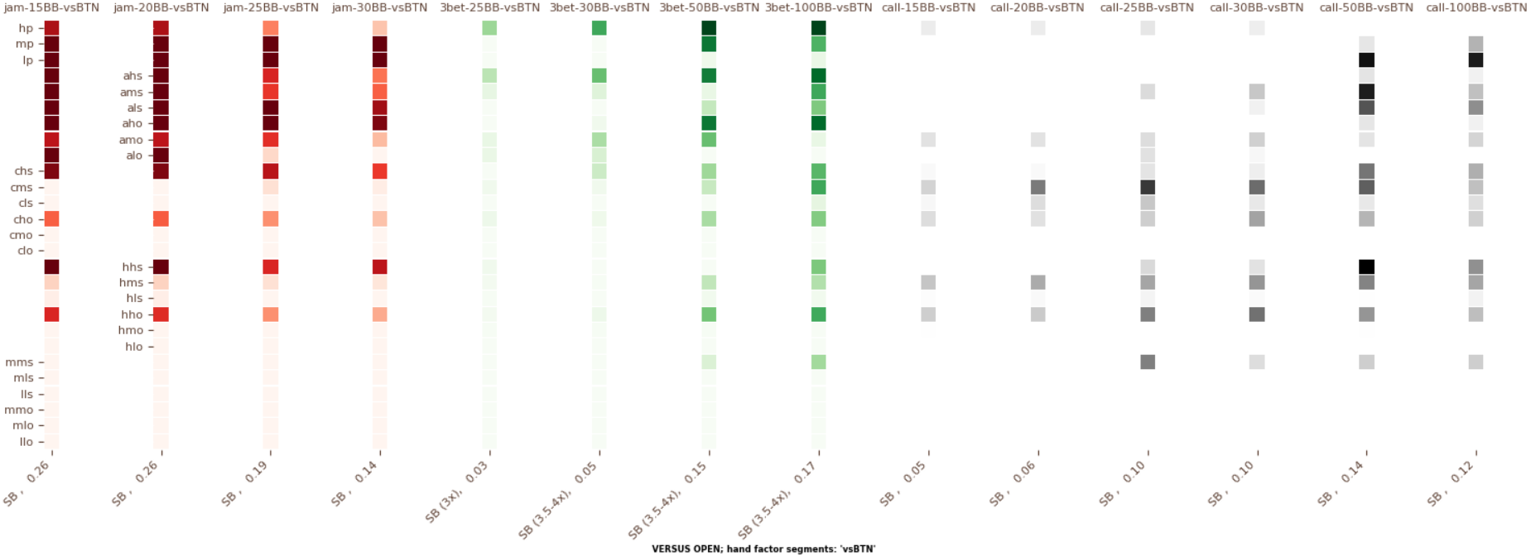

Slide 13
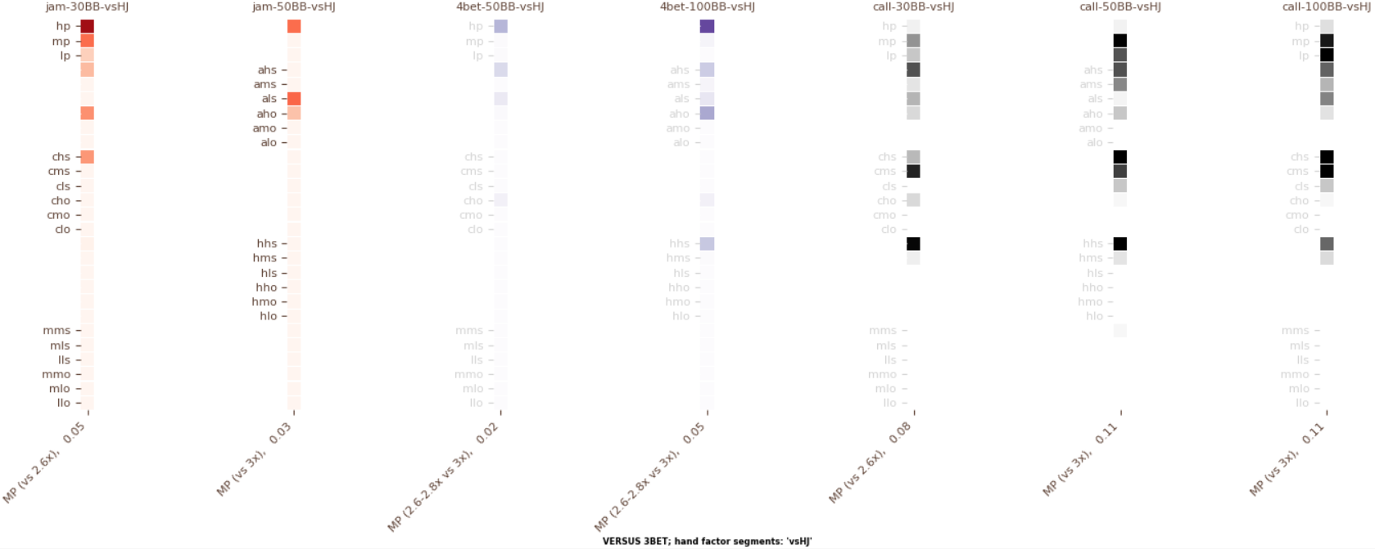

Slide 14
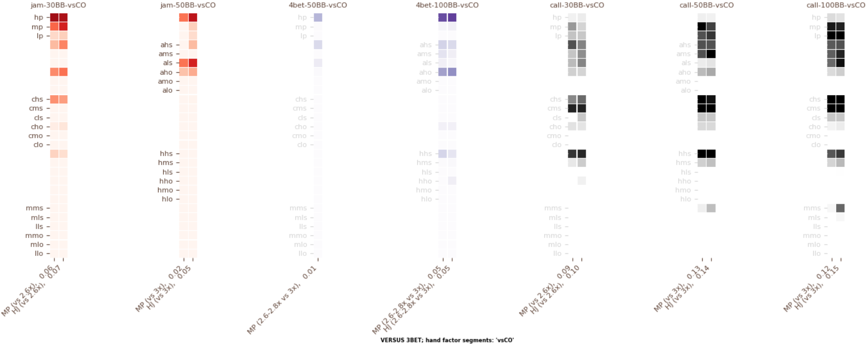

Slide 15
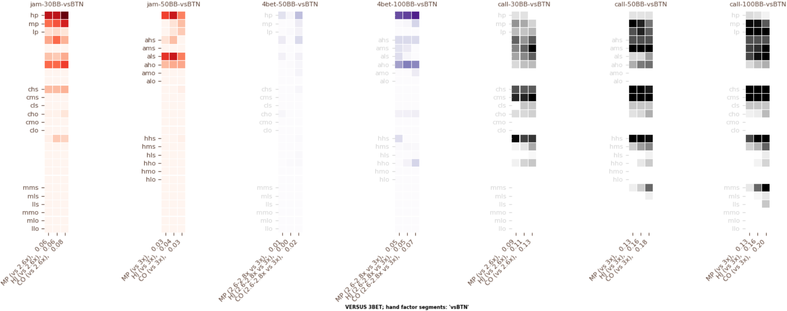

Slide 16
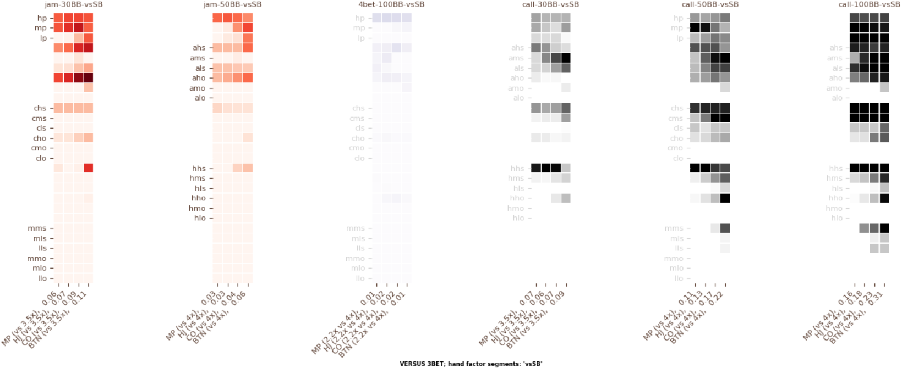

Slide 17
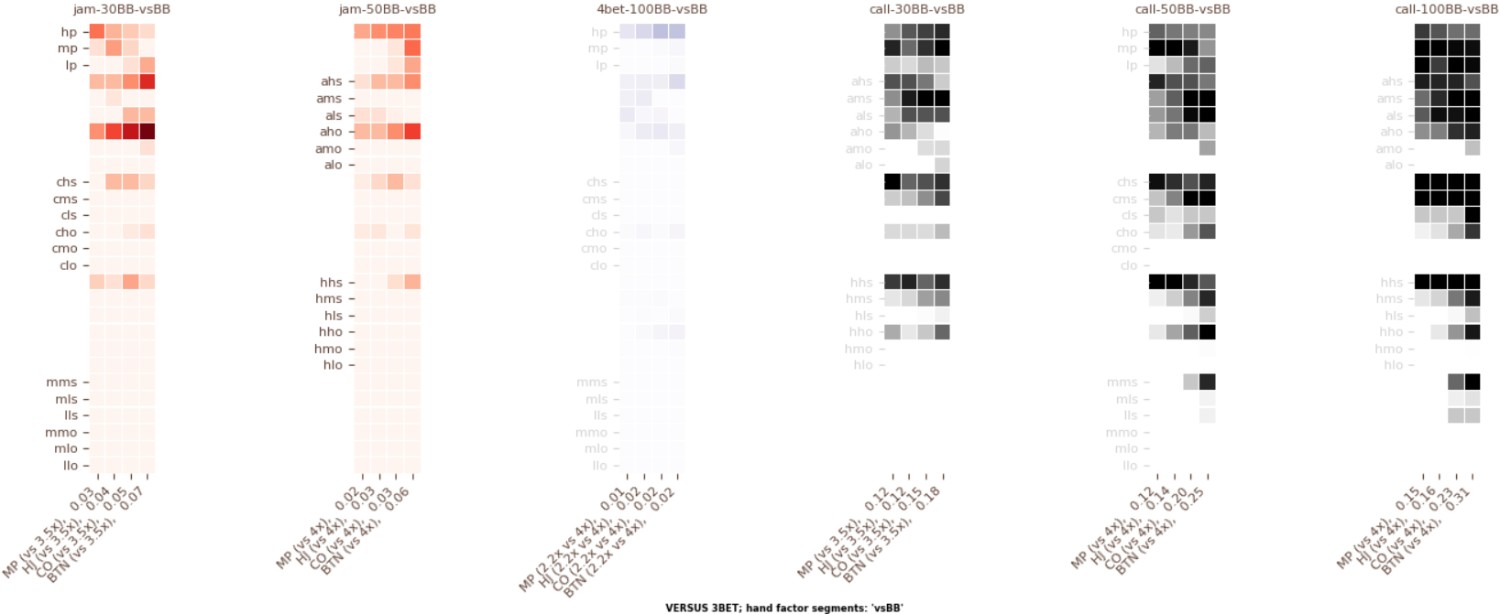

Slide 18
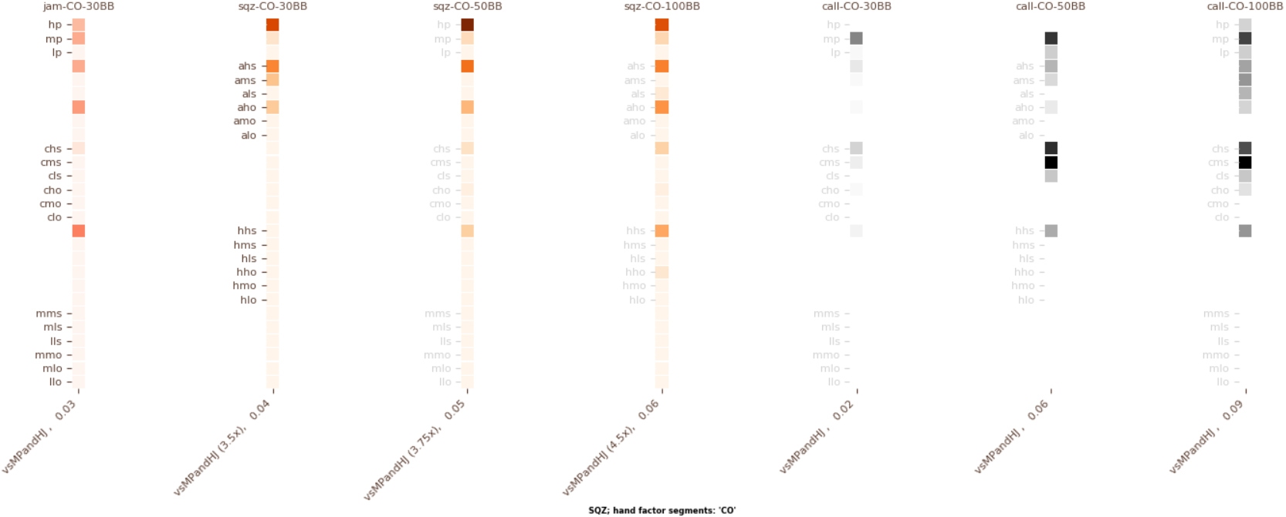

Slide 19
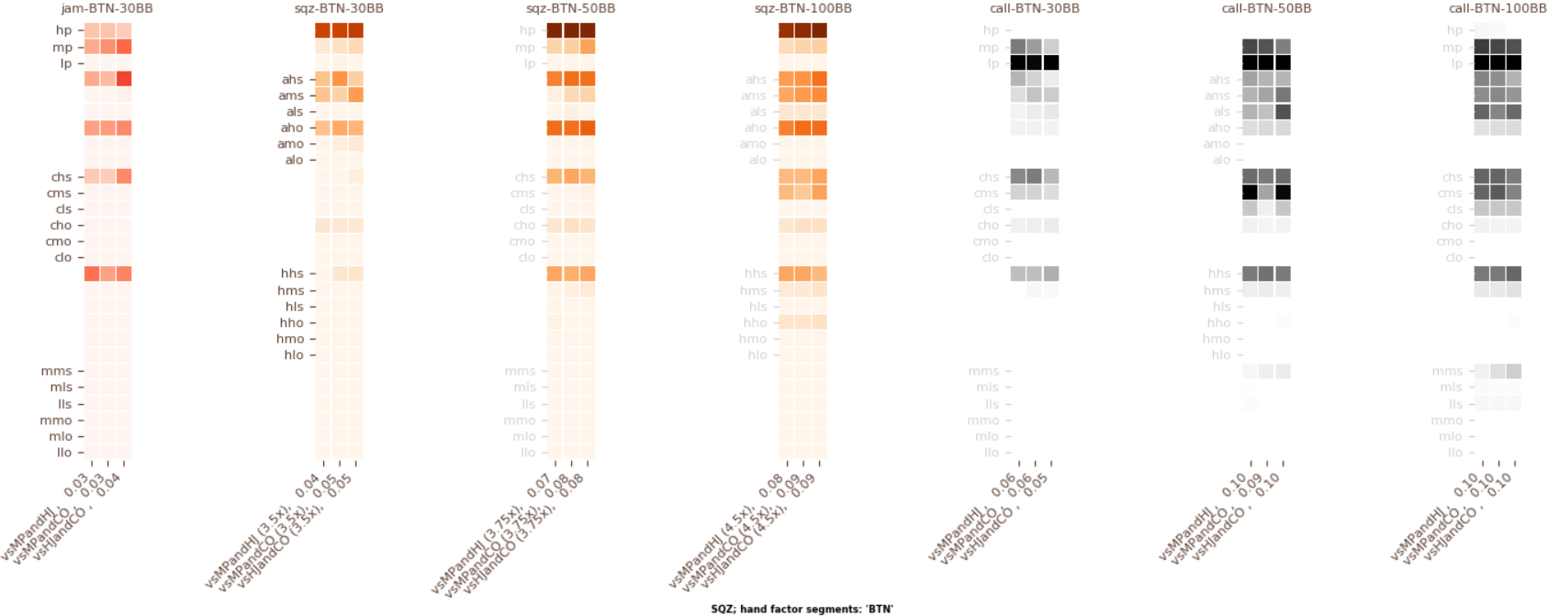

Slide 20
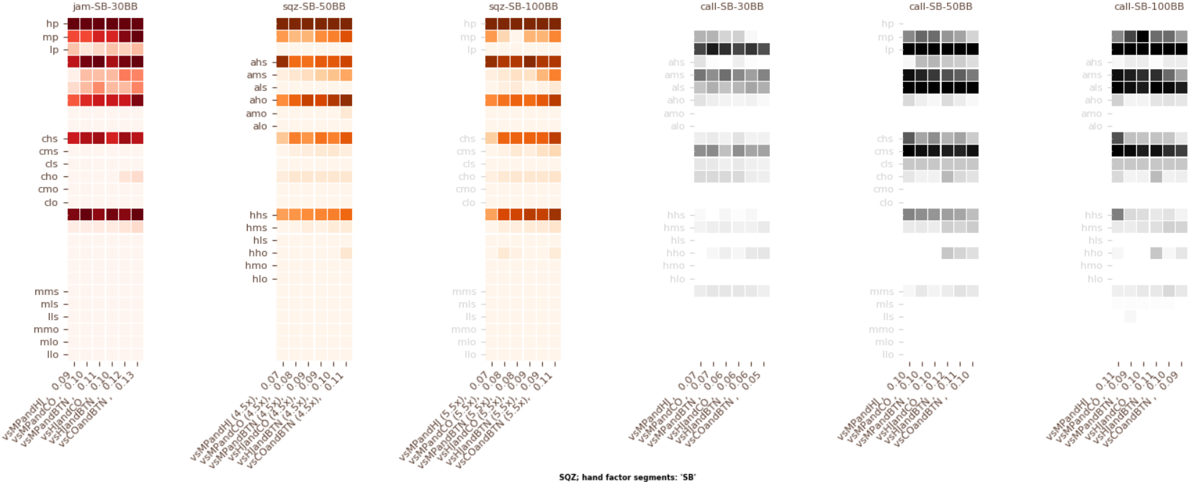

Slide 21
