Slide 1
Market Analysis
Customer purchasing behavior & product performance
SQL analysis + Power BI dashboard
1.05M
orders
63.1K
users
49K
products
Presented by Shaik Jameer
Notes:
Introduce the project: a market-basket style analysis of grocery orders, answered with 20 SQL questions and summarised in a Power BI dashboard.

Slide 2
Objective & data
Goal
Understand how customers shop and which products perform best, to sharpen marketing and improve satisfaction.
Approach
Joined five tables in MySQL to answer 20 business questions, then visualised the key results in Power BI.
1
orders
Order timing: day, hour, days since prior order
2
order_products
Products in each order and whether reordered
3
products
Product name, aisle and department
4
aisles
Aisle names
5
departments
Department names
Market Analysis | 2
Notes:
Five source tables. Orders and order_products carry the behaviour; products, aisles and departments describe the catalogue.

Slide 3
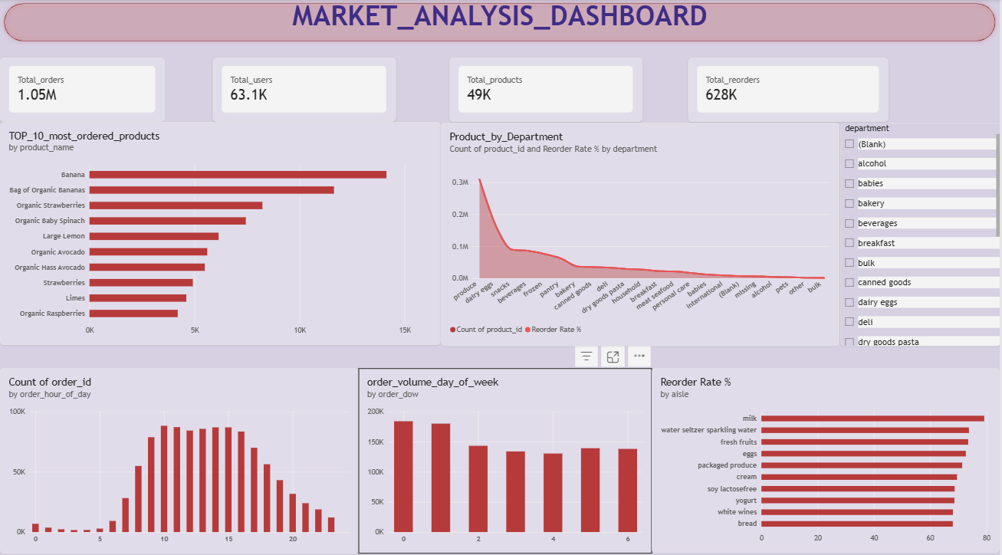
The dashboard at a glance
4
KPI cards
6
charts
1
department slicer
Built in Power BI from the same MySQL data
Market Analysis | 3
Notes:
Walk through the layout: KPIs on top, product and department views in the middle, time and reorder views at the bottom.

Slide 4
Business at a glance
Headline numbers from the dashboard
1.05M
63.1K
49K
628K
Total orders
Total users
Total products
Total reorders
Order records analysed
Unique customers
Items in the catalogue
Items bought again
Reordering is a major share of buying behaviour, so retention matters as much as acquisition.
Market Analysis | 4
Notes:
628K reorders shows customers come back to the same products again and again.

Slide 5
When customers order: hour of day
Orders per hour (approximate values read from the dashboard)
10 AM to 4 PM
sustained peak window
Plateau of roughly 85K to 88K orders per hour
Ramp-up from 7 AM, steady decline after 5 PM
Overnight (12 AM to 5 AM) is the quietest period
Market Analysis | 5
Notes:
Peak ordering runs through the late morning and afternoon. Values are approximate, read from the dashboard chart.

Slide 6
When customers order: day of week
Order volume by day (approximate values read from the dashboard)
Days 0 and 1
busiest, about 180K to 185K orders each
Days 2 to 6 sit between roughly 130K and 145K
That is about 20% to 30% below the two peak days
Plan inventory and promotions around the early-week surge
Market Analysis | 6
Notes:
order_dow is coded 0 to 6. Confirm which weekday is 0 in your data dictionary before presenting (in the public Instacart data 0 is Sunday). Values are approximate, read from the dashboard.

Slide 7
Top 10 most ordered products
Order count (thousands)
10 of 10
are fresh fruit or vegetables
Bananas alone (Banana plus the organic bag) account for the top two spots
6 of the 10 are organic, showing strong demand for organic produce
Market Analysis | 7
Notes:
Every product in the top 10 is fresh produce, and six are organic.

Slide 8
Products ordered by department
Approximate order-line counts (thousands), read from the dashboard
What it shows
Produce is by far the largest department, at roughly 0.3M order lines
Dairy eggs is a clear second
Volume then drops into a long tail: snacks, beverages, frozen, pantry, and smaller departments such as pets and bulk
Market Analysis | 8
Notes:
Values are approximate. The dashboard chart also overlays reorder rate by department as a second series.

Slide 9
Reorder rate by aisle: top 10
Share of items that were reordered (%)
79.23%
of milk items are reorders, the highest aisle
Everyday staples lead: milk, eggs, yogurt, cream, bread
Fresh fruits and packaged produce also rank high
Every aisle in the top 10 is above 68%
Market Analysis | 9
Notes:
Reorder rate is the average of the reordered flag per aisle (SQL question 17).

Slide 10
Recommendations for marketing
Turning the insights into action
1
Time campaigns to demand
2
Lead with produce
Send promotions and push notifications in the late morning, ahead of the 10 AM to 4 PM peak, and reserve overnight hours for off-peak deals.
Feature organic produce and bananas in homepage placements and bundles, since the top 10 products are all fresh items.
3
Make staples effortless
4
Prepare for the early-week surge
Offer subscribe-and-save or one-tap reorder for milk, eggs, yogurt and bread, the aisles customers repurchase most.
Stock and staff for days 0 and 1, and use quieter days for targeted discounts to even out demand.
Market Analysis | 10
Notes:
Each recommendation ties back to a specific chart: hour of day, top products, aisle reorder rate, day of week.

Slide 11
Key takeaways
1
Peak time
Orders concentrate between 10 AM and 4 PM, with days 0 and 1 the busiest.
2
Product mix
Fresh, often organic, produce dominates the top 10 and the largest department.
3
Loyalty
Staples like milk, eggs and yogurt have the highest reorder rates, near or above 70%.
Thank you
Notes:
Close by restating the three insights and inviting questions.

