Slide 1
Overwriting the Exception Handling Cache Pointer - Dwarf Oriented Programming
James Oakley
Electron100 *noSPAM* gmail.com
Rodrigo Rubira Branco (@BSDaemon)
rodrigo *noSPAM* kernelhacking.com
Sergey Bratus (@SergeyBratus)
Sergey *noSPAM* cs.dartmouth.edu

Slide 2
Motivation
Software exploitation is not generic anymore
There are different exploitation primitives in different contexts
A modern exploitation technique shows how to take advantage of those primitives
Targets as written are capable of many more computations that intended. Exploitation is proof of that

Slide 3
This Talk in One Minute
GCC exception handling unwinds stack by running special bytecode in a VM; that VM is inside any GCC-built process runtime
This bytecode is Turing-complete: you can write any program in it
Your non-native binary payload could use it!
Memory leak to set it up + a write primitive (then use our DWARF-only dyn. linker!)

Slide 4
A Bit of Theory
Trustworthiness of a computer system is what the system can and cannot compute
Can the system decide if an input is invalid/unexpected/malicious & reject it?
Will program perform only expected computations, or malicious ones too?
Exploitation is setting up, instantiating, and programming a weird machine
A part of the target is overwhelmed by crafted input and enters an unexpected but manipulable state

Slide 5
Software Exploitation
A part of the target is overwhelmed by crafted input and enters an unexpected but manipulable state
Primitives are exposed
Memory corruption, unexpected control flows, …
From a formal model point of view, primitives supply extra state and/or transitions
A “weird machine” is constructed from primitives
A more powerful, programmable execution environment than intended or expected

Slide 6

Weird Machine is Born!

Slide 7
Exploiting Additional Computations
Finally we are in our talk line…
There are many auxiliary computations inside a process/runtime that can be used to subvert code execution (and some of then have nothing to do with the original code)
This isn’t like ROP, we are borrowing an existing machine fully (but in unexpected way)

Slide 8
*nix Exception Handling
Binaries compiled with GCC and that support exception handling have Dwarf bytecode:
Describe the stack frame layout
Interpreted to unwind the stack after an exception occurs
The process image includes the Dwarf interpreter (part of the GNU C++ runtime)
Bytecode can be written to force the interpreter to perform any computation (Turing-Complete), including, but not limited to, setup a library/system call modifying registers such as stack and base pointers -> See James and Sergey previous work on Dwarf Trojans

Slide 9
James Oakley and Sergey Bratus
Proved that Dwarf can replace code creating a Trojan completely using Dwarf bytecode
Proved that Dwarf is a complete development environment:
Can read memory
Can compute with values from memory/registers
Can influence the flow of execution of a process

Slide 10
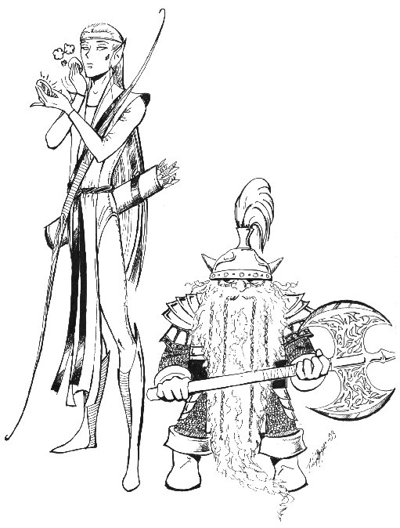
ELF layout of process space

Slide 11

Dwarf
Developed as a debugging format to replace STABS
Standard: http://dwarfstd.org
Provide information such as code line, variable types, backtraces, others
ELF Sections: .debug_info, .debug_line, .debug_frame are defined in the standard
.debug_frame defines how to unwind the stack (how to restore each entry in the previous call frame)

Slide 12
Linux Exception Handling
GCC, the Linux Standards Base and the ABI x86_64 adopted a very similar format used in the .debug_frame to describe the stack unwind during an exception: .eh_frame
It is not exactly the same as dwarf
It adds pointer encoding and language-specific data
As usual, the documentation is not perfect:
Partially discussed in the Linux Standards Base
Partially defined in the ABI
Partially implemented in GCC

Slide 13
.eh_frame
Theoretically it is a table, where for each address in the .text it is describe how to restore the registers to the previous call frame
CFA (Canonical Frame Address) – Address relative to the call frame
Each line defines how each part of the code can return to the previous frame
EIP | CFA | EBP | EBX | EAX | RET
0xf000f000 | rsp+16 | *(cfa-16) |  |  | *(cfa-8)
0xf000f001 | rsp+16 | *(cfa-16) |  |  | *(cfa-8)
0xf000f002 | rbp+16 | *(cfa-16) |  | eax=edi | *(cfa-8)
… | … | … | … | … | …
0xf000f00a | rbp+16 | *(cfa-16) | *(cfa-24) | eax=edi | *(cfa-8)

Slide 14
Size Limitations
Obviously, keep such a table would use more space then the code itself
That’s why the adoption of bytecode: The table is ‘compressed’, providing everything required to create it when needed
Portions of the table are created as needed (on-demand)

Slide 15
.eh_frame
.eh_frame section
.-----------------------.
| CFI | CFI = Call Frame Information
| .---------------. |
| | CIE | | CIE = Common Information Entry
| '---------------’ |
| | FDE | | FDE = Frame Description Entry
| | .-------. | |
| | | *LSDA | | | LSDA = Language Specific Data Area
| | '-------' | |
| '---------------’ |
| | FDE | |
| | .-------. | |
| | | *LSDA | | |
| | '-------' | |
| '---------------' |
| | | |
| | ... | |
| '---------------' |
| | FDE | |
| | .-------. | |
| | | *LSDA | | |
| | '-------' | |
| '---------------' |
'-----------------------’
"The .eh_frame section shall contain 1 or more Call Frame Information (CFI) records. The number of records present shall be determined by size of the section as contained in the section header. Each CFI record contains a Common Information Entry (CIE) record followed by 1 or more Frame Description Entry (FDE) records. Both CIEs and FDEs shall be aligned to an addressing unit sized boundary”
Linux Standard Base Specification 1.3

Slide 16
FDE x CIE
FDE (Frame Description Entry) exists for each logical
Instruction block
CIE (Common Information Entry) holds common
Information between FDEs
INSTRUCTIONS in FDE hold the DWARF bytecode

Slide 17
FDE x CIE
initial_location/address_range:
Defines for which instructions this FDE applies
augmentation:
Language-specific information
return_address_register:
Entry in a virtual table that defines the .text location
to return to (eip)
instructions:
Table rules. Dwarf has a language to describe
the table.

Slide 18
Dwarf Instructions
Works as an assembly language (unexpected computations)
Turing-Complete Stack-Based Machine
Can access memory and register values
Have some limitations:
Cannot write to memory (but we can force out-of-order code execution and obtain writes)
Cannot call native code
Cannot write to registers that are not callee-saved in the ABI (we can write to callee-saved register though)
GCC limits the stack to 64 words

Slide 19
Dwarf Programming
DW_CFA_set_loc N Next instructions apply to the first N bytes of the function
DW_CFA_def_cfa R OFF CFA is calculated starting from register R and offset OFF
DW_CFA_offset R OFF Register R is restored from the value in CFA OFF
DW_CFA_register R1 R2 Register R1 is restored with the contents of R2

Slide 20
And the table is back…
Each architecture register receives a DWARF equivalent (the mapping is architecture specific)
Dwarf Instructions define rules for a column or advances to the next line (program location)
In FDE, lines inherit from instruction lines above them
EIP | CFA | EBP | EBX | EAX | RET
0xf000f000 | rsp+16 | *(cfa-16) |  |  | *(cfa-8)
0xf000f001 | rsp+16 | *(cfa-16) |  |  | *(cfa-8)
0xf000f002 | rbp+16 | *(cfa-16) |  | eax=edi | *(cfa-8)
… | … | … | … | … | …
0xf000f00a | rbp+16 | *(cfa-16) | *(cfa-24) | eax=edi | *(cfa-8)

Slide 21
Dwarf Expressions
To not anticipate all unwinding mechanisms of a system, the standard defines flexibility:
DW_CFA_expression R EXPRESSION
R receives the value from the EXPRESSION result
DW_CFA_val_expression R EXPRESSION
R restored to result of EXPRESSION
Expressions have their own instructions:
Constant Values: DW_OP_constu, DW_OP_const8s, etc
Arithmetic: DW_OP_plus, DW_OP_mul, DW_OP_and, DW_OP_xor, etc
Memory read: DW_OP_deref
Register read: DW_OP_bregx
Flow Control: DW_OP_le, DW_OP_skip, DW_OP_bra, etc

Slide 22
Katana
Emit a dwarfscript
$e=load "demo"
Loaded ELF "demo"
dwarfscript emit ".eh_frame" $e "demo.dws"
Wrote dwarfscript to demo.dws
Dwarfscript assembler
$ehframe=dwarfscript compile "demo.dws"
replace section $e ".eh_frame" $ehframe[0]
Replaced section ".eh_frame"
save $e "demo_rebuilt"
Saved ELF object to "demo_rebuilt"
!chmod +x demo_rebuilt

Slide 23
So what?
With Katana you can see and modify unwind tables in an easy way
Control the unwinding flow (how the call stack is handled)
Avoid an exception handler to execute another one
Redirect exceptions
Find/solve symbols
Calculate relocations

Slide 24
Example
If function foo is responsible for an exception
Change flow to function bar
Thru static analysis, we see that bar is at 0x600DF00D
In the FDE, we change:
DW_CFA_offset r16 1
To:
DW_CFA_val_expression r16
begin EXPRESSION
DW_OP_constu 0x600DF00D
dnd EXPRESSION

Slide 25
.gcc_except_table
So far, redirected only to ‘catch’ blocks
The .gcc_except_table hold language-specific data (where the exception handlers are)
Interpreted by the personality routines
We can stop an exception at any time
Unlike the .eh_frame, do not have standards
There is no documentation, so let’s see the code ;)

Slide 26
Assembly
While compiling a program using GCC, do:
--save-temps –fverbose-asm –dA
.section .gcc_except_table,"a",@progbits
.align 4
.LLSDA963:
.byte 0xff # @LPStart format (omit) .byte 0x3 # @TType format (udata4) .uleb128.LLSDATT963−.LLSDATTD963 # @TType base offset
.LLSDATTD963: .byte 0x1 # call−site format (uleb128) .uleb128 .LLSDACSE963−.LLSDACSB963 # Call−site table length
.LLSDACSB963: .uleb128 .LEHB0−.LFB963 # region 0 start .uleb128 .LEHE0−.LEHB0 # length .uleb128 .L6−.LFB963 # landing pad .uleb128 0x1 # action .uleb128 .LEHB1−.LFB963 # region 1 start .uleb128 .LEHE1−.LEHB1 # length .uleb128 0x0 # landing pad .uleb128 0x0 # action .uleb128 .LEHB2−.LFB963 # region 2 start .uleb128 .LEHE2−.LEHB2 # length .uleb128 .L7−.LFB963 # landing pad .uleb128 0x0 # action
.LLSDACSE963: .byte 0x1 # Action record table .byte 0x0 .align 4 .long _ZTIi

Slide 27
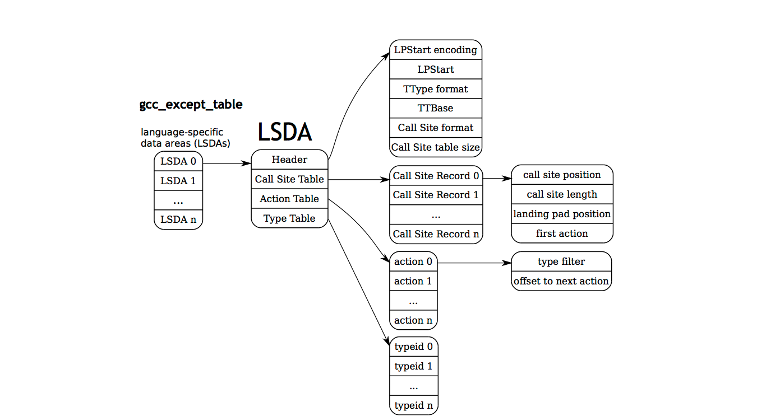
Layout

Slide 28
Exception Handling Flow

Slide 29
Exceptions are not asynchronous
Functions that call throw() just call:
__cxa_allocate_exception() -> To allocate space using malloc (or buffers in the .bss if malloc fails – gcc-xxx/libstd++v3/libsupc++/eh_alloc.:84)
And then __cxa_throw() -> That will go thru the frames until a handler for the exception is found

Slide 30
Proving (assembly)
Dump of assembler code for function main:
...
<+9>: mov $0x4,%edi # std::size_t thrown_size
# Allocates a new "__cxa_refcounted_exception" followed by 4 bytes; we
# do a "throw(1)", 1 being an "int" occupies 4 bytes.
<+14>: callq 0x400930 <__cxa_allocate_exception@plt>
...
<+25>: mov $0x0,%edx # void (*dest) (void *)
<+30>: mov $0x6013c0,%esi # std::type_info *tinfo
<+35>: mov %rax,%rdi # void *obj
<+38>: callq 0x400940 <__cxa_throw@plt>

Slide 31
__cxa_allocate_exception()
Returns a pointer to a
struct __cxa_refcounted_exception, which helds a reference to an object __cxa_exception
__cxa_throw() is then executed to:
Initialize the current context (register values)
Iterate in the stack until it finds the exception handler

Slide 32
What We've Shown Before
Ret-into-libc
Used the dynamic-linker already in Dwarf to find execvpe
Used Dwarf to prepare the stack
In less than 200 bytes and less than 20 words in the stack (showing that a 64-stack word limitation is not an obstacle)
Started in an offset of execvpe where they can control the Dwarf registers (and not in the function beginning)

Slide 33
What else can be done?
Old GCC had both, the .eh_frame and the .gcc_except_table as +W
Well…
Libgcc/libstdc++ need to find those areas in memory, right?
The program header, GNU_EH_FRAME contains the .eh_frame location (dl_iterate_phdr is the function that finds it)
Libgcc caches the value!

Slide 34
Fake EH
If we can overwrite the cached value, we are able to control the exceptions and leverage everything already explained
Libgcc does not export symbols, so we need to find an heuristic/reverse to find what to overwrite

Slide 35
Caching
The pointer caching is done in: unwind-dw2-fde-glibc.c:
#define FRAME_HDR_CACHE_SIZE 8
...
static struct frame_hdr_cache_element
{
_Unwind_Ptr pc_low;
_Unwind_Ptr pc_high;
_Unwind_Ptr load_base;
const ElfW(Phdr) *p_eh_frame_hdr;
const ElfW(Phdr) *p_dynamic;
struct frame_hdr_cache_element *link;
} frame_hdr_cache[FRAME_HDR_CACHE_SIZE];

Slide 36
Caching
8 cache entries for the frame header
Uses a Least Used Replacement Algorithm (_Unwind_IteratePhdr_Callback())
Most recently used is the head of the list
In the test environment, the frame_hdr_cache was at 0x6e0 bytes from the offset of the writable data segment of libgcc
This is the aforementioned array, with 48 bytes in size
The executable itself is the 3rd element of the array (the first two are the libgcc and libstdc++)
The offset for the writable data segment of libgcc can be found in this way (based in what we know):
0x6e0+48*2=0x740
The entry p_eh_frame_hdr that we want to overwrite is at 24 bytes of this structure.

Slide 37
Exploiting
To simplify the exploitation, it is interesting to align the structures in known offsets/controlled offsets:
.eh_frame in the example aligned to start exactly at 0x50 bytes from the start of the .eh_frame_hdr
.gcc_except_table aligned to start exactly at 0x200 bytes from the start of the .eh_frame

Slide 38
Memleak
We need the value of EBP, so we going to use a memleak. It can be achieved in different ways, depending on the target program (e.g.: overwriting parameters to printf-like functions, or if the vulnerability is a format string, which is our sample case)
To calculate the EBP_PREVIOUS we use %llx (format string), so we use 4 bytes of space in the buffer and advance the stack pointer in 8 bytes (so the premise for exploiting the sample program is to manage to leak the EBP):
...
#to get the value of ebp_previous
instr=r"%llx%llx%llx%llx%llx%llx%llx%llx%llx%llx%llx%llx%llx%llx%llx%llx%llx%llx%llx%llx%llx%llx%llx%llx%llx%llx%x%x"
proc.sendline(instr)
proc.expect("unknown command: [0-9a-f]* ([0-9a-f]*).*")
ebp_previous=int(proc.match.group(1),16)
info("\nfound ebp_previous = 0x%x" % ebp_previous)

Slide 39
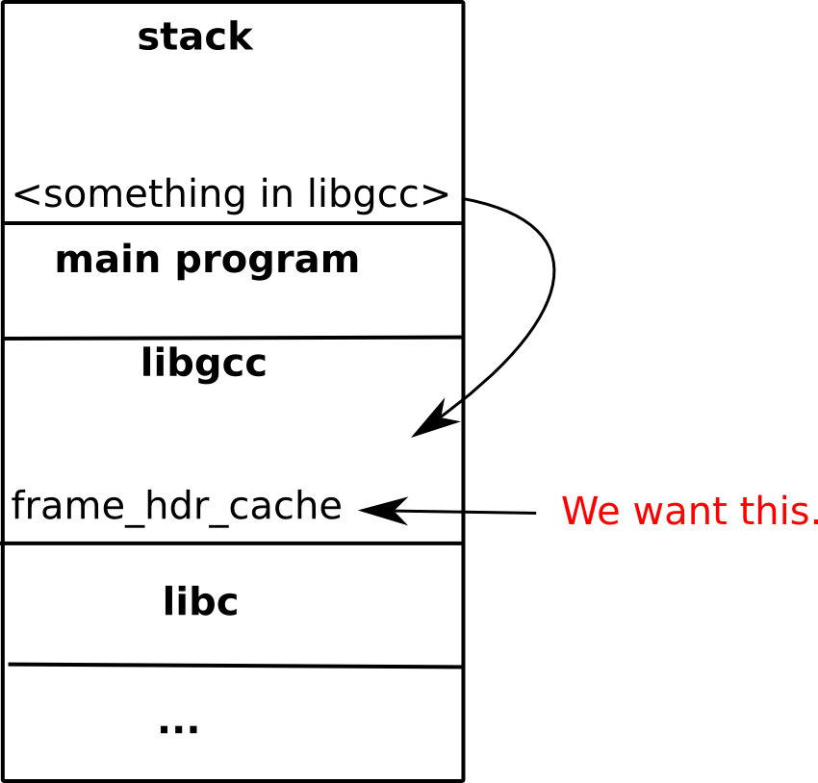
Memleak

Slide 40
Heuristics
We know the size of the previous frame (disassembling), so we are capable of calculate the EBP of our frame:
ebp=ebp_previous-PREV_FRAME_SIZE
With our frame address, we can calculate the address of libgcc, since we know the offsets:
libgcc_reveal_location=ebp-LIBGCC_REVEAL_EBP_OFFSET;

Slide 41
More Heuristics
The value that reveals the .text location of the libgcc is at 0xffffc798 (discovered in the previous slide), and it is 0x679 above ESP and 0x750 above EBP
The libgcc base is calculated using the previously revealed address and masking the 3 low nibbles. We also use a fixed value to adjust the result (found thru disassembly):
libgcc_base=(libgcc_revealed & 0xFFFFF000) - LIBGCC_REVEAL_ADJUST
The separation between .text and .data segments in libgcc is 0x19000 (x86):
libgcc_data_base=libgcc_base+LIBGCC_DATA_OFFSET

Slide 42
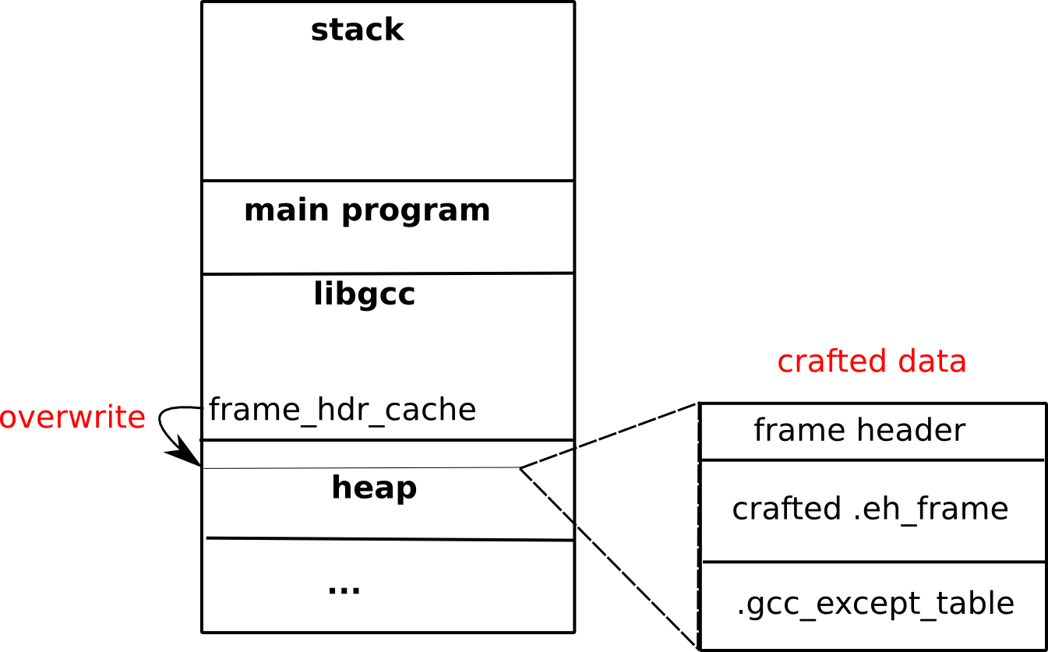
Overwriting the Frame Header Cache

Slide 43
Finalizing
Finally, we find the frame_hdr_cache and the respective p_eh_frame_hdr from the libgcc_data_base, as previously described:
frame_hdr_cache=libgcc_data_base+CACHE_LIBGCC_OFFSET
p_eh_frame_hdr=frame_hdr_cache+CACHE_ENTRY_SIZE*PREVIOUS_CACHE_ENTRIES+OFFSET_IN_CACHE_ENTRY

Slide 44
In the demo case
The Dwarf payload is injected in the dictionary been readed by the target program (instead of using a shellcode). We find the pointers, overwrite the caching target address and the desired catch block is executed.
With all the values, we redirect the execution:
Function doWork throws an exception
We redirect it to I_am_never_called

Slide 45
Other possibilities
If you have a Write N you can overwrite the .eh_frame entirely (if it is +W, what is not normal in new systems)
You can overwrite the .eh_frame using a shellcode
You can use a stagered ret-into-lib to remap the .eh_frame as +W and then overwrite it

Slide 46
THE END! Really!? http://katana.nongnu.org https://github.com/rrbranco/defcon2012
James Oakley (Electron)
Electron100 *noSPAM* gmail.com
Rodrigo Rubira Branco (@BSDaemon)
rodrigo *noSPAM* kernelhacking.com
Sergey Bratus (Sbratus)
Sergey *noSPAM* cs.dartmouth.edu

