Slide 1
Exploring INTEL SGX
Praveen Keshava Murthy
Aboobacker Rizwan

Slide 2
Motivation
Creating an app and hosting it in the cloud platform involves many levels of trust
Operating System, cloud provider, other applications in the cloud.
Provides a huge attack surface with potential bad code for adversaries.
Secure remote computation is an unsolved problem
Hardware support reduces this trust level
Need to trust only the processor which substantially reduces the attack surface.
Intel SGX preserve the confidentiality and integrity of sensitive code and data
By creating isolated enclaves

Slide 3
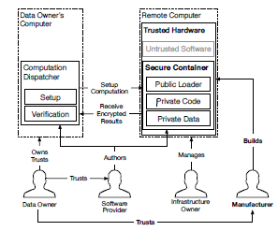
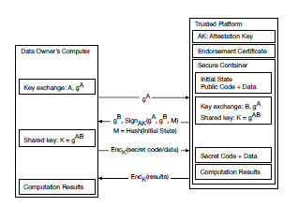
Intel SGX

Slide 4
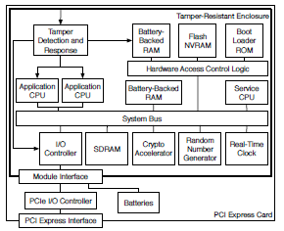
Previous Work related to Trusted Execution Environment
The IBM 4765 Secure Coprocessor
The IBM 4765 secure coprocessor consists of an entire
computer system placed inside an enclosure that can deter and detect
physical attacks.

Slide 5
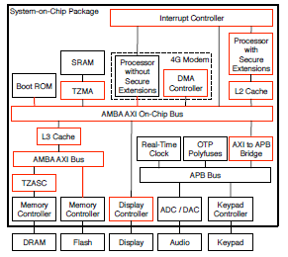
Previous Work related to Trusted Execution Environment
ARM TrustZone
Smartphone SoC design based on TrustZone. The
red IP blocks are TrustZone-aware.

Slide 6
Previous Work related to Trusted Execution Environment
The XOM Architecture
Introduced DRAM encryption, container execution, HMAC functionality
No Paging support. Not tolerant to hardware exceptions like page fault
The Trusted Platform Module ( TPM )
Introduced Software Attestation Model with attestation key stored in tamper resistant chip - Static Root of Trust for Measurements ( SRTM )
TPM Measured Boot Feature and TPM Verified Boot feature.
Intel’s Trusted Execution Technology ( TXT )
TXT requires a TPM chip with an extended register to store SRTM
When a TXT VM is initialized, it updates TPM registers that make up the Dynamic Root of Trust Measurement (DRTM)
Vulnerable to physical DRAM attacks as no DRAM encryption
Aegis Secure Processor
Bastian Architecture

Slide 7
Intel SGX in Context
No modifications to the processor’s critical execution path.
SGX’s TCB consists of the CPU’s microcode and a few privileged containers.
SGX always flushes TLB’s during context switch between trusted and untrusted software
SGX uses Bastion Architecture approach of maintaining inverted page map to reject address translations for memory that does not belong to the current container.
SGX guarantees DRAM privacy, authentication, and freshness by virtue of a Memory Encryption Engine (MEE)
SGX’s microcode ensures the privacy, authenticity, and freshness of each container’s evicted pages using version-based Merkle tree.
SGX’s software attestation is implemented using Intel’s Enhanced Privacy ID (EPID) group signature scheme.

Slide 8
Project Proposal Plan
Explore Intel SGX Architecture
Familiarize Intel SGX programming
Design and Develop a sample simple e-voting client – server application with server running on Intel SGX.
Explore the SDK Support.
Perform remote attestation
Find the limitations of Intel SGX during the implementation
Compare the performance with a normal application

