Slide 1
High Performance Fuzzing
Richard Johnson | Offensive Summit 2015

Slide 2
Introduction
Whoami
Richard Johnson / @richinseattle
Research Manager, Vulnerability Development
Cisco, Talos Security Intelligence and Research Group
Agenda
Why Performance Matters
Targeting & Input Selection
Engine Design
Host Configuration
Notes:
Talk a little bit about what Talos does
Mention previous talks
Breakdown the agenda
<number>

Slide 3
Why Performance Matters
Notes:
Last two years worked on engines and distributed cluster fuzzing management system
We are moving tools from prototype designs into deployable production software
<number>

Slide 4
Why Performance Matters
Mutational fuzzing almost seems too easy
Just throw some hardware at the problem
Majority of CPU cycles are wasted
Program load time vs file parsing time
Fuzzing requires high I/O, blocking CPU
Mutations on large files are inefficient
Quantitatively analyze fuzzer designs
Qualitatively analyze fuzzer strategies
Notes:
Talk about traditionally structured fuzzing, argv fuzzing, or whole applicatin mutation fuzzing
Talk about more people in the game == higher compeition
Talk about maximizing use of resources
Fuzzing for known bugs quickly so we can build coverage into our products
<number>

Slide 5
Microsoft SDL Verification Guidance
Fuzzing is a requirement of SDLC Verification:
“Where input to file parsing code could have crossed a trust boundary, file fuzzing must be performed on that code. All issues must be fixed as described in the Security Development Lifecycle (SDL) Bug Bar. Each file parser is required to be fuzzed using a recommended tool.”
https://msdn.microsoft.com/en-us/library/windows/desktop/cc307418.asp
Notes:
Fuzzing is also now built in as a requirement in many company’s SDLC
<number>

Slide 6
Microsoft SDL Verification Guidance
Fuzzing is a requirement of SDL Verification:
“Win32/64/Mac: An Optimized set of templates must be used. Template optimization is based on the maximum amount of code coverage of the parser with the minimum number of templates. Optimized templates have been shown to double fuzzing effectiveness in studies. A minimum of 500,000 iterations, and have fuzzed at least 250,000 iterations since the last bug found/fixed that meets the SDL Bug Bar”
https://msdn.microsoft.com/en-us/library/windows/desktop/cc307418.asp
Notes:
Guidance is minimal but it’s a start
<number>

Slide 7
Microsoft SDL Verification Guidance
Required fuzzing is a good thing
How did they calibrate?
Iterations limited by practical resources
Parsers with greater complexity require more resources
Iterations is a poor choice for defining guidance
What properties define the theoretical limit of available resources
What are the best practices for fuzzing to optimize our effectiveness
Notes:
Questions I wanted to answer are last two bullets
<number>

Slide 8
Historical Performance Stats
Microsoft Windows Vista 2006
350mil iterations, 250+ file parsers
~1.4mil iterations per parser (on average)
300+ issues fixed (1 bug / 1.16 million tests)
Microsoft Office 2010
800 million iterations, 400 file parsers
1800 bugs fixed (1 bug / 44444 tests)
http://blogs.technet.com/b/office2010/archive/2010/05/11/how-the-sdl-helped-improve-security-in-office-2010.aspx
Charlie Miller 2010
7mil iterations, 4 parsers
~1.8m iterations per parser (on average)
320 - 470 unique crashes (1 bug / 14893 - 21875 tests)
Notes:
Some perspective on numbers, data is not clear, numbers are approximate
Charlie – CSW – army of monkeys
FIXME -
how many vulns from charlie?
This slide and next slide need work
15 month campaign vs vista
3 mo for charlie
30-40 reader 230-280 preview
30-70 impress 30-80 powerpoint
320 - 470
<number>

Slide 9
Historical Performance Stats (cmiller)
Charlie Miller intentionally went with a poor design
5-lines of python to mutate input
AppleScript to iterate files with system handler
Microsoft minifuzz is equally stupid
Input Selection
80,000 PDFs reduced to 1515 via code coverage minset
Input | Software | Count | avg time
PDF | Adobe Reader 9.2.0 | 3M | 5.35s
PDF | Apple Preview (OS X 10.6.1) | 2.8M | 7.68s
PPT | OpenOffice Impress 3.3.1 | 610k | 32s+
PPT | MSOffice PowerPoint 2008 Mac | 595k | 32s
Notes:
Public example of a fuzzing campaign
We will talk more about input selection later
Targeting limited to main executable, execution time is abysmal
Interesting his fuzzing was more efficient with a dumb fuzzer
<number>

Slide 10
Targeting and Input Selection
Notes:
We’ve seen historic fuzzing campaigns have reached ~2-3 million tests and
<number>

Slide 11
Target Selection
64-bit vs 32-bit applications (x86 architecture)
64-bit binaries are fatter than 32-bit
64-bit runtime memory usage is greater than 32-bit
64-bit OSs take more memory and disk for your VMs
Some software only comes compiled as 32-bit binaries
Some fuzzers and debuggers only support 32-bit
64-bit CPUs have more registers to increase performance
Optimization depends on compiler
Notes:
Merge or delete this slide and next slide

Slide 12
Target Selection
So are 64-bit programs faster?
On x64? It varies either way to a small degree
Chrome - Negligible
http://www.7tutorials.com/google-chrome-64-bit-it-better-32-bit-version
Photoshop - YES?
8-12% (but talks about unrelated disk i/o optimizations)
https://helpx.adobe.com/photoshop/kb/64-bit-os-benefits-limitations.html
On SPARC? NO
True story, but who cares
http://www.osnews.com/story/5768/Are_64-bit_Binaries_Really_Slower_than_32-bit_Binaries_/page3/
Notes:
We’re going to call this one a wash
<number>

Slide 13
Target Selection
Much more important: Minimize lines of code
What is the ratio of time spent initializing program and executing actual parser code
Optimization strategy
Target libraries directly
Write thin wrappers for each API
This allows feature targeting
Patch target to eliminate costly checksums / compression
This is what flayer is all about (Drewery & Ormandy WOOT'07)
Instrument target for in-memory fuzzing
Notes:
Beginning to sound like unit testing but this pays off in bugs
<number>

Slide 14
Input Selection
Input is a numerical set
Input parsers are (should be) state machines
Specifications described using FSM
Actual parser code typically not implemented using FSM
LangSec Paper on high performance FSM Parsers
http://www.cs.dartmouth.edu/~pete/pubs/LangSec-2014-fsm-parsers.pdf
Goal: search space and discover new transitions
Each search is computationally expensive
We need to optimize for time
Notes:
Fuzzing == Search problem
Dj bernstein
FSM was DNS protocol
<number>

Slide 15
Input Selection
Optimize input selection
File size is very important
Mutations are more meaningful with smaller input size
Smaller inputs are read and parsed quicker
Some test generation approaches utilize large amounts of memory per-input-byte
Specific feature set per input allows for focused targeting
Handcrafted or minimized samples
Feedback fuzzing or concolic testing automates creation of unique small inputs with different features

Slide 16
Input Selection
CMU Coverset
Optimizing Seed Selection for Fuzzing – USENIX 2014
https://www.usenix.org/system/files/conference/usenixsecurity14/sec14-paper-rebert.pdf
Minset helps less than expected
Unweighted Minset is the winner
Conclusion: Minset is good when it’s not broken
Peach minset tool is not minimal set algorithm
Peach minset performs equivalent to random selection
We will talk more about coverage tracer perf in a bit..
Notes:
Tried optimizing for time, size, random, hot set (# of bugs per seed), etc
Focus on coverset results, drop comments related to peach / charlie?
<number>

Slide 17
Engine Design

Slide 18
Engine Design
Generate new inputs
Execute target with new input
Detect failure conditions

Slide 19
Engine Design
Generate new inputs
Execute target with new input
Trace target execution
Monitor trace output
Detect failure conditions
Detect non-failure conditions

Slide 20
Input Generation
Most important is the selection of mutators
AFL
Deterministic bitflip
1, 2, 4, 8, 16, 32 bits
Deterministic addition/subtraction
Values { 1 – 35 } for each byte, short, word, dword
Little endian and big endian
Deterministic 'interesting' constant values
27 boundary values
Dictionary keywords
Havoc
Random bitflips, arithmetic, block move/copy, truncate
Splice
Merge two previously generated inputs

Slide 21
Input Generation
Most important is the selection of mutators
Radamsa
ab: enhance silly issues in ASCII string data handling
bd: drop a byte
bf: flip one bit
bi: insert a random byte
br: repeat a byte
bp: permute some bytes
bei: increment a byte by one
bed: decrement a byte by one
ber: swap a byte with a random one
sr: repeat a sequence of bytes
sd: delete a sequence of bytes
ld: delete a line

Slide 22
Input Generation
Most important is the selection of mutators
Radamsa
lds: delete many lines
lr2: duplicate a line
li: copy a line closeby
lr: repeat a line
ls: swap two lines
lp: swap order of lines
lis: insert a line from elsewhere
lrs: replace a line with one from elsewhere
td: delete a node
tr2: duplicate a node
ts1: swap one node with another one
ts2: swap two nodes pairwise

Slide 23
Input Generation
Most important is the selection of mutators
Radamsa
tr: repeat a path of the parse tree
uw: try to make a code point too wide
ui: insert funny unicode
num: try to modify a textual number
xp: try to parse XML and mutate it
ft: jump to a similar position in block
fn: likely clone data between similar positions
fo: fuse previously seen data elsewhere
Mutation patterns (-p)
od: Mutate once
nd: Mutate possibly many times
bu: Make several mutations closeby once
Notes:
Notice that there isnt any binary mutators like there used to be
Automata, n-gram, compression
<number>

Slide 24
Input Generation
Deterministic mutators first
Permutations and infinite random mode
Stack permutations to a reasonable level
Need feedback loop to assess effectiveness of new mutators

Slide 25
Execute Target
Using an execution loop is slow
process creation, linking, initialization
Use a fork() server
Skip initialization
Copy-on-write process cloning is very fast on Linux
Windows and OSX manually copy process memory
30x+ performance hit over COW pages
Notes:
RtlCloneUserProcess vs RtlCreateProcessReflection (procdump –r)
Windows only does COW on mapped files by default
<number>

Slide 26
Execute Target
Windows black magic SUA posix fork() tangent
ZwCreateProcess (NULL, …) – Windows 2000
No sections, threads, CSRSS, User32, etc
RtlCloneUserProcess – Windows Vista
Works to limited extent
Applications cannot use Win32 API
RtlCreateProcessReflection - Windows 7
Designed for quick full memory dump creation
Does not restore threads
Windows 10 fork...
Notes:
Services for Unix / Interix
NULL section handle
RtlCloneUserProcess vs RtlCreateProcessReflection (procdump –r)
Currently in research phase, cygwin guys still don’t have it working reliably
<number>

Slide 27
Execute Target
Are you forking kidding me??
linux
10000 fork()
0.763s → 13106 exec/sec
10000 fork/exec(/bin/false)
2.761s → 3621 exec/sec
10000 fork/exec(/bin/false) w/ taskset
2.073s → 4823 exec/sec
cygwin
10000 fork()
29.954s → 333 exec/sec
10000 fork/exec(/bin/false)
63.898s → 156 exec/sec
RtlCloneUserProcess (older hardware)
10000 fork()
17.457s → 574 exec/sec
ZwCreateUserProcess
...
Notes:
Services for Unix / Interix
NULL section handle
RtlCloneUserProcess vs RtlCreateProcessReflection (procdump –r)
Currently in research phase, cygwin guys still don’t have it working reliably
msys
10000 fork()
74.952s → 135 exec/sec
All tests done on Intel i7-5600U CPU @ 2.60GHz
<number>

Slide 28
A Forking Demo

Slide 29
Trace Target Execution
Feedback loop fuzzing finally realized with AFL
Allows qualitative assessment of fuzzing strategy
Optimized instrumentation strategy
Optimized feedback signal
Source code only**
Previous attempts at binary feedback were too slow
EFS was overly complicated and used PaiMei
BCCF uses COSEINC code coverage Pintool
Honggfuzz uses BTS
Notes:
hooking memcmp / strcmp in experiments_readme and flayer notes
does it use an IR?
higher level api abstractions are slow
<number>

Slide 30
Trace Target Execution
Hooking engine selection is critical
Pin / DynamoRIO are slow
**** ~5-10x slowdown on block coverage
Can benefit from fork server
TurboTrace:
1. Fork self in LD_PRELOADed library.
2. Ptrace the forked child.
3. Break on _start
4. Inject a call to the actual function that will be doing repeated fork()ing.
5. Step over a call.
6. Repair the _start and resume execution.
Notes:
PIN – pldi05 paper
<number>

Slide 31
TurboTracer Demo

Slide 32
Trace Target Execution
Hooking engine selection is critical
TurboTrace performance, 100 iterations
20 – 50% speed increase
First test (without pintool, just instrumentation):
Pin without pintool on test_png : 55.03 seconds
Turbotrace without pintool on test_png : 37.24 seconds
Second test (bblocks pintool):
Pin bblocks pintool on test_png : 72.62 seconds
Turbotrace bblocks pintool on test_png : 51.07 seconds
Second test (calltrace pintool):
Pin calltrace pintool on test_png : 106.19 seconds
Turbotrace calltrace pintool on test_png : 85.24 seconds
Notes:
PIN – pldi05 paper
turbotrace took 560.14 seconds to execute 1000 iterations over crackme with concolicexecution pintool.
pin-in-a-loop took 1371.32 seconds to do the same 1000 iterations.
<number>

Slide 33
Trace Target Execution
Hooking engine selection is critical
QEMU
Uses QEMU userland block tracing
Statically compiled binaries
Linux only
Readpng: ~860 ex/s vs ~3800 afl-gcc – 4.5x slower
DynInst
Static binary rewriting
Dynamically compiled binaries
Linux only for now (windows port in progress)
Readpng: ~2400 ex/s vs ~3300 afl-gcc – 1.3x slower
Notes:
PIN – pldi05 paper
Dyninst inlining vs callbacks
<number>

Slide 34
AFL-DYNINST DEMO

Slide 35
But wait there's more! Ruxcon Special Demo

Slide 36
Monitor Trace Output
Logging is critical, tracers perform way too much I/O
Only store enough for feedback signal
Block coverage is weak, edge transitions are better
Use shared memory
cur_location = (block_address >> 4) ^ (block_address << 8);
shared_mem[cur_location ^ prev_location]++;
prev_location = cur_location >> 1;

Slide 37
Detect Failure / Non-Failure
Failure
Linux
#define WTERMSIG(status) ((status) & 0x7f)
Windows
Debugger is the only option
Non-Failure
Timeout
Self calibrate
Lowest possible timeout,
CPU Usage
If CPU utilization drops to near zero for X millisec

Slide 38
Host Configuration

Slide 39
System Cache
Windows
Pre-Windows 7 used only 8 MB memory for filesystem cache
HKEY_LOCAL_MACHINE\SYSTEM\CurrentControlSet\Control\Session Manager\Memory Management
Set value LargeSystemCache = 1
Enable disk write caching in disk properties

Slide 40
System Cache
Linux
Enables large system cache by default
/sbin/hdparm -W 1 /dev/hda 1 Enable write caching
$ sysctl -a | grep dirty
vm.dirty_background_ratio = 10
vm.dirty_background_bytes = 0
vm.dirty_ratio = 20
vm.dirty_bytes = 0
vm.dirty_writeback_centisecs = 500
vm.dirty_expire_centisecs = 3000

Slide 41
Storage: HDD
~100 MB/s
Cache commonly used programs proactively
Windows Superfetch (default)
Linux Preload
http://techthrob.com/tech/preload_files/graph.png
Features are most useful in low memory availability scenarios
Typical for fuzzing w/ 1-2gb memory per VM

Slide 42
Storage: HDD
Use a solid state USB drive for cache
Benefit is low latency, not high bandwidth
Windows ReadyBoost (available by default)
Random access is 10x faster on flash than hdd
http://www.7tutorials.com/files/img/readyboost_performance/readyboost_performance14.png
If you aren't already using a device for caching, and the new device is between 256MB and 32GB in size, has a transfer rate of 2.5MB/s or higher for random 4KB reads, and has a transfer rate of 1.75MB/s or higher for random 512KB write
https://technet.microsoft.com/en-us/magazine/2007.03.vistakernel.aspx
Linux >3.10 bache / zfs l2arc
12.2K random io/sec -> 18.5K/sec with bcache, 50% increase
http://bcache.evilpiepirate.org/

Slide 43
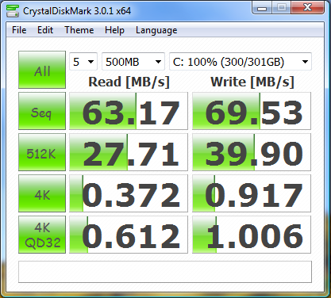
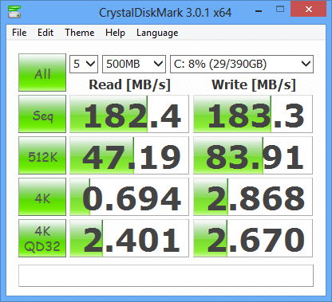
Host Configuration
Standard HDD
Raid 0

Slide 44
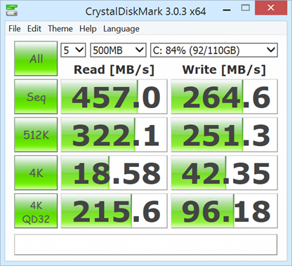
Storage: SSD
Major performance gains over HDD
Raid 0
SSD

Slide 45
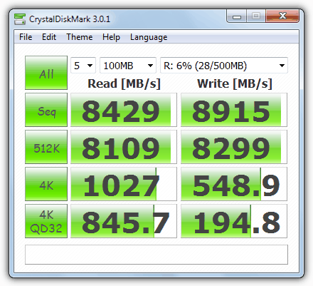
Storage: Ram Disk
Much faster than SSD, eliminates fragmentation
http://superuser.com/questions/686378/can-ssd-raid-be-faster-than-ramdisk (10GB/s - 17GB/s)
Linux - built in
ramfs or tmpfs
Windows - 3rd party
High amount of variance
https://www.raymond.cc/blog/12-ram-disk-software-benchmarked-for-fastest-read-and-write-speed/
SoftPerfect RamDisk is winner for free software
https://www.softperfect.com/products/ramdisk/
Notes:
Ramfs == same as cache, unable to limit size
Tmpfs is backed by swap
Windows solutions vary wildly on random read/write.. As low as 89/150 mb/s, stil lbetter than .7 or 1mb/sec
<number>

Slide 46
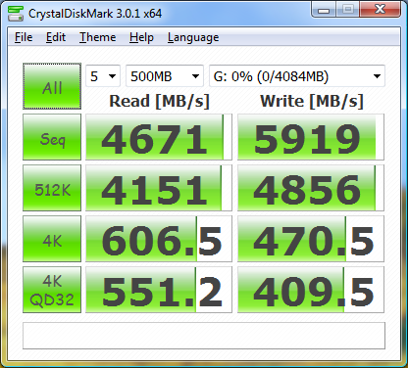
Host Configuration
SSD
Ramdisk

Slide 47
Memory
32-bit memory limits
Linux - built in to PAE kernels
Windows
Limited based on SKU of your OS
Driver compatibility is the claimed reasoning
http://blogs.technet.com/b/markrussinovich/archive/2008/07/21/3092070.aspx
kernel patching required
http://www.geoffchappell.com/notes/windows/license/memory.htm
http://news.saferbytes.it/analisi/2012/08/x86-4gb-memory-limit-from-a-technical-perspective/
http://news.saferbytes.it/analisi/2013/02/saferbytes-x86-memory-bootkit-new-updated-build-is-out/

Slide 48
Conclusions

Slide 49
Thank You!
Cisco Talos VulnDev Team
Richard Johnson
rjohnson@sourcefire.com
@richinseattle
Marcin Noga
Yves Younan
Piotr Bania
Aleksandar Nikolic
Ali Rizvi-Santiago

Slide 50
[Concolic Testing]
taint analysis
instruction level tracing
constraint solving
translation to SMT
Notes:
performance matrix: https://nebelwelt.net/publications/13USENIX_ATC/atc13-payer-memTrace.pdf page 11
https://github.com/trimpsyw/taint/blob/master/taintcheck.cpp (dynamorio, ugly ugly code, executes 150 LOC at every call!)
https://github.com/jrjr/taint-parade/blob/master/src/tainttracer.cpp (uses XED directly instead of the IL!)
https://git.cs.vu.nl/r.vermeulen/libdft - great design, unfortunately tied to PIN API
https://github.com/dingelish/dftwin/
https://github.com/tinkerZf/tt4pin - libdft wrapper for dta
https://github.com/DynamoRIO/drmemory - umbra shadow memory library
https://github.com/behzad-a/Dytan
BAP-0.8 gentrace
taintgrind - slow
fast taint analysis
https://github.com/brainsmoke/minemu
https://github.com/gannimo/memTrace
<number>

Slide 51
Benchmark set
AFL thoughts - found X bugs, all found within 48h
NIST bug set - samate.nist.gov/SARD/testcases/000/001/297/crackaddr-bad.c
set of sliced vulns i sent before

