Slide 1
Architecture independent Virtual Machine introspection
Shane Macaulay

Slide 2
Outline
Overview
Demos
Work todo

Slide 3
High level – What are we talking about?
Forensics memory recovery
How to enhance and expand on some open source tools
Microarchitecture issues, closed source issues
Will find time for enhancements depending on feedback ;)

Slide 4
VMI – Virtual Machine Introspection
Active VMI
VMWare (vShield)
Largely used for antivirus consolidation
Passive VMI
Volatility based Actaeon: http://www.syssec-project.eu/m/page-media/3/raid13_graziano.pdf [1]
Google’s Rekall (volatility fork) http://www.rekall-forensic.com/ [2]
“Turtles project” - Defines a lot of abstractions around nested VM operations

Slide 5
VMI Uses
Untrusted execution
Scripts to malware
Analysis of untrusted code at runtime for antivirus or a backdoor
Hypervisor/OS evaluation
Low-level interactions
Nested is needed for testing a virtualization based rootkit
Easy access to hardware state
E.g. able to look at vTLB w/o causing changes

Slide 6
Where to start?
Hypervisors are, usually, executing guests as processes under some other OS
Find all of the processes is a good place to start

Slide 7
What’s a Process?
A Process is an address space configuration
The configuration “file” is the page table
A container for threads which are executed on a CPU.
Threads share address space.
Hard to know if you have all processes.
Wait, wait?
Can’t I inject a library/thread to an existing process?
Code overwrite or injection is an integrity issue
Hash Check
Notes:
Rootkit hiding

Slide 8
In Memory Process Detection
Dumping memory is a pain physically
Scanning VS. List traversal
Scanning
Can be very slow
Tends to be high assurance
Link/Pointer Traversal
Easily confused (DKOM attacks)
Super Fast !

Slide 9
Process Detection
Volatility to the rescue! https://code.google.com/p/volatility/wiki/CommandReference#psxview
It compares the following logical identifiers:
PsActiveProcessHead linked list
EPROCESS pool scanning
ETHREAD pool scanning (then it references the owning EPROCESS)
PspCidTable
Csrss.exe handle table
Csrss.exe internal linked list (unavailable Vista+)

Slide 10
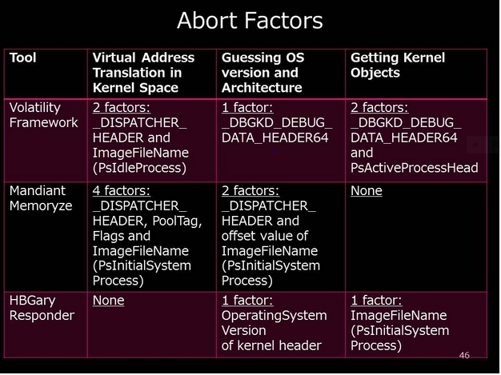
Takahiro Haruyama -- April 2014, discuss his BH Europe 2012 talk with respect to Abort Factors.
Notes:
Interesting that at least the 32bit technique is not represented

Slide 11
64bit Process Detection
Earlier presentation for kernel code & DefCon 22
E.g. CSW14 Diff CPU Page table & Logical kernel objects (to detect hidden kernel modules, “rootkit revealer”)
Also uses page tables “Locating x86 paging structures in memory images” https://www.cs.umd.edu/~ksaur/saurgrizzard.pdf
Karla Saur, Julian B. Grizzard
New process detection technique is faster - single pass
Similar to “pmodump”, enhanced with 64bit & additional checks (64bit scan has much more verifiability)
Notes:
32bit space is pretty crowded and necessitated advanced verification re: suargrizzard.pdf.
64bit address space makes life much easier(more verifiable bits (e.g. most significant bits of PFN 0) and less complicated.

Slide 12
64bit Process Detection Integrity
Not easily attacked
Many modifications result in BSOD
Able to extract candidate memory for integrity checking of memory pages to fully qualify
Always room to grow with respect to countermeasures and performance

Slide 13
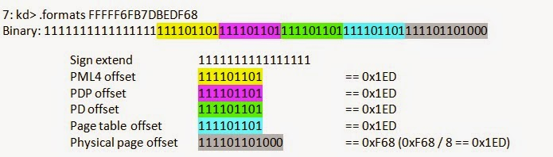
X64 Self MAP – BSD “recursive” PD entry
Self pointer
A pointer to self is very powerful

Slide 14
X64 Kernel Virtual Address Space
http://www.codemachine.com/article_x64kvas.html
Start | End | Size | Description | Notes
FFFF0800`00000000 | FFFFF67F`FFFFFFFF | 238TB | Unused System Space | WIN9600 NOW USE & CAN CONTAIN +X AREAS
FFFFF680`00000000 | FFFFF6FF`FFFFFFFF | 512GB | PTE Space | -X used to be executable Win7
FFFFF700`00000000 | FFFFF77F`FFFFFFFF | 512GB | HyperSpace | 8.1 seems to have cleaned up here, 9200 had 1 +X page
FFFFF780`00000000 | FFFFF780`00000FFF | 4K | Shared System Page
FFFFF780`00001000 | FFFFF7FF`FFFFFFFF | 512GB-4K | System Cache Working Set
FFFFF800`00000000 | FFFFF87F`FFFFFFFF | 512GB | Initial Loader Mappings | Large Page (2MB) allocations
FFFFF880`00000000 | FFFFF89F`FFFFFFFF | 128GB | Sys PTEs
FFFFF8a0`00000000 | FFFFF8bF`FFFFFFFF | 128GB | Paged Pool Area
FFFFF900`00000000 | FFFFF97F`FFFFFFFF | 512GB | Session Space
FFFFF980`00000000 | FFFFFa70`FFFFFFFF | 1TB | Dynamic Kernel VA Space
FFFFFa80`00000000 | *nt!MmNonPagedPoolStart-1 | 6TB Max | PFN Database
*nt!MmNonPagedPoolStart | *nt!MmNonPagedPoolEnd | 512GB Max | Non-Paged Pool | DEFAULT NO EXECUTE
FFFFFFFF`FFc00000 | FFFFFFFF`FFFFFFFF | 4MB | HAL and Loader Mappings
Notes:
Establishing kernel code topology

Slide 15
Self Map detection Windows AMD64
Self Map exists for each process (not only kernel:)
Examining a page table - !process 0 0 → dirbase/cr3
!dq 7820e000
#7820e000 00800000`60917867
[physical addr] [value]
!dq 7820e000+0xf68
#7820ef68 80000000`7820e863
^-- current PFN found --^ (PFN FTW)
Notes:
I’m going to speak to the colors here: GREEN = PFN, RED = OFFSET and BLUE == verifiable & other flags
There is a lot of power here

Slide 16
PFN FTW Trick! (or Defensive exploit!!)
#7820ef68 80000000`7820e863
^----------^
64Bit is a more powerful check
Valid PFN will be bounded by system physical memory constraints
Valid self map address will always increase from previous
Notes:
Additional checking based on known system memory topology strengthens the 64 bit check (i.e. we can go fast & not loose ☺ Defensive Exploit sounds so much more fun than tool/technique/trick ;)?

Slide 17
These are the BITs your looking for…
typedef struct _HARDWARE_PTE {
ULONGLONG Valid : 1; ⬅ Indicates hardware or software handling (mode 1&2)
ULONGLONG Write : 1;
ULONGLONG Owner : 1;
ULONGLONG WriteThrough : 1;
ULONGLONG CacheDisable : 1;
ULONGLONG Accessed : 1;
ULONGLONG Dirty : 1;
ULONGLONG LargePage : 1; ← Mode2
ULONGLONG Global : 1;
ULONGLONG CopyOnWrite : 1;
ULONGLONG Prototype : 1; ← Mode2
ULONGLONG reserved0 : 1;
ULONGLONG PageFrameNumber : 36; ← PFN, always incrementing (mode 1&2)
ULONGLONG reserved1 : 4;
ULONGLONG SoftwareWsIndex : 11; ← Mode2
ULONGLONG NoExecute : 1;
} HARDWARE_PTE, *PHARDWARE_PTE;
Notes:
A PTE entry itself, we will check a minimum of bits, mode 2 //111 1111 1111 1111 0000 0000 0000 0000 0000 0000 0000 0000 0000 0100 1000 0000

Slide 18
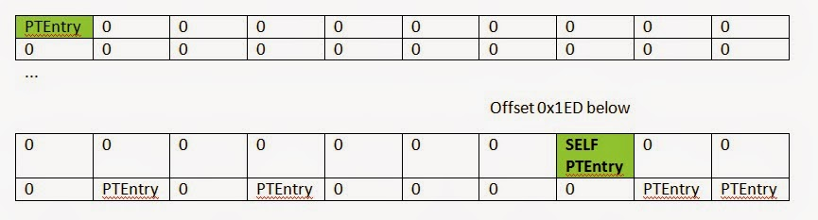
Base PageTable offsets
Below example of 512-way page table

Slide 19
These are the OFFSETS your looking for.
512 way Table (512 * 8 = 0x1000, a page)
PFN Offset 0 configured and valid bit
PFN Offset 0x1ed Point’s to self and valid bit
This allows us to identify *current position
Mode2 has more checks for typical page table
Mode1 is for heightened assurance
Both work together to extract PFN & MEMORY_RUN gaps
http://blockwatch.ioactive.com/MProcDetect.cs

Slide 20
Self Map Detection Attacks
Attacks against performance
If we de-tune performance we can validate spoof entries and various malformed cases
Windows zero’s memory quickly (no exiting processes, so far:)
!ed [physical] can be done to assess evasive techniques
Simply destroying self map results in BSOD!! ☺
Looking for feedback testing to identify better more comprehensive PTE flag checks (edge cases, missed tables or extra checks)
Notes:
Having such wide entries gives us many bit’s to check, tweaking a few of the initial flag LSB check may not really hurt that much. Especially if you are able to have a bounded range of PFN (max pages on your system) additional 0 checks can be done. We haven’t added this enforcement at this time since it’s not needed due to lack of known countermeasures etc..

Slide 21
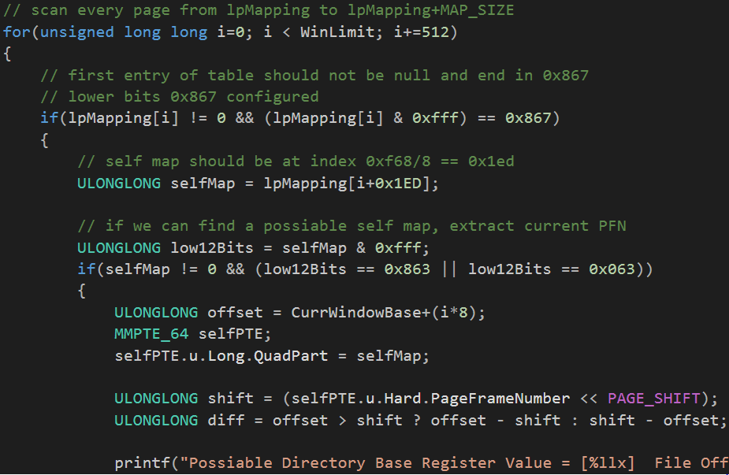
Implementation (basically in 1 line)
Notes:
I need source code snapshots in my preso’s ☺

Slide 22
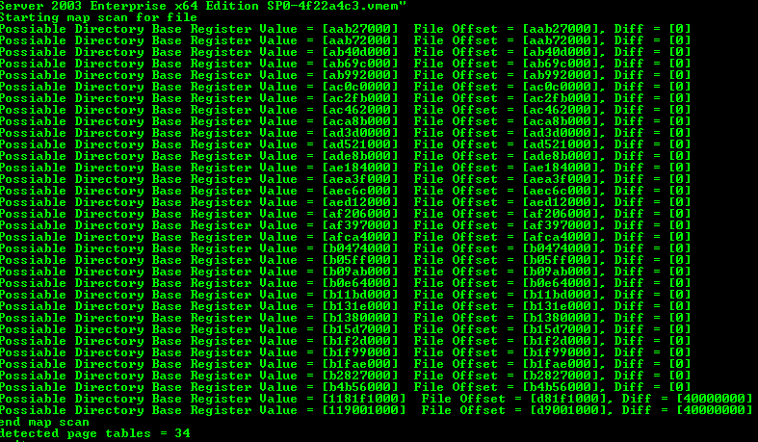
Example execution (.vmem starts @0 offset), .DMP (0x2000+) or other autodetect header offset ☺

Slide 23
Detected Memory Runs
Round value by offset to find gap size, adjust to automate memory run detection
Takahiro Haruyama blog post on related issue (large memory) and also memory run detection issues from logical sources
*previous slide, detecting gap, when offset changes;
ROUND_UP(0xb4b56000, 0x40000000) = first run end 0xc0000..
ROUND_DOWN(0x1181f1000, 0x40000000)

Slide 24
Good start for process detection
At least for OS which mm use recursive PD or self mapping
Most of the time since it is usually simpler to setup and can transition to the HW managing the tables quickly
Really * except for linux!

Slide 25
CPU support for Hypervisors
Various extensions over the years
We will focus on newer stuff 64bit with hardware support
Work In progress
Ideas for Linux ? ☺

Slide 26
Hypervisor Page tables
Overview of physical memory addressing
Evolution towards more comprehensive hardware support of what earlier generation hypervisors had too by hand
i.e. Shadow page tables have largely given way towards EPT/SLAT type hardware driven structures.

Slide 27
Shadow Paging
Older virtualization systems (no need for HW support)
Some perf issues:
Hypervisor required to intercept a variety of possible malicious actions by guest
Write protected or uses ring 1 to isolate guest paging system
Must implement full virtual TLB

Slide 28
Nested paging
AKA: SLAT (Second level address translation)
Intel: EPT (Extended Page Table)
AMD: RVI (Rapid Virtualization Indexing)
No SPT/vTLB -- Per VM HW managed SLAT
TLB miss is expensive (4 vs. 24 memory accesses)
HW SLAT needs good locality
HW paging, use 2MB pages skips a level of translation
Detect if your in a hypervisor if by using 1GB pages
Memory load perf will be a problem until an alternatives to 2D nested page walks implemented
Speculative Inverted page table: SpecISP
Speculative MMU: SpecTLB
Notes:
When guest pages are vastly larger than host, HW page tables have very bad performance mapping many entries to 1 guest. It’s still a lot less complexity and acceleration to use the hardware and predominantly supports allowing unmodified guests to run under a VMM.

Slide 29
We’re doing the impossible!
“Unfortunately, developing a completely generic and automated algorithm to forensically analyze nested virtualization environments is - in the general case impossible.” [1]
True for VMCS in isolation, but leveraging earlier work on hidden process detection, we made it possible.
There’s always more to-do

Slide 30
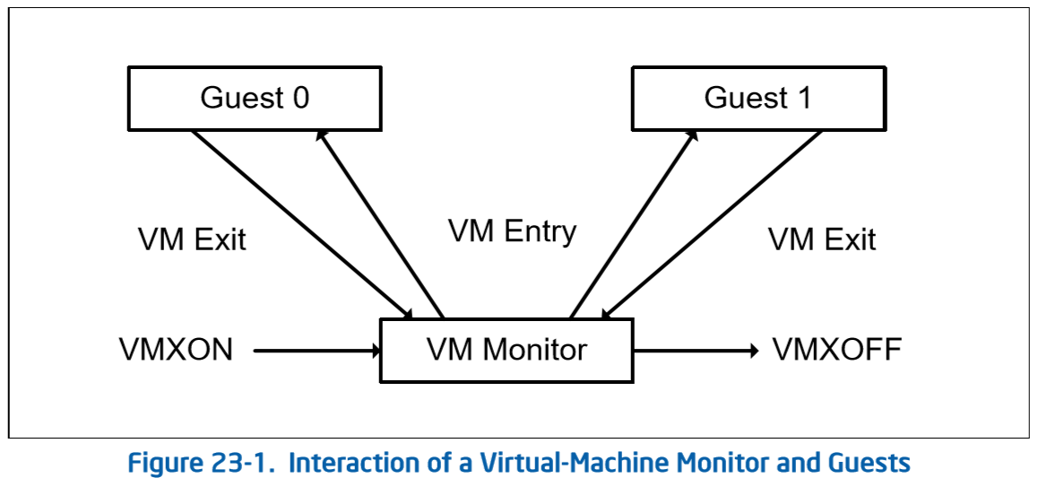
Intel VM spec

Slide 31
VM Entry/Exit
Managed by VMCS (VMCB AMD)
Typically 1 per VM (always?)
Several groupings maintain overall state
Full Host & Guest register state’s
VM Execution, Exit & Entry control flags
Exit Info (extra data describing exit
Due to this, link pointer is (always?) 0xffffffffffffffff

Slide 32
VMCS context only (guest register state)
64bit: CR0, CR3, CR4, DR7, RSP, RIP, RFLAGS, GDTR, IDTR, DEBUGCTL, IA32_EFER, IA32_PAT, PERF_GLOBAL_CTRL, SYSENTER_EIP, SYSENTER_ESP
32bt: SYSENTER_CS, SMBASE
Selectors(80bits): CS SS DS ES FS GS LDTR TR
Selector(16) + Baseaddress(64) + Seg lim(32)+access rights(32)
960 + 64 + 640 = 1664bits or 208 bytes
Rough estimate…

Slide 33
Current challenges
Issues with the linux mm and overall page table handling does not use the recursive or self map characteristics.
Support is fairly solid for Free/OpenBSD and Windows
Recursive hypervisor encapsulation is handled by joining the independent physical addresses found co0-located into ta given VMCS page.
Extents based & emulated VT mappings
Caching structures being ignored
Maybe gaps if the caches are not consistent? Is this a real problem?

Slide 34
Hypervisor as an application
Many modern analysis or software protection systems are based on similar VMM as an application that is not fundamentally part of the underlying OS kernel.
zer0mem/frookSINATRA & MiniHyperVisorProject
Uses modified vbox to do some hacky tricks
Other project is more custom hypervisor for deep analysis. Maybe harder to identify.

Slide 35
Demo’s
Questions?
Code ?
Requests ?

