Slide 1
iVote 2015: Security failures and verification flaws in a live online election
Vanessa Teague
Ruxcon 2015
vjteague@unimelb.edu.au
Joint work with Alex Halderman
Full version at http://arxiv.org/abs/1504.05646

Slide 2
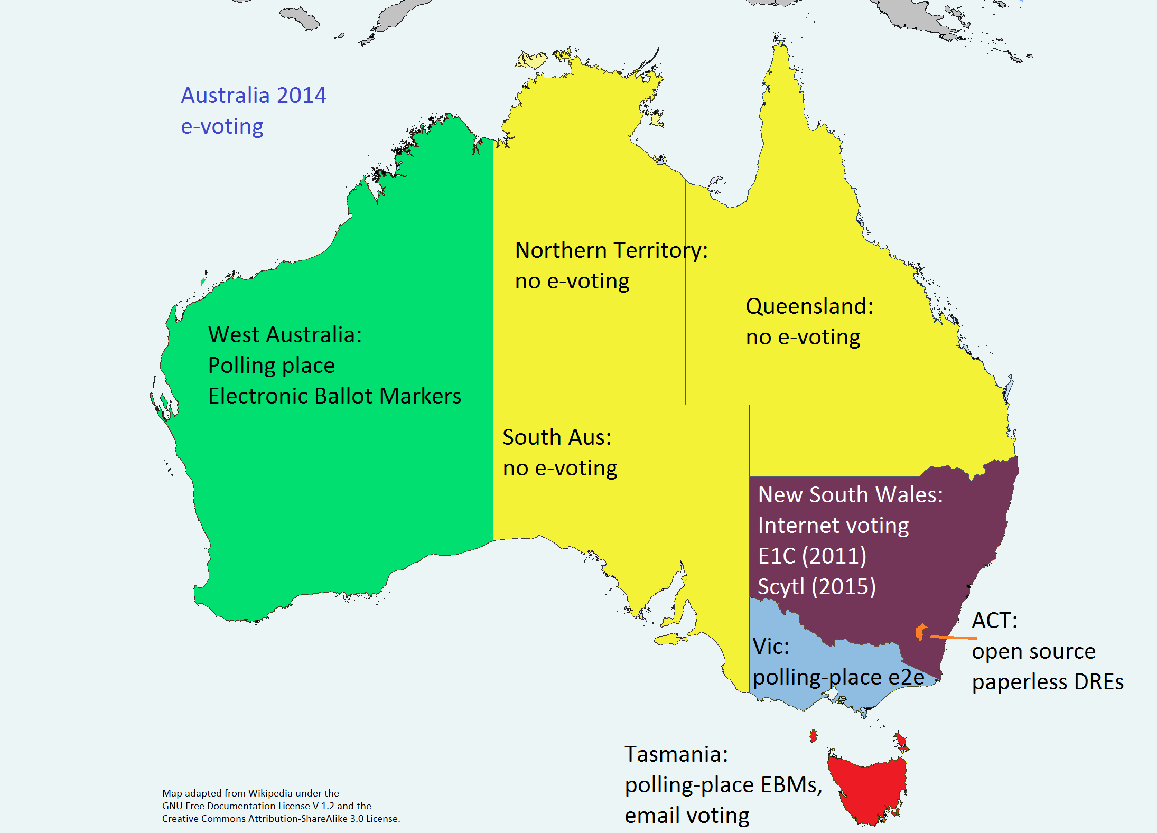
Australian e-voting

Slide 3
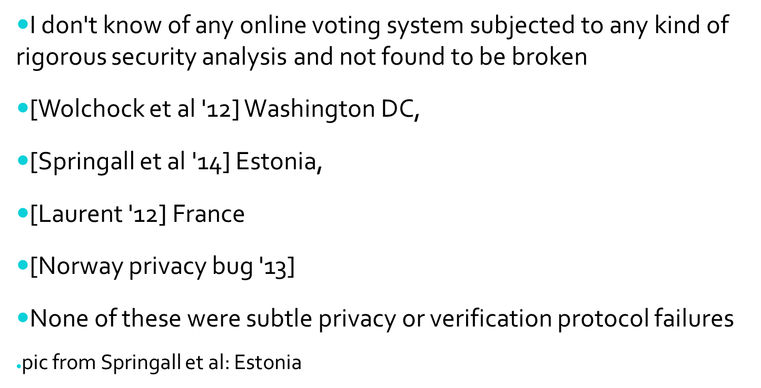
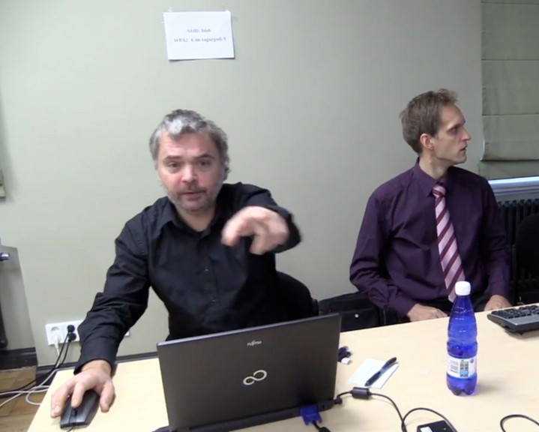
Related work
Notes:
Laurent: http://tnerual.eriogerg.free.fr/autovote.pdf
“Comment mon ordinateur a voté à ma place”
Norway: http://www.osce.org/odihr/elections/109517

Slide 4
iVote history and background
New South Wales ran Internet voting in 2011 also
  Using a system by Everyone Counts
  43 of the ballots output were invalid
    With ‘N’s where there should have been preference numbers
The 2015 iVote software was supplied by Scytl
  Telephone, (remote) Internet and pollsite e-voting
  More than 280,000 votes
    Out of nearly 4.6 million (4.3 million formal)

Slide 5
Advertising
“People's vote is completely secret.
“It's fully encrypted and safeguarded, it can't be tampered with, and for the first time people can actually after they've voted go into the system and check to see how they voted just to make sure everything was as they intended.”
(Richard Carroll NSWEC, http://www.abc.net.au/news/2015-02-04/computer-voting-may-feature-in-march-nsw-election/6068290)

Slide 6
The attack
Using a practice version of iVote, during the election we could
    intercept votes,
    expose how the person intended to vote
    manipulate the vote
    interfere with the verification process
        in many but not all circumstances
The real voting server was vulnerable to the same attack
We notified the Australian CERT
    NSWEC/Scytl fixed the problem
    But by then 66,000 votes had been cast in the state election
    The margin for the last Legislative Council seat was only 3177.

Slide 7
The system
Telephone, (remote) Internet and pollsite e-voting
    Register: get an iVote ID
    Vote: with iVote ID, PIN; get Receipt Number
        Send encr(vote) = AES_{k}(vote); ElG_{ECPK}(k) ; ElG_{VSPK}(k)
        and encrypted ID, PIN, ReceiptNumber
  Verify: by telephone only
      Key in your iVote ID, PIN, Receipt Num
      Listen to your vote read back
  Query whether your Receipt Num was included
No verifiable mixing or bulletin board, but some auditing by some other parties

Slide 8







iVote (Scytl/NSW) 2015
Electoral Commission
Vote Server
ReceiptNum
RNum''
Encr(vote), RNum', iVoteID, PIN
ReceiptNumbers
can be queried
for inclusion
by Internet
Auditor
?
Verification
Server
Plaintext vote check by phone

Slide 9
Investigating the iVote practice server
See browser
Notes:
https://practise.ivote.nsw.gov.au/#/remote-login
Note piwik .js
Point out 3rd party server power

Slide 10
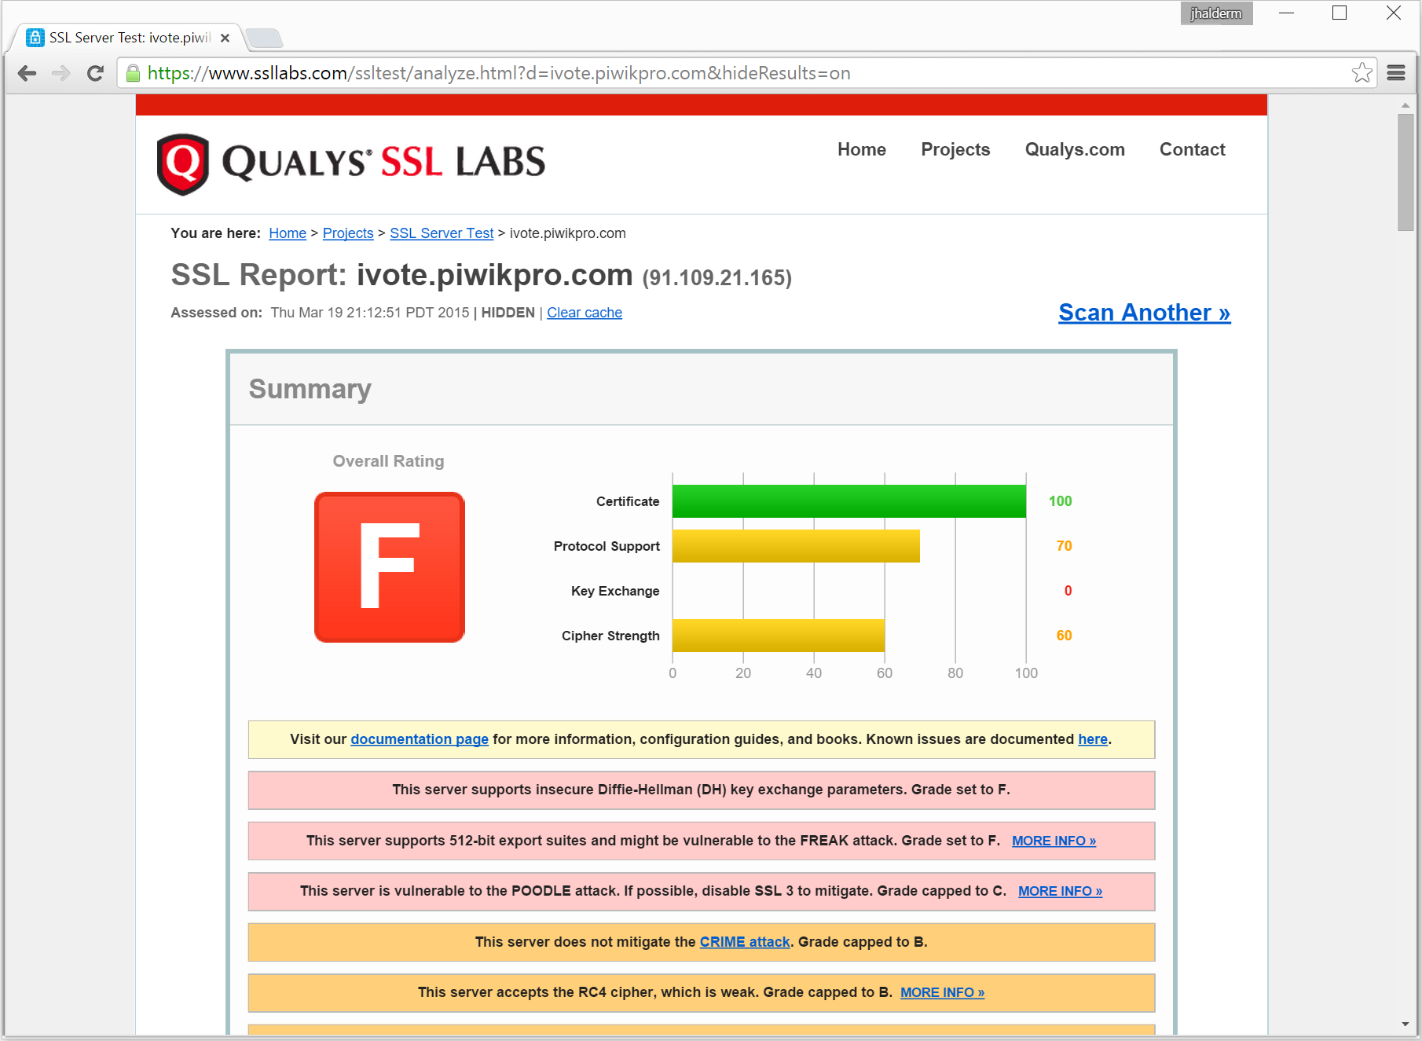
Piwik: export grade RSA & DH
Notes:
“verifiability” by one server isn’t verifiability.

Slide 11
Factoring RSA Export keys (FREAK)
“A messy state of the Union: taming the composite state machines of TLS” [Beurdouche et al.]
  Some TLS clients accept Export-grade RSA even if they didn't ask for it.
512-bit “export grade” RSA now costs about $100 to break running overnight on Amazon’s EC2 cloud. (https://www.cis.upenn.edu/~nadiah/projects/faas/)

Slide 12
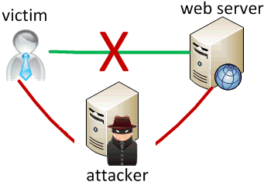
FREAK – intercepting SSL/TLS key establishment
1. Client hello:
I’d like to use
RSA...
3. Server response:
OK, here’s my
512-bit RSA-EXP
Key (with valid
Certificate chain)
4. (Buggy) Client:
Accepts 512-bit key
Uses it to encrypt
pre master secret.
2. Client hello:
I can only use
RSA-EXP
5. Attacker:
Uses factored 512-bit key
to control SSL/TLS session

Slide 13
Factoring RSA Export keys (FREAK)
But surely no servers still offer RSA-EXP?
  Many did until very recently (freakattack.com)
Many servers used the same 512-bit key over and over again.

Slide 14
Factoring the RSA key
Piwikpro didn't keep the same key permanently
  it seemed to have 11, cycled roughly on the hour
  we managed to keep one TLS session open for about 20 hrs, which maintained the same key.
  clients thought they were making a fresh connection
  server thought it was renegotiating one session
  this left 13 hours to intercept connections after 7 hours to factor
  Thanks to Nadia Heninger

Slide 15
Intercepting the vote
Having MITM'd the connection, substitute arbitrary javascript
Now the attacker has javascript running inside the browser at the same privilege level as the iVote javascript
Can intercept & modify vote
  As it is passed between AngularJS worker modules to do the crypto.
Notes:
“verifiability” by one server isn’t verifiability.

Slide 16
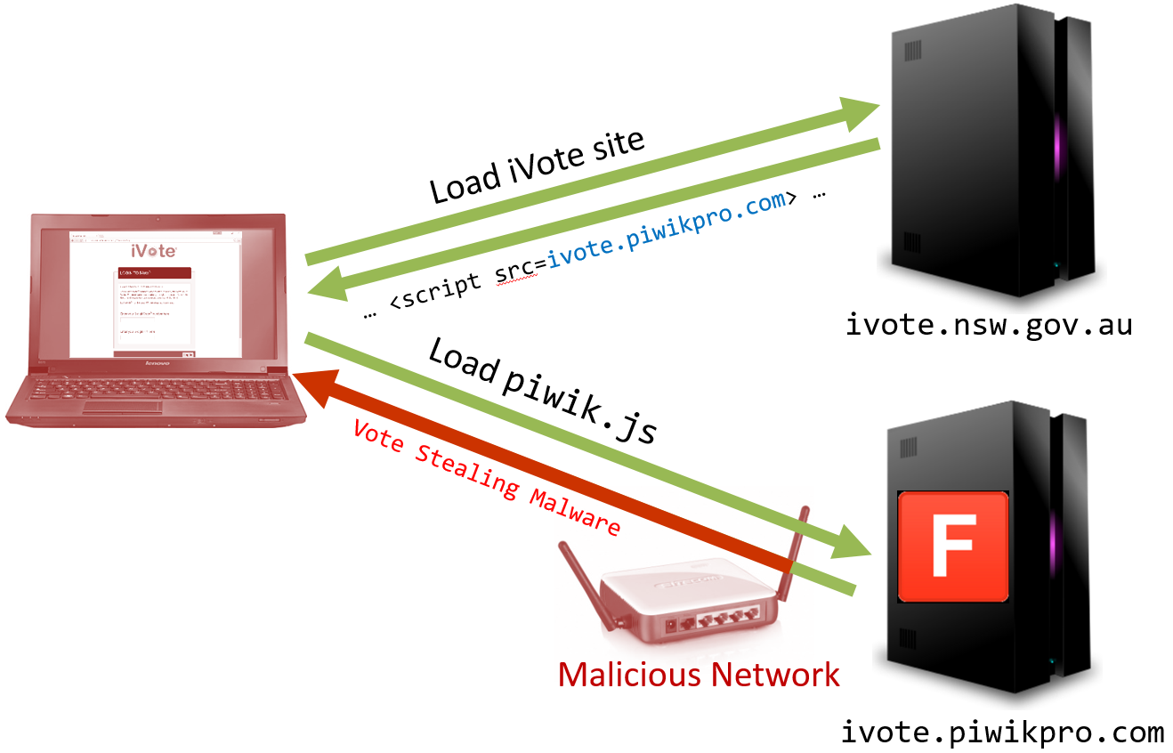
Intercepting the vote
Notes:
“verifiability” by one server isn’t verifiability.

Slide 17
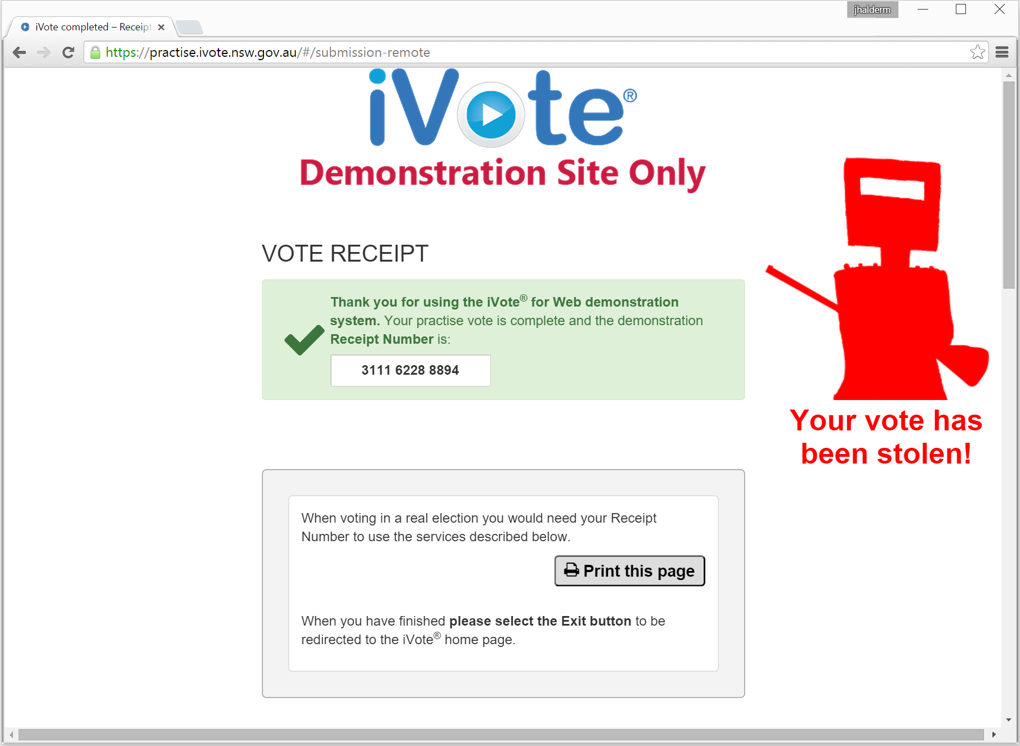
Intercepting the vote
Notes:
“verifiability” by one server isn’t verifiability.

Slide 18
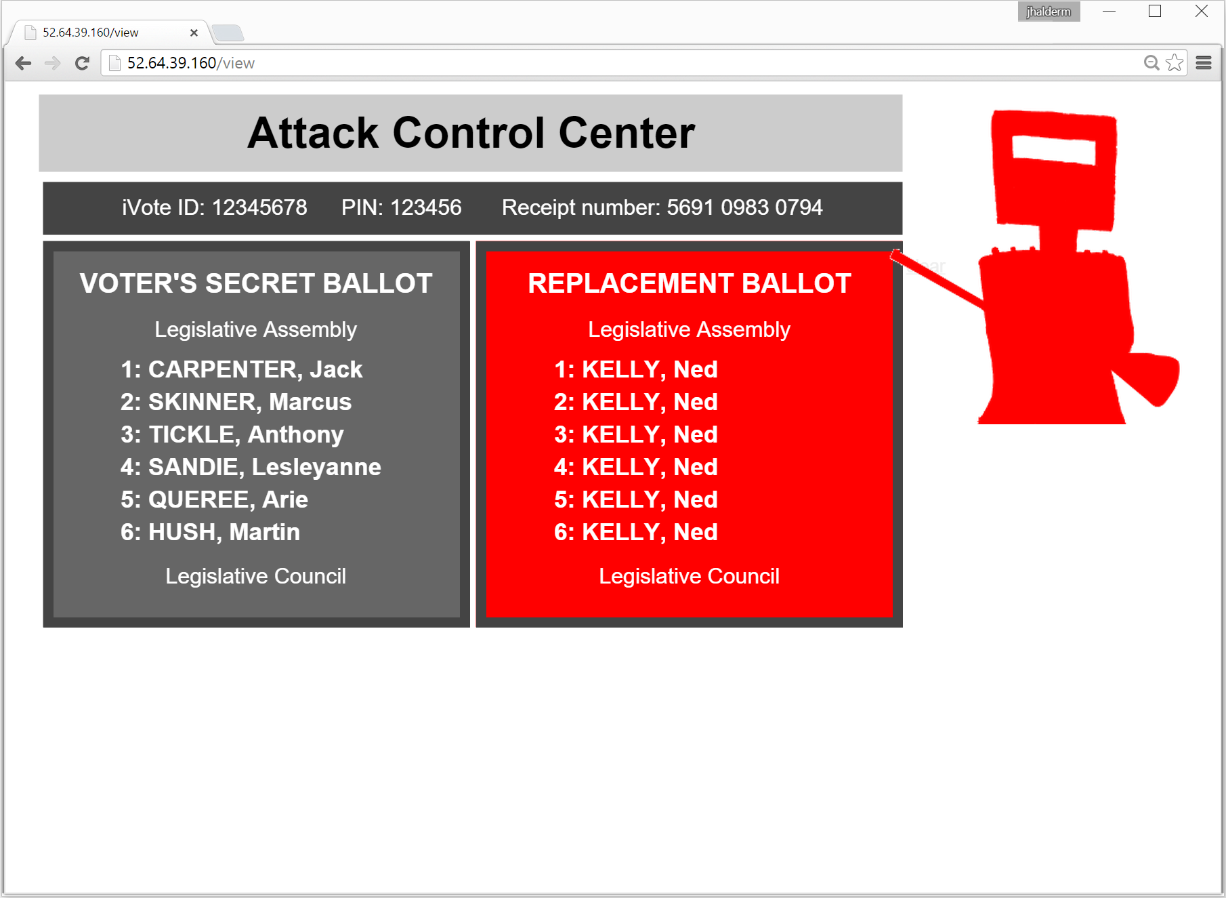
Remote control

Slide 19
logjam
NSWEC & Scytl put much effort into arguing that few browsers would (still) have been vulnerable to FREAK more than a week after patches were released
  I don't know of any hard data either way
  Not all browsers were vulnerable anyway, though many common ones were
But a careful look shows piwikpro also served export grade DH
  The logjam attack was not public until May, ie. months later
  [Imperfect Forward Secrecy: How Diffie-Hellman Fails in Practice Adrian et al, ACM CCS ‘15]
  All browsers were vulnerable
  By sheer good luck, the way they patched for FREAK also removed vulnerability to logjam
Notes:
“verifiability” by one server isn’t verifiability.
**nb cedric F says that not a TLS flaw and not all clients vulnerable. Check.

Slide 20
TLS on the main gateway
There wasn't any (until we pointed this out to NSWEC)
So in fact the easiest way for a MITM attacker to compromise the voting session would simply have been to misdirect registration and/or voting.
Notes:
https://www.ivote.nsw.gov.au/

Slide 21
Openness and transparency
Apart from the JavaScript we could see in the browser, no source code is available for any other parts of the system
No idea what other vulnerabilities or errors might be present
  To either external or internal attackers
Notes:
Emphasise extra “insiders” e.g. Piwik

Slide 22
Verification and scrutiny
Apart from telephone-based cast-as-intended verification, no meaningful verifiability
  (Some auditors did some reconciling of the voting system's database against the verification server's)
Verification is easily sidestepped, e.g. by halting the Receipt Num, or by misdirecting the phone
Also possible to perform a “clash” attack on registrations
  As formalised in Kusters et al '12

Slide 23
Privacy
It was never quite clear before the election exactly how the votes were going to be encrypted
  “iVote strategy for the NSW state general election 2015 v1 (2013)” said votes would be encrypted with a 10-digit Receipt Number
    With others, I pointed out this might not be good enough
  The “Security implementation statement” (March 2014) said they’d be encrypted with El Gamal
    That sounded good, because it might allow true cryptographic mixing
  When we looked at the javascript, neither was quite accurate
    encr(vote) = AES_{k}(vote); ElG_{ECPK}(k) ; ElG_{VSPK}(k)
  In many applications, this would be a fine way to encrypt data.
  However, the use of AES, which can’t be rerandomised, means that the encrypted vote looks identical all through the process

Slide 24
Timeline
FREAK announced
3 March
3 March
FREAK Patches released
around 10 March
iVote opens for voting
16 March
flaw notified
to Au CERT
20 March
System fixed
System fixed
21 March (midday)
TV News story
TV News story
TV News story
21 March (evening)
21 March (evening)
21 March (evening)
Technical blog post
23 March
Election Day
(iVote closes)
28 March
Legislative Council
count announced
17 April
logjam announced
20 May
Notes:
Show pic of giant senate ballot; say NSW even bigger.

Slide 25
Tallying
Most Legislative Assembly ballots are cast on paper and hand-counted
But the 4.6 million Legislative Council ballots are counted electronically by randomized Single Transferable Vote (STV)
  No source code available
  No public seeding of randomness
  preference data available at http://www.vtr.elections.nsw.gov.au/lc-home.htm#lc/state/preferences
      Released in August, 4 months after the election
    margin about 3000, varying by randomness
      Probability of a different answer small but nonzero
    Compare this with the 66,000 votes cast while the system was vulnerable to FREAK & Logjam

Slide 26
Conclusion
External privacy breach and manipulation are only the most obvious of security threats to Internet voting
Internal/insider threats are arguably a greater problem
  There are lots of insiders
  Perhaps the subtle arguments about privacy and verifiability might one day become important
These processes provided no meaningful evidence of having announced the correct election outcome
  We know the opportunity for manipulation was there; there is neither evidence that it was exploited nor evidence that it wasn’t
  particularly serious for the closest Legislative Council seat

