Slide 1



MALWAIRDROP: COMPROMISING IDEVICES VIA AIRDROP
Air Drop

Slide 2
Introduction
Physical-proximity attacks are a thing now
Getting access to a locked device
Also useful as an injection vector in to a network/ protected computer
IoT/smartphone usb-based or “airborne” vectors
See: WireLurker, FitBit thing
iOS in particular is a challenging target
FBI recently lamented “impossible to get access to if they’re locked” (http://www.smh.com.au/it-pro/security-it/fbi-director-slams-apple-over-iphone-encryption-20140925-10ma5a.html)

Slide 3
Introduction
Apple has made a recent push for sharing files and activities between iDevices / OSX machines
“Continuity” – Handoff / Phone calls
AirPlay - stream media
AirDrop – share files
Little to no public security research about any of these
Novel / Unique attack vectors
I chose to look at AirDrop, largely because I felt like it

Slide 4
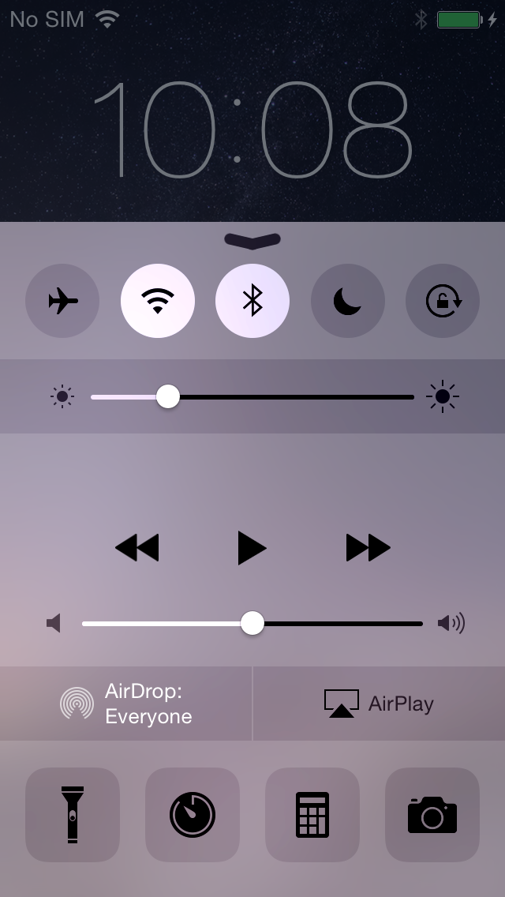
Introduction
Why look at AirDrop, anyway?
Doesn’t require iCloud
Many people turn it on (source: some trains I caught)
Can be enabled by default from the lock screen
Also, John has it on

Slide 5
Introduction
Two attack scenarios:
Someone with AirDrop enabled in close proximity (Abuse in the past: “cyber flashing”)
Temporary physical access to someone’s phone (lock screen bypass)
I will describe a method I used to install arbitrary software on a locked iPhone
Not particularly hard to exploit, but several OS features make turning the bug in to something useful an interesting challenge

Slide 6
PART I: ABOUT AIRDROP

Slide 7
About AirDrop
AirDrop is a feature for effortlessly sharing media between iDevices/OSX machines in close physical proximity
Off by default (but can be enabled by the lock screen)
Basic access control – off, contacts only, everyone

Slide 8
About AirDrop
AirDrop utilizes BTLE and WiFi
Discovery via BT
Used to set up an ad-hoc WiFi network using Apple Wireless Direct Link (AWDL) interface awdl0
Client browses for AirDrop service via mDNSResponder (for _airdrop._tcp.local service)
Returns an IP/port for a HTTPS webserver
Transaction takes place

Slide 9
About AirDrop
HTTPS web server implemented by /usr/libexec/sharingd (uses CFNetwork for HTTP/S parsing)
Understands POST requests to three URIs: Discover, Ask, Upload
Requests are parsed by sharingd’s [SDWormholeConnection handleReadStreamEvent] function
Most work farmed out to handle/parse XXX Request functions

Slide 10
About AirDrop
Discover Request
No input data
Returns human-readable name of device
{
"user\U2019s iPhone";
}

Slide 11
About AirDrop
Ask Request
Provides information about incoming file(s) to be transferred
Apple PLIST format
Generates a prompt for accepting files (requires unlock)

Slide 12
About AirDrop
{
BundleID = "com.azimuth.adtool";
FileIcon = <0000000c 6a502020 ... >
Files = (
{
FileBomPath = "./test.jpg";
FileIsDirectory = 0;
FileName = "test.jpg";
FileType = "public.jpeg";
}
);
Items = (
);
ItemsDescription = description;
SenderComputerName = jerk;
SenderID = 837384937bc7;
SenderModelName = AirDropTool;
}

Slide 13
About AirDrop
Upload Request
Contains actual files being sent
Can be in ZIP or CPIO format
Extracted to temporary location in /var/tmp
If the user accepts transfer, files are moved to /var/mobile/xxx
Key point: Upload requires an Ask request to precede it, but does *not* require it to be acknowledged

Slide 14
About AirDrop
Attack Surface
Bluetooth stack
IP stack
mDNSResponder
JPEG2000 parsing
HTTP/S (CFNetwork)
Request parsing (sharingd)
Unpacking

Slide 15
About AirDrop
Attack Surface
Bluetooth stack
IP stack
mDNSResponder
JPEG2000 parsing
HTTP/S (CFNetwork)
Request parsing (sharingd)
Unpacking

Slide 16
PART II: VULNERABILITY

Slide 17
Vulnerability
Upload Request Unpacking
Handled by [SDFileZipper unzip]
Relies on Bom.framework to do actual unzipping
int BOMCopierCopyWithOptions( BOMCopier *Copier, char *DestinationPath, char *ArchivePath, CFDictionaryRef Options );

Slide 18
Vulnerability
Options dictionary dictates what the function does
In this case, we care about CPIO functionality
Dictionary requires extractCPIO => 1
Occurs if Content-Type header of Upload request is set to application/x-cpio or application/x-dvzip

Slide 19
Vulnerability
Vulnerability occurs reading CPIO header (function _BOMCPIOReadHeader())
__int64 BOMCPIOReadHeader(struct_ArchiveFile *ArchiveFile, const char *CpioFilenameEntry, struct cpio_record_t *OutCpioRecord)
Read and parse CPIO header structure
struct CPIOHeader
{
char magic[6]; // 070707
char dev[6];
char ino[6];
char mode[6];
char uid[6];
char gid[6];
char nlink[6];
char rdev[6];
char mtime[11];
char namesize[6];
char filesize[11];
// filename follows, then file data
};

Slide 20
Vulnerability
if ( totalBytesRead == sizeof( CPIOHeader ) )
{
rc = 3;
if ( sscanf(
&headerString,
"%06s%06ho%06ho%06ho%06ho%06ho%06ho%06ho%011o%06ho%011llo",
&magic,
&dev,
&ino,
&cpio_record->mode,
&uid,
&gid,
&cpio_record->nlink,
&rdev,
&mtime,
&filename_length,
&filesize) == 11 )

Slide 21
Vulnerability
if ( !strcmp(&magic, "070707") && filename_length <= 1024 )
{
// Read the filename from the CPIO record
readBytes = BOMFileRead(ArchiveFile->stream,
CpioFilenameEntry, filename_length);
cpio_entry_filename_length = readBytes;
if ( (readBytes < 0 || readBytes != filename_length )
{
...
}
else if ( !strcmp(CpioFilenameEntry, "TRAILER!!!") )
{
...
}
else
{
rc = sanitizePath(CpioFilenameEntry, cpio_entry_filename_length);
}

Slide 22
Vulnerability
sanitizePath() attempts to strip out directory traversal
Iterate through filename_length bytes, search for /.. occurrences
If some exist, split the path into segments using CFStringCreateArrayBySeparatingStrings()
Delete offending segments (and resolve)
/Foo/../bar => /bar
Combine resultant array back in to original input buffer

Slide 23
Vulnerability
Mistake: _BOMReadCPIOHeader() never ensures input filename is NUL-terminated
sanitizePath() only validates filename_length bytes
Bytes in input/output buffer after filename_length bytes form part of the filename, but are not validated
Input/output buffer is part of a data structure re-used for each file in CPIO archive
Controlling bytes beyond the end is trivial!

Slide 24
Vulnerability
Exploiting the bug requires a CPIO archive with 3 records
Regular directory (“aaaaaaaaaaa”)
Regular file with name like (“aaaaaaaaaaaa/../../../../../dir/file”)
Regular file with same name and length as record 1, but no NUL-terminator

Slide 25
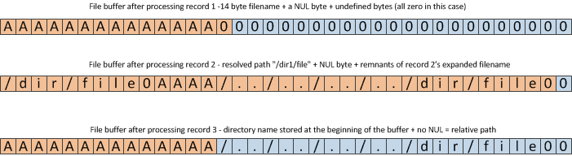
Vulnerability

Slide 26
Vulnerability
Vulnerability exists on OSX an iOS
Possibly other software
In the context of AirDrop, it’s a useful bug: can be triggered whether they accept the incoming transfer or not

Slide 27
PART III: EXPLOITATION

Slide 28
Vulnerability
Properties of the bug
We can exploit this bug multiple times with the same archive
Can write (or overwrite) arbitrary files as ‘mobile’ user
Can create directories, regular files, symlinks
Can replace files with symlinks

Slide 29
Vulnerability
What can we write to?
Cannot write over files on system partition (read-only)
Can write to /var partition
Most interesting configuration files are in /var/mobile/Library
3rd party applications in /var/mobile/Containers

Slide 30
Exploitation
Surprisingly hard to get code execution from here
Not much in the way of pathnames in config files
3rd party applications are stored in randomly generated subdirectories (/var/mobile/Containers/Bundle/Application/<UUID>)
Don’t know location to write to!

Slide 31
Exploitation
Can we install new apps?

Slide 32
Exploitation
First, a word about containers…
Containers are isolated sub-directories that contain a discrete component of an app
Different types of containers
App containers (contain executable bundle)
Data containers (contain data pertaining to and private to that app)
Shared containers (contain data relevant to a group of apps)
PluginKit containers (contain plugin bundles)
A few other types

Slide 33
Exploitation
Each container has a unique identifier (UUID)
Managed centrally by com.apple.containermanagerd (/usr/libexec/containermanagerd)
Non-system apps and all data containers stored in the /var/mobile/Containers directory
Subdirectories for the different types of containers
Bundle/Applications
Data/Applications
etc

Slide 34
Exploitation
Each container has cached info added by containermanagerd during initialization (/var/mobile/Containers/Bundle/Application/<UUID>/.com.apple.mobile_container_manager.metadata.plist)
Stores cached metadata for the container
Type of metadata depends on container type
containermanagerd exports MACH APIs to interrogate containers and their metadata

Slide 35
Exploitation
{
MCMMetadataContentClass = 1;
MCMMetadataIdentifier = "com.duolingo.DuolingoMobile";
MCMMetadataInfo = {
"com.apple.MobileInstallation.BundleCodeInfoIdentifier" = "com.duolingo.DuolingoMobile";
"com.apple.MobileInstallation.BundleEntitlements" = {
"application-identifier" = "VS2788CQ34.com.duolingo.DuolingoMobile";
"aps-environment" = production;
"com.apple.developer.associated-domains" = (
"applinks:duolingo.com",
"applinks:www.duolingo.com"
);
"com.apple.developer.team-identifier" = VS2788CQ34;
"com.apple.security.application-groups" = (
"group.duolingo.CoachWidgetGroup"
);
};
"com.apple.MobileInstallation.BundleMaxLinkedSDKVersion" = 589824;
"com.apple.MobileInstallation.BundleSignerIdentity" = "Apple iPhone OS Application Signing";
"com.apple.MobileInstallation.BundleValidatedByProfile" = 0;
"com.apple.MobileInstallation.StaticDiskUsage" = 41177088;
};
MCMMetadataUUID = "ECD343FE-E684-4607-8A3B-35000548B5E9";
}

Slide 36
Exploitation
Apps usually installed directly by installer application
Registers application using mach service “com.apple.mobile.installd” (/usr/libexec/installd)
Directs com.apple.containermanagerd (/usr/libexec/containermanagerd) to create containers on its behalf
Application container
Data container
Group container
Others…

Slide 37
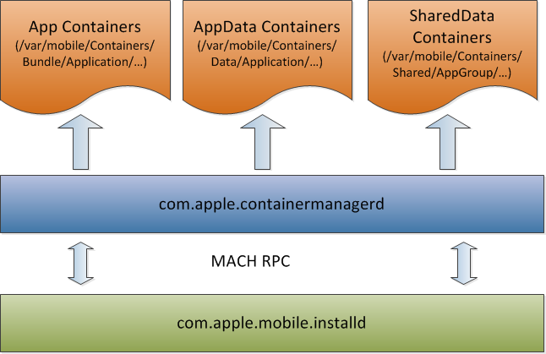
Exploitation

Slide 38
Exploitation
We can’t run the installer
However, installd/containermanagerd scan the file system at boot time (at the behest of Launch Services Daemon – “com.apple.lsd”)
Scans /var/mobile/Containers/Bundle/Application (and other container directories)

Slide 39
Exploitation
Method: Just copy the application we want to install to the containers directory, add metadata file, reboot!
Problem: Content Protection
Content protection is a per-file attribute describing when file will be encrypted
Primarily used to encrypt sensitive data when device is locked

Slide 40
Exploitation
Four protection classes primarily used
Protection Class A - Always encrypted
Protection Class B - Always encrypted except when open
Protection Class C - Encrypted until first authentication after a reboot
Protection Class D - Always unencrypted
Newly created files inherit protection class from parent directory

Slide 41
Exploitation
By default, writing any files to /var/mobile/Containers/.., files receive Protection Class C (encrypted until first boot)
Not good – installd scans directories before first unlock
Logical solution: symlinks
Find a location to write where files will be created with Protection Class D (always unencrypted)
/var/mobile/Library/Logs

Slide 42
Exploitation
Unfortunately, installd specifically filters directories and apps containing symlinks
Primarily [MIFileManager urlsForItemsInDirectoryAtURL]
Need another solution
Let’s look closer at containermanagerd
Before scanning takes place at boot, some recovery options are performed
Interesting one: [MCMClientConnection(Internal) _recoverFromReplaceOperationsWithError:]

Slide 43
Exploitation
Open the /var/mobile/Library/MobileContainerManager/Replace directory
Directory holds PLIST files describing containers to be “recovered”
Each file is parsed is acted upon for a restore operation
Validation is performed by [MCMClientConnection(Internal) _readAndValidateReplaceFileAtUrl]

Slide 44
Exploitation
For each PLIST file:
Ensure there is a field MCMReplaceOperationOldURL
Ensure there is a field MCMReplaceOperationNewURL
Ensure there is a field MCMReplaceOperationStagingURL
Ensure there is a field MCMReplaceOperationDestURL
The above file references are then converted to File URLs as directories (that is, a '/' is appended to the end)
Ensure that MCMReplaceOperationOldURL DOES NOT exist
Ensure that MCMReplaceOperationDestURL DOES exist

Slide 45
Exploitation
Move the directory referred to by MCMReplaceOperationStagingURL to the location referred to by MCMReplaceOperationOldURL
So, we can move directories as mobile before app directories are scanned at boot
/var/mobile/Library/Logs/a/My.app => /var/mobile/Containers/Bundle/Application/<UUID>/

Slide 46
Exploitation
<?xml version="1.0" encoding="UTF-8"?>
<!DOCTYPE plist PUBLIC "-//Apple//DTD PLIST 1.0//EN" "http://www.apple.com/DTDs/PropertyList-1.0.dtd">
<plist version="1.0">
<dict>
<key>MCMReplaceOperationOldURL</key>
<string>/var/mobile/Containers/Bundle/Application/1EFBCF04-4DA8-4381-BD48-C63621E35E45</string>
<key>MCMReplaceOperationDestURL</key>
<string>/var/mobile/Containers/Bundle/Application/1EFBCF04-4DA8-4381-BD48-C63621E35E45</string>
<key>MCMReplaceOperationStagingURL</key>
<string>/var/mobile/Library/Logs/blah</string>
<key>MCMReplaceOperationNewURL</key>
<string>/var/mobile/Containers/Bundle/Application/1EFBCF04-4DA8-4381-BD48-C63621E35E45</string>
</dict>
</plist>

Slide 47
Exploitation
Problem: Files created in /var/mobile/Library/MobileContainerManager/Replace also have Protection Class C – unreadable at boot
It’s OK – we can use symlinks here
/var/mobile/Library/MobileContainerManager/Replace/replace.plist -> /var/mobile/Library/Logs/replace.plist
App creation success!

Slide 48
Exploitation
Code signing is a whole thing
Primary solution: code signing bypass (could probably steal TaiG/Pangu one)
We will assume we don’t have one for this
Apple has developer and enterprise provisioning profiles
Developer profiles are tied to specific devices
Enterprise profiles are not
Used by some malware / Jailbreaks (YiSpecter, Pangu)
We will use that too

Slide 49
Exploitation
Installing provisioning profiles are easy – just copy one to /var/MobileDevice/ProvisioningProfiles
Must be renamed to the UUID of the provisioning profile (stored in the file itself)
Managed by com.apple.misagent
Takes immediate effect (no reboot required)

Slide 50
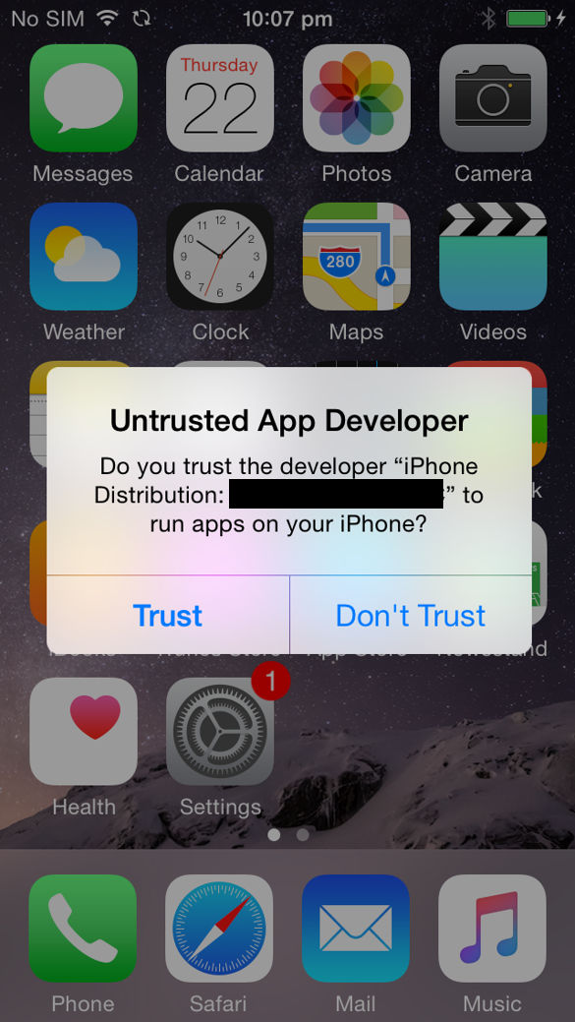
Exploitation
Problem: Enterprise-signed apps generate a warning when run for the first time

Slide 51
Exploitation
Solution: Add the signer to SpringBoard’s trusted code signing entities
Add name to SBTrustedCodeSigningIdentities in /var/mobile/Library/Preferences/com.apple.springboard.plist
Prompt won’t happen afterwards

Slide 52
Exploitation
<?xml version="1.0" encoding="UTF-8"?>
<!DOCTYPE plist PUBLIC "-//Apple//DTD PLIST 1.0//EN" "http://www.apple.com/DTDs/PropertyList-1.0.dtd">
<plist version="1.0">
<dict>
...
<key>SBSoftwareUpdateOSVersion</key>
<string>8.4.1:12H321</string>
<key>SBTrustedCodeSigningIdentities</key>
<array>
<string>iPhone Developer: Mark Dowd (1111111111)</string>
<string>iPhone Distribution: MDOWD Cashquik Enterprises</string>
</array>
<key>SystemVibrationDataMigrationVersion</key>
<integer>2</integer>
...
</dict>
</plist>

Slide 53
Exploitation
What can a self-signed app do, anyway?
Limited by app sandbox
You can add a few of your own entitlements
What about microphone etc?

Slide 54
Exploitation
The tccd service controls access to a lot of resources:
Address Book
Calendar
Camera
Microphone
Photos
etc
TCC gives access to these via entitlements

Slide 55
Exploitation
Apps don’t actually need these entitlements
Usually prompt the first time they try to access contacts etc
User acceptance is recorded in /var/mobile/Library/TCC/TCC.db
Overwriting this file will allow us immediate access to these resources – no prompt

Slide 56
Exploitation
sqlite> .open TCC.db
sqlite> .dump access
PRAGMA foreign_keys=OFF;
BEGIN TRANSACTION;
CREATE TABLE access (service TEXT NOT NULL, client TEXT NOT NULL, client_type INTEGER NOT NULL, allowed INTEGER NOT NULL, prompt_count INTEGER NOT NULL, csreq BLOB, CONSTRAINT key PRIMARY KEY (service, client, client_type));
INSERT INTO "access" VALUES('kTCCServiceMotion','com.apple.Health',0,1,1,NULL);
INSERT INTO "access" VALUES('kTCCServiceAddressBook',‘x.Hello',0,1,0,NULL);
COMMIT;

Slide 57
Exploitation
New app installed! Why isn’t it on the screen?
Need to refresh SpringBoard
Well-known for Jailbreakers
Just overwrite /var/mobile/Library/Caches/com.apple.LaunchServices-108.csstore with garbage
SpringBoard will rebuild this at boot, causing your app to show up

Slide 58
Exploitation
What if we want to replace a System app?
We can’t disappear apps from SpringBoard
We can re-arrange the layout though
/var/mobile/Library/SpringBoard/IconState.plist contains layout information
Straight-forward layout description

Slide 59
Exploitation
<?xml version="1.0" encoding="UTF-8"?>
<!DOCTYPE plist PUBLIC "-//Apple//DTD PLIST 1.0//EN" "http://www.apple.com/DTDs/PropertyList-1.0.dtd">
<plist version="1.0">
<dict>
<key>buttonBar</key>
<array>
<string>com.apple.mobilephone</string>
...
</array>
<key>iconLists</key>
<array>
<array>
<string>com.apple.MobileSMS</string>
...
</array>
</array>
</dict>
</plist>

Slide 60
Exploitation
The buttonBar describes the buttons at the bottom of the screen
iconLists is an array – each member is an array for a page
Nested iconLists possible for things like “Extras” and “Newsstand”

Slide 61
Exploitation
Replace a System app with our app that has the same icon
Move the System app in to the “Extras” tab
Problem: we don’t know what other apps a random jerk has installed
Doesn’t really matter – no app can not appear on SpringBoard
Screen will be repopulated with whatever apps are installed

Slide 62
Exploitation
Putting it all together, we need:
An Application folder containing the malicious app files in /var/mobile/Library/Logs
A replacement PLIST file such as the one described previously, also in /var/mobile/Library/Logs
A symlink in /var/mobile/Library/MobilecontainerManager/Replace to the replacement PLIST file in /var/mobile/Library/Logs
The relevant provisioning profile in /var/MobileDevice/ProvisioningProfiles
A replacement /var/mobile/Library/Preferences/com.apple.springboard.plist file with the trusted codesigning identity entry
A replacement /var/mobile/Library/SpringBoard/IconState.plist file.
A replacement TCC.db if desired

Slide 63
PART IV: MITIGATION

Slide 64
Protecting Yourself
Apple has now comprehensively patched this attack
Added sandboxing to sharingd in iOS 9
Prevents it from writing files to arbitrary locations on the filesystem
Patch to Bom.framework in iOS 9.1 (CVE-2015-7006)

Slide 65
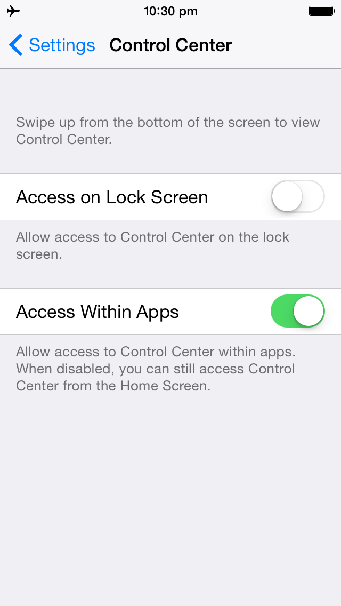
Protecting Yourself
Additional measures: disable AirDrop and Control Center on the lock screen

Slide 66
EOF
Questions?

