Slide 1

ISCOF
ONLINE VOTING SYSTEM

Slide 2

ISCOF ONLINE VOTING SYSTEM
A voting system that uses mobile phones to cast a vote, a website to manage parties and other data, and a cloud server that aids in storing data and counting votes..

Slide 3
TOPICS
Voting System
Users
Configurations
Terms

Slide 4
Voting System

Slide 5


Types of Online Voting System
System-wide
Campus-wide
System-wide
Campus-wide
A online voting system that can be used by all students all over ISCOF System. Data is separate per campus
The system is limited only on one campus

Slide 6
Manage parties per campus
1 Super Admin User that supervises System-wide data
Unlimited administrators for each campuses
Election summary report
Campus-ide
Maximum of 5 voters per minute
System-wide
Data reset

Slide 7
Manage parties only on one campus
1 Super Admin User that supervises campus data
Election summary report
Maximum of 5 voters per minute
Campus-ide
Campus-wide
Data reset
System-wide

Slide 8






Setup 1
cloud
server
Setup 1 is using a custom server that is deployed on a cloud hosting. Advantages of a server type setup is that there are no tech guy required in this setup. However, the hosting is paid in a minimum of 350 php per month. Click the link below for additional references. https://www.hostinger.ph/?ppc_campaign=google_search_brand&bidkw=hostinger&gclid=CjwKCAjwxo6IBhBKEiwAXSYBs-ttkJyQgHeqxFR17LxspxUBbY0d-RwockTbOFiXXwG9d0k1vWj5fRoCQDAQAvD_BwE
administrators
voters

Slide 9


Setup 2
cloud
Firebase server
Setup 2 is using a pay as you go server that is developed by google. It provides real-time data and its completely free when data limit is not maximized. Disadvantages of this setup are: If it is used in system-wide scale the server might crash needs a tech guy to alter a programming code to reset the server. Recommended on campus wide system only
administrators
voters

Slide 10
Types of User
Super Admin
Administrator
Voter
Has all access rights. Can manage or see all data
Has access rights but limited only for a specific task and election summary
Has voting rights and can view the election summary

Slide 11
Configurations

Slide 12
Setup 1
Custom server type needs hosting for accessing the data online and accessing the website. The said setup is payment before usage. The configurations are prepared by the developer.
Custom server type

Slide 13
Setup 2
Firebase server type is completely free. However the website is manually installed by the developer on the desktop of the super admin and administrators. Needs a tech guy in every election
Firebase server type

Slide 14
Developer Terms
Initial payment must be 20% before starting the project.
Scope of the project must be finalized on the first meeting any additional features that will be added that is not mention in the scope will have an additional payment and the price will solely depends on the developer’s reasonable judgement.
Upon 50% of the project completion. Client must have paid 50% in order for the developer to continue the project.
If Custom server type is chosen. Client must purchase the hosting for the testing of the said project.
Upon complete testing and the project should be 100% complete. The client must provide a full payment in order to get the said system.
Online website maintenance is free for 1 year ( needs client full cooperation ).

Slide 15
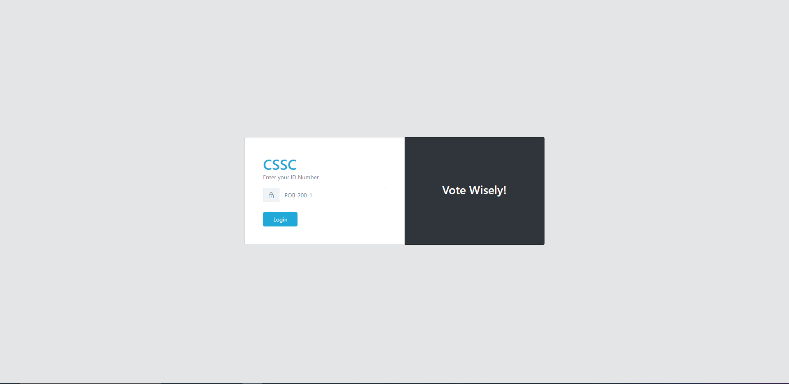
Mock up
Website

Slide 16
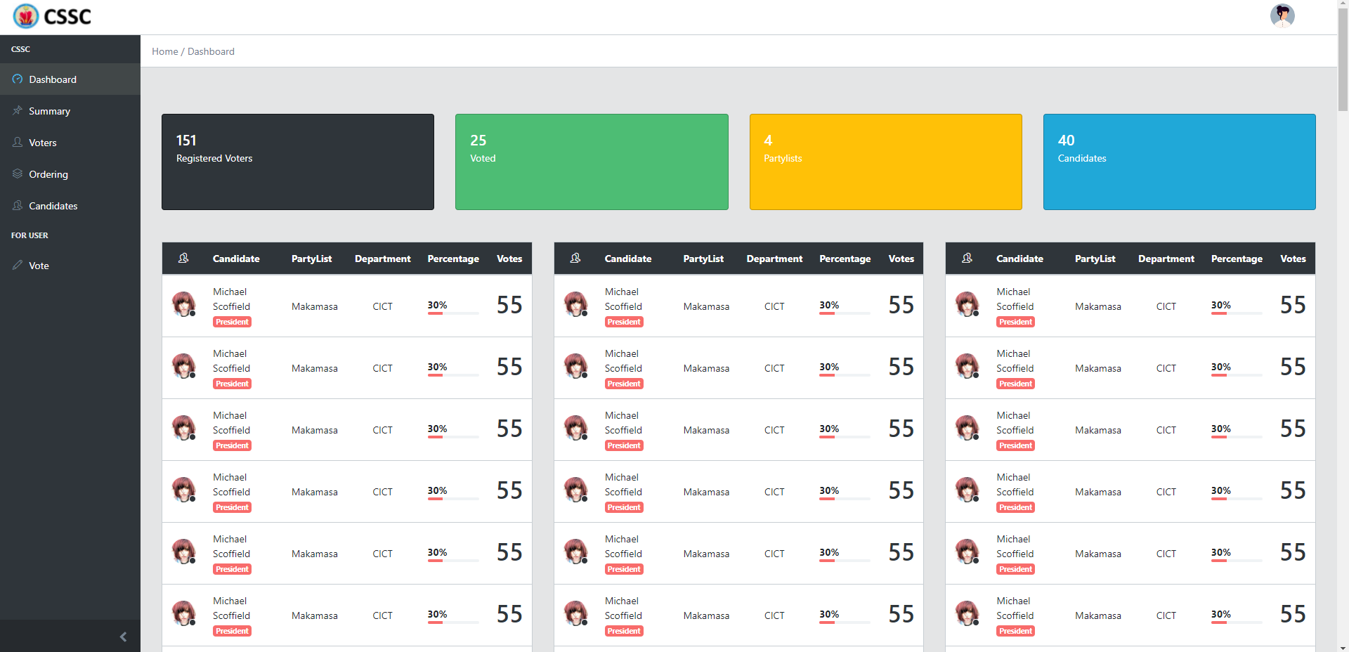
Mock up
Website

Slide 17
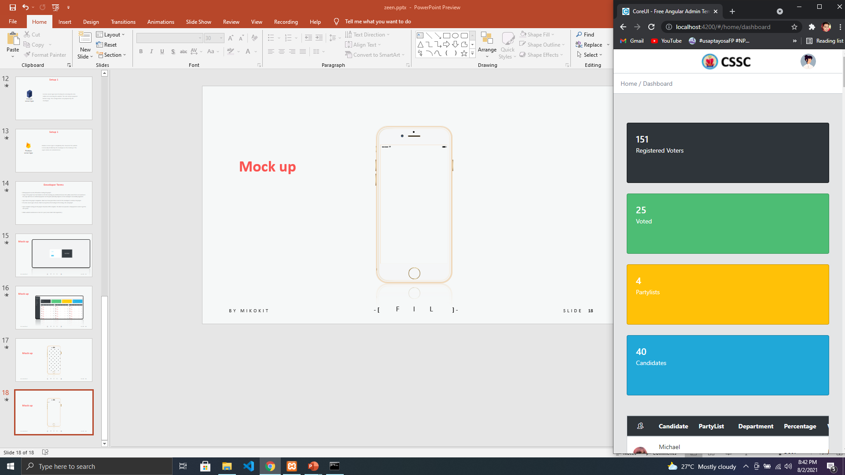
Mock up
Website

Slide 18
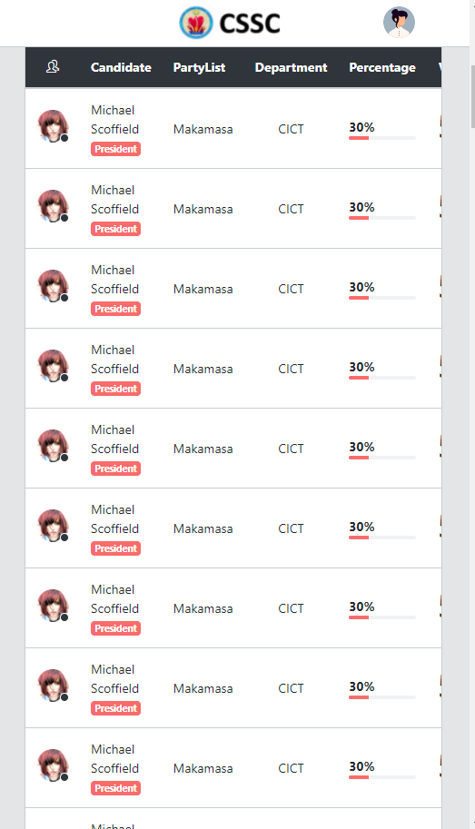
Mock up
Website

Slide 19
Mobile App
Coming Soon

Slide 20
Thank You!

