Slide 1


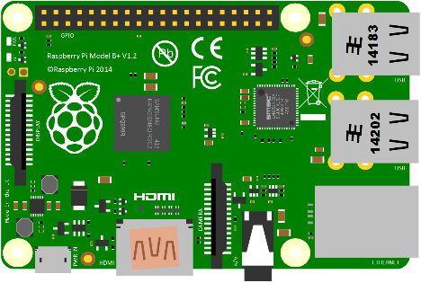

Image Storing
Firebase
4. Data has been Stored Successfully
3. Student Information & Hash
1. Student Information & Images
2. Store Image and Hash

Slide 2



Login
Firebase
5. Compare/Store Login
6. 7. Face Detected/Not Detected
2. Mode( Login, Logout)
4. Face
3. Face
5. Hash
1. Room

