Slide 1
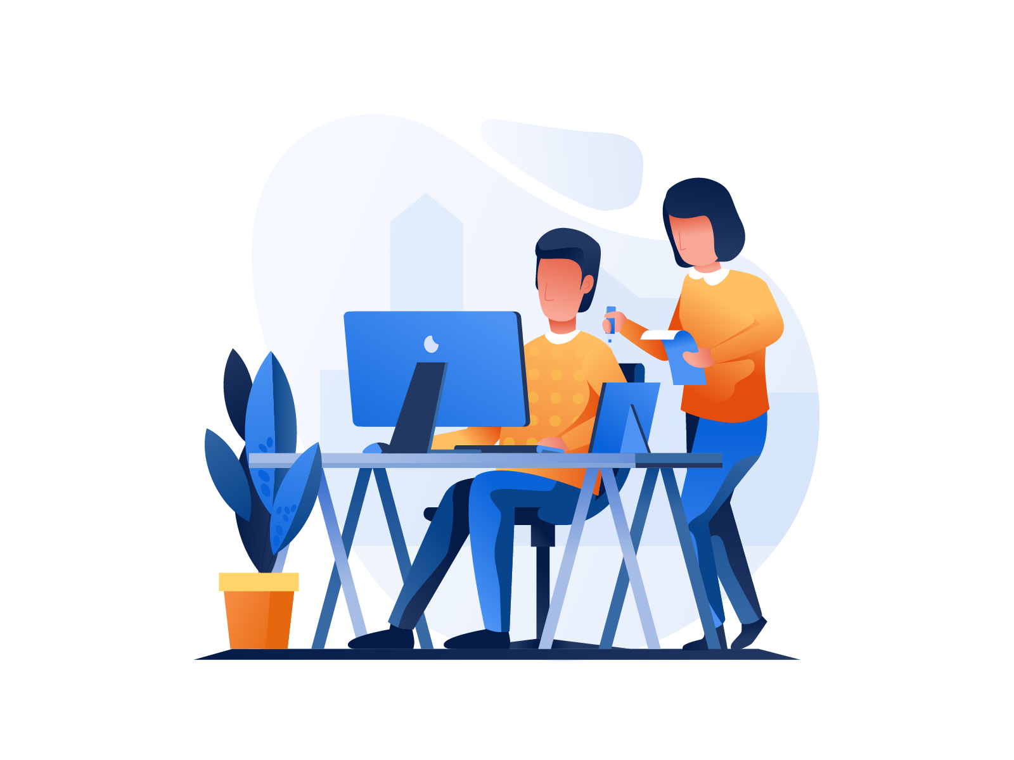
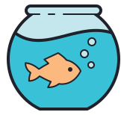
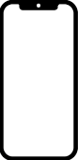

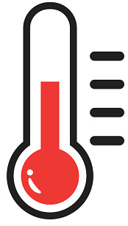
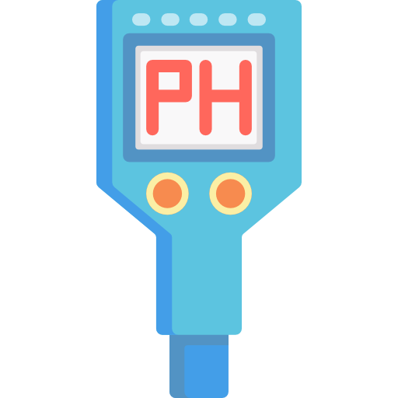
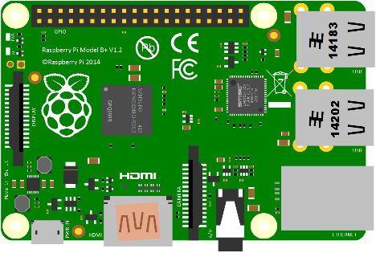
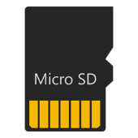
1. Experiments Koi Behaviors and statuses based on variables
ADMIN
2. Store results of the experiment on a cloud server
CLIENT
3. Every time client access the app. The app gets real-time data from the cloud server
Sensor detects water quality and raspberry pi send it to a cloud server
Firebase

