Slide 1
Flutter Recap
A Flutter Recap

Slide 2
What is Design Pattern?
Design patterns are like reusable blueprints for solving common problems in software development. They are not complete code solutions, but rather proven approaches and structures that can be adapted to different situations. They help developers build flexible, maintainable, and efficient software.
Notes:
In each and every one of us has the identity when it comes on how we code.
Call a student.
Name of the student, you --- you have an identity on how you code. It is the distinction or personality in technical term we can call it "LOGIC"
Here in our session for today we will learn how we code faster. "Not typing faster"
THE POWER OF TEMPLATING

Slide 3
What is MVC?
It was Trygve Reenskaug who developed MVC. This design pattern was primarily intended to address the issue of users managing a sizable and intricate data collection by segmenting a huge program into discrete parts, each serving a distinct function.
An architectural/design pattern known as the Model-View-Controller (MVC) framework divides an application into three primary logical components: the controller, view, and model. Every architectural element is designed to manage particular application development facets. It separates the presentation layer from the business logic. Historically, desktop graphical user interfaces (GUIs) have been utilized with it. In order to produce scalable and flexible applications, MVC is currently one of the most widely utilized industry-standard web development frameworks. Mobile app design is another usage for it.
Notes:
One of the most usable formats of the frameworks especially the [Mobile and Web development.]
It was Trygve Reenskaug who developed MVC. This design pattern was primarily intended to address the issue of users managing a sizable and intricate data collection by segmenting a huge program into discrete parts, each serving a distinct function.
An architectural/design pattern known as the Model-View-Controller (MVC) framework divides an application into three primary logical components: the controller, view, and model. Every architectural element is designed to manage particular application development facets. It separates the presentation layer from the business logic. Historically, desktop graphical user interfaces (GUIs) have been utilized with it. In order to produce scalable and flexible applications, MVC is currently one of the most widely utilized industry-standard web development frameworks. Mobile app design is another usage for it.

Slide 4
What is Cross Platform
Cross-platform development is a software development approach where you create software products that can run on multiple platforms or operating systems without having to rewrite the code for each one. This means, with one codebase, you can develop an app that works on different devices like Android phones, iPhones, Windows laptops, MacBook, etc.

Slide 5
What is a Framework?
A framework is similar to a structure that serves as the foundation for the process of developing an application. You don't have to write everything from scratch if you have a framework. A collection of components and technologies known as frameworks facilitates the rapid development process. It serves as a kind of template that may be used and even altered to fit the needs of the project.
Notes:
You may hear of different frameworks based on a programming language whenever you deal with one. Any framework can be used when working on software to improve the overall quality of the program. Frameworks save developers time and effort during the development process and offer a number of benefits. They make it possible for developers to build clear, intelligible code.
A framework is similar to a structure that serves as the foundation for the process of developing an application. You don't have to write everything from scratch if you have a framework. A collection of components and technologies known as frameworks facilitates the rapid development process. It serves as a kind of template that may be used and even altered to fit the needs of the project.
Writing the code from scratch is a laborious process fraught with dangers and mistakes. The code must be clear, well-tested, error-free, and free of defects. It will be challenging for other developers to work with and comprehend the code. Working with the frameworks that satisfy your needs is therefore preferable. They facilitate easier development processes with fewer mistakes. It is an all-purpose template that may be used and altered to suit the needs. Others that are experienced with frameworks will find it easy to understand your code.
In the industry they want to lessen the from the scratch development because they want a faster production.
Share my industry friends.
Using a framework will give a head start on the developers.
Common types of frameworks:
>> Web development frameworks: Django, Ruby on Rails, Express.js, Angular, React
>> Mobile development frameworks: React Native, Flutter, Xamarin
>> Game development frameworks: Unity, Unreal Engine
>> Machine learning frameworks: TensorFlow, PyTorch
>> Testing frameworks: JUnit, Selenium

Slide 6

SAMPLE MVC DIAGRAM

Slide 7
Dart
Dart is a general-purpose, object-oriented programming language developed by Google. It's known for its clean syntax, strong typing, and ability to compile to multiple platforms, making it a versatile choice for various development projects.

Slide 8
Flutter
Flutter is an open-source UI framework created by Google for building beautiful, high-performance, and cross-platform applications. It allows you to develop apps for mobile, web, desktop, and embedded devices from a single codebase.

Slide 9
Flutter
Archive

Slide 10
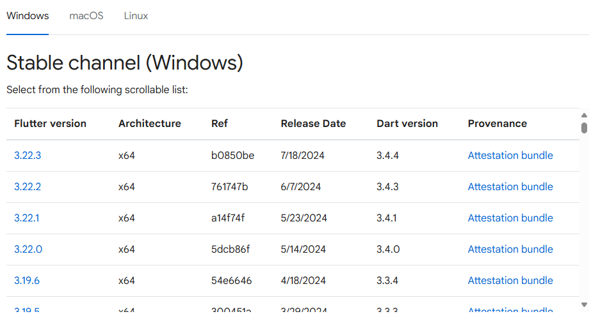
https://docs.flutter.dev/release/archive
Flutter Archive

Slide 11
Flutter
Front-End Development

Slide 12
Widgets
Types of Widgets:
Basic Widgets: These are the fundamental building blocks like Text, Container, Row, Column, Image, IconButton, etc. They provide the core elements for displaying text, images, buttons, and other UI components.
Layout Widgets: These widgets help you arrange your basic widgets on the screen, like Row for horizontal arrangements, Column for vertical arrangements, Stack for overlapping widgets, etc.

Slide 13
Widgets
Types of Widgets:
Stateful Widgets: Unlike stateless widgets with fixed appearances, stateful widgets can change their appearance based on data or user interactions. They manage their own state using the StatefulWidget class.
Material Widgets: If you're building Android-inspired apps, Flutter offers a rich set of Material Design widgets that follow Google's design guidelines, promoting consistent and beautiful UIs.

Slide 14
Widgets
Types of Widgets:
Cupertino Widgets: Similarly, for iOS-inspired apps, there are Cupertino widgets that adhere to Apple's design language, ensuring a native look and feel on iPhones and iPads.
Custom Widgets: Flutter empowers you to create your own custom widgets by extending the Widget class. This lets you build reusable and specialized UI components tailored to your specific needs.

Slide 15
Flutter
Front-End Functionalities

Slide 16
Navigation
Types of Navigation:
Stack Navigation: The most common approach, where screens are pushed onto a stack and popped off to return. Ideal for linear flows and hierarchical structures.
Tab Navigation: Used for switching between independent sections of your app, typically represented by tabs at the bottom of the screen.

Slide 17
Navigation
Types of Navigation:
Bottom Navigation: Similar to tab navigation, but often with a circular layout and animation for a more modern feel.
Drawer Navigation: Provides a hidden menu that slides in from the side, usually containing less frequently accessed options.

Slide 18
Navigation
Flutter Navigation Tools:
Navigator: The core widget for managing the navigation stack and transitions between screens.
MaterialPageRoute: A common route definition for pushing new screens onto the stack with platform-specific animations.
CupertinoPageRoute: Similar to MaterialPageRoute, but with Cupertino-style animations for iOS-inspired apps.

Slide 19
Navigation
Flutter Navigation Tools:
Named Routes: Define routes with names for easier navigation and code organization.
Navigation Packages: Consider packages like go_router or provider_router for more complex navigation needs and declarative routing approaches.

Slide 20

Dialogs

Slide 21
Flutter State Management
Presented by: Cyrus Rj W. Robles

Slide 22
Stateful Widget Life Cycle
Intro to State Management

Slide 23
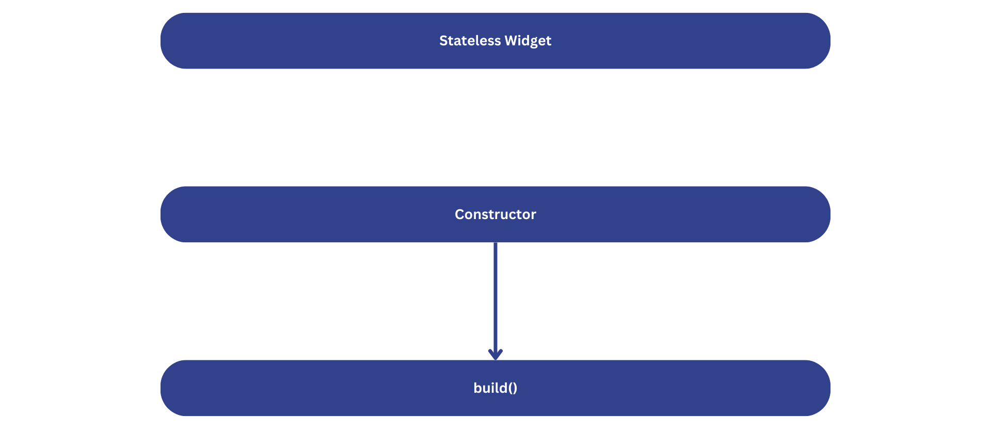
Stateless Widget
Stateless widgets are the simplest building blocks in Flutter. As the name suggests, they don't hold any state, meaning their appearance remains constant throughout their lifetime.

Slide 24
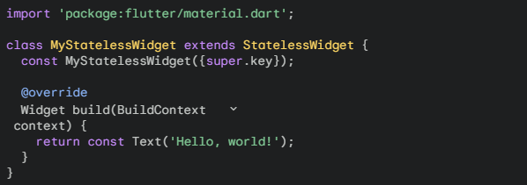
Example
MyStatelessWidget is a Stateless Widget.
The build method is overridden to return a Text widget, which is the UI for this widget.
The widget will remain unchanged unless its parent rebuilds, causing the build method to be called again.

Slide 25
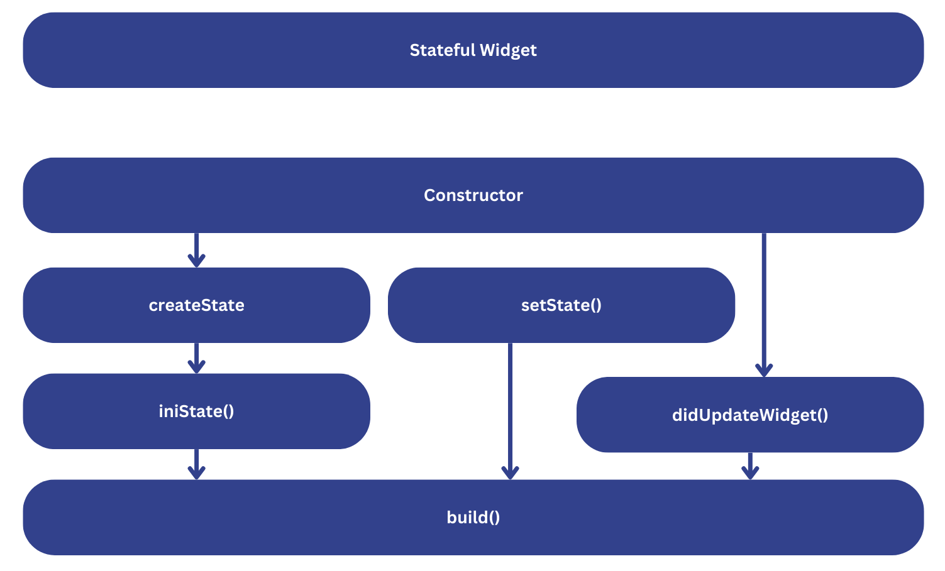
Stateful Widget
Unlike stateless widgets, Stateful Widgets can maintain and modify their state over time. This allows for dynamic updates to the UI based on user interactions, data changes, or other events.
createState(): This method is called when the widget is first inserted into the widget tree. It returns a State object, which holds the mutable state of the widget.
initState(): Called immediately after createState(), it's used for initial setup, like initializing state variables or subscribing to streams. This method is called only once during the widget's lifetime.
didChangeDependencies(): Called after initState() and whenever the dependencies of the widget change (e.g., InheritedWidget changes, locale changes).
build(): Called to construct the widget's UI. It's called every time the state changes or the widget is rebuilt due to other reasons.
didUpdateWidget(): Called when the widget configuration changes (e.g., properties passed to the widget).
deactivate(): Called when the widget is removed from the tree but might be inserted again later.
dispose(): Called when the widget is permanently removed from the tree and will never be inserted again. This is the final opportunity to release resources like timers, network connections, or subscriptions.

Slide 26
Restore state
When a user runs a mobile app and then selects another app to run, the first app is moved to the background, or backgrounded. The operating system (both iOS and Android) might kill the backgrounded app to release memory and improve performance for the app running in the foreground.
Flutter has a solution for this with the RestorationManager (and related classes) in the services library. With the RestorationManager, the Flutter framework provides the state data to the engine as the state changes, so that the app is ready when the OS signals that it's about to kill the app, giving the app only moments to prepare.
Notes:
Additional Mid: When the user selects the app again, bringing it back to the foreground, the OS relaunches it. But, unless you've set up a way to save the state of the app before it was killed, you've lost the state and the app starts from scratch. The user has lost the continuity they expect, which is clearly not ideal. (Imagine filling out a lengthy form and being interrupted by a phone call before clicking Submit.)

Slide 27
Instance state vs long-lived state
When should you use the RestorationManager and when should you save state to long term storage? Instance state (also called short-term or ephemeral state), includes unsubmitted form field values, the currently selected tab, and so on. On Android, this is limited to 1 MB and, if the app exceeds this, it crashes with a TransactionTooLargeException error in the native code.

Slide 28
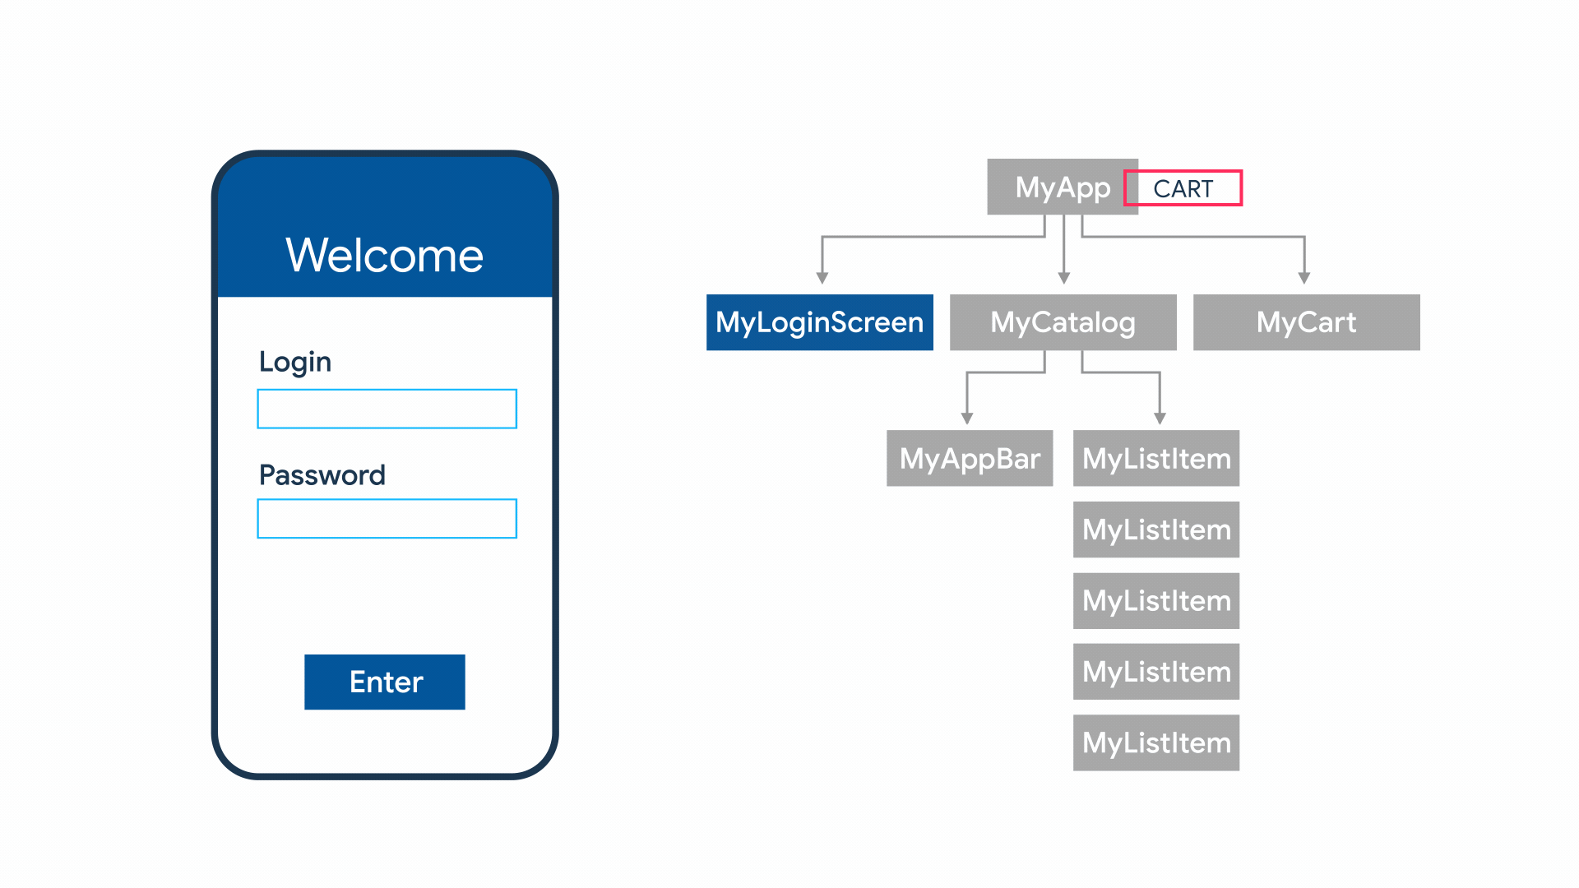
Flutter State Management
There comes a time when you need to share application state between screens, across your app. There are many approaches you can take, and many questions to think about.

Slide 29
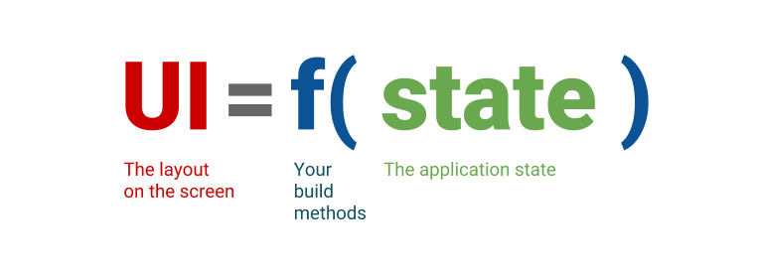
Think Declaratively
If you're coming to Flutter from an imperative framework (such as Android SDK or iOS UIKit), you need to start thinking about app development from a new perspective.
Many assumptions that you might have don't apply to Flutter. For example, in Flutter it's okay to rebuild parts of your UI from scratch instead of modifying it. Flutter is fast enough to do that, even on every frame if needed.
Flutter is declarative. This means that Flutter builds its user interface to reflect the current state of your app
Notes:
Conclusion: When the state of your app changes (for example, the user flips a switch in the settings screen), you change the state, and that triggers a redraw of the user interface. There is no imperative changing of the UI itself (like widget.setText)—you change the state, and the UI rebuilds from scratch.
The declarative style of UI programming has many benefits. Remarkably, there is only one code path for any state of the UI. You describe what the UI should look like for any given state, once—and that is it.
At first, this style of programming might not seem as intuitive as the imperative style.

Slide 30
Ephemeral State
vs.
App State
Scope: Local to a specific widget or a small part of the UI.
Lifespan: Short-lived, existing only as long as the widget is mounted and visible.
Management: Typically handled within the StatefulWidget using the setState method.
Examples:
  The current text in a text field.
  Whether a checkbox is checked or not.
  The selected tab in a tab bar.
  The current page in a paginated view.
Scope: Shared across multiple widgets or even the entire application.
Lifespan: Longer-lived, often persisting across user sessions (e.g., using local storage).
Management: Requires a dedicated state management solution like Provider, Riverpod, BLoC, or Redux.
See: List of state management approaches | Flutter
Examples:
  User preferences
  Login info
  Notifications in a social networking app
  The shopping cart in an e-commerce app
  Read/unread state of articles in a news app
Notes:
Ephemeral State
Ideal for:
UI-specific data that doesn't need to be shared across multiple widgets. 1. Differentiate between ephemeral state and app state - Flutter Documentation
docs.flutter.dev
Temporary values that don't persist beyond the widget's lifetime.
Simple state management within a single widget. 1. Differentiate between ephemeral state and app state - Flutter Documentation
docs.flutter.dev
Examples:
Text input values
Checkbox states
Dropdown menu selections
Animation states
Tab selection
App State
Ideal for:
Data that needs to be shared across multiple widgets or screens. 1. Differentiate between ephemeral state and app state - Flutter Documentation
docs.flutter.dev
Persistent data that needs to survive navigation or app restarts.
Complex state management scenarios with multiple interrelated data points.
Examples:
User authentication status
Shopping cart items
User preferences (theme, language)
Application settings
Real-time data (e.g., chat messages)

Slide 31
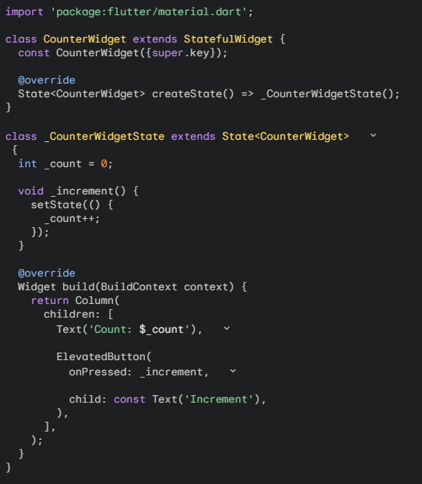
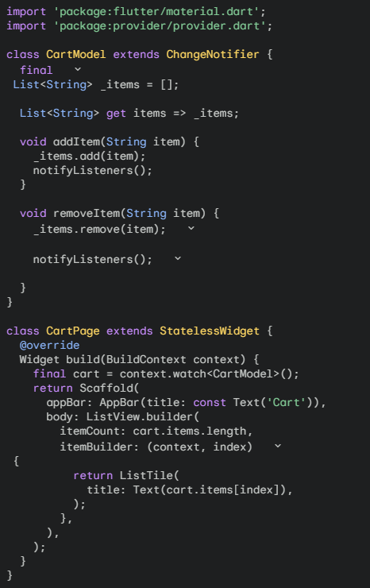
Ephemeral State
vs.
App State
Code-to-code Comparison
Notes:
Ephemeral State
In this example, _count is an ephemeral state. It's local to the CounterWidget and doesn't persist beyond its lifecycle. The setState method is used to trigger a rebuild of the widget whenever the _count value changes.
App State
In this example, CartModel represents the app state, containing a list of items in the cart. It uses ChangeNotifier to notify listeners (widgets) when the cart changes. The CartPage accesses the cart state using context.watch and rebuilds whenever the cart is updated.

Slide 32
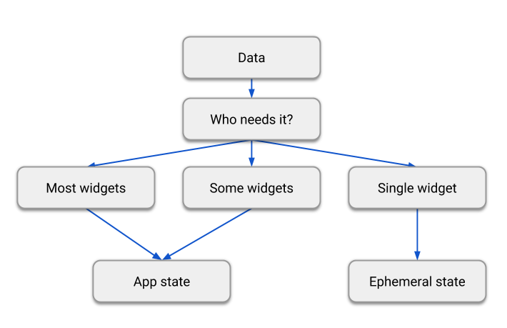
There is no clear-cut rule
There is no clear-cut, universal rule to distinguish whether a particular variable is ephemeral or app state. Sometimes, you'll have to refactor one into another. For example, you'll start with some clearly ephemeral state, but as your application grows in features, it might need to be moved to app state.
For that reason, take the following diagram with a large grain of salt:
Notes:
Intro: To be clear, you can use State and setState() to manage all of the state in your app. In fact, the Flutter team does this in many simple app samples (including the starter app that you get with every flutter create).
It goes the other way, too. For example, you might decide that—in the context of your particular app—the selected tab in a bottom navigation bar is not ephemeral state. You might need to change it from outside the class, keep it between sessions, and so on. In that case, the _index variable is app state.

Slide 33
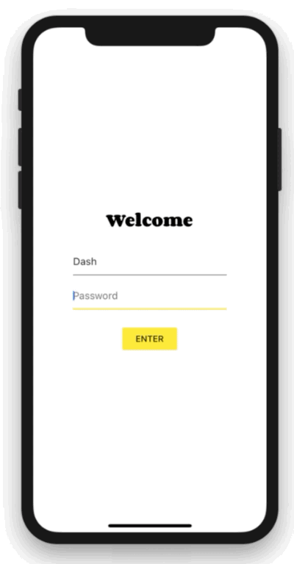
Simple app state management
For illustration, consider the following simple app.
The app has two separate screens: a catalog, and a cart (represented by the MyCatalog, and MyCart widgets, respectively). It could be a shopping app, but you can imagine the same structure in a simple social networking app (replace catalog for "wall" and cart for "favorites").
The catalog screen includes a custom app bar (MyAppBar) and a scrolling view of many list items (MyListItems).
Notes:
Now that you know about declarative UI programming and the difference between ephemeral and app state, you are ready to learn about simple app state management.
On this page, we are going to be using the provider package. If you are new to Flutter and you don't have a strong reason to choose another approach (Redux, Rx, hooks, etc.), this is probably the approach you should start with. The provider package is easy to understand and it doesn't use much code. It also uses concepts that are applicable in every other approach.
That said, if you have a strong background in state management from other reactive frameworks, you can find packages and tutorials listed on the options page.

Slide 34
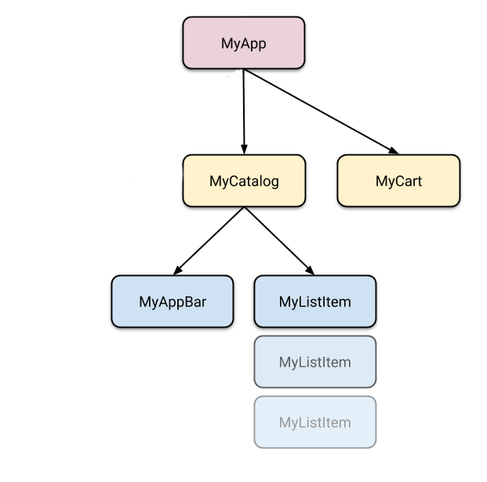
Simple app state management
Here's the app visualized as a widget tree.
So we have at least 5 subclasses of Widget. Many of them need access to state that "belongs" elsewhere. For example, each MyListItem needs to be able to add itself to the cart. It might also want to see whether the currently displayed item is already in the cart.
This takes us to the first question: where should we put the current state of the cart?

Slide 35
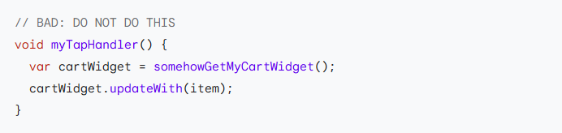
Lifting state up
In Flutter, it makes sense to keep the state above the widgets that use it.
Why? In declarative frameworks like Flutter, if you want to change the UI, you have to rebuild it. There is no easy way to have MyCart.updateWith(somethingNew). In other words, it's hard to imperatively change a widget from outside, by calling a method on it. And even if you could make this work, you would be fighting the framework instead of letting it help you.

Slide 36
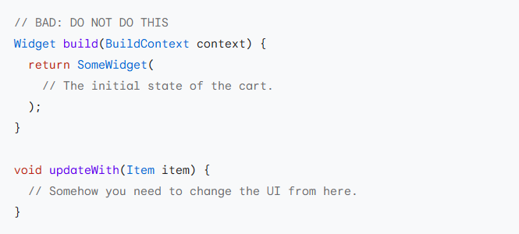
Lifting state up (cont.)
Even if you get the above code to work, you would then have to deal with the following in the MyCart widget:

Slide 37
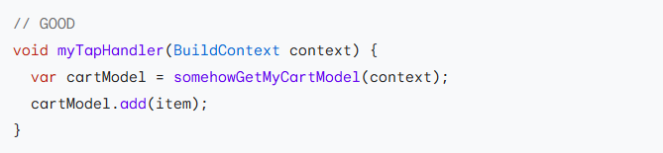
Lifting state up (cont.)
You would need to take into consideration the current state of the UI and apply the new data to it. It's hard to avoid bugs this way.
In Flutter, you construct a new widget every time its contents change. Instead of MyCart.updateWith(somethingNew) (a method call) you use MyCart(contents) (a constructor). Because you can only construct new widgets in the build methods of their parents, if you want to change contents, it needs to live in MyCart's parent or above.

Slide 38
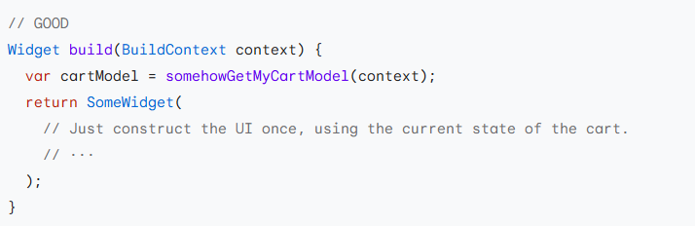
Lifting state up (cont.)
Now MyCart has only one code path for building any version of the UI.

Slide 39
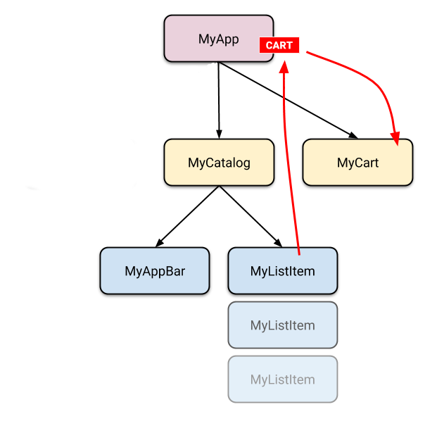
Simple app state management
In the example, contents needs to live in MyApp. Whenever it changes, it rebuilds MyCart from above (more on that later). Because of this, MyCart doesn't need to worry about lifecycle—it just declares what to show for any given contents. When that changes, the old MyCart widget disappears and is completely replaced by the new one.
This is what we mean when we say that widgets are immutable. They don't change—they get replaced.
Now that we know where to put the state of the cart, let's see how to access it.

Slide 40
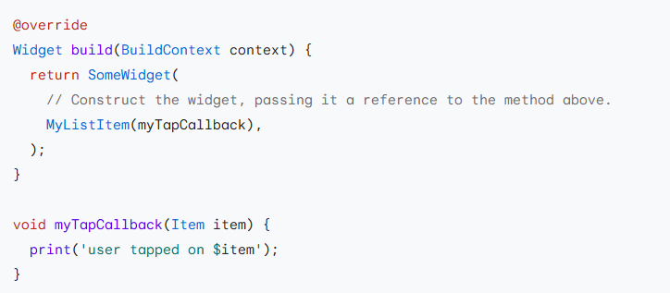
Accessing the state
When a user clicks on one of the items in the catalog, it's added to the cart. But since the cart lives above MyListItem, how do we do that?
A simple option is to provide a callback that MyListItem can call when it is clicked. Dart's functions are first class objects, so you can pass them around any way you want. So, inside MyCatalog you can define the following:

Slide 41
Accessing the state
This works okay, but for an app state that you need to modify from many different places, you'd have to pass around a lot of callbacks—which gets old pretty quickly.
Fortunately, Flutter has mechanisms for widgets to provide data and services to their descendants (in other words, not just their children, but any widgets below them). As you would expect from Flutter, where Everything is a Widget™, these mechanisms are just special kinds of widgets—InheritedWidget, InheritedNotifier, InheritedModel, and more. We won't be covering those here, because they are a bit low-level for what we're trying to do.
Instead, we are going to use a package that works with the low-level widgets but is simple to use. It's called provider.
Before working with provider, don't forget to add the dependency on it to your pubspec.yaml.
To add the provider package as a dependency, run flutter pub add:

Slide 42
Provider
Now you can import 'package:provider/provider.dart'; and start building.
With provider, you don't need to worry about callbacks or InheritedWidgets. But you do need to understand 3 concepts:
  ChangeNotifier
  ChangeNotifierProvider
  Consumer

Slide 43
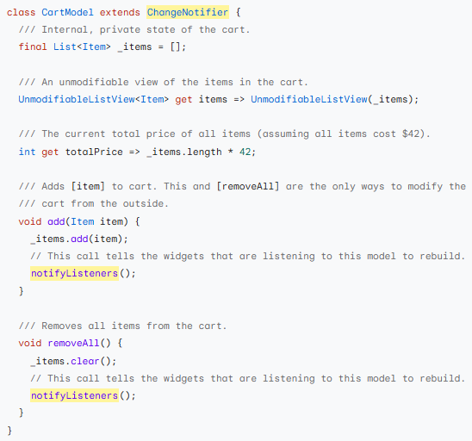
ChangeNotifier
ChangeNotifier is a simple class included in the Flutter SDK which provides change notification to its listeners. In other words, if something is a ChangeNotifier, you can subscribe to its changes. (It is a form of Observable, for those familiar with the term.)
In provider, ChangeNotifier is one way to encapsulate your application state. For very simple apps, you get by with a single ChangeNotifier. In complex ones, you'll have several models, and therefore several ChangeNotifiers. (You don't need to use ChangeNotifier with provider at all, but it's an easy class to work with.)
In our shopping app example, we want to manage the state of the cart in a ChangeNotifier. We create a new class that extends it, like so:

Slide 44
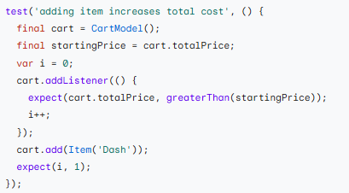
ChangeNotifier
The only code that is specific to ChangeNotifier is the call to notifyListeners(). Call this method any time the model changes in a way that might change your app's UI. Everything else in CartModel is the model itself and its business logic.
ChangeNotifier is part of flutter:foundation and doesn't depend on any higher-level classes in Flutter. It's easily testable (you don't even need to use widget testing for it). For example, here's a simple unit test of CartModel:

Slide 45
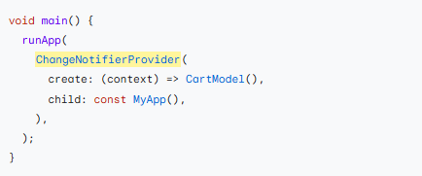
ChangeNotifierProvider
ChangeNotifierProvider is the widget that provides an instance of a ChangeNotifier to its descendants. It comes from the provider package.
We already know where to put ChangeNotifierProvider: above the widgets that need to access it. In the case of CartModel, that means somewhere above both MyCart and MyCatalog.
You don't want to place ChangeNotifierProvider higher than necessary (because you don't want to pollute the scope). But in our case, the only widget that is on top of both MyCart and MyCatalog is MyApp.

Slide 46
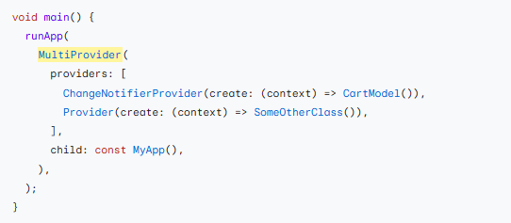
ChangeNotifierProvider
Note that we're defining a builder that creates a new instance of CartModel. ChangeNotifierProvider is smart enough not to rebuild CartModel unless absolutely necessary. It also automatically calls dispose() on CartModel when the instance is no longer needed.
If you want to provide more than one class, you can use MultiProvider:

Slide 47
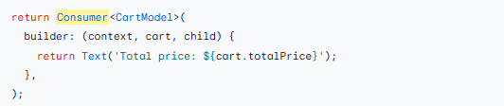
Consumer
Now that CartModel is provided to widgets in our app through the ChangeNotifierProvider declaration at the top, we can start using it.
This is done through the Consumer widget.

Slide 48
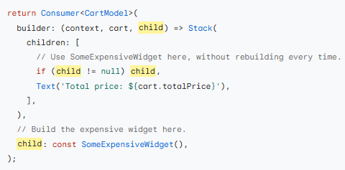
Consumer
We must specify the type of the model that we want to access. In this case, we want CartModel, so we write Consumer<CartModel>. If you don't specify the generic (<CartModel>), the provider package won't be able to help you. provider is based on types, and without the type, it doesn't know what you want.
The only required argument of the Consumer widget is the builder. Builder is a function that is called whenever the ChangeNotifier changes. (In other words, when you call notifyListeners() in your model, all the builder methods of all the corresponding Consumer widgets are called.)
The builder is called with three arguments. The first one is context, which you also get in every build method.
The second argument of the builder function is the instance of the ChangeNotifier. It's what we were asking for in the first place. You can use the data in the model to define what the UI should look like at any given point.
The third argument is child, which is there for optimization. If you have a large widget subtree under your Consumer that doesn't change when the model changes, you can construct it once and get it through the builder.

Slide 49
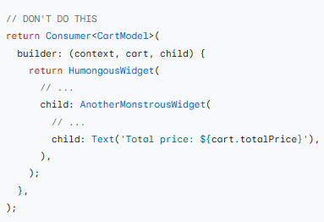
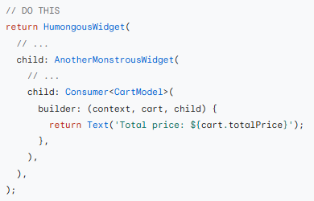
Consumer
It is best practice to put your Consumer widgets as deep in the tree as possible. You don't want to rebuild large portions of the UI just because some detail somewhere changed.

Slide 50
Provider.of
Sometimes, you don't really need the data in the model to change the UI but you still need to access it. For example, a ClearCart button wants to allow the user to remove everything from the cart. It doesn't need to display the contents of the cart, it just needs to call the clear() method.
We could use Consumer<CartModel> for this, but that would be wasteful. We'd be asking the framework to rebuild a widget that doesn't need to be rebuilt.
For this use case, we can use Provider.of, with the listen parameter set to false.
Using the above line in a build method won't cause this widget to rebuild when notifyListeners is called.

Slide 51
Flutter App with Back End Data
Presented by: Cyrus Rj W. Robles

Slide 52
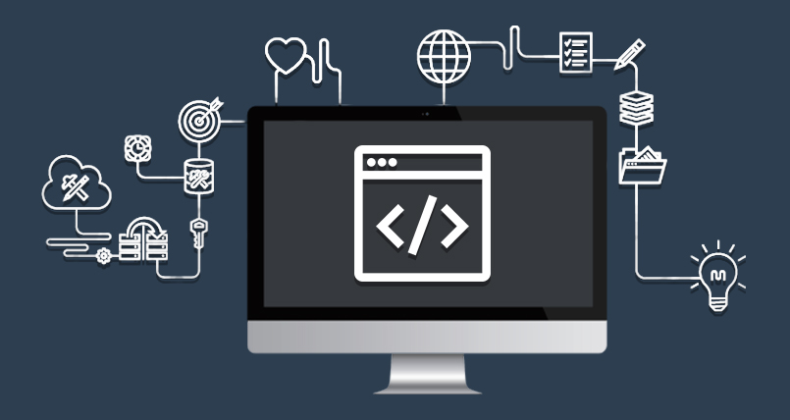
Back-end
is the programming side of an application that users don't directly see. It's the "behind the scenes" work that makes websites and apps function and interact with data.
Responsibilities:
Building APIs: Creating Application Programming Interfaces that enable communication between your app and various data sources or services.
Storing and managing data: Implementing databases (e.g., SQL, NoSQL) to store and retrieve user information, app data, and other essential information.
Developing server-side logic: Writing code that processes user requests, performs calculations, and interacts with databases to deliver functionality.
Handling security: Implementing secure authentication, authorization, and encryption to protect user data and privacy.
Ensuring performance and scalability: Optimizing code and infrastructure to handle high traffic and ensure your app stays responsive.

Slide 53
Async and Await
Understanding Asynchronous Programming

Slide 54
Asynchronous Programming
Asynchronous programming is a style of programming where tasks can start running without waiting for previous tasks to complete. This allows a program to continue executing other code while long-running tasks are processed in the background.
Key characteristics:
  Non-blocking: The program doesn't halt execution while waiting for a task to finish.
  Concurrency: Multiple tasks can run concurrently, improving responsiveness.
  Event-driven: Often relies on events or callbacks to handle task completion.
Example:
  Imagine downloading a large file. In synchronous programming, the program would be blocked until the download finishes, making the application unresponsive. With asynchronous programming, the download can start in the background, and the application can continue to perform other tasks while the download progresses.
Notes:
Example:
Imagine downloading a large file. In synchronous programming, the program would be blocked until the download finishes, making the application unresponsive. With asynchronous programming, the download can start in the background, and the application can continue to perform other tasks while the download progresses.

Slide 55
Future
A Future in Flutter is an object representing a computation that will be completed at some point in the future. It encapsulates the eventual result of an asynchronous operation. This result can be a value (if the operation succeeds) or an error (if it fails)
Key Characteristics:
  Asynchronous: Represents an operation that doesn't block the main thread.
  Eventual Result: Holds the result of the operation when it completes.
  Error Handling: Can handle errors that occur during the operation
import 'package:http/http.dart' as http;
Future<String> fetchData() async {
final response = await http.get(Uri.parse('https://api.example.com/data’));
if (response.statusCode == 200) {
return response.body;
} else {
throw Exception('Failed to load data');
}
}

Slide 56
async
The async keyword in Flutter is used to mark a function as asynchronous. This means the function can perform operations that might take time without blocking the main thread of execution.
Key Characteristics:
  Non-blocking: An async function doesn't halt the program's execution while waiting for the operation to finish.
  Future return type: An async function implicitly returns a Future object.
  Use with await: The await keyword can only be used within an async function.
import 'package:http/http.dart' as http;
Future<String> fetchData() async {
final response = await http.get(Uri.parse('https://api.example.com/data’));
if (response.statusCode == 200) {
return response.body;
} else {
throw Exception('Failed to load data');
}
}

Slide 57
await
The await keyword in Flutter is used to pause the execution of an asynchronous function until a Future completes. It's a crucial part of asynchronous programming in Dart and Flutter.
Key Characteristics:
  Can only be used within an async function.
  Pauses execution: The code after await won't run until the Future finishes.
  Returns the result: When the Future completes, await returns its value.
import 'package:http/http.dart' as http;
Future<String> fetchData() async {
final response = await http.get(Uri.parse('https://api.example.com/data’));
if (response.statusCode == 200) {
return response.body;
} else {
throw Exception('Failed to load data');
}
}

Slide 58
Code samples
import 'package:http/http.dart' as http;
Future<String> fetchData() async {
final response = await http.get(Uri.parse('https://api.example.com/data’));
if (response.statusCode == 200) {
return response.body;
} else {
throw Exception('Failed to load data');
}
}
// Error handling
try {
final data = await fetchData();
// Process the data
} catch (error) {
print('Error fetching data: $error');
}

Slide 59
Chaining Futures
Future<String> fetchData1() async { ... }
Future<String> fetchData2() async { ... }
Future<void> main() async {
final data1 = await fetchData1();
final data2 = await fetchData2();
// Process data1 and data2
}

Slide 60
Future Builder
FutureBuilder is a widget in Flutter that builds its UI based on the latest snapshot of interaction with a Future. It's specifically designed to handle asynchronous operations and update the UI accordingly
Key Characteristics:
  Asynchronous operations: Handles Future objects, which represent asynchronous computations.
  UI updates: Reconstructs the widget based on the Future's state (waiting, completed, or error).
  ConnectionState: Provides information about the Future's current state.
import 'package:http/http.dart' as http;
FutureBuilder<String>(
future: fetchData(),
builder: (context, snapshot) {
if (snapshot.connectionState == ConnectionState.waiting) {
return CircularProgressIndicator();
} else if (snapshot.hasError) {
return Text('Error: ${snapshot.error}');
} else {
return Text(snapshot.data!);
}
},
),

Slide 61
Future Builder
import 'package:http/http.dart' as http;
FutureBuilder<String>(
future: fetchData(),
builder: (context, snapshot) {
if (snapshot.connectionState == ConnectionState.waiting) {
return CircularProgressIndicator();
} else if (snapshot.hasError) {
return Text('Error: ${snapshot.error}');
} else {
return Text(snapshot.data!);
}
},
),
FutureBuilder(
future: yourFuture, // The Future to be monitored
builder: (BuildContext context, AsyncSnapshot snapshot) {
switch (snapshot.connectionState) {
case ConnectionState.none:
return Text('No
data');
case ConnectionState.waiting:
return CircularProgressIndicator();
case ConnectionState.active:
return
Text('Loading...');
case ConnectionState.done:
if (snapshot.hasError) {
return Text('Error: ${snapshot.error}');
} else {
return Text('Data: ${snapshot.data}');
}
}
},
)

Slide 62
Async/Await in State Management
import 'package:flutter/material.dart';
import 'package:http/http.dart' as http;
class MyStatefulWidget extends StatefulWidget {
const MyStatefulWidget({super.key});
@override
State<MyStatefulWidget> createState() => _MyStatefulWidgetState();
}
class _MyStatefulWidgetState extends State<MyStatefulWidget> {
String _data = ‘’;
@override
void initState() {
super.initState();
fetchData();
}
@override
Widget build(BuildContext context) {
return Text(_data);
}
}
Future<void> fetchData() async {
final response = await http.get(Uri.parse('https://api.example.com/data'));
if (response.statusCode == 200) {
setState(() {
_data = response.body;
});
} else {
// Handle error
}
}

Slide 63
Common Pitfalls
1. Ignoring Future Returns
Problem: Not handling the returned Future can lead to unhandled exceptions or lost data.
Solution: Always handle the returned Future using await, .then(), or a FutureBuilder.
2. Misusing setState in Async Functions
Problem: Calling setState directly in an async function without awaiting the asynchronous operation can lead to unexpected behavior.
Solution: Use setState within the then block of a Future or after awaiting the operation to ensure the UI updates correctly.
3. Incorrect Error Handling
Problem: Not handling errors properly can lead to app crashes.
Solution: Use try-catch blocks to handle exceptions and provide informative feedback to the user.
4. Blocking the UI Thread
Problem: Excessive use of await without proper asynchronous handling can block the UI thread.
Solution: Use FutureBuilder or other techniques to handle asynchronous operations without blocking the UI.
5. Unnecessary async Keyword
Problem: Using async when not needed can impact performance.
Solution: Only use async when dealing with asynchronous operations.

Slide 64

Best Practices
Clear Function Naming
  Use descriptive function names that reflect the operation performed.
  This improves code readability and maintainability.
Example:

Slide 65
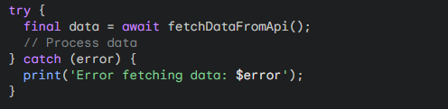
Best Practices
Consistent Error Handling
  Employ try-catch blocks to handle potential exceptions.
  Provide informative error messages.
  Consider using custom error types for better error handling.
Example:

Slide 66

Best Practices
Breaking Down Complex Operations
  For long or complex asynchronous tasks, consider breaking them down into smaller functions.
  This improves code organization and reusability.
Example:
Note: processRawData method parses the rawData into a certain data types.

Slide 67

Best Practices
Leveraging async/await for Readability
  Use async/await to write sequential asynchronous code in a synchronous-like style.
  Avoid excessive nesting of then chains.
Example:

Slide 68
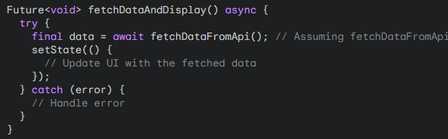
Best Practices
Consider Performance Implications
  While async/await is convenient, excessive use can impact performance.
  For performance-critical sections, explore alternative approaches like Future.then or Stream
Using FutureBuilder for UI Updates
  Employ FutureBuilder to update the UI based on the Future's state.
  Handle loading, error, and success states appropriately.
Example:

Slide 69
API
Understanding APIs in Flutter

Slide 70
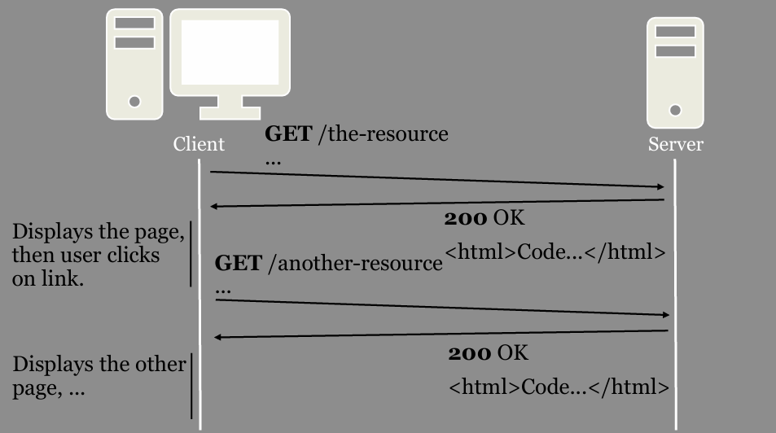
Traditional Web Applications

Slide 71
Traditional Web Applications
The interface is built on HTML & HTTP.
Drawbacks:
  The client must understand both HTTP and HTML.
  The entire webpage is replaced with another one.
    No way to animate transitions between webpages.
Same data is usually sent in multiple responses.
  E.g. HTML code for the layout.

Slide 72
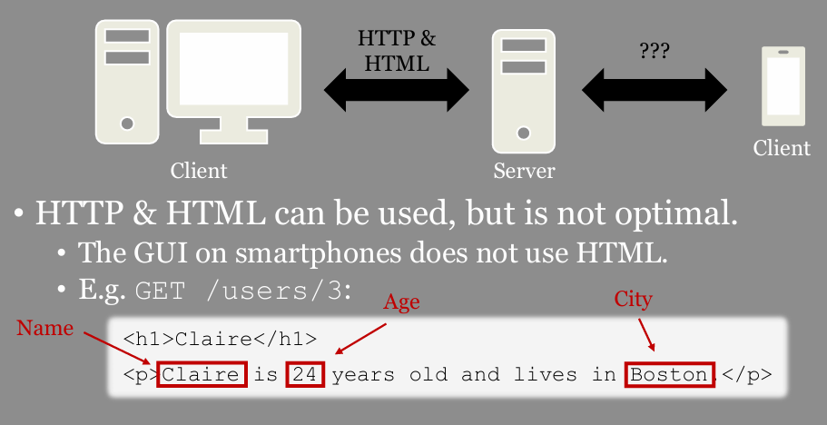
Traditional Web Applications

Slide 73
API
acts as a middleman, enabling communication and data exchange between different software applications. Imagine it as a waiter in a restaurant: you (the user) provide your request (order), the waiter (API) sends it to the kitchen (backend system), and then delivers the response (dish) back to you.
Structure:
  Endpoints: Specific URLs that applications use to access API functionality. Imagine them as different sections of the restaurant menu.
  Requests: Messages sent by applications to an API, specifying what data or action they need. These are like your order to the waiter.
  Responses: Data sent back by the API in response to a request, containing the requested information or indicating success/failure. Think of this as the food you receive from the kitchen.

Slide 74
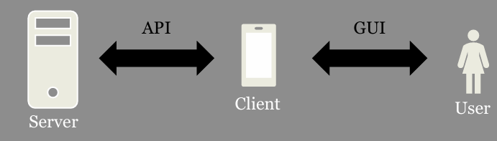
API
A GUI is an interface for Human ↔ Machine communication
An API is an interface for Machine ↔ Machine communication.
An API making use of HTTP is called a Web API

Slide 75
DIFFERENT TYPES OF WEB APIs
Remote Procedure Call, RPC.
Clients can call functions on the server.
Remote Method Invocation, RMI.
Clients can call methods on objects on the server.
Representational State Transfer, REST.
Clients can apply CRUD operations on resources on the server.

Slide 76
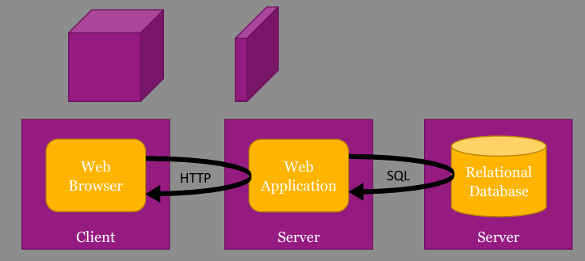
WHAT IS REST?
An architectural style for distributed hypermedia systems described by Roy Thomas Fielding in his doctoral dissertation 2000.
Consists of constraints:
1. Client - Server
2. Stateless
3. Cache
4. Uniform Interface
5. Layered System
6. Code-On-Demand

Slide 77
WHAT DOES REST MEAN?
The name "Representational State Transfer" is intended to evoke an image of how a well-designed Web application behaves: a network of web pages (a virtual state-machine), where the user progresses through the application by selecting links (state transitions), resulting in the next page (representing the next state of the application) being transferred to the user and rendered for their use.
From Roy's dissertation

Slide 78
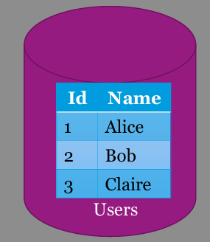
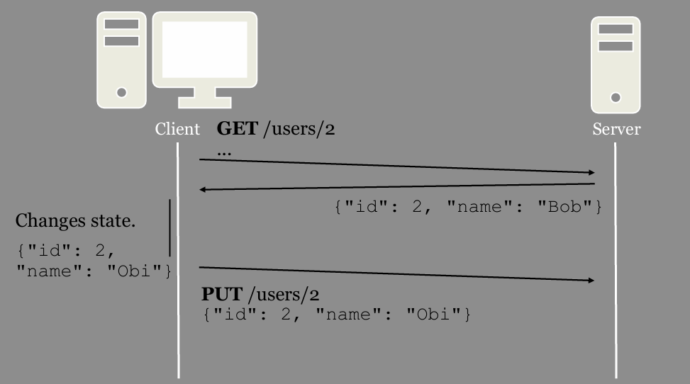
WHAT DOES REST MEAN?

Slide 79
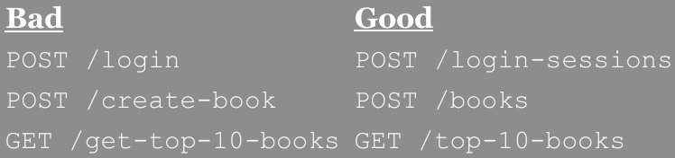
USING HTTP AS THE UNIFORM INTERFACE
Use URIs to identify resources.
Use HTTP methods to specify operation:
  Create: POST (or PUT)
  Retrieve: GET
  Update: PUT (or PATCH)
  Delete: DELETE Bad POST /login POST /create-book GET /get-top-10-books
Use HTTP headers Content-Type and Accept to specify data format for the resources.
Use HTTP status code to indicate success/failure.

Slide 80
USING HTTP AS THE UNIFORM INTERFACE
REST is an architectural style, not a specification.
In practice, it can be used in many different ways.
  But some are better than others.
Good recommendations:
Web API Design - Crafting Interfaces that Developers Love
  https://pages.apigee.com/rs/apigee/images/api-design-ebook-2012-03.pdf

Slide 81
REST EXAMPLE
A server with information about users.
The GET method is used to retrieve resources.
GET | /users
GET | /users/2
GET | /users/pages/1 | GET | /users?page=1
GET | /users/gender/female | GET | /users?gender=female
GET | /users/age/18 | GET | /users?age=18
GET GET | /users/??? /users/2/name | GET | /users?gender=female&age=18
GET | /users/2/pets

Slide 82
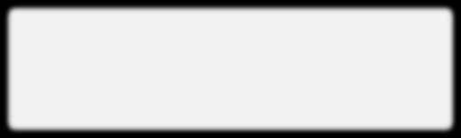
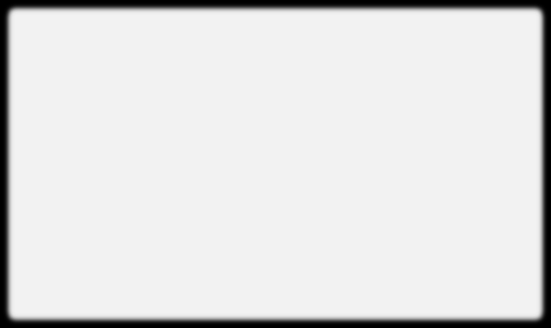


REST EXAMPLE
A server with information about users.
The GET method is used to retrieve resources.
  Which data format? Specified by the Accept header!
GET /users HTTP/1.1 Host: the-website.com Accept: application/json
HTTP/1.1 200 OK
Content-Type: application/json Content-Length: 66
[
{"id": 1, "name": "Alice"},
{"id": 2, "name": "Bob"}
]
application/xml was popular before JSON.

Slide 83


REST EXAMPLE
A server with information about users.
The POST method is used to create resources.
  Which data format? Specified by the Accept and Content-Type header!
POST /users HTTP/1.1
Host: the-website.com Accept: application/json
Content-Type: application/xml
Content-Length: 49
<user>
<name>Claire</name>
</user>
HTTP/1.1 201 Created
Location: /users/3
Content-Type: application/json
Content-Length: 28
{"id": 3, "name": "Claire"}
application/xml was popular before JSON.

Slide 84


REST EXAMPLE
A server with information about users.
The PUT method is used to update an entire resource
PUT /users/3 HTTP/1.1
Host: the-website.com
Content-Type: application/xml Content-Length: 52
<user>
<id>3</id>
<name>Cecilia</name>
</user>
HTTP/1.1 204 No Content
PUT can also be used to create a resource if you know which URI it should have in advance.
application/xml was popular before JSON.

Slide 85

REST EXAMPLE
A server with information about users.
The DELETE method is used to delete a resource.
DELETE /users/2 HTTP/1.1
Host: the-website.com
HTTP/1.1 204 No Content
application/xml was popular before JSON.

Slide 86


REST EXAMPLE
A server with information about users.
The PATCH method is used to update parts of a resource.
PATCH /users/1 HTTP/1.1
Host: the-website.com
Content-Type: application/xml Content-Length: 37
<user>
<name>Amanda</human>
</user>
HTTP/1.1 204 No Content
The PATCH
method is only a
proposed standard.
application/xml was popular before JSON.

Slide 87

REST EXAMPLE
A server with information about users.
What if something goes wrong?
Use the HTTP status codes to indicate success/failure.
Read more about the different status codes at:
  http://www.restapitutorial.com/httpstatuscodes.html
Optionally include error messages in the response body.
GET /users/999 HTTP/1.1
Host: the-website.com
Accept: application/json
HTTP/1.1 404 Not Found

Slide 88
DESIGNING A REST API
How should you think?
Make it as easy as possible to use by other programmers.
Facebook:
Always return 200 OK.
GET /v2.7/{user-id}
GET /v2.7/{post-id}
GET /v2.7/{user-id}/friends
GET /v2.7/{object-id}/likes

Slide 89
DESIGNING A REST API
How should you think?
Make it as easy as possible to use by other programmers.
Twitter:
Only use GET and POST.
GET/1.1/users/show.json?user_id=2244994945
POST/1.1/favorites/destroy.json?id=243138128959913986

Slide 90
Networking with HTTP Package
Building Connected Apps

Slide 91
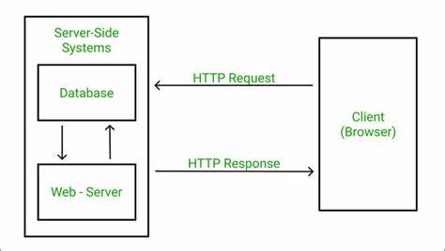
HTTP Package
This how a client sends an HTTP request to a web server, which then processes the request, retrieves data from a database if necessary, and sends an HTTP response back to the client.

Slide 92
HTTP Package
The HTTP package is a powerful tool in Flutter for making HTTP requests to web servers.
Key Features:
Easy-to-use API for various HTTP methods (GET, POST, PUT, DELETE)
Support for different content types (JSON, XML, plain text)
Handling response codes and errors
Customizable headers and body
Benefits:
Simplifies networking tasks
Efficient and reliable communication
Integrates seamlessly with Flutter's asynchronous programming model

Slide 93
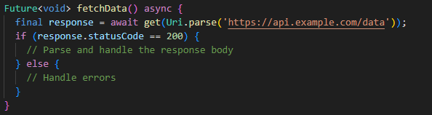
HTTP Request (GET)

Slide 94
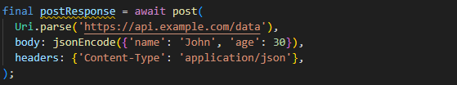
HTTP Request (Post)

Slide 95
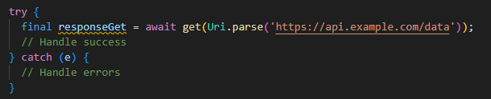
HTTP Request (Error Handling)

Slide 96
JSON
Derulo?

Slide 97
JSON
JSON stands for JavaScript Object Notation. It is a format for structuring data. This format is used by different web applications to communicate with each other. JSON is the replacement of the XML data exchange format in JSON. It is easy to struct the data compare to XML. It supports data structures like arrays and objects and the JSON documents that are rapidly executed on the server. It is also a Language-Independent format that is derived from JavaScript. The official media type for the JSON is application/json and to save those file .json extension.
The official media type for the JSON is application/json and to save those file .json extension. JSON was initially created by Douglas Crockford in the early 2000s, and first standardized in 2013 after that in 2007 JSON’s latest standard was published.
Features of JSON:
Easy to understand: JSON is easy to read and write.
Format: It is a text-based interchange format. It can store any kind of data in an array of video, audio, and image anything that you required.
Support: It is light-weighted and supported by almost every language and OS. It has a wide range of support for the browsers approx each browser supported by JSON.
Dependency: It is an Independent language that is text-based. It is much faster compared to other text-based structured data.

Slide 98
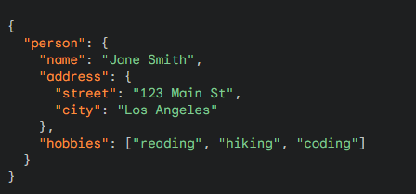
JSON (Syntax Example)

Slide 99
JSON
Types

Slide 100

Strings
Enclosed in double quotes.
Can contain any character except control characters.

Slide 101

Numerical Value
Can be integers or floating-point numbers.
Must adhere to JavaScript number syntax.

Slide 102
Numerical Value
Can be integers or floating-point numbers.
Must adhere to JavaScript number syntax.

Slide 103

Booleans
Only two values: true or false.

Slide 104

Arrays
Ordered collections of values enclosed in square brackets.
Can contain any data type

Slide 105
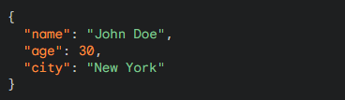
Objects
Unordered collections of key-value pairs enclosed in curly braces.
Keys must be strings.
Values can be any data type.

Slide 106
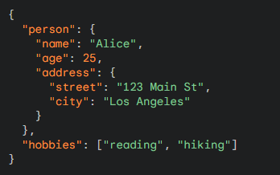
Nested Structures
JSON allows for nested structures, meaning objects can contain other objects or arrays, and arrays can contain objects or other arrays.

