Slide 1
Efficient Allocation of Renewable Energy Sources under Uncertainty in the UK

Slide 2
The Problems - Renewables
Climate change increasing demand for Renewables
Many renewable sources reliant on weather
Can we predict to outputs?
Notes:
So what are the problems we're attempting to solve in this project?
Well, in todays world, due to the threat of climate change there is ever more demand for renewable energy.
However the majority of renewable energy sources are reliant on the weather for their output, introducing an inherent uncertainty and inconsistency.
We want to tackle this uncertainty and build some method of predicting the output based on the weather.

Slide 3
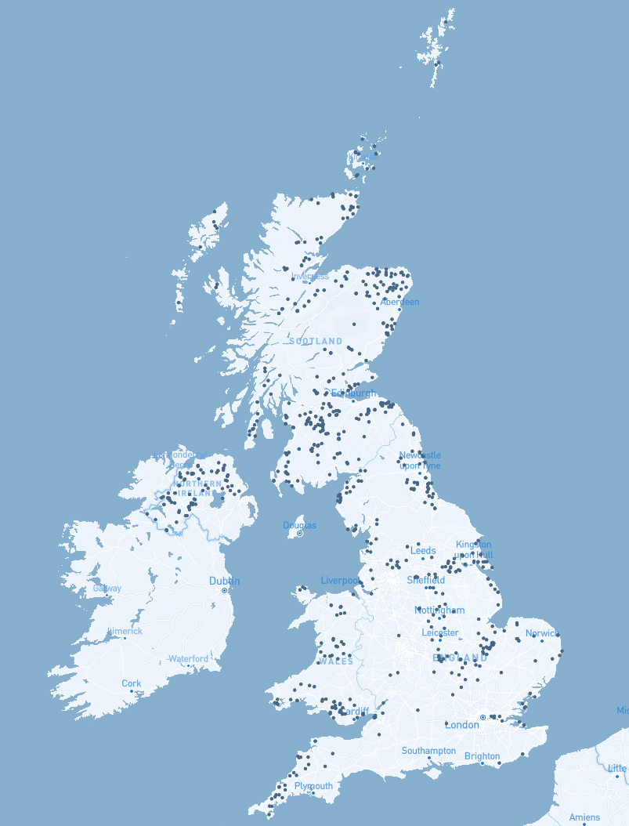
The Problems – Allocation
Performance Uncertainty
Exponentially large search space
How do we find optimal solutions?
Notes:
The other problem we will be approaching is that the search space for this problem grows exponentially as more candidate locations are added to consideration. Combined with the uncertainty of how well a given allocation will perform this is not something that can easily be worked out by brute force and therefore we propose an AI based solution to these problems.

Slide 4
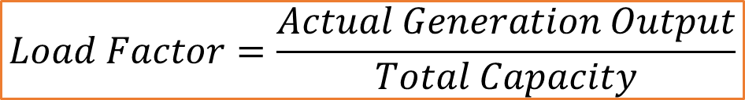
Background
Types of renewable energy
Wind
Solar
Scalability
Existing Performance
UK onshore wind average Load Factor of 26.5%
$$Load Factor=\frac{Actual Generation Output}{Total Capacity}$$
Notes:
Before beginning our development we needed to research a few areas to inform our decision making.
First we considered which renewable energy sources would be applicable to this sort of problem, and found that the main ones to look further into would be Wind & Solar. Each of these types of sources are impacted by different aspects of the weather, intuitively the main factors of each being Wind Speed and sunlight time as their names would suggest.
Considering the both Wind & Solar we have to determine if they are both applicable to the scale we aim to achieve, in a cost perspective wind is cheaper per MW and is more commonly deployed on a large scale whereas large scale solar farms need a lot of space and are often more suitable for individuals to have installed on their property.
Finally when researching the background it is important to know what standards we need to achieve to consider our project an improvement over the status quo. Within the industry of renewable energy the term 'Load Factor' refers to the percentage of its maximum capacity a generator outputs. Using this as a metric we can see that existing onshore wind turbines had a load factor of 26.5% in 2019. Setting us a target to improve upon.

Slide 5
Defining Scope & Constraints
Only consider Wind Turbines.
More appropriate to project
Ignore Offshore
Data unavailable
Use predetermined set of locations
Limits cost considerations
Notes:
From our research we determined that a focus on wind turbines would be most suitable for this project as an initial look at the feasibility and performance of our approaches. This is because at the scale we would want to propose solar energy is not all appropriately scalable due to the amount of land required to match the generation capacity of a set of large wind turbines.
Another factor in our decision was that the generation of solar cells if very much strictly dependent on the amount of sunlight a quality that does not vary all that much across regions of the UK whereas factors such as wind speed and air pressure are much more variable across altitudes and locations. Furthermore this will also only consider onshore wind, as considering offshore wind would require accurate data that is much less accessible, impacting our ability to build a dataset.
The last constraint we introduce is that in our allocation we will work with a predefined set of locations based upon already existing windfarms so we can remove factors such as planning permission and other associated costs & issues from our model.

Slide 6
Approach Overview
1. Train a prediction model
2. Model “expected weather” per location
3. Combine previous steps informing allocation algorithm
Notes:
We'll now briefly cover our overall approach to this project before going into more detail about each step.
Firstly we will be training a regression model that will map a set of weather features to the load factor allowing us to predict the output of a location based on the weather.
Next we will model the "expected weather" for each of our candidate locations, this will allow us to sample a set of 'expected days' to test the out allocations against.
Then finally these previous two steps will be combined into the fitness heuristic that will inform our allocation system. This will aim to maximise a set of objectives and return us a set of results that it has deemed the most performant for review.

Slide 7
Data Collection
Weather Features
Actual generation amount
Historic weather trends
Notes:
Before developing anything we needed to build our datasets, for our training and testing set we need two components, weather features at a point in time and then the actual amount generated by the turbine at that time as a target value.
We sourced these values from reliable APIs allowing us to build a large dataset 7000+ entry dataset to test and train upon. We also collected daily weather averages of each candidate location for the past 2 years to allow us to construct our "expected weather" model.

Slide 8
Location Selection
List selected from available data & refined
ID | Name | Latitude | Longitude | Capacity (MW)
ABRTW-1 | Auchrobert Wind Farm | 55.6105574 | -4.015384592 | 36
ACHRW-1 | AChruach Wind Farm | 56.1269712 | -5.3432396 | 42.6
AKGLW-2 | AIKENGALL II | 55.9150047 | -2.49688 | 63.84
ANSUW-1 | An Suidhe 1 | 56.224051 | -5.2130074 | 19.36
ARCHW-1 | Arecleoch Wind Farm | 55.0416812 | -4.770743 | 120
BEINW-1 | Beinneun Wind farm | 57.17827288 | -4.82109217 | 108.8
Notes:
Next we constructed our list of locations, this was initially extracted from our available data to ensure that each location had suitable data available add to the training set. We then went over the list and refined it to remove any locations that were offshore taking our list of locations to 56.

Slide 9
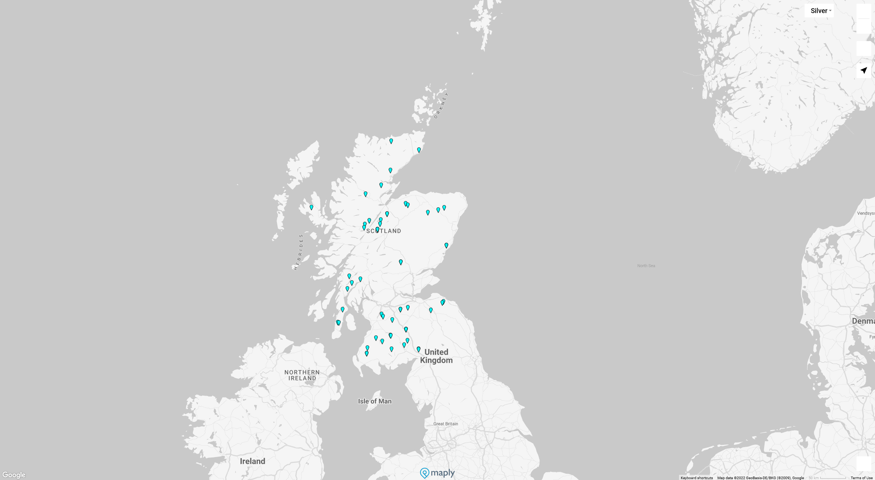
Locations Visualised
Notes:
Before developing anything we needed to build our datasets, for our training and testing set we need two components, weather features at a point in time and then the actual amount generated by the turbine at that time as a target value.
We sourced these values from reliable APIs allowing us to build a large dataset 7000+ entry dataset to test and train upon. We also collected daily weather averages of each candidate location for the past 2 years to allow us to construct our "expected weather" model.

Slide 10
Training Set
ID | Temp | Windspd | Windgust | Sealevelpressure | Visibility | Cloudcover | Precip | Dew | Humidity | Load Factor
ABRTW-1 | 5.5 | 11.6 | 15.5 | 1008.1 | 12.1 | 86.3 | 0 | 3.9 | 89.4 | 0.697666667
ABRTW-1 | 4.1 | 22.2 | 30.8 | 969.9 | 3.8 | 86.2 | 0 | 2.5 | 89.1 | 0.667611111
ABRTW-1 | 8.6 | 4.4 | 6 | 1028.8 | 39 | 38.6 | 0 | 1.6 | 61.48 | 0.071444444
ABRTW-1 | 17 | 7.6 | 6.9 | 1014.6 | 33.8 | 4.8 | 0 | 5.4 | 46.24 | 0.053333333
ABRTW-1 | 13.7 | 11.8 | 0 | 1019.3 | 23.6 | 76.8 | 0 | 10.2 | 79.66 | 0.331277778
ABRTW-1 | 22.6 | 13.4 | 0 | 1013.5 | 33.6 | 36.2 | 0 | 10.6 | 46.81 | 0.279888889
ABRTW-1 | 7.6 | 25.7 | 30 | 1015.7 | 26.2 | 29.6 | 0 | 6.3 | 92 | 0.892222222
Notes:
Here you can see a sample of the training set, each entry contains 7 features and one target values as well as an id refering to the specific wind farm.

Slide 11
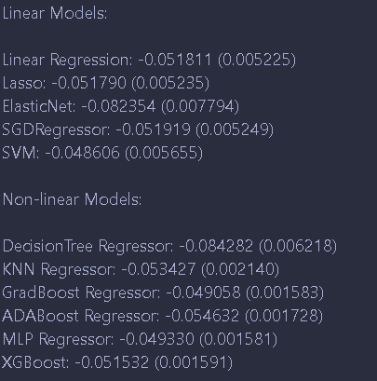
Regression Model
Tested Linear & Non-linear models
Gradient Boosting approaches appeared to work the best.
Notes:
Next we will discuss the regression model and our approach to getting the best possible results.
We tested a variety of standard regression models and evaluated them based on the mean squared error of our testing set which was sampled from the full dataset.
We found that non-linear approaches such a gradient boosting based techniques tended to perform better but to improve further we needed a larger pipeline of techniques.

Slide 12
Regression Model - Pipeline
Used a library to search for an appropriate pipeline.
A 10 step pipeline produced best output.
Pipeline: a linear sequence of data preparation options, modelling operations, and prediction transform operations.
Notes:
A pipeline is a combination of multiple steps where the output of one step is passed to the input of the next, allowing for the combination of multiple pre and post processing steps to improve prediction.
We used an open source library for this which gave us another boost in accuracy.

Slide 13
Allocation - Definition
Inputs:
Objectives
Budget
Locations
Output:
Allocation
Notes:
Happy with our regressor model, we moved onto the allocation task. here we define our task, we want to give our system a list of objectives to maximise, a budget - meaning number of turbines total we are allowed to place (under the assumption that every turbine has an equal capacity), and the set of candidate locations and the system should return to us a list of values corresponding to the number of turbines to place at each location.

Slide 14
Allocation - Objectives
Generation Amount
Load Factor Variance
Minimum Load Factor
Maximum Load Factor
Notes:
What makes this problem slightly different to a standard search is that we want to optimise for multiple objectives, namely the output of our allocation (budget used x mean load factor), the varience in load factor, and the min & max load factor.
Combined, these optimising these objectives should result in an allocation that will have the highest output while still remaining consistent, exactly the qualities we want.

Slide 15
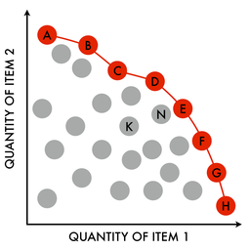
Allocation – Genetic Approach
NSGA-II – Multi-Objective Elitist Genetic Algorithm
Ranks Populations:
Dominating Fronts
Crowding Distance
Notes:
To implement these we elected to take a genetic algorithm approach, using the well establish NGSA-II algorithm. This ranks the population based on how well the perform relative to every other member of the population.
A member i dominates member j if for each objective i is at least as good as j AND it it strictly better in at least one objective.
This allows us to define "fronts" based on the number of members each member is dominated by. In cases where we need tie breakers we want to encourage exploration in the set so we rank members who are more isolated higher to reduce crowding.
Using these metrics we can select our best members of each population and let them reproduce. This will not give us one explicit "correct" answer as our rankings rank based on domination, so we will get a list of solutions which dominate all others and we can examine to determine which gives us the focus we desire.

Slide 16
Allocation – Genetic Approach
NGSA-II is not cutting edge
Genetic algorithms relatively slow
Project not time critical
Performance improvements exist
Notes:
This approach is not the perfect solution however, NGSA-II is by no means a cutting edge algorithm any more and it along with evolutionary algorithms in general tend to suffer in the time department. However it has proven itself to be reliable and with multiple spins allowing for future improvements.
Due to the large search space the solutions found in a finite number of iterations is restricted based on the starting seed, meaning to find the best solutions we will need to run a large number of batches to be confident in our "best" outputs. We believe this trade off is acceptable though as this task is not time critical and will likely need to be ran relatively irregularly. We also believe there is much room for performance improvements in future work by parallelising batches and investigating modifications to NGSA-II.

Slide 17
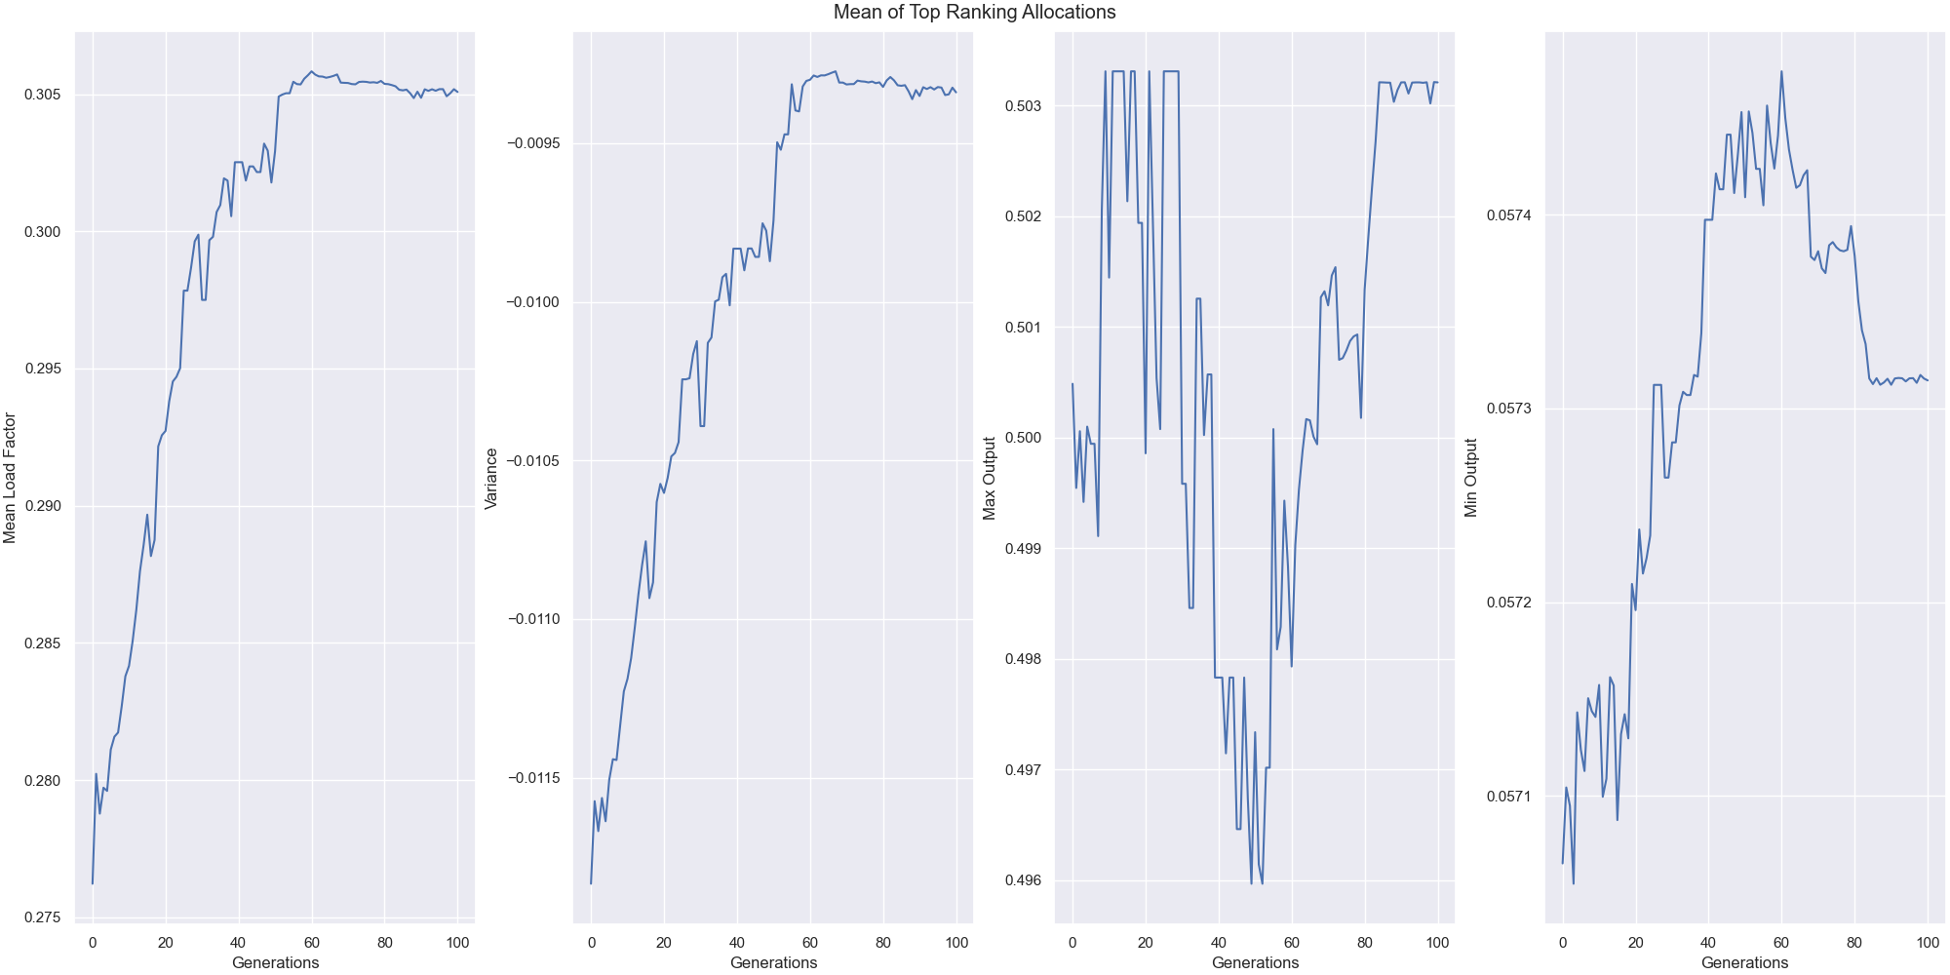
Allocation – Results
Notes:
Every initial seed explores differently, we can visualise how it changes generation to generation by plotting the average objective value within the top-cut and seeing how it generally trends up with some occasional dips. Going back to the "fronts" way of visualising the selection process it is understandable that some population members may sacrifice one objective value to dominate in another dragging the mean value of that objective down. this just means that to see which results best balance the objective values in a appealing way requires a bit more of a human touch.

Slide 18
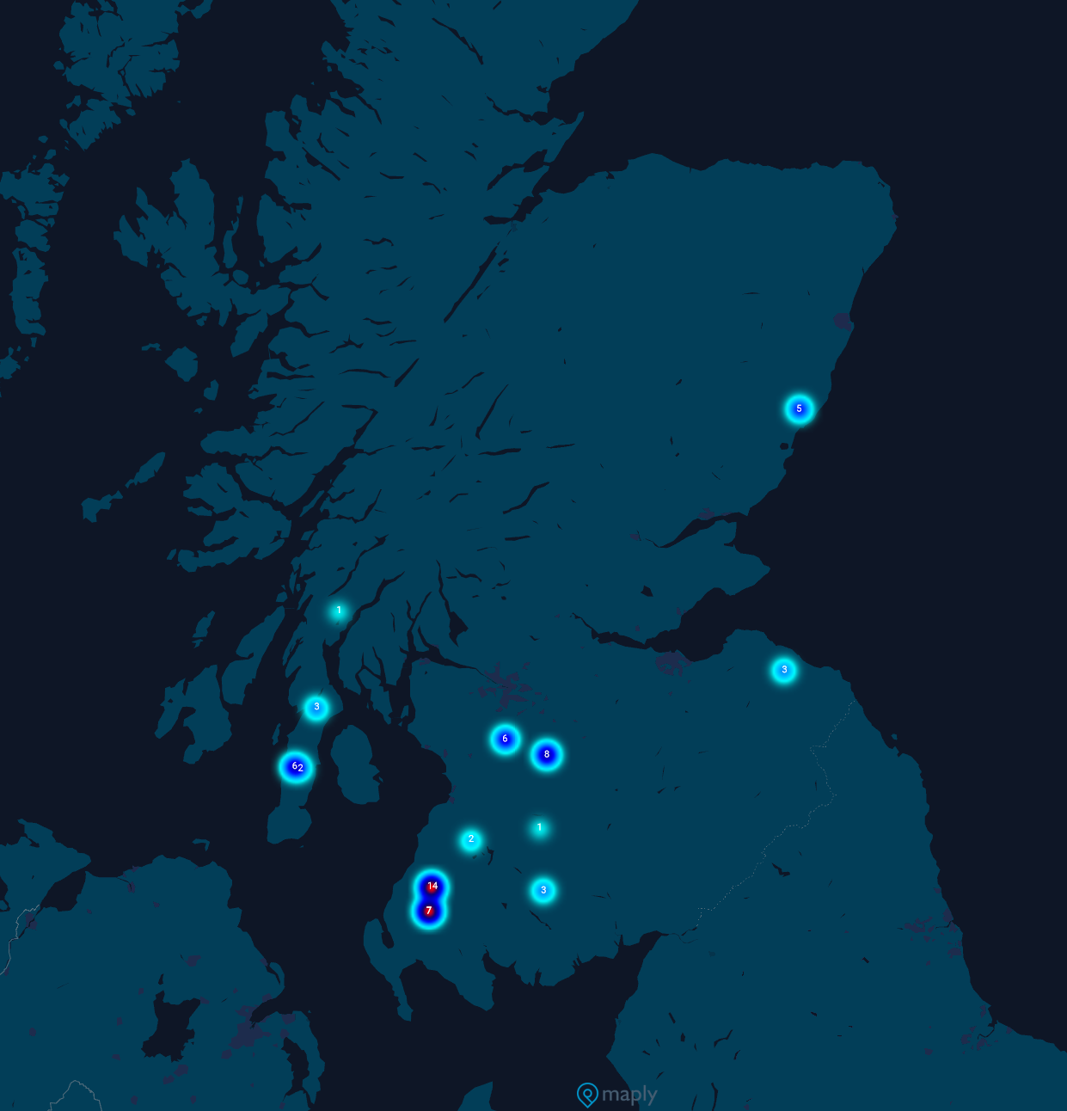
Allocation – Genetic Approach
Allocations are sparse
A few heavily favoured locations
Rest lower weighted to balance out
Notes:
Once we have examined our set of dominant allocations and picked it we can visualise the locations to examine the trends in the algorithms choices. We see that it picks a very sparse selection of locations usually around 10-15 of the 56 possible, despite it having plenty of budget to pick more. We also see that it tends to prefer more coastal allocations despite there being a few in land choices. The final observation we have made at this stage is that most allocations consist of few more heavily weighted choices to increase the mean and less weighted ones which act as an almost "stabilising factor" to reduce the variance that would come from relying on one location.

Slide 19
Future Works
Generalization
Performance
Long term modelling
Notes:
There is still work to be done finalising this project by tweaking the objective functions and conducting larger scale searches for optimal allocations, however there are also a few more in depth extensions that could be investigated in further projects.
The current system somewhat acts as a proof of concept that this approach can perform suitably and offer insight into planning of new wind infrastructure, however it would be a useful work to generalise the approach such that any set of locations could be searched rather than a predefined list. The prediction model should likely hold up to a more general setting however a larger dataset would much likely improve the accuracy and reliability further.
Another improvement to examine in future is the performance, while processing time is not an issue in this current examination it would be useful in future to look at improvements with parallelisation and NSGA-II improvements.
Finally to circle back to the initial cause for this investigation, climate change of course changing weather patterns. And as such retooling the "expected weather" section to account for that change would allow for allocations to be future proofed.

Slide 20
Any Questions?
Notes:
This approach is not the perfect solution however, NGSA-II is by no means a cutting edge algorithm any more and it along with evolutionary algorithms in general tend to suffer in the time department. However it has proven itself to be reliable and with multiple spins allowing for future improvements.
Due to the large search space the solutions found in a finite number of iterations is restricted based on the starting seed, meaning to find the best solutions we will need to run a large number of batches to be confident in our "best" outputs. We believe this trade off is acceptable though as this task is not time critical and will likely need to be ran relatively irregularly. We also believe there is much room for performance improvements in future work by parallelising batches and investigating modifications to NGSA-II.

