Slide 1

Efficient Allocation of Renewable Energy Sources under Uncertainty in the UK

Slide 2
The Problem - Renewables
(Department for Business, Energy & Industrial Strategy, 2022)
The climate crisis is ever increasing the focus on renewable energy sources around the world.
Many of the common renewable sources are dependent on weather as an energy source.
Therefore, the consistency and reliability of these sources is never certain.

Slide 3
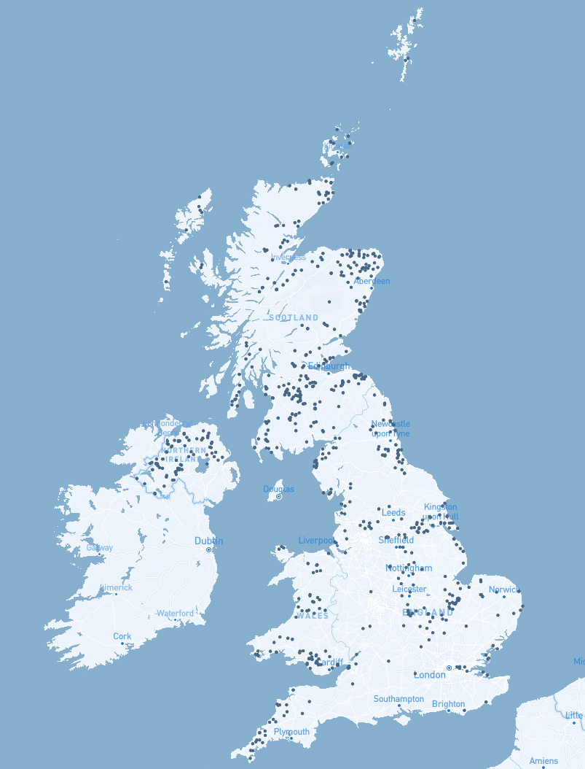
The Problem - Allocation
Uncertainty of weather – hard to know where will perform best
Large scale – how do you make an efficient decision balancing a range of factors?
We will be proposing a system to tackle these issues by using AI techniques.
Notes:
Due to this uncertainty in output, the decision of where to allocate a budget of new energy sources can be difficult.
On top of this, when considering a country wide scale the number of potential candidate locations can be huge leading to another problem – how do you make an efficient decision balancing a range of factors?
This project is proposing an AI based approach to tackle both the problem of uncertainty and scale of allocating a budget for new energy sources across the UK.

Slide 4
Background Research
Types of renewable sources to investigate,
Factors affecting different generation types,
Costs,
Location suitability,
Where to source data from
Notes:
Before beginning this project, we required some initial information to base our decisions upon.
Sources – We found that the main candidates are Wind, Solar and Tidal
Factors –
Costs – We found that cost per MW at a large scale was best in Wind Turbines and that the main costs apart from purchasing costs came from land rental and connection costs wchic would vary per location
Location suitability – For wind power the intuitive best location would be somewhere with constantly high winds, however being close to infrastructure may be something to consider
Data – Visual Crossing and Nationgrid balancing mechanisms

Slide 5
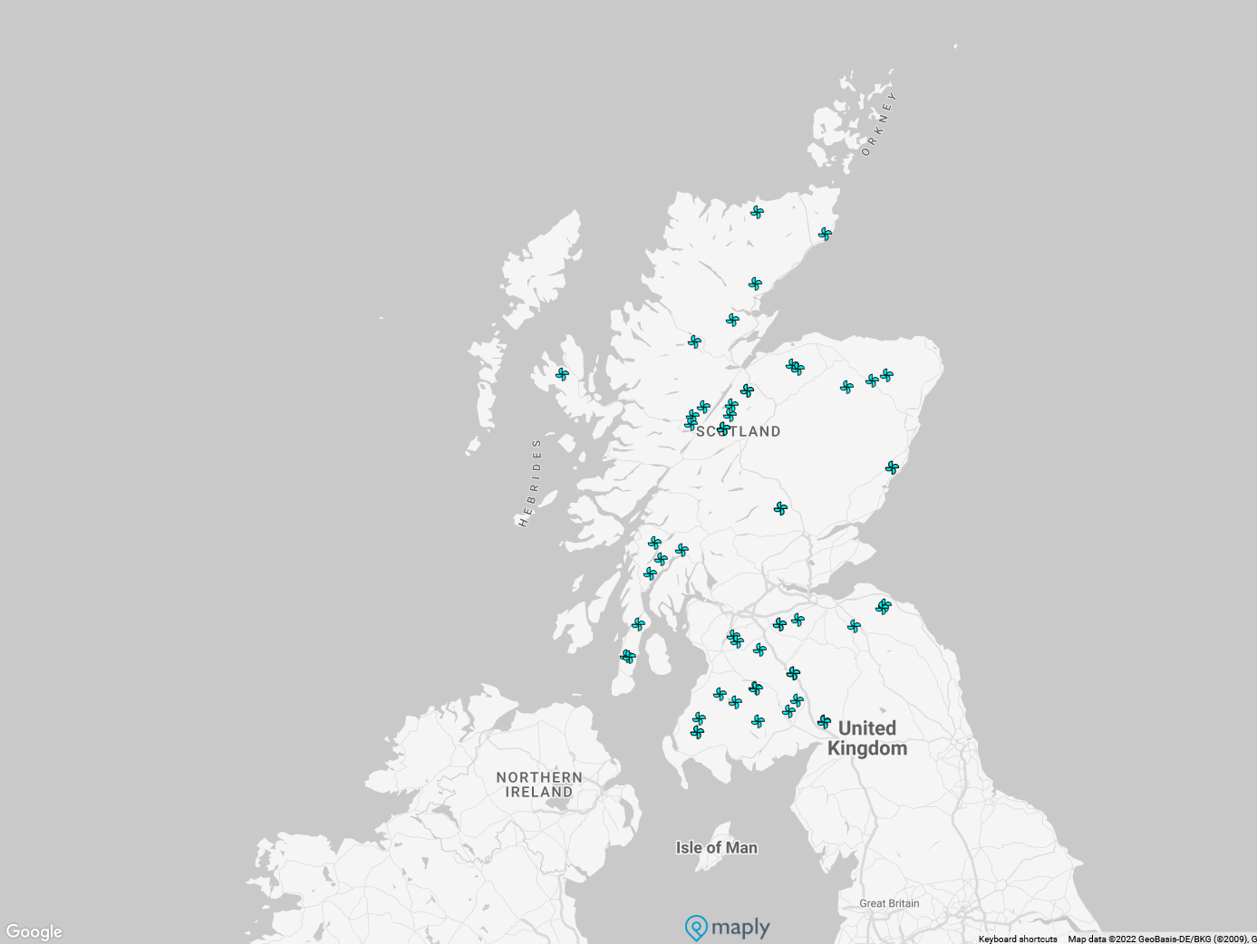
Constraints & Scope Restrictions
Focus on allocation of Wind turbines
Limit this to onshore wind farms due to data accessibility
Initial locations sourced from pre-existing wind farms - reducing complexity
Notes:
Based upon background research, to keep the project feasible we narrowed the scope to focus on specific areas:
Consider only the allocation of a budget of Wind Turbines as they are more location dependent than alternatives such as solar and much more suitable for large scale use.
Limit to onshore wind farm allocation as comprehensive weather information (for a training set) is not as readily available for locations out at sea.
Initially demonstrate allocation to locations with pre-existing windfarms as location eligibility introduces large amounts of complexity with construction permits and such.
We believe these limitations will still allow us to demonstrate a proof of concept that can be expanded to more general cases in future work.

Slide 6
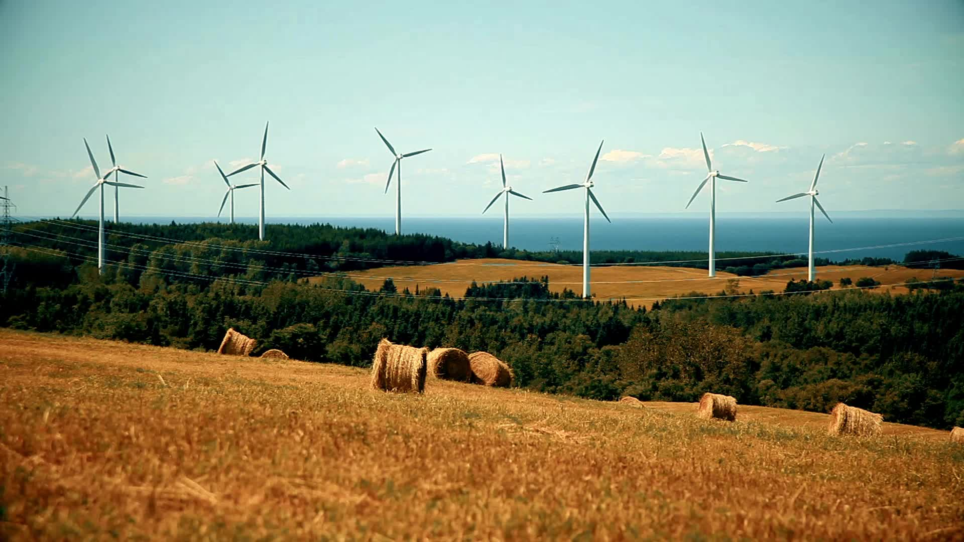
Solution Overview
Training an output prediction model
Model the “expected weather” based on past data
Use previous steps to inform allocation algorithm to find “optimal allocation”
Notes:
Our approach can be broken up into three sections:
Training a general wind turbine generation model based upon predicted or recorded weather features.
For each of our locations, producing a statistical model of the weather (based off long term past weather information) allowing us to produce a sample of ‘expected’ for each location.
Using the above two steps to calculate the performance of a given allocation, and to search for an allocation that will maximise a set of performance objectives.

Slide 7
Location Selection
BMU_ID | Name | Latitude | Longitude | Capacity (MW)
ABRTW-1 | Auchrobert Wind Farm | 55.6105574 | -4.01538 | 36
ACHRW-1 | AChruach Wind Farm | 56.1269712 | -5.34324 | 42.6
AKGLW-2 | AIKENGALL II | 55.9150047 | -2.49688 | 63.84
ANSUW-1 | An Suidhe 1 | 56.224051 | -5.21301 | 19.36
ARCHW-1 | Arecleoch Wind Farm | 55.0416812 | -4.77074 | 120
BEINW-1 | Beinneun Wind farm | 57.17827288 | -4.82109 | 108.8
BETHW-1 | Beinn Tharsuinn | 57.80099228 | -4.33468 | 29.75
BHLAW-1 | Bhlaraidh Windfarm 1 | 57.23963581 | -4.69546 | 108
BLKWW-1 | Blackcraig Windfarm | 55.1170696 | -4.03614 | 52.9
BLLA-1 | Black Law Wind Farm 1 | 55.78118772 | -3.76792 | 96
BLLA-2 | Black Law Wind Farm Extension | 55.78118772 | -3.76792 | 69
BNWKW-1 | Burn of Whilk Windfarm | 58.3545735 | -3.21659 | 22.5
BRYBW-1 | Berry Burn Wind Farm | 57.48729382 | -3.54668 | 66.7
BTUIW-2 | Beinn An Tuirc 2 | 55.5603353 | -5.5887 | 43.7
CGTHW-1 | Corriegarth Wind Farm | 57.18658614 | -4.36815 | 69
CLDCW-1 | Clyde Central Windfarm | 55.44617453 | -3.59929 | 112
CLDNW-1 | Clyde North Windfarm | 55.44617453 | -3.59929 | 108
CLDRW-1 | Clashindarroch Wind Farm | 57.36729169 | -2.96057 | 37
Initial location set based upon data availability.
Refined to remove offshore windfarms, and locations with inconsistent data availability.
Dataset based upon limited to Scotland as seen in prior visualisation
Notes:
The main requirements for location candidacy here was the availability of data to form a training and testing set.
We pulled from a dataset on the National Grid ESO data website, giving us a list of unique IDs for UK wind farms.
This then underwent a couple of cuts removing offshore wind farms, and any locations where past generation data was not consistently available leaving us with the following locations.
Coincidentally they are all located in Scotland which adds another constraint to our investigation.

Slide 8
Data Collection
Needed to build our training set which would consist of:
Historical Weather data with a range of features
The actual generation of a location compared to its maximum capacity.
Sourced this from VisualCrossing.com and the Elexon Balancing Mechanism Reporting Service.
Each had long term historical records at up to 15-minute resolutions.

Slide 9
Data Collection – The Dataset
 | BMUID | temp | windspd | windgust | sealevelpressure | visibility | cloudcover | precip | dew | humidity | loadFactor
0 | ABRTW-1 | 5.5 | 11.6 | 15.5 | 1008.1 | 12.1 | 86.3 | 0 | 3.9 | 89.4 | 0.697666667
1 | ABRTW-1 | 4.1 | 22.2 | 30.8 | 969.9 | 3.8 | 86.2 | 0 | 2.5 | 89.1 | 0.667611111
2 | ABRTW-1 | 8.6 | 4.4 | 6 | 1028.8 | 39 | 38.6 | 0 | 1.6 | 61.48 | 0.071444444
3 | ABRTW-1 | 17 | 7.6 | 6.9 | 1014.6 | 33.8 | 4.8 | 0 | 5.4 | 46.24 | 0.053333333
4 | ABRTW-1 | 13.7 | 11.8 |  | 1019.3 | 23.6 | 76.8 | 0 | 10.2 | 79.66 | 0.331277778
5 | ABRTW-1 | 22.6 | 13.4 |  | 1013.5 | 33.6 | 36.2 | 0 | 10.6 | 46.81 | 0.279888889
6 | ABRTW-1 | 7.6 | 25.7 | 30 | 1015.7 | 26.2 | 29.6 | 0 | 6.3 | 92 | 0.892222222
7 | ACHRW-1 | 3.8 | 13.5 | 12.6 | 1008.3 | 23.5 | 39.4 | 0 | 2.7 | 92.44 | 0.126525822
8 | ACHRW-1 | 3.4 | 19.6 | 22.1 | 969.4 | 4.5 | 51.8 | 0 | 1.6 | 87.85 | 0.598028169
9 | ACHRW-1 | 6 | 13.7 | 19 | 1029.9 | 29.7 | 23.8 | 0 | 1 | 70.48 | 0.228497653
10 | ACHRW-1 | 16.4 | 7.8 | 6.2 | 1014.8 | 35.2 | 35.4 | 0 | 4.4 | 44.87 | 0.062488263
11 | ACHRW-1 | 12.2 | 10.7 |  | 1018.4 | 9.3 | 61.5 | 0 | 11.8 | 97.56 | 0.082769953
12 | ACHRW-1 | 14.6 | 10 | 14.2 | 1014.3 | 32.2 | 45.9 | 0 | 9.6 | 72.2 | 0.386244131
13 | ACHRW-1 | 7 | 18.2 | 18.6 | 1014.4 | 9.3 | 67.1 | 0 | 5.5 | 90.17 | 0.749671362
14 | AKGLW-2 | 4.3 | 9.2 |  | 1007.2 | 26.9 | 33.3 | 0 | 3.1 | 92.31 | 0.64924812
15 | AKGLW-2 | 3.6 | 22.7 | 31.1 | 969.1 | 11.5 | 80.7 | 0 | 2.2 | 90.64 | 0.850407268
16 | AKGLW-2 | 8.4 | 6 |  | 1028.5 | 29.1 | 70.6 | 0 | -0.1 | 55.08 | 0.033364662
17 | AKGLW-2 | 9.7 | 12.3 |  | 1016.5 | 20.7 | 23.6 | 0 | 6.2 | 79.02 | 0.056453634
18 | AKGLW-2 | 11.9 | 4.2 |  | 1019.9 | 20.3 | 20.9 | 0 | 11.4 | 97.3 | 0.529573935
Using these sources, we constructed a 7000+ entry dataset of weather features and the percentage of maximum capacity output during that same period.

Slide 10
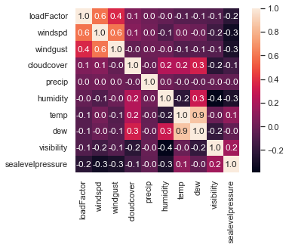
Prediction Model
From this dataset we can visualise the correlation between different features.
A range of different regression models were tested, from standard linear regressors to MLP and gradient boosting variants.

Slide 11

Prediction Model - TPOT
After tuning hyperparameters of a gradient boost model and still not being 100% satisfied with the accuracy we discovered a meta-learning library called TPOT.
This allowed us to find a pipeline of different models combined to improve the performance further using the following model.
exported_pipeline = make_pipeline(
StackingEstimator(estimator=ExtraTreesRegressor(bootstrap=False, max_features=0.55, min_samples_leaf=1, min_samples_split=5, n_estimators=100)),
StackingEstimator(estimator=ExtraTreesRegressor(bootstrap=False, max_features=0.55, min_samples_leaf=9, min_samples_split=8, n_estimators=100)),
VarianceThreshold(threshold=0.01),
StackingEstimator(estimator=AdaBoostRegressor(learning_rate=0.001, loss="linear", n_estimators=100)),
SelectPercentile(score_func=f_regression, percentile=28),
StackingEstimator(estimator=LinearSVR(C=0.5, dual=False, epsilon=0.0001, loss="squared_epsilon_insensitive", tol=0.01)),
StackingEstimator(estimator=GradientBoostingRegressor(alpha=0.95, learning_rate=0.01, loss="lad", max_depth=7, max_features=1.0, min_samples_leaf=9, min_samples_split=10, n_estimators=100, subsample=0.5)),
StackingEstimator(estimator=LinearSVR(C=20.0, dual=True, epsilon=0.001, loss="epsilon_insensitive", tol=1e-05)),
KNeighborsRegressor(n_neighbors=61, p=2, weights="distance")
)

Slide 12

The Allocation
As weather is uncertain, no matter our allocation we expect some variation.
Ideally want a maximised expected output while keeping the variation low.
One approach would be a weighted sum as our heuristic value.
This would require us to determine the relative importance of each aspect.
Notes:
Due to the uncertain aspects of the weather, we expect quite a variation in the no matter the allocation.
In an ideal world we want to find an allocation that maximises the mean output of our proposed new wind turbines (ideally improving on the current average load factor) while also minimising the variance in the outputs.
To do this we could combine these values as a weighted sum and use it as a performance heuristic for a searching algorithm.
This would require us to determine the relative importance of each aspect.

Slide 13
The Allocation – Genetic Algorithm
Alternative approach using ‘dominating fronts’ and ‘crowding distance’
The NGSA-II algorithm is a genetic algorithm using the above approach to search for a set of optimal assignments.
Published 2002 – not state of the art but has a proven record and many published improvements that could be implemented in future work where needed.
Notes:
An alternate approach is to use a Genetic Algorithm based approach.
The NGSA-II algorithm published in 2002 gives a fast search methodology based around ranking its populations based on dominating fronts and crowding distances.
This algorithm is not state of the art anymore with many different improvements being published, but as a baseline it is provenly reliable and showed much room for expansion by slight changes – opening a clear route to performance improvements in future works.

Slide 14
The Allocation – Genetic Algorithms
Main issue with a genetic approach is time.
Large numbers of iterations and testing a range of starting states combine to long run time requirement.
By running search in batches can find “best” allocation for an allotted time.
Project is not time critical so can accept this trade off.
Potential performance improvements to be had by searching batches in parallel in future work.

Slide 15
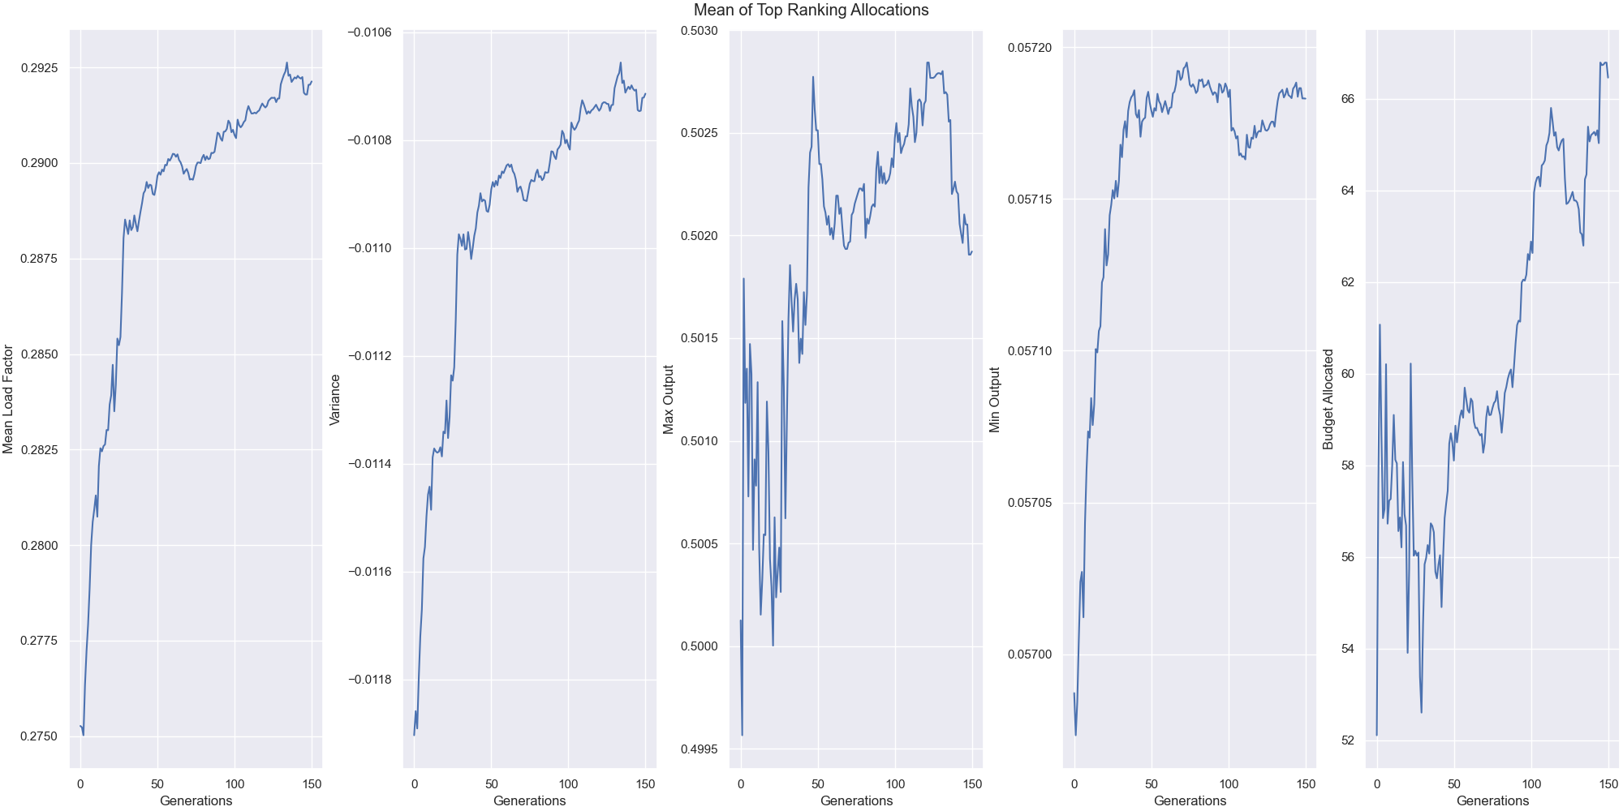
Results
By saving a history of the evolution process can see how generations improve.
Looking at the mean value over time, we see it generally trends up
However some dips illustrate that the algorithm doesn’t prioritise any particular objective.
Notes:
When testing with a range of initial seeds, we see the algorithm trend towards a higher mean every generation, but usually caps around the 30% load factor.
This is already theoretically an improvement over the average across the UK currently.
However, this value shouldn’t be taken at face value. Throughout the chain of operations, we can find small errors that will likely add to an inaccuracy of this result.

Slide 16
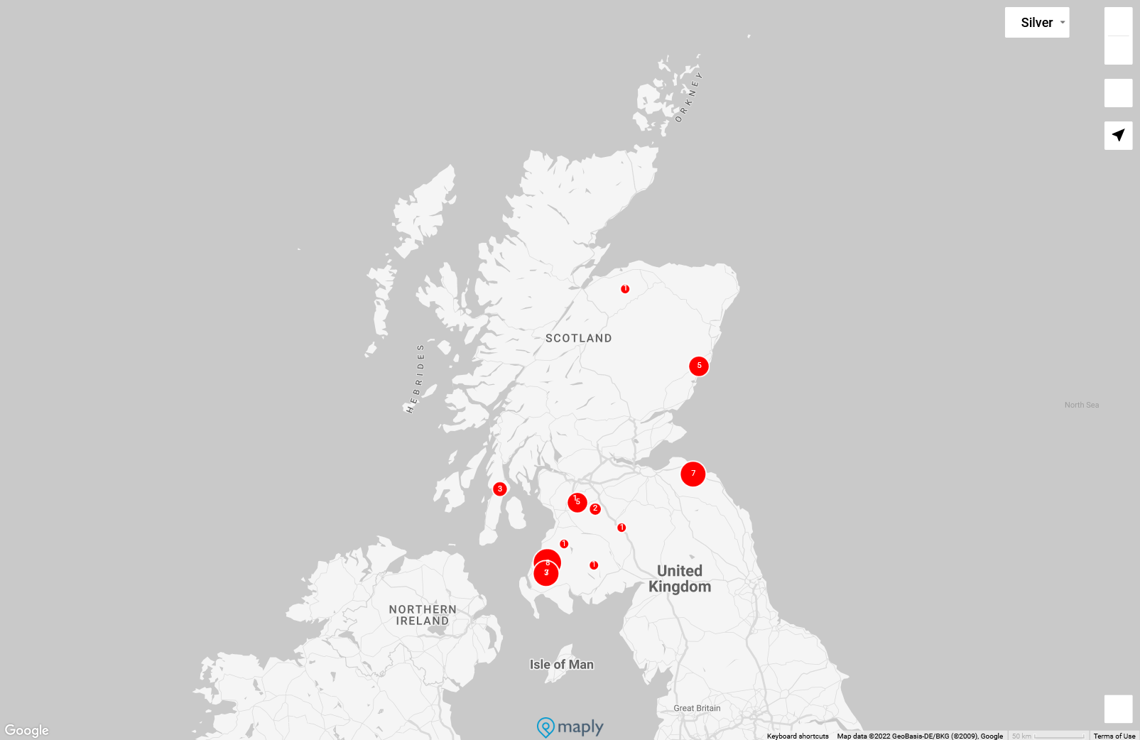
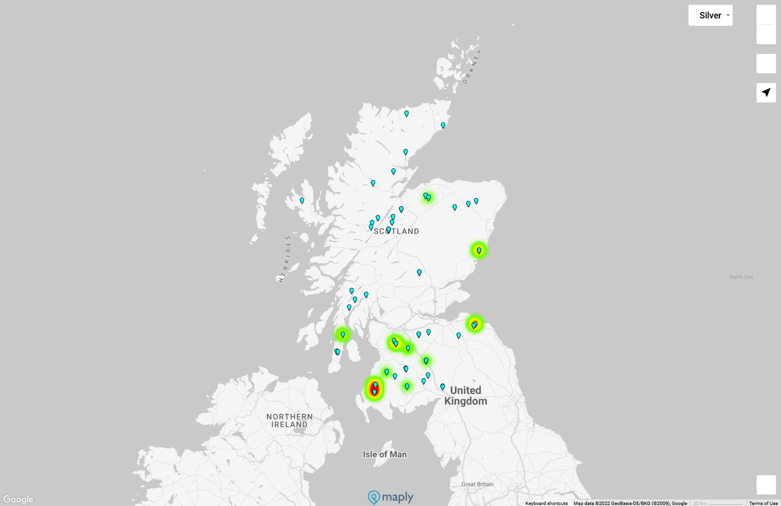
“The Efficient Allocation”
After running a range of seeds we can examine performance and pick the “best”
The found allocation is fairly sparse
Most of the budget allocated to 3 or 4 locations
Seems to have favoured coastal locations.

Slide 17
Future Extensions
Performance – Multithreading & NGSA-II improvements
Generalisation – Currently trained on a localised dataset and allocates to a fixed set of locations
Long Term Prediction – Changing weather could lead to different optimal locations caused by climate change.
Notes:
One of the main extensions I believe would be useful in future would be adjusting the current setup to be more general.
Currently we require a backlog of data for each location we want to predict for which can make it more complex to query the system for a new location.
I would also like to investigate extensions to the NSGA-II algorithm as increasing performance would make this much more scalable for larger location sets.

