Slide 1
Efficient Allocation of Renewable Energy Sources under Uncertainty in the UK

Slide 2
The Problems - Renewables
Climate change increasing demand for Renewables
Many renewable sources reliant on weather
Can we predict to outputs?

Slide 3
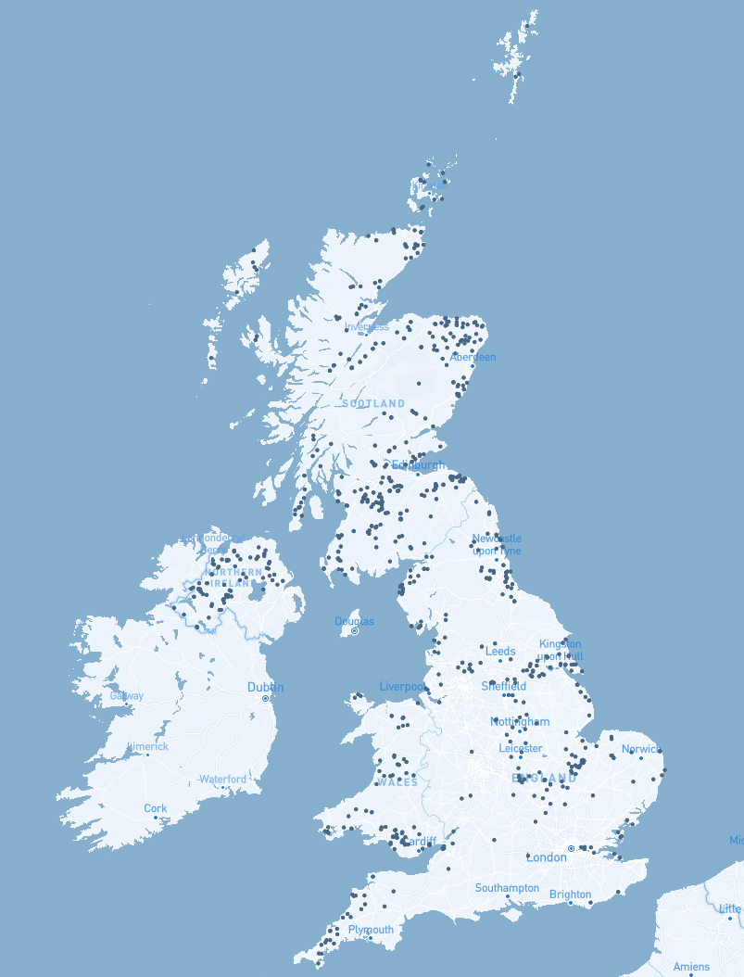
The Problems – Allocation
Performance Uncertainty
Exponentially large search space
How do we find optimal solutions?

Slide 4
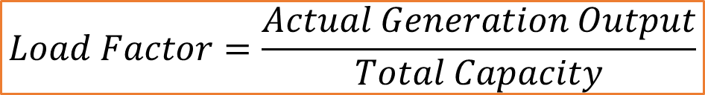
Background
Types of renewable energy
Wind
Solar
Scalability
Existing Performance
UK onshore wind average Load Factor of 26.5%
$$Load Factor=\frac{Actual Generation Output}{Total Capacity}$$

Slide 5
Defining Scope & Constraints
Only consider Wind Turbines.
More appropriate to project
Ignore Offshore
Data unavailable
Use predetermined set of locations
Limits cost considerations

Slide 6
Approach Overview
1. Train a prediction model
2. Model “expected weather” per location
3. Combine previous steps informing allocation algorithm

Slide 7
Data Collection
Weather Features
Actual generation amount
Historic weather trends

Slide 8
Location Selection
List selected from available data & refined
ID | Name | Latitude | Longitude | Capacity (MW)
ABRTW-1 | Auchrobert Wind Farm | 55.6105574 | -4.015384592 | 36
ACHRW-1 | AChruach Wind Farm | 56.1269712 | -5.3432396 | 42.6
AKGLW-2 | AIKENGALL II | 55.9150047 | -2.49688 | 63.84
ANSUW-1 | An Suidhe 1 | 56.224051 | -5.2130074 | 19.36
ARCHW-1 | Arecleoch Wind Farm | 55.0416812 | -4.770743 | 120
BEINW-1 | Beinneun Wind farm | 57.17827288 | -4.82109217 | 108.8

Slide 9
Training Set
ID | Temp | Windspd | Windgust | Sealevelpressure | Visibility | Cloudcover | Precip | Dew | Humidity | Load Factor
ABRTW-1 | 5.5 | 11.6 | 15.5 | 1008.1 | 12.1 | 86.3 | 0 | 3.9 | 89.4 | 0.697666667
ABRTW-1 | 4.1 | 22.2 | 30.8 | 969.9 | 3.8 | 86.2 | 0 | 2.5 | 89.1 | 0.667611111
ABRTW-1 | 8.6 | 4.4 | 6 | 1028.8 | 39 | 38.6 | 0 | 1.6 | 61.48 | 0.071444444
ABRTW-1 | 17 | 7.6 | 6.9 | 1014.6 | 33.8 | 4.8 | 0 | 5.4 | 46.24 | 0.053333333
ABRTW-1 | 13.7 | 11.8 | 0 | 1019.3 | 23.6 | 76.8 | 0 | 10.2 | 79.66 | 0.331277778
ABRTW-1 | 22.6 | 13.4 | 0 | 1013.5 | 33.6 | 36.2 | 0 | 10.6 | 46.81 | 0.279888889
ABRTW-1 | 7.6 | 25.7 | 30 | 1015.7 | 26.2 | 29.6 | 0 | 6.3 | 92 | 0.892222222

Slide 10
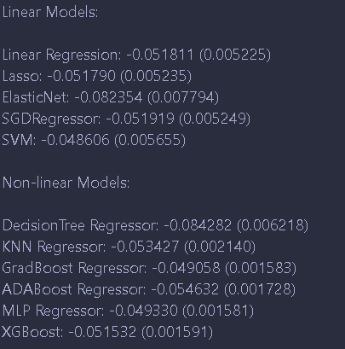
Regression Model
Tested Linear & Non-linear models
Gradient Boosting approaches appeared to work the best.

Slide 11
Regression Model - Pipeline
Used a library to search for an appropriate pipeline.
A 10 step pipeline produced best output.
Pipeline: a linear sequence of data preparation options, modelling operations, and prediction transform operations.

Slide 12
Allocation - Definition
Inputs:
Objectives
Budget
Locations
Output:
Allocation

Slide 13
Allocation - Objectives
Generation Amount
Load Factor Variance
Minimum Load Factor
Maximum Load Factor

Slide 14
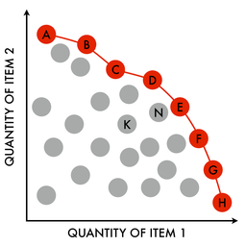
Allocation – Genetic Approach
NSGA-II – Multi-Objective Elitist Genetic Algorithm
Ranks Populations:
Dominating Fronts
Crowding Distance

Slide 15
Allocation – Genetic Approach
NGSA-II is not cutting edge
Genetic algorithms relatively slow
Project not time critical
Performance improvements exist

Slide 16
Allocation – Results
NGSA-II is not cutting edge
Genetic algorithms relatively slow
Project not time critical
Performance improvements exist

Slide 17
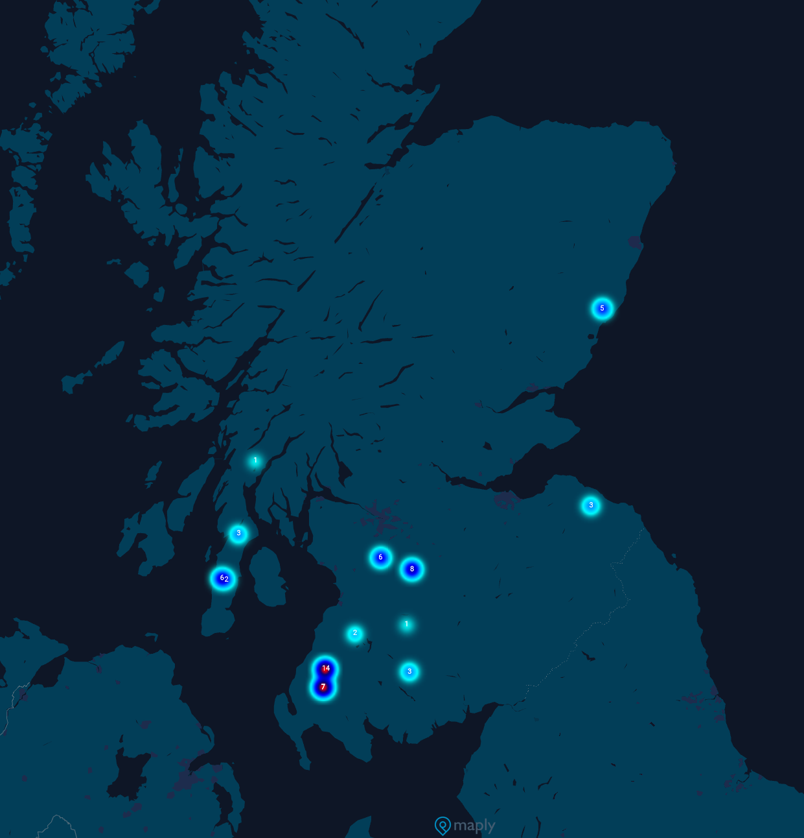
Allocation – Genetic Approach
.

