Slide 1

ANNOUNCEMENTS this week, the role of Jim will be played by Jeannie & Mark
WARMUP what is a (real-world) TODO list?
why are lists useful?
TODAY array lists

Slide 2
array lists

Slide 3
motivation

Slide 4
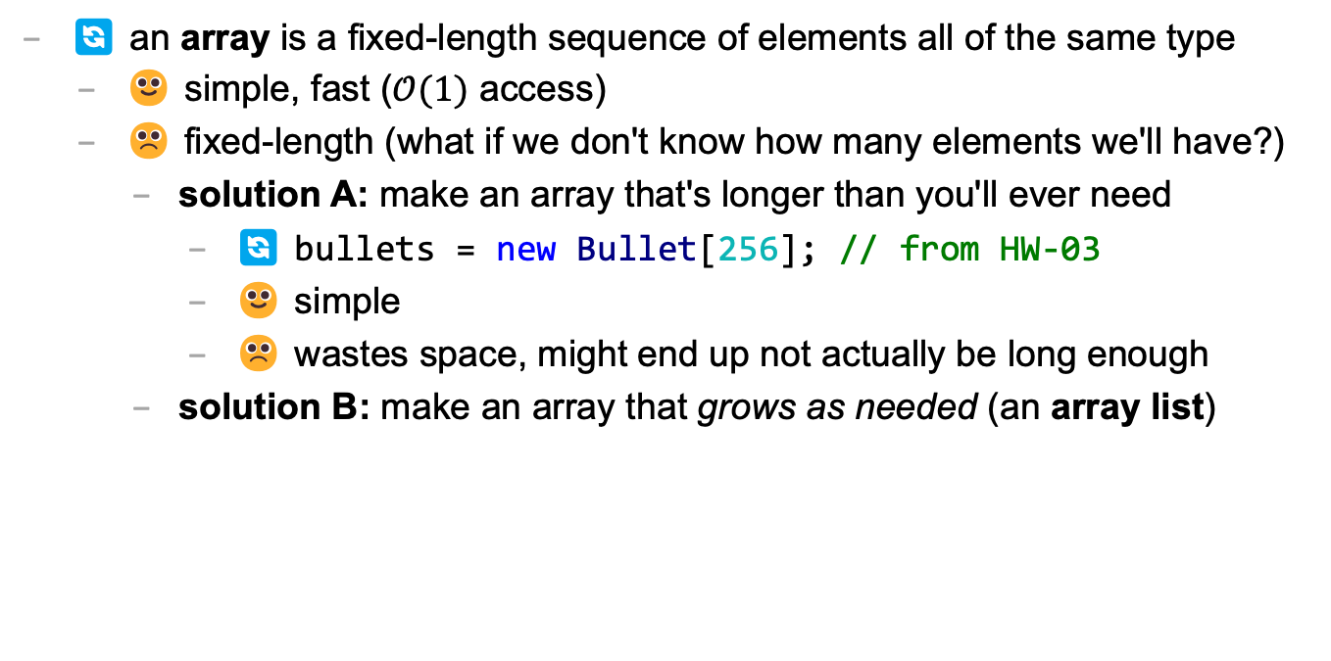
arrays are fixed-length
🔄 an array is a fixed-length sequence of elements all of the same type
🙂 simple, fast ($𝒪(1)$ access)
☹️ fixed-length (what if we don't know how many elements we'll have?)
solution A: make an array that's longer than you'll ever need
🔄 bullets = new Bullet[256]; // from HW-03
🙂 simple
☹️ wastes space, might end up not actually be long enough
solution B: make an array that grows as needed (an array list)

Slide 5
array list

Slide 6
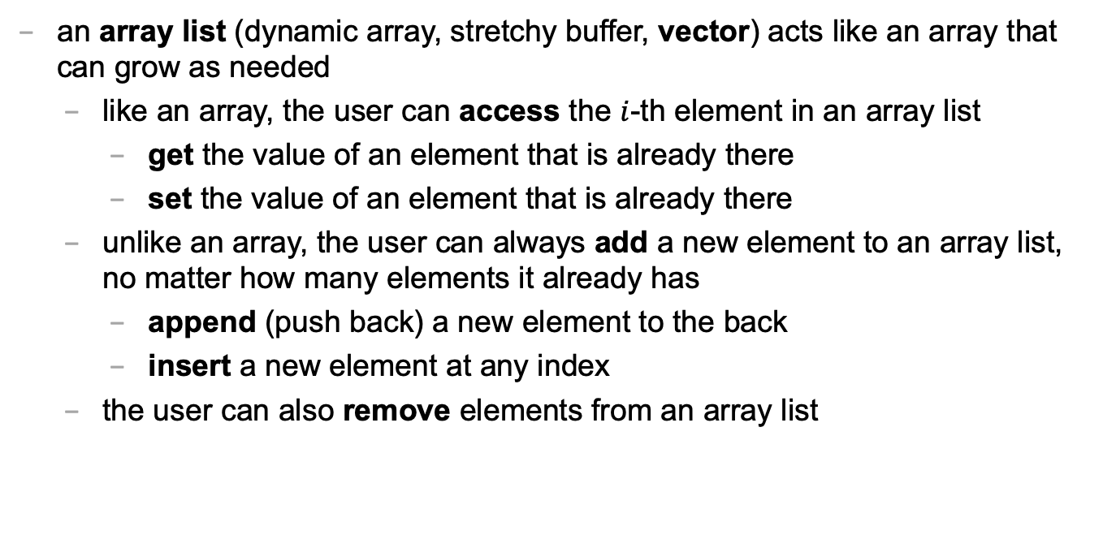
array list
an array list (dynamic array, stretchy buffer, vector) acts like an array that can grow as needed
like an array, the user can access the $i$-th element in an array list
get the value of an element that is already there
set the value of an element that is already there
unlike an array, the user can always add a new element to an array list, no matter how many elements it already has
append (push back) a new element to the back
insert a new element at any index
the user can also remove elements from an array list

Slide 7
the internal (private) array
an array list stores its elements inside of an array
an array list's capacity is the length of this array
an array list's size (length) is the number of (non-null) elements currently actually stored in this array
class ArrayList<ElementType> {
private ElementType[] privateArray;
private int numberOfElementsActuallyStoredInPrivateArray;
// int capacity() { return privateArray.length; }
int size() {
return numberOfElementsActuallyStoredInPrivateArray;
};
}

Slide 8
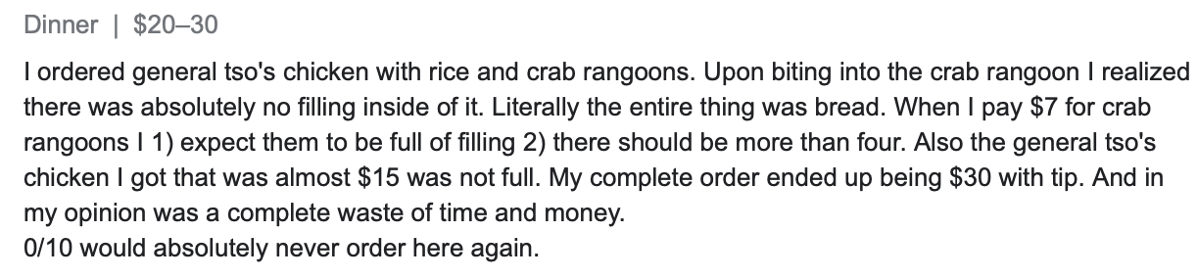
array list
☠️ an array list's capacity is NOT the same thing as its size
imagine ArrayList<String> bestaurants; with capacity 5 and size 3 // if we could print bestaurants.privateArray... ["Blango", "Sproot", "Sparket", null, null] ...we would see 5 – 3 = 2 "empty slots."

Slide 9
array list
☠️ even though another name for an array list is a "vector," the array list is NOT related to Vector2 (vector from math/physics)

Slide 10
Java's ArrayList<ElementType>

Slide 11
generic
Java's ArrayList<ElementType> is generic
// make a list of Foo's ArrayList<Foo> list = new ArrayList<>();
// make a list of int's // NOTE: you must use Integer instead of int inside the <> ArrayList<Integer> list = new ArrayList<>();
ArrayList<Boolean> list = new ArrayList<>();
ArrayList<Double> list = new ArrayList<>();

Slide 12
generic
Java's ArrayList<ElementType> is generic
// make a lists of lists of Vector2's ArrayList<ArrayList<Vector2>> list = new ArrayList<>();

Slide 13
internal array is private
Java's ArrayList<ElementType> uses access modifiers
specifically, its internal array is private (so is the int storing its size)
private means you can't access a variable/function directly
instead, you will need to use the functions (instance methods) given in our Documentation
class ArrayList<ElementType> {
int size(); // number of elements in the list
void add(ElementType element); // add element to the end of the list
void add(int index, ElementType element); // insert element into the list at index
ElementType get(int index); // get element at index
void removeElementAt(int index); // remove element by index
boolean removeElement(ElementType element); // remove element by value
}

Slide 14
the user doesn't think about the "empty slots"
ArrayList<String> list = new ArrayList<>();
System.out.println(list); // []
list.add("Hello");
list.add("World");
System.out.println(list); // [Hello, World]
list.add(1, "Cruel");
System.out.println(list); // [Hello, Cruel, World]
System.out.println(list.size()); // 3
System.out.println(list.get(1)); // Cruel
list.removeElementAt(0);
System.out.println(list); // [Cruel, World]

Slide 15
array list functions (under the hood)

Slide 16
ArrayList() { ... } // constructor
a new array list should have...
this.privateArray = new ElementType[STARTING_CAPACITY];
this.numberOfElementsActuallyStoredInPrivateArray = 0;
there isn't one right answer to what the STARTING_CAPACITY should be
perhaps...8?
8 sounds good.
🙂👍
note: in the tutorial, we'll use 1 🤷

Slide 17
ElementType get(int index) { ... }
to get an element with a given index...
return privateArray[index];
this is a "getter"
we need it because privateArray is private

Slide 18
void add(ElementType element) { ... }
to append (push back) a new element to the back of an array list...
if privateArray is full...
make a new array two times the length of the current private array
copy the elements of the current private array into this new array (using a for loop)
update the privateArray reference to refer to this new array
write the new element to the first available empty slot in privateArray
increment numberOfElementsActuallyStoredInPrivateArray

Slide 19
void add(int index, ElementType element)
to insert a new element so it has a given index...
assert that the given index is valid!
0 OK ("prepend")
numberOfElementsActuallyStoredInPrivateArray OK (append)
-1 BAD VERY BAD (out of bounds)
if privateArray is full...
double its length (see previous slide)
make room for the new element!
move elements with index greater than or equal to the given index one slot to the right
✨ for (int i = ...; i >= index, --i) { ... }
write the new element to the given index in privateArray
increment numberOfElementsActuallyStoredInPrivateArray

Slide 20
✨ functions can call other functions
the less general add (append) can be implemented using the more general add (insert)
void add(ElementType element) { add(numberOfElementsActuallyStoredInPrivateArray, element); }
☠️ however, if i were implementing an array list from scratch, i would implement the less general version first because it is simpler

Slide 21
void remove(int index) { ... }
to remove an element with a given index...
move elements with index greater than or equal to the given index one slot to the left
decrement numberOfElementsActuallyStoredInPrivateArray

Slide 22
💻 Array List Tutorial (linked on website)

Slide 23
runtime of array list functions

