Slide 1
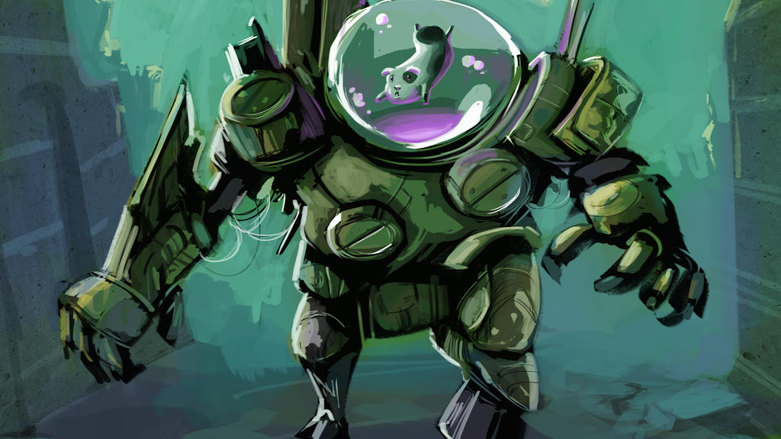
hello world

Slide 2
about the class

Slide 3
goals
help you become the best programmer you can be
CS136 is the foundation for all the programming you will do after!
have fun
let’s get comfortable coding up cool stuff from scratch

Slide 4
expectations
the lectures should make sense (you may have to watch more than once)
if something doesn’t make sense, raise your hand!
the homework should take 10-15+ hours per week
if it’s too hard, let’s chat and make a plan for success
if it’s too easy, let’s chat and i’ll find you something to do
the exams should be challenging and unsurprising

Slide 5
disclaimer
homework and exams will be a bit different than in previous years
you will sometimes feel like a guinea pig 🐹
the TA’s will sometimes feel confused
it will also be cool 🙂👍

Slide 6
about the lectures

Slide 7
🐮 how to read side by side code
i often show equivalent code side by side in order to...
relate new concepts to old concepts
compare and contrast different design decisions, e.g.,
a piece of code | equivalent code | equivalent code | equivalent code
boolean isEven; if (i % 2 == 0) { isEven = true; } else if (i % 2 != 0) { isEven = false; } if (isEven) { ... } | boolean isEven; if (i % 2 == 0) { isEven = true; } else { isEven = false; } if (isEven) { ... } | boolean isEven = (i % 2 == 0); if (isEven) { ... } | if (i % 2 == 0) { ... }

Slide 8
🐮 how to read emojis
i use emojis to help you read and study
🐮 info only relevant inside the world of CS136
☕ fun Java fact! (i.e., NOT relevant to C/C++; please forget after CS136)
🐍 comparison to Python
☠ common misconception or potential source of bugs
👀 spoilers/hints
⏱ big O runtime
✨ optional (NOT on exams) but sparks joy
🧠 question for you to think about
🗣️ question for your to talk about
🧪 question for you to experiment with
🙂👍

Slide 9
🐮 how to read emojis
🧠 what is code?
code tells a computer how to do something
🗣️ what makes code good?
good code makes your computer do the thing you want it to do, and...
runs fast
is small
is easy to read
🧪 make this code worse
Java code to make your computer print Hello World!
class HelloWorld { public static void main(String[] args) { System.out.println("Hello, World!"); } }

Slide 10
🧪
public class HelloWorld {public static void main(String[] args){ int[][] t = new int[][]{{202,1026,1100,396,324,1080,192,609,555,888,72,432}, {3,9,8,5},{2,2,5,9},{4,6,1,9,2,11},{4,6,1,9,3,2,11,7,0,5,10},{2,1,5,9},{1,9,2,5},{0,2,10,5,1,6,3,11,8,4},{10,4,2,6}, {1,10,2,3,5,9,7,4,11,6},{7,0,3,6},{2,9,10,1},{7,1,10,6},{12,0,-0}};do{while(t[13][1]+1<t[t[13][0]].length){ t[13][2]=t[0][t[t[13][0]][t[13][1]]];t[0][t[t[13][0]][t[13][1]]]=t[0][t[t[13][0]][++t[13][1]]];t[0][t[t[13][0]][t[13][1]++]]=t[13][2];} }while(!(--t[13][0]<=(int)Math.sin(Math.PI))&&((t[13][1]=0)<1));while(t[4][2]<=t[9][5]+3)System.out.print((char)(t[0][t[4][2]-1]/t[4][2]++));}}

Slide 11
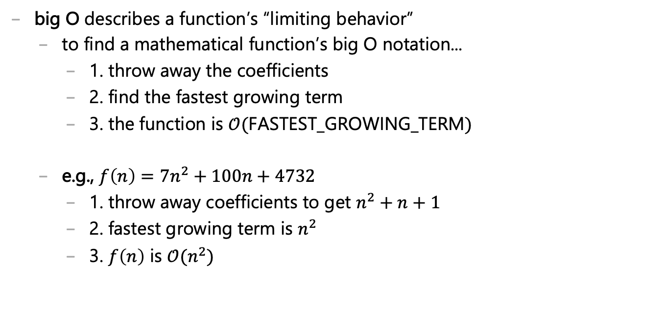
how to read/write big O notation
big O describes a function’s “limiting behavior”
to find a mathematical function’s big O notation...
1. throw away the coefficients
2. find the fastest growing term
3. the function is $𝒪($FASTEST_GROWING_TERM$)$
e.g., $f\left(n\right)=7n^{2}+100n+4732$
1. throw away coefficients to get $n^{2}+n+1$
2. fastest growing term is $n^{2}$
3. $f\left(n\right)$ is $𝒪(n^{2})$

Slide 12

how to read/write big O notation
e.g., what is $f\left(n\right)=77n^{7}+2^{n}$ in big O notation?
$n^{2}+2^{n}$
$2^{n}$ 🧪 is this true?
$𝒪(2^{n})$
e.g., what is $f\left(n\right)=100$ in big O notation?
$1$
$1$ 🧠 what does this mean?
$𝒪(1)$
e.g., what is $f\left(n\right)=n+log⁡(n)$ in big O notation?
$n+log⁡(n)$
$n$ 🧪 is this true?
$𝒪(n)$

Slide 13
🐮 how to read a step-by-step diff?
to show you the step-by-step process by which i write code, i will use something called a diff, which shows us the “difference” between two files
i will basically always be diffing the code at the current step with the code at the previous step, i.e.,
+ this line of code was just added - this line of code was just deleted this line of code was here last step and is still here now

Slide 14
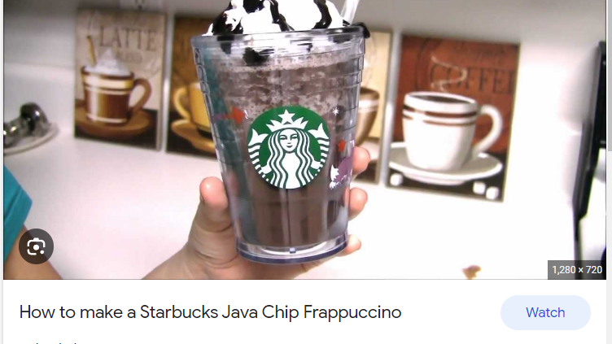
week 1: Java basics

Slide 15
primitives

Slide 16
operators

Slide 17
scope

Slide 18
+=, -=, *=, /=
shorthand assignment operators can make your code easier to read
using shorthand | not using shorthand
a += b; | a = a + b;
a -= b; | a = a - b;
a *= b; | a = a * b;
a /= b; | a = a / b;

Slide 19
increment
increment means to increase the value of something by one
the pre-increment ++i increments i and returns the new value of i
the post-increment i++ increments i and returns the old value of i
one line | two lines
j = ++i; | i = i + 1; j = i;
j = i++; | j = i; i = i + 1;
for (int i = 0; i < n; ++i) | for (int i = 0; i < n; i++)

Slide 20
scope
a scope is a region of code in which variables live
in Java, a scope is define by a pair of curly braces
OUTSIDE_SCOPE { INSIDE_SCOPE } OUTSIDE_SCOPE
remember, Java doesn't care about whitespace

Slide 21
scope
💖 you can use scope to avoid bugs!
TODO | for (int i = 0; i < n; i++)

Slide 22
whitespace
whitespace includes spaces and newlines
🐍 Python does care about whitespace (indentation changes what code does)
Java does NOT care about whitespace
🗣️ do you care about whitespace?
some guidelines:
be consistent!
carefully indent your scopes (and make sure your curly braces line up)
✨ your text editor can do this for you!
sparks joy | NOT equivalent -- doesn’t spark joy
for (int i = 0; i < 10; ++i) { if (i % 3 == 0) { System.out.println("fizz"); } } | for (int i = 0; i < 10; ++i) { if (i % 3 == 0) { } System.out.println("fizz"); }

Slide 23

arrays

Slide 24
array
an array is
int[] foo;
double[] baz;
String[] bar;

Slide 25
accessing an array
⏱️ accessing an array is O(1)
i.e., ” access an array takes a constant number of CPU cycles”
getting the value of array’s i-th element
int currentValue = array[i];
setting the value of array’s i-th element
array[i] = newValue;

Slide 26
creating an array
⏱️ creating an array is O(n)
creating a new integer array with 7 elements
int[] array = new int[7];
creating a new String array with n elements
String[] array = new String[n];

