Slide 1
Week08a
ANNOUNCEMENTS today is No Laptop Monday!
WARMUP "a chain is only as strong as its weakest link"
- what does this expression mean?
- what is a chain?
- what is a link?
- is this true for real-world metal chains? why or why not?
TODAY linked lists
🦜🦜🦜🦜🦜🦜🦜🦜

Slide 2


Slide 3
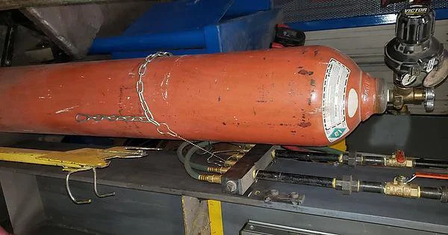

Slide 4
linked lists
record lecture

Slide 5
(p)review: list interface

Slide 6
list interface
// Get the element with this index.
ElementType get(int index);
// Add (append) an element to the back of the list. void add();
// Add (insert) an element into the list so it has this index void add(int index, ElementType element);
// Remove (delete) the element in the list at this index. void remove(int index);
// Get the number of elements currently in the list. int size();

Slide 7
list interface (cont.)
// NOTE: Many other functions could be included // in this interface.
void sort(); // Sort the list.
void reverse(); // Reverse the list.
List<ElementType> sorted(); // Get sorted copy of the list.
List<ElementType> reversed(); // Get reversed copy of list.
// Get index of first element with this value. int find(ElementType element);
...

Slide 8
a few weeks ago, we implemented the list interface using an array the array list

Slide 9
this week, we will implement the list interface using nodes with "links" (references) to other nodes this will be called a linked list

Slide 10
note

Slide 11
today we will be discussing the simplest possible linked list (LinkedList literally just has a reference to Node head.)

Slide 12
🐍
3.0
head
|
|
head.next
|
|
|
|
|
null

Slide 13
some other implementations are possible. some will be faster than this one.

Slide 14
for linked lists, do NOT memorize big O runtimes out of context

Slide 15
why are we doing this?

Slide 16
A: it will be cool to see two very different implementations of the same interface ☃️

Slide 17
B: linked lists will prepare us for trees and graphs🌳

Slide 18
C: linked lists are incredibly FUNdaMENTAL 🥳 (for us, as fundamental as arrays)

Slide 19
D: linked lists are actually big O better (than array lists) in very specific cases

Slide 20
E: linked lists are actually really, really important (especially in the C programming language)

Slide 21
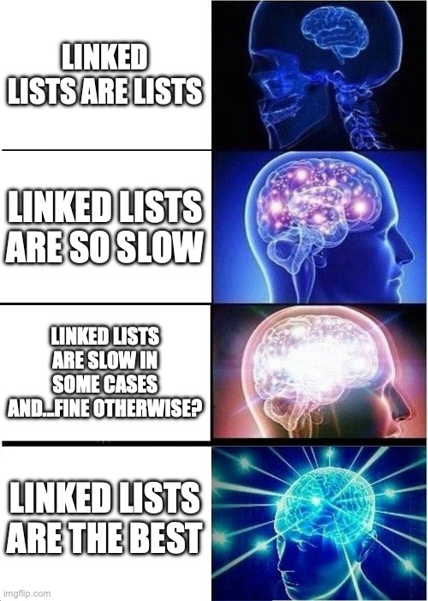

Slide 22
linked list

Slide 24
1.0
2.0
3.0

Slide 25
3.0
1.0
2.0

Slide 26
linked list
LinkedList list = new LinkedList();
class LinkedList {
Node head;
}
list.head = new Node(1.0);
1.0
class Node {
Value value;
Node next;
Node(Value value) {
this.value = value;
}
}
list.head.next = new Node(2.0);
1.0
2.0
list.head.next.next = new Node(3.0);
1.0
2.0
3.0

Slide 27
linked list
LinkedList list = new LinkedList();
class LinkedList {
Node head;
void add(Value value) {
...
}
}
list.add(1.0);
1.0
list.add(2.0);
1.0
2.0
class Node {
Value value;
Node next;
Node(Value value) {
this.value = value;
}
}
list.add(3.0);
1.0
2.0
3.0

Slide 28
example: addFront(value)

Slide 29
addFront(2.0)
value
next
value
next
3.0
4.0 | null
head

Slide 30
addFront(2.0)
3.0
4.0 | null
head

Slide 31
addFront(2.0)
Node tmp = new Node(2.0);
2.0 | null
3.0
4.0 | null
tmp
head

Slide 32
addFront(2.0)
2.0 | null
3.0
4.0 | null
tmp
head

Slide 33
addFront(2.0)
tmp.next = head;
2.0
3.0
4.0 | null
tmp
head

Slide 34
addFront(2.0)
2.0
3.0
4.0 | null
tmp
head

Slide 35
addFront(2.0)
head
head = tmp;
2.0
3.0
4.0 | null
tmp

Slide 36
addFront(2.0)
head
2.0
3.0
4.0 | null
tmp

Slide 37
addFront(2.0)
head
2.0
3.0
4.0 | null
// tmp leaves scope
tmp

Slide 38
addFront(2.0)
head
2.0
3.0
4.0 | null

Slide 39
same thing but with labels instead of arrows for head and tmp

Slide 40
addFront(2.0)
head
3.0
4.0 | null

Slide 41
addFront(2.0)
Node tmp = new Node(2.0);
tmp
head
2.0 | null
3.0
4.0 | null

Slide 42
addFront(2.0)
tmp
head
2.0 | null
3.0
4.0 | null

Slide 43
addFront(2.0)
tmp.next = head;
tmp
head
2.0
3.0
4.0 | null

Slide 44
addFront(2.0)
tmp
head
2.0
3.0
4.0 | null

Slide 45
addFront(2.0)
head = tmp;
head
2.0
3.0
4.0 | null

Slide 46
addFront(2.0)
head
2.0
3.0
4.0 | null

Slide 47
head
2.0
3.0
4.0 | null

Slide 48
2.0
3.0
4.0
(even) more abstract diagram

Slide 49
example: remove

Slide 50
remove
prev
curr
curr.next
3.0
4.0
5.0
Node prev = null; // the previous node
Node curr = head; // the current node
while (...) {
...
prev = curr;
curr = curr.next;
}

Slide 51
remove
prev
curr
curr.next
3.0
4.0
5.0

Slide 52
remove
prev
curr
curr.next
3.0
4.0
5.0

Slide 53
remove
prev.next = curr.next;
prev
curr
curr.next
3.0
4.0
5.0

Slide 54
remove
prev.next = curr.next;
prev
curr
curr.next
3.0
4.0
5.0

Slide 55
remove
prev.next = curr.next;
prev
curr.next
3.0
5.0

Slide 56
remove
3.0
5.0

Slide 57
remove
3.0
5.0

Slide 58
where did the middle node go? - way back when...we created it using new - then we just like..."stopped referring to it" - is it gone now? 😥

Slide 59
🚛it has been garbage collected

Slide 60
[board discussion of "no directed path from stack to the node"]

Slide 61
big O runtimes

Slide 62
what is the big O runtime of size()? [pointing activity]

Slide 63
O(n) 😢

Slide 64
singly-linked list worst case runtimes
head
list.add(index, value)
// O(n)
list.removeByIndex(index)
// O(n)
list.size()
// O(n)
list.addFront() // list.add(0, value)
// O(1)
list.removeFront() // list.removeByIndex(0)
// O(1)
list.addBack()
// O(n)
list.removeBack()
// O(n)

Slide 65
beyond big O runtime

Slide 66

what does this actually look like in memory?
1.0
2.0
3.0

Slide 67
class LinkedList {
Node head;
}
list
LinkedList list = new LinkedList();
list.head = new Node(1.0);
list.head.next = new Node(2.0);
list.head.next.next = new Node(3.0);
0x0a2bcefa
class Node {
double value;
Node next;
}
0x2349d47a3
1.0 0x05287a12
3.0 null
2.0 0xab334b19

Slide 68
1.0 0x05287a12
3.0 null
2.0 0xab334b19

Slide 69
what does this mean? cons? ☹️ pros? 🙂 (how is this very different than an array list?)

Slide 70
https://x.com/_kzr/status/1672497446705037312

Slide 71
class LinkedList {
Node head;
}
List list = new List();
list.head = new Node("Hans");
list.head.next = new Node("The");
list.head.next.next = new Node("Parrot");
list
class Node {
String value;
Node next;
}
0x0a2bcefa
'H' 'a' 'n' 's'
0x2349d47a3
'T' 'h' 'e'
0x234c8b7a 0x05287a12
0x7766231a null
0x3425ff1a 0xab334b19
'P' 'a' 'r' 'r' 'o' 't'

Slide 73
ANNOUNCEMENTS friday's colloquium will be cool!
my friend Pascal makes ✨underwater robotic spheres✨!
midterms will be returned Fri
WARMUP review: for a linked list, size() is O(n) runtime
- how could you make size() (or perhaps... size) O(1)?
-- is this at all...spooky?👻
TODAY size() and riffs on linked lists
Week08b
🦜🦜🦜🦜🦜🦜🦜🦜

Slide 74
🐍
3.0
the front of the snek
head
|
|
head.next
|
|
|
|
the back of the snek
|
null

Slide 75
linked lisssssst

Slide 76
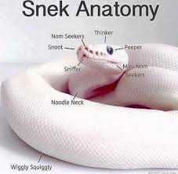

Slide 77
[record lecture]

Slide 78
LinkedList review

Slide 79
runtimes

Slide 80
worst case singly-linked list runtimes
head
list.add(index, value)
// O(n)
list.removeByIndex(index)
// O(n)
list.size()
// O(n)
list.addFront()
// O(1)
list.removeFront()
// O(1)
list.addBack()
// O(n)
list.removeBack()
// O(n)

Slide 81
additional warmup: prepending a list

Slide 82
example
Node snap = new Node(1.0);
Node crackle = new Node(2.0);
Node pop = new Node(3.0);
snap.next = crackle;
crackle.next = pop;
pop.next = head;
head = snap;
✍️
4.0
5.0
head

Slide 83
example
Node snap = new Node(1.0);
Node crackle = new Node(2.0);
Node pop = new Node(3.0);
snap.next = crackle;
crackle.next = pop;
pop.next = head;
head = snap;
4.0
5.0
head

Slide 84
example
Node snap = new Node(1.0);
Node crackle = new Node(2.0);
Node pop = new Node(3.0);
snap.next = crackle;
crackle.next = pop;
pop.next = head;
head = snap;
snap
1.0 | null
4.0
5.0
head

Slide 85
example
Node snap = new Node(1.0);
Node crackle = new Node(2.0);
Node pop = new Node(3.0);
snap.next = crackle;
crackle.next = pop;
pop.next = head;
head = snap;
snap
crackle
1.0 | null
2.0 | null
4.0
5.0
head

Slide 86
example
Node snap = new Node(1.0);
Node crackle = new Node(2.0);
Node pop = new Node(3.0);
snap.next = crackle;
crackle.next = pop;
pop.next = head;
head = snap;
snap
crackle
pop
1.0 | null
2.0 | null
3.0 | null
4.0
5.0
head

Slide 87
example
Node snap = new Node(1.0);
Node crackle = new Node(2.0);
Node pop = new Node(3.0);
snap.next = crackle;
crackle.next = pop;
pop.next = head;
head = snap;
snap
crackle
pop
1.0
2.0 | null
3.0 | null
4.0
5.0
head

Slide 88
example
Node snap = new Node(1.0);
Node crackle = new Node(2.0);
Node pop = new Node(3.0);
snap.next = crackle;
crackle.next = pop;
pop.next = head;
head = snap;
snap
crackle
pop
1.0
2.0
3.0 | null
4.0
5.0
head

Slide 89
example
Node snap = new Node(1.0);
Node crackle = new Node(2.0);
Node pop = new Node(3.0);
snap.next = crackle;
crackle.next = pop;
pop.next = head;
head = snap;
snap
crackle
pop
1.0
2.0
3.0
4.0
5.0
head

Slide 90
example
Node snap = new Node(1.0);
Node crackle = new Node(2.0);
Node pop = new Node(3.0);
snap.next = crackle;
crackle.next = pop;
pop.next = head;
head = snap;
snap
crackle
pop
1.0
2.0
3.0
4.0
5.0
head

Slide 91
example
Node snap = new Node(1.0);
Node crackle = new Node(2.0);
Node pop = new Node(3.0);
snap.next = crackle;
crackle.next = pop;
pop.next = head;
head = snap;
1.0
2.0
3.0
4.0
5.0
head

Slide 92
🧠 was that faster than calling addFront() n times? 🧠 same big O or different big O? (if we were to call it many times)
Node snap = new Node(1.0);
Node crackle = new Node(2.0);
Node pop = new Node(3.0);
snap.next = crackle;
crackle.next = pop;
pop.next = head;
head = snap;
addFront(3.0);
addFront(2.0);
addFront(1.0);
vs.

Slide 93
🧠 was that faster than calling addFront() n times? yes (only updated head once) 🧠 same big O or different big O? same (still have to "hook up" O(n) references)

Slide 94
[implement LinkedList]

Slide 95
[implement LinkedList]

Slide 96
size()

Slide 97
[ implement size() poorly ]

Slide 98
[ implement size() poorly ]

Slide 99
joyful implementation of size

Slide 100
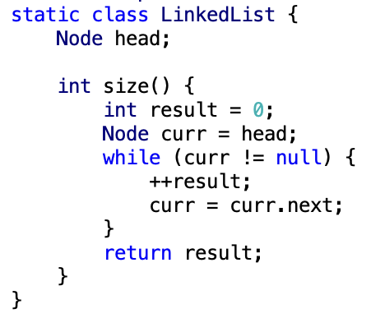

Slide 101
size()
what is the big O runtime of this method?
O(n) ☹️
this seems like a pretty steep cost to pay just to know the list’s size... what would be a more efficient approach?
store size as an instance variable
update it every time you change the number of elements in the list (inside of add, remove, etc.)
what is the runtime of this approach?
O(1) 🙂

Slide 102
while way more efficient, this approach is perhaps a bit spooky 👻 multiple functions are now also responsible for carefully modifying an instance variable (mess up, and any code that depends on size will be very weirdly broken)

Slide 103
note: the A homework doesn't use size at all

Slide 104
but if you were going to implement/use the list's size... i would start with size() as a function, get everything working perfectly, and only then carefully turn it into an instance variable 🙂👍

Slide 105


(it's this thing again)

Slide 106
tail reference

Slide 107
singly-linked list with reference to tail
head
tail
class LinkedList {
Node head;
Node tail;
}
class Node {
Value value;
Node next;
}

Slide 108
singly-linked list with reference to tail worst case runtimes
head
tail
list.add(index, value)
// O(n)
list.removeByIndex(index)
// O(n)
list.size()
// O(n)
list.addFront()
// O(1)
list.removeFront()
// O(1)
list.addBack()
// O(1) 😀
list.removeBack()
// O(n) 😡

Slide 109
doubly-linked list

Slide 110
singly- vs. doubly-linked

Slide 111
singly-linked list
head
class LinkedList {
Node head;
}
class Node {
Value value;
Node next;
}

Slide 112
doubly-linked list
tail
head
class LinkedList2 {
Node2 head;
Node2 tail;
}
class Node2 {
Value value;
Node2 next;
Node2 prev;
}

Slide 113
🤷
3.0
4.0
5.0

Slide 114
3.0
4.0
5.0

Slide 115
runtimes

Slide 116
worst case doubly-linked list runtimes
tail
head
list.add(index, value)
// O(n)
list.removeByIndex(index)
// O(n)
list.size()
// O(n)
list.addFront()
// O(1)
list.removeFront()
// O(1)
list.addBack()
// O(1) 😀
list.removeBack()
// O(1) 😀

Slide 117
a doubly-linked list is a great way to implement a deque (double-ended queue)
O(1) addFront() O(1) removeFront() O(1) addBack() O(1) removeBack()
🧠 could you pull this off with an array list?
no.
addFront() is O(n)
🧠 could you pull this off with an array?
sort of!—the array deque (amortized O(1) add)

Slide 118
Week08c
warmup: have you pre-registered? what classes are you taking?
🦜
underwater robotic spheres!
colloquium today in Wege (TCL123)
@ 2:30pm

Slide 119
pre-reg

Slide 120
237

Slide 121
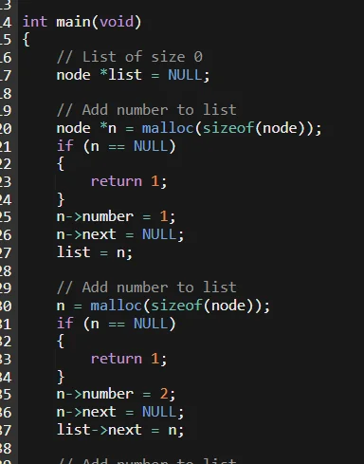

Slide 122
"the stack"
local variable primitives & references to Objects
undefined by default (will NOT compile if used)
"the heap"
the actual Objects (arrays and String's count as Objects)
cleared to 0 or null by default

Slide 124
LinkedList list =
new LinkedList("Hans -> Parrot");

Slide 125
LinkedList list;
{
Node node;
String string;
list = new LinkedList();
node = new Node();
string = "Hans";
node.value = string;
list.head = node;
node = new Node();
string = "Parrot";
node.value = string;
list.head.next = node;
}

Slide 126
LinkedList list;
{
Node node;
String string;
list = new LinkedList();
node = new Node();
string = "Hans";
node.value = string;
list.head = node;
node = new Node();
string = "Parrot";
node.value = string;
list.head.next = node;
}
list
UNDEFINED

Slide 127
LinkedList list;
{
Node node;
String string;
list = new LinkedList();
node = new Node();
string = "Hans";
node.value = string;
list.head = node;
node = new Node();
string = "Parrot";
node.value = string;
list.head.next = node;
}
list
node
UNDEFINED
UNDEFINED

Slide 128
LinkedList list;
{
Node node;
String string;
list = new LinkedList();
node = new Node();
string = "Hans";
node.value = string;
list.head = node;
node = new Node();
string = "Parrot";
node.value = string;
list.head.next = node;
}
list
node
string
UNDEFINED
UNDEFINED
UNDEFINED

Slide 129
LinkedList list;
{
Node node;
String string;
list = new LinkedList();
node = new Node();
string = "Hans";
node.value = string;
list.head = node;
node = new Node();
string = "Parrot";
node.value = string;
list.head.next = node;
}
list
node
string
0x11111111
UNDEFINED
UNDEFINED
null

Slide 130
LinkedList list;
{
Node node;
String string;
list = new LinkedList();
node = new Node();
string = "Hans";
node.value = string;
list.head = node;
node = new Node();
string = "Parrot";
node.value = string;
list.head.next = node;
}
list
node
string
0x11111111
0x22222222
UNDEFINED
null
null null

Slide 131
LinkedList list;
{
Node node;
String string;
list = new LinkedList();
node = new Node();
string = "Hans";
node.value = string;
list.head = node;
node = new Node();
string = "Parrot";
node.value = string;
list.head.next = node;
}
list
node
string
0x11111111
0x22222222
0x88888888
null
null null
H a n s

Slide 132
LinkedList list;
{
Node node;
String string;
list = new LinkedList();
node = new Node();
string = "Hans";
node.value = string;
list.head = node;
node = new Node();
string = "Parrot";
node.value = string;
list.head.next = node;
}
list
node
string
0x11111111
0x22222222
0x88888888
null
0x88888888 null
H a n s

Slide 133
LinkedList list;
{
Node node;
String string;
list = new LinkedList();
node = new Node();
string = "Hans";
node.value = string;
list.head = node;
node = new Node();
string = "Parrot";
node.value = string;
list.head.next = node;
}
list
node
string
0x11111111
0x22222222
0x88888888
0x22222222
0x88888888 null
H a n s

Slide 134
LinkedList list;
{
Node node;
String string;
list = new LinkedList();
node = new Node();
string = "Hans";
node.value = string;
list.head = node;
node = new Node();
string = "Parrot";
node.value = string;
list.head.next = node;
}
list
node
string
0x11111111
0x33333333
0x88888888
0x22222222
0x88888888 null
null null
H a n s

Slide 135
LinkedList list;
{
Node node;
String string;
list = new LinkedList();
node = new Node();
string = "Hans";
node.value = string;
list.head = node;
node = new Node();
string = "Parrot";
node.value = string;
list.head.next = node;
}
list
node
string
0x11111111
0x33333333
0x99999999
0x22222222
0x88888888 null
null null
H a n s
P a r r o t

Slide 136
LinkedList list;
{
Node node;
String string;
list = new LinkedList();
node = new Node();
string = "Hans";
node.value = string;
list.head = node;
node = new Node();
string = "Parrot";
node.value = string;
list.head.next = node;
}
list
node
string
0x11111111
0x33333333
0x99999999
0x22222222
0x88888888 null
0x99999999 null
H a n s
P a r r o t

Slide 137
LinkedList list;
{
Node node;
String string;
list = new LinkedList();
node = new Node();
string = "Hans";
node.value = string;
list.head = node;
node = new Node();
string = "Parrot";
node.value = string;
list.head.next = node;
}
list
node
string
0x11111111
0x33333333
0x99999999
0x22222222
0x88888888 0x33333333
0x99999999 null
H a n s
P a r r o t

Slide 138
LinkedList list;
{
Node node;
String string;
list = new LinkedList();
node = new Node();
string = "Hans";
node.value = string;
list.head = node;
node = new Node();
string = "Parrot";
node.value = string;
list.head.next = node;
}
list
0x11111111
0x22222222
0x88888888 0x33333333
0x99999999 null
H a n s
P a r r o t

Slide 139
LinkedList list;
{
Node node;
String string;
list = new LinkedList();
node = new Node();
string = "Hans";
node.value = string;
list.head = node;
node = new Node();
string = "Parrot";
node.value = string;
list.head.next = node;
}
list
0x11111111
0x22222222
0x88888888 0x33333333
0x99999999 null
H a n s
P a r r o t

Slide 140
memory in C

Slide 141
in C, we often get to choose whether to allocate memory on the stack or the heap

Slide 142
memory allocation
// Java
int[] heapAllocatedArray = new int[10]
heapAllocatedArray[0] = 3;
// C
int stackAllocatedArray[10];
int *heapAllocatedArray = malloc(10000000 * sizeof(int));
stackAllocatedArray[0] = 3;
heapAllocatedArray[0] = 3;
free(heapAllocatedArray);

Slide 143
256

Slide 144
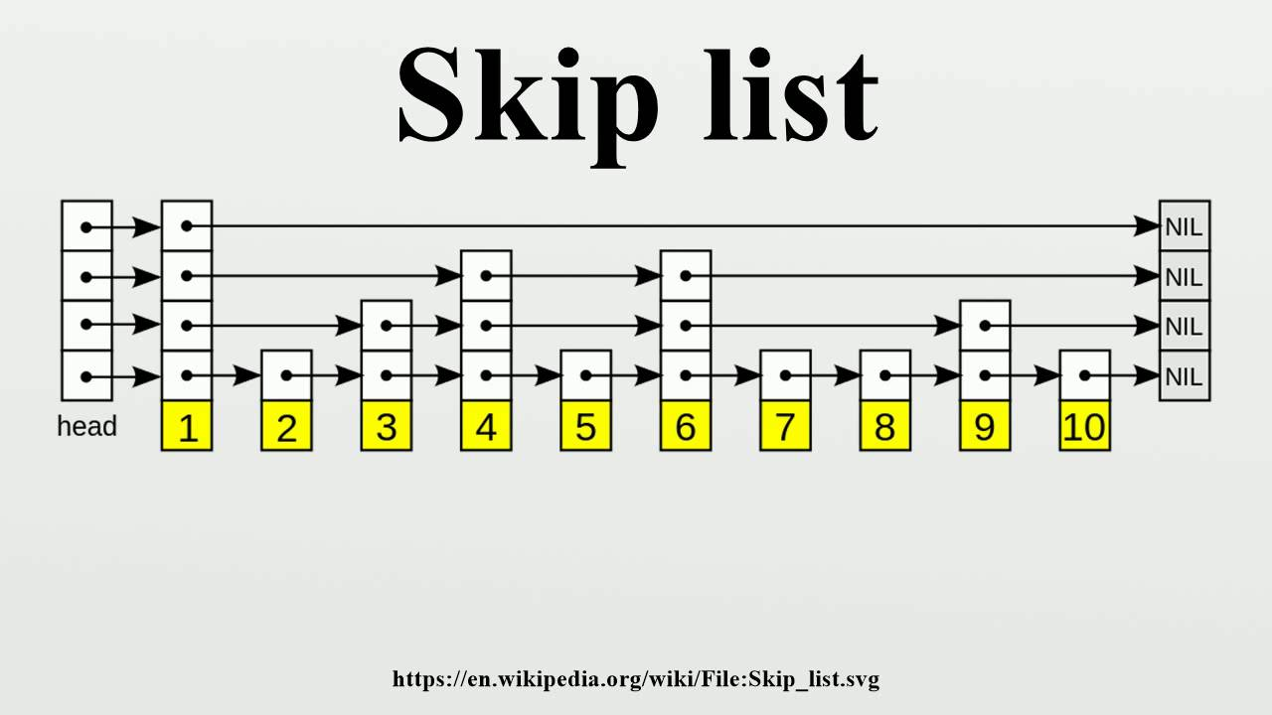

Slide 145
334

Slide 146
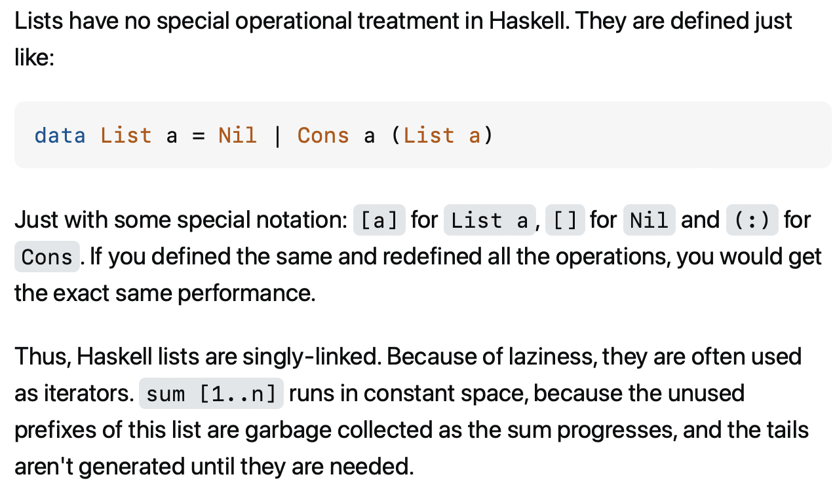

Slide 147
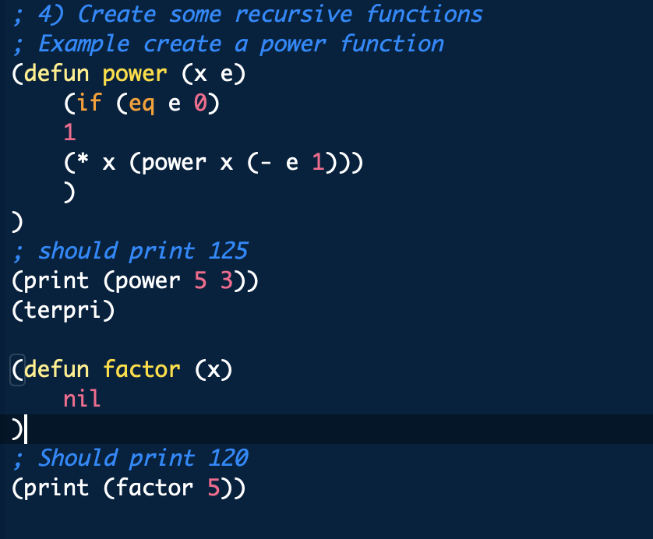

Slide 148
something fun?

Slide 149
fun friday menu - jim rants about comments and syntax highlighting - jim continues codeing (some of) microsoft paint from scratch - jim updates you on his CAD software - jim show and tells about his favorite element - jim reads aloud from grugbrain.dev - jim reads aloud from vim creep - jim reads aloud from hexing the technical interview - jim reads aloud from the truth about lisp - jim reads aloud from the worst API ever made

Slide 150
midterm

Slide 151
common areas of struggle

Slide 152
question 1
syntax
list.add(int 3); // void add(int element);
True
}

Slide 153
}
generally speaking {
you want your curly braces {
}
to look {
something like this {
}
}
}

Slide 154
}
generally speaking
{
you want your curly braces
{
}
to look
{
something like this
{
}
}
}

Slide 155
}
this is quite spooky {
and hard {
to read }
it's hard to tell {
where one scope starts {
and the next ends
}}
do i have enough braces?

Slide 156
question 3
control flow
returning too early (inside for loop)
handling special case too late (after creating array)
if...if vs. if...else if vs. if...else
syntax
list[i]
null
boolean 7Found;
;

Slide 157
question 5
complete understanding of app
pool
single enemy vs. multiple enemies

Slide 158
question 6
complete understanding of app
buffer is 8 characters long, but only length many characters are drawn
last question

Slide 159
results

Slide 160
summay
distribution is very wide (this is normal)
some grades are low (< ~50)
this does not mean you will fail the coure
"if you do all the homework, and the exams just aren't working for you, you will pass CS136" – James Bern, Fri Nov 1
my comments are very sparse
if you don't know why you lost points, or you think i may have made a mistake please ask

Slide 161
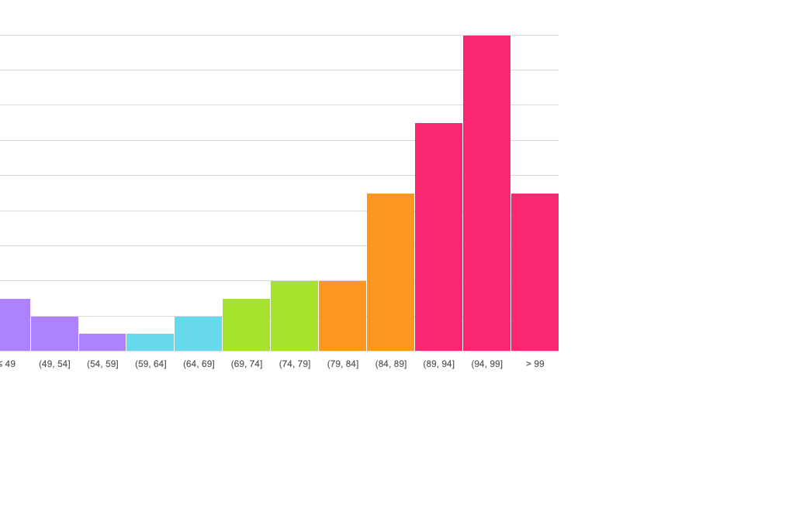
mean: 86.4
standard deviation: 15.9

Slide 162
thoughts

