Slide 1
hello

Slide 2
i am very excited to have you all on the 136 team

Slide 3
this semester will be a bit different

Slide 4
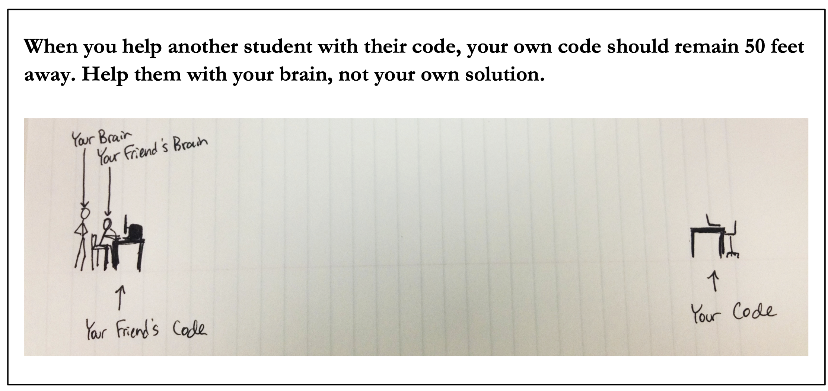
specifically...
no more structure5
no more textbook
no more quizzes
no more evolene
no more git pull/add/commit/pull
no more checkstyle
no more JavaDoc comments
no more CoinStrip (various new labs)
we now have a game engine called Cow.java
our course website is now a GitHub wiki
VSCode is now DrJava
practice midterm and final will be released as we go
midterm and final are in-person and on-paper
every TA will come to a lab section
Jim will come to some TA help hours 🙂👍
homework is now called homework
homeworks are one file each (ish)
homeworks are easier to get an A on
homeworks are harder to get an A+ on
homeworks are submitted on gradescope
homeworks are graded by live demo/checklist during lab or autograder (TA's will never run tests by hand as they did in the past)
students can collaborate with whoever they want provided they follow the 50 ft. rule

Slide 5
why?

Slide 6
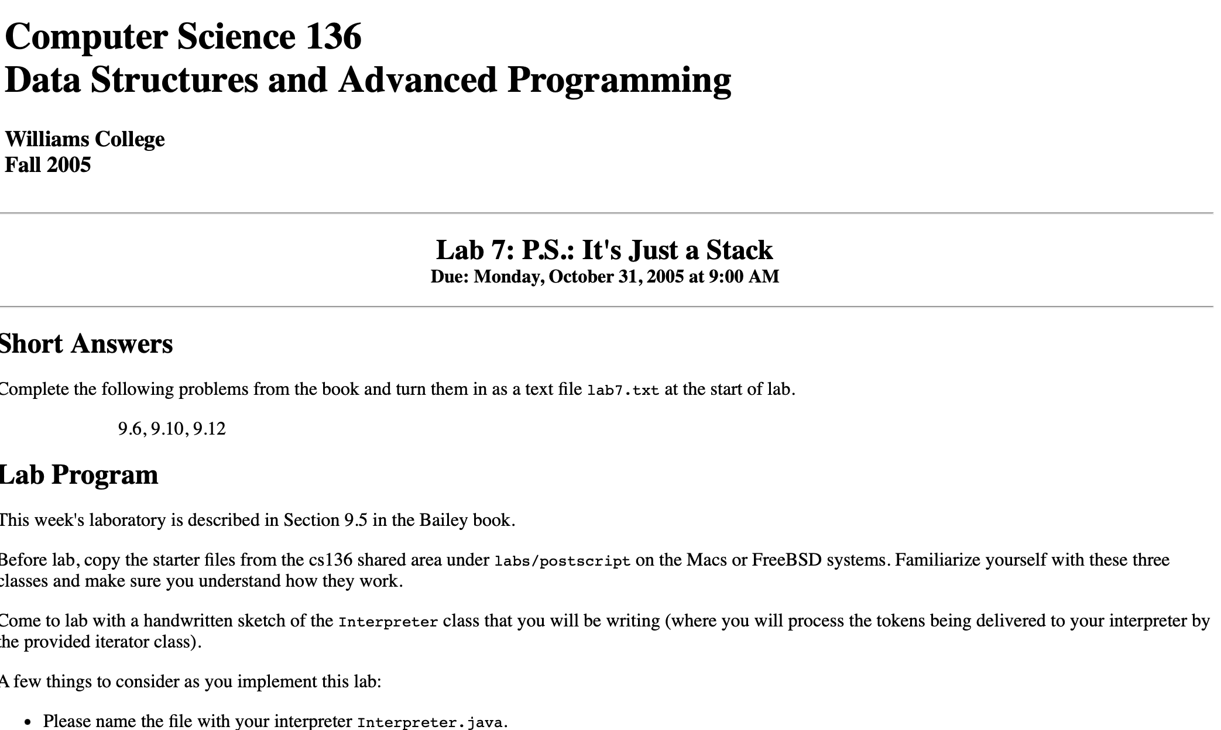

Slide 7
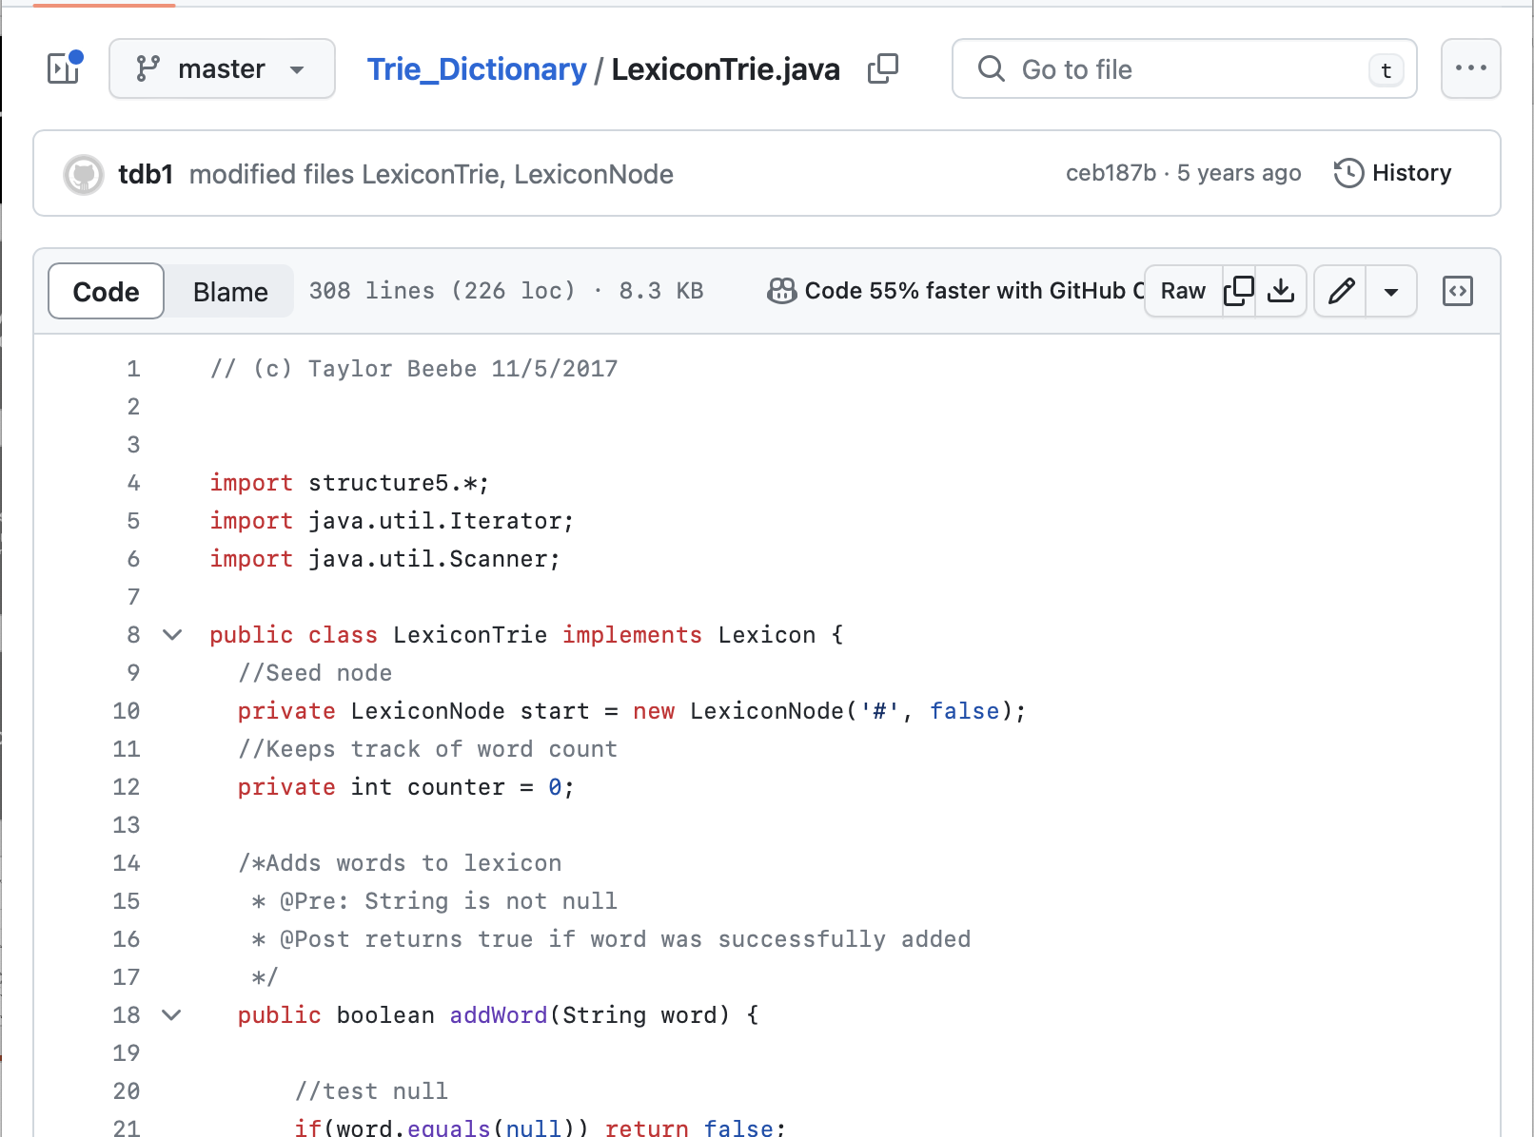

Slide 8
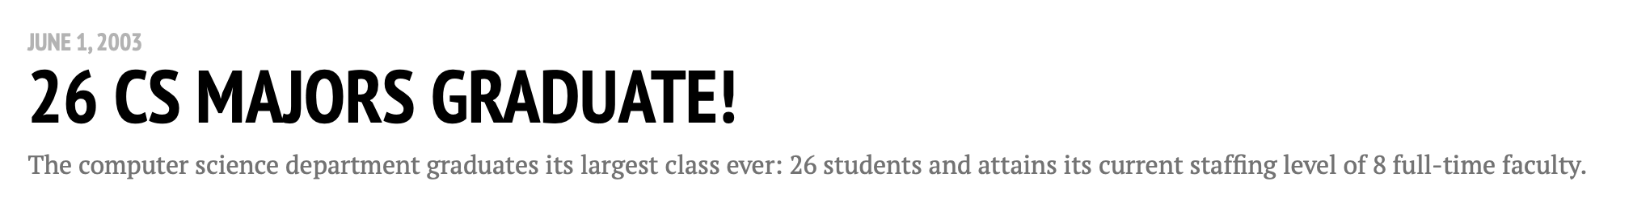

Slide 9
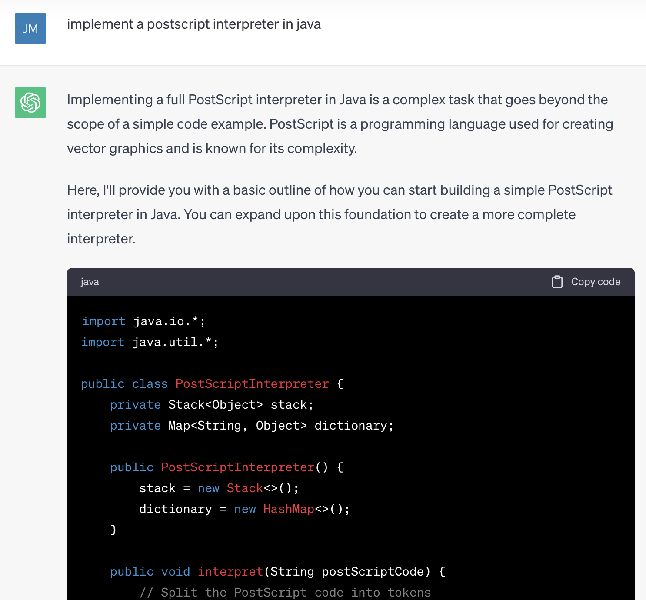

Slide 10
goals for CS 136
get students excited about programming independently
in my perfect world, all students would be coding every day for fun
in the real world...let's see what we can do 🙂👍
experiment with a simpler, more scalable course
we dropped 21 students this semester
let's move towards a future where we don't have to do this
try very hard NOT to "weed students out"
every student in the course should have the opportunity to succeed
(success ~ B)

Slide 11
ask 3+ questions

Slide 12
3+ minutes of getting to know your fellow TA's (and me, if we haven't met)

Slide 13
activity: what is CS 136?

Slide 14
let's look at the homeworks

Slide 15
conclusion

Slide 16
pros and cons of TA'ing CS136 this semester
pros
learn something new!
spend way less time grading
experience the thrill of the unknown 🚀
cons
spend more time prepping for Lab and Help Hours
assert timeSpentPrepping > 0.0;
experience may not be what you were expecting
if you have concerns, please talk to me after the meeting or reach out over email 🙂👍

Slide 17
my asks of you
please tell me if something seems wrong/bad/confusing/worse than before...
i will try to address your feedback
come to the TA meetings (TODO: schedule these)
i will try not to waste our time
try to have a somewhat open mind...
...though not too open; see first point 🙂👍

Slide 18
tl;dr i'm sure everything is going to be just fine

Slide 19
ask 1+ question

Slide 20
logistics: volunteers for 1st class (on Friday) logistics: TA meeting (virtual/multiple meetings/Tuesday @ 6.....?)

Slide 21
your ticket out – make a GitHub account if you don't already have one and email me your username / email so I can add you to our homework solutions repo (reply to the email thread about this meting)

Slide 22
b-b-b-b-bonus slides!

Slide 23
we will also experiment with simplified coding style
homeworks will be one file each
note: i will sometimes go to bizarre, extraordinary lengths to pull this off (nested classes)
i recognize that this has risks, but for now it seems worth
note: some homeworks will use our game library Cow.java, and so are technically two files
we will use fewer Java features
less use of interfaces
less use of inheritance
less use of access modifiers
note: occassionally Java will force us to use public (e.g., main, toString);
i will take care of this for the students
less use of try...catch
note: occassionally Java will force us to use a try...catch;
i will take care of this for the students, and wrap it up into a helper function

Slide 24
we will try to emphasize readability
tend to use easy to read variable names, even if they are longer
Scanner sc = new Scanner();
Scanner scanner = new Scanner();

Slide 25
general philosophy: more important that YOU like reading your code than that, e.g., checkstyle does
Token(boolean value) { type = TYPE_BOOLEAN; _valueIfTypeBoolean = value; }
Token(double value) { type = TYPE_DOUBLE; _valueIfTypeDouble = value; } Token(String value) { type = TYPE_STRING; _valueIfTypeString = value; } Token(List value) { type = TYPE_LIST; _valueIfTypeList = value; }
public Token(double value)
// post: constructs a double token with value value
{
kind = NumberKind;
this.number = value;
}
public Token(boolean bool)
// post: constructs a boolean token with value bool
{
kind = BooleanKind;
this.bool = bool;
}
public Token(String symbol)
// post: constructs a symbol token with value symbol
{
kind = SymbolKind;
this.symbol = symbol;
}
public Token(List proc)
// post: constructs a procedure token with values from List
{
kind = ProcedureKind;
this.procedure = proc;
}

Slide 26
general philosophy: more important that YOU like reading your code than that, e.g., checkstyle does
Token(boolean value) { type = TYPE_BOOLEAN; _valueIfTypeBoolean = value; }
Token(double value) { type = TYPE_DOUBLE; _valueIfTypeDouble = value; } Token(String value) { type = TYPE_STRING; _valueIfTypeString = value; } Token(List value) { type = TYPE_LIST; _valueIfTypeList = value; }
public Token(double value)
// post: constructs a double token with value value
{
kind = NumberKind;
this.number = value;
}
public Token(boolean bool)
// post: constructs a boolean token with value bool
{
kind = BooleanKind;
this.bool = bool;
}
public Token(String symbol)
// post: constructs a symbol token with value symbol
{
kind = SymbolKind;
this.symbol = symbol;
}
public Token(List proc)
// post: constructs a procedure token with values from List
{
kind = ProcedureKind;
this.procedure = proc;
}

