Slide 1
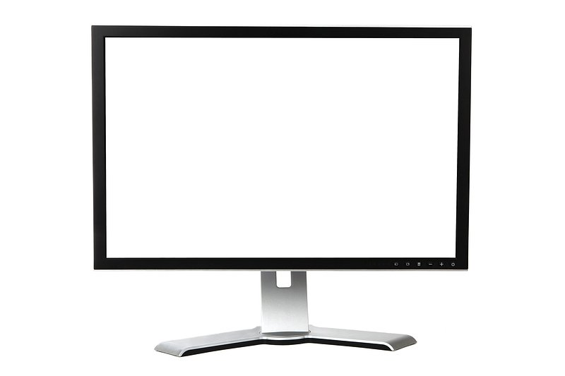
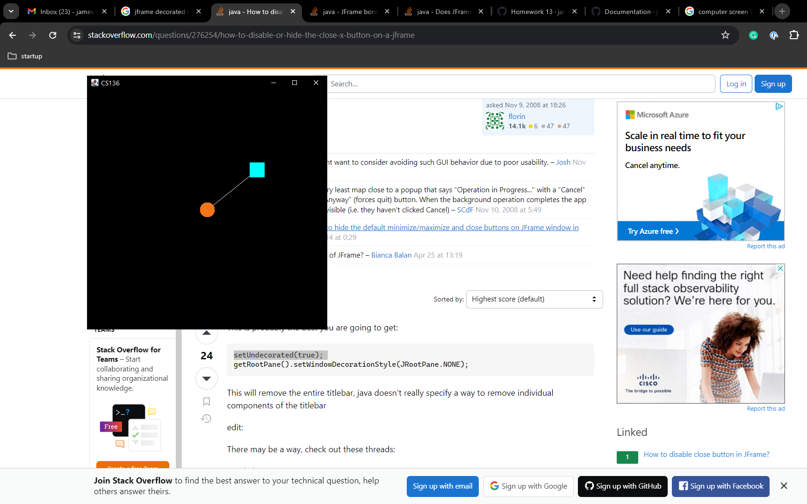

topLeftCorner
(in pixels)
"world coordinates"
(origin and axes)
mousePosition
windowHeight
windowCenter
(origin)
windowWidth

