Slide 1

Week02c
!
🛌
Today is...
✨Jeannie Friday! ✨
swap
array examples
that use swaps
array big O
WARMUP:
How do we swap two numbers...
...in Java?
...in Python?
...in C using XOR and no temporary?
BONUS:
What is the big O runtime of pressing backspace in your text box (n is buffer.length)

Slide 2
swap

Slide 3
🐍 Python swap

Slide 4
🐍 Python swap
a = 0
b = 1
a, b = b, a # Python swap
# a is now 1
# b is now 0

Slide 5
☠️ BAD VERY BAD BROKEN swap

Slide 6
☠️ BAD VERY BAD BROKEN swap
int a = 0;
int b = 1;
{ // BAD VERY BAD BROKEN swap
a = b; // a <- 1
b = a; // b <- 1
}

Slide 7
swap

Slide 8
swap
int a = 0;
int b = 1;
{ // swap
int tmp = a; // tmp <- 0
a = b; // a <- 1
b = tmp; // b <- 0
}

Slide 9
array algorithms that use swaps

Slide 10
reversing an array

Slide 11
out-of-place reverse
we can reverse an array out-of-place using an additional array
static int[] outOfPlaceReverse(int[] array) {
int[] result = new int[array.length];
for (int i = 0; i < array.length; ++i) {
int j = (array.length - 1) - i;
result[i] = array[j];
}
return result;
}

Slide 12
in-place reverse
we can reverse an array in-place using "swaps" (no additional array)
static void inPlaceReverse(int[] array) {
for (int i = 0; i < array.length / 2; ++i) {
int j = (array.length - 1) - i; // "mirror index"
// swap array[i] <-> array[j]
int tmp = array[i];
array[i] = array[j];
array[j] = tmp;
}
}

Slide 13
bubble sort

Slide 14
bubble sort
bubble sort is a simple in-place sorting algorithm that uses swaps
boolean arrayIsSorted;
do {
arrayIsSorted = true;
for (int i = 0; i < array.length - 1; ++i) {
if (array[i] > array[i + 1]) {
arrayIsSorted = false;
// swap
int tmp = array[i];
array[i] = array[i + 1];
array[i + 1] = tmp;
}
}
} while (!arrayIsSorted);

Slide 15
big O runtime (arrays)

Slide 16

runtime of array operations
arrays are fast!
  ⏱️ creating an array takes $𝒪(n)$ time, where $n$ is the length of the array
  ⏱️ getting the value of the i-th element of an array takes $𝒪(1)$ time
  ⏱️ setting the value of the i-th element of an array takes $𝒪(1)$ time

Slide 17
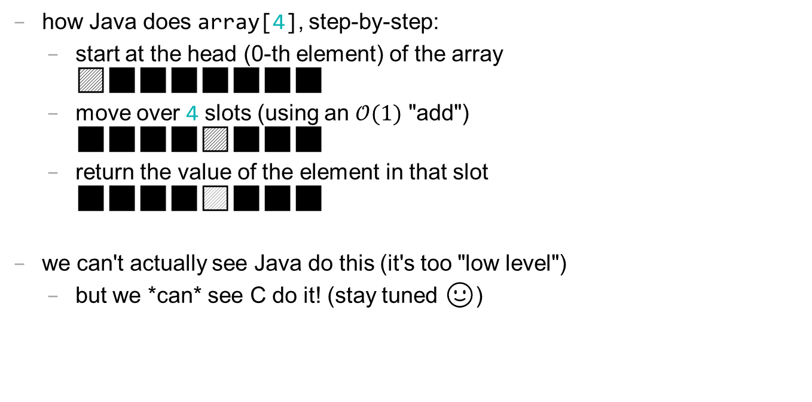
accessing an array "under the hood"
how Java does array[4], step-by-step:
  start at the head (0-th element) of the array
  🟦⬛⬛⬛⬛⬛⬛⬛
  move over 4 slots (using an $𝒪(1)$ "add")
  ⬛⬛⬛⬛🟦⬛⬛⬛
  return the value of the element in that slot
  ⬛⬛⬛⬛🟨⬛⬛⬛
we can't actually see Java do this (it's too "low level")
  but we *can* see C do it! (stay tuned 🙂)

Slide 18
see C do it

Slide 19
Cecilia sees C by the Sea Shore

Slide 20


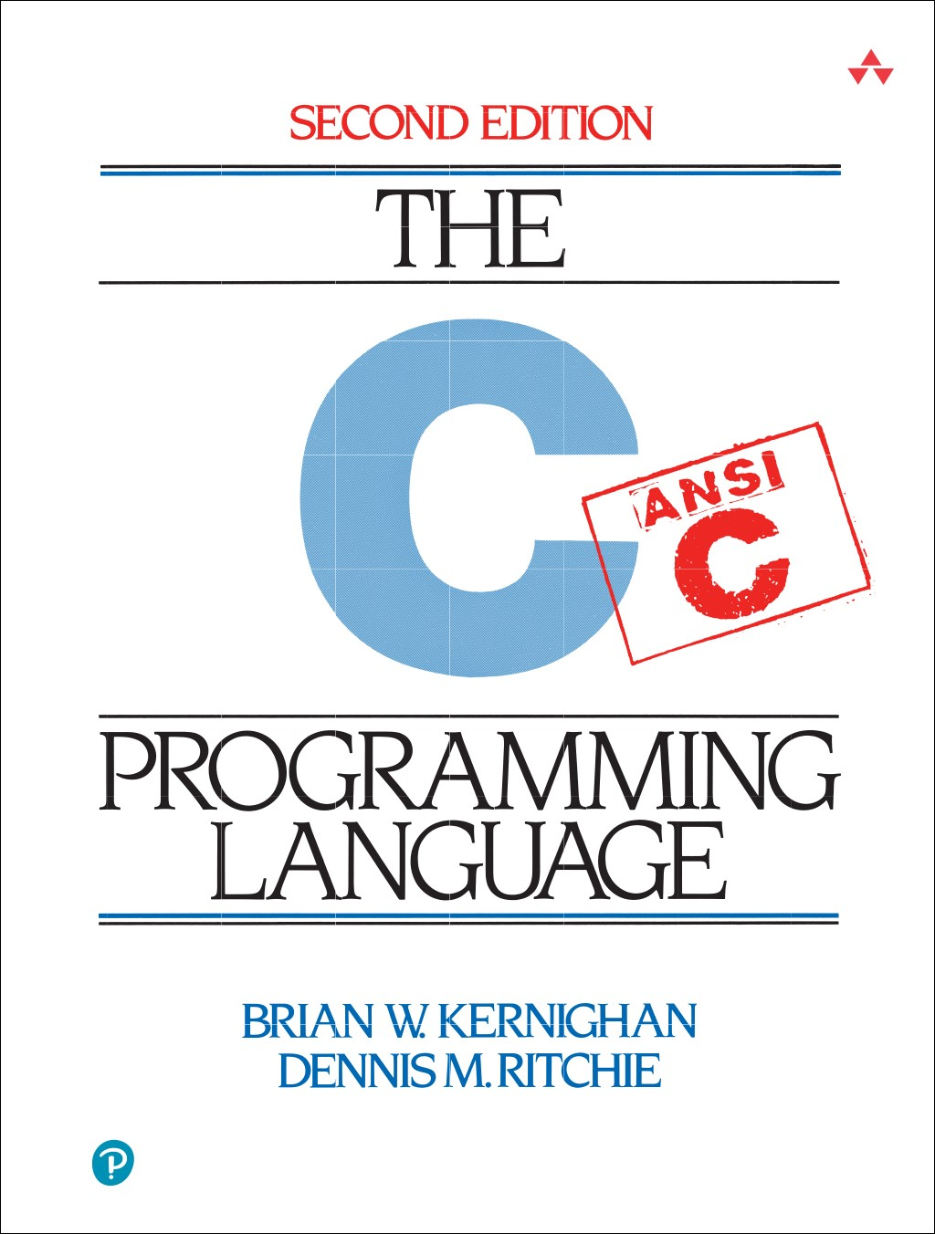

Slide 21
big O runtime of array operations

Slide 22
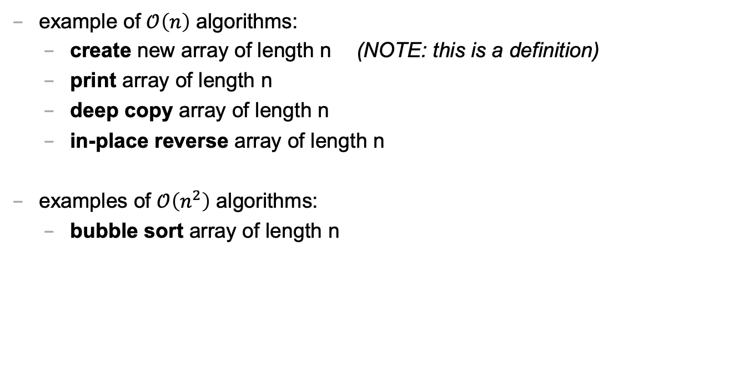
big O runtime of array operations
example of $𝒪\left(n\right)$ algorithms:
  create new array of length n (NOTE: this is a definition)
  print array of length n
  deep copy array of length n
  in-place reverse array of length n
examples of $𝒪\left(n^{2}\right)$ algorithms:
  bubble sort array of length n

Slide 23
💻 array tutorial

Slide 24
💻 array tutorial

Slide 25
💻 array tutorial
// 🟢 ([5, 4, 7, 0, 7], 7) -> 2
// 🟢 ([5, 4, 7, 0, 7], 3) -> -1
static int findFirstIndexOf(int[] array, int value);
// 🟦 ([1, 3, 3, 2, 3, 4], 3) -> [1, 2, 4]
static int[] removeAllOccurences(int[] array, int value);
// ♦️ [[1, 3], [2, 4, 5], [0, 5]] -> [0, 1, 2, 3, 4, 5, 5]
static int[] mergeArrayOfSortedArrays(int[][] arrays);

Slide 26
Week03
Today is...
✨No-Laptop Monday! ✨
🦜🦜🦜
WARMUP
What is a bullet hell?
functions
classes
BONUS
Who wrote the game Everyday Shooter?
What is she working on now?
BONUS
What does Touhou 7: Perfect Cherry Blossom's Extra Stage look like? Who wrote this?

Slide 27
functions

Slide 28
anatomy of a function

Slide 29
anatomy of a function (1/2)
a function is a lil chunk of code you can call from elsewhere
  a function takes any number of arguments
    ... foo(int arg) { ... } // function foo takes an int
  a function with a non-void return type must return a value of that type
    int bar(...) { ... } // bar returns an int
    void baz(...) { ... } // baz doesn't return anything
ReturnType functionName(ArgumentOneType argumentOne, ...) {
...
}

Slide 30
anatomy of a function (2/2)
void drawLine(
double a_x,
double a_y,
double b_x,
double b_y,
Color color
) {
...
}

Slide 31
return

Slide 32
return (1/2)
a return statement stops execution of a function and returns the program to where the function was called
  some return statements return a value
    return 123;
  others do not (they "return void")
    return;
      ✨ this can be used to stop running a void-returning function in the middle

Slide 33
return (2/2)
a function with a non-void return type must return a value of that type, regardless of the path taken through the function
Error: missing return statement
static boolean isEven(int n) {
if (n % 2 == 0) {
return true;
}
}

Slide 34
return (2/2)
a function with a non-void return type must return a value of that type, regardless of the path taken through the function
static boolean isEven(int n) {
if (n % 2 == 0) {
return true;
}
return false;
}

Slide 35
return (3/2)
a function with a non-void return type must return a value of that type, regardless of the path taken through the function
static boolean isEven(int n) {
return (n % 2 == 0);
}

Slide 36
void

Slide 37
void
void is a special return type meaning a function does not return a value
  void functions often modify (the objects referenced by) their arguments
    static void inPlaceReverse(int[] array) { ... }
      // ( no need to return a reference to array
      // user of the function already has one )
  in Java, the main method is a void function (it doesn't return anything)
    public static void main(String[] arguments) { ... }

Slide 38
the call stack

Slide 39
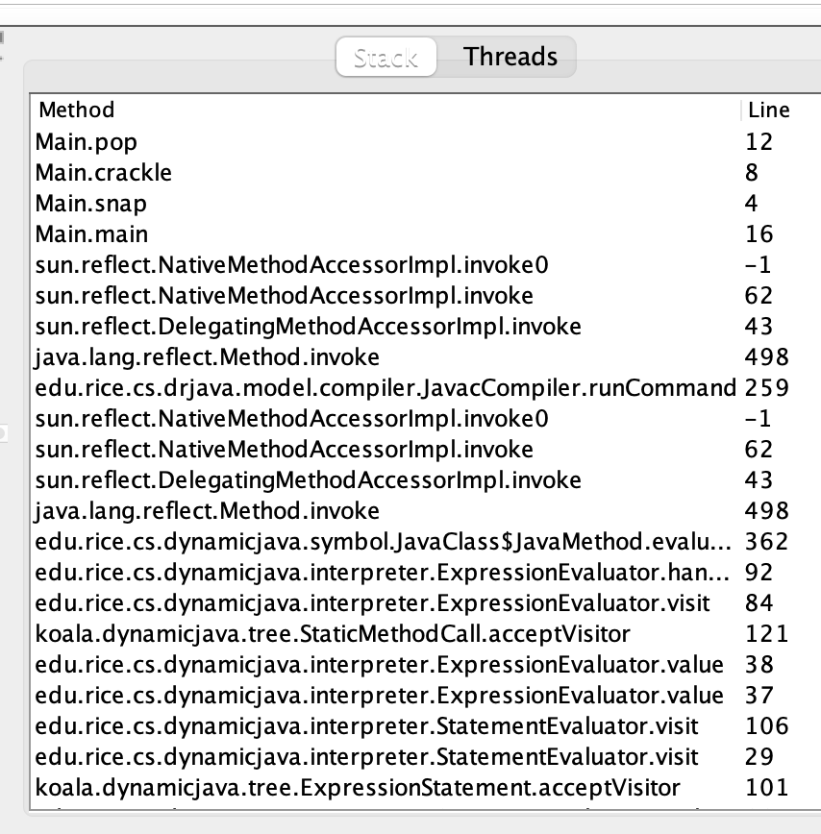
the call stack
functions can call other functions
  the resulting "stack" of function calls is called the call stack
class Main {
static void snap() {
crackle();
}
static void crackle() {
pop();
}
static void pop() {
return;
}
public static void main(String[] arguments) {
snap();
}
}

Slide 40
🤔

Slide 41
recursive functions

Slide 42
recursive functions (1/2)
a recursive function is a function that calls itself
  each call must make progress towards a base case
  (when the function finally returns without calling itself)
    ✨ when in doubt, try something like zero for your base case
class Main extends Cow {
static int digitSum(int n) {
if (n == 0) {
return 0;
}
return digitSum(n / 10) + (n % 10);
}
public static void main(String[] arguments) {
PRINT(digitSum(256)); // 13
}
}

Slide 43
static int digitSum(int n) {
if (n == 0) {
return 0;
}
return digitSum(n / 10) + (n % 10);
}
return 0;
return digitSum(0) + 2;
return digitSum(2) + 5;
return digitSum(25) + 6;
int a = digitSum(256);

Slide 44
static int digitSum(int n) {
if (n == 0) {
return 0;
}
return digitSum(n / 10) + (n % 10);
}
return 0;
return digitSum(0) + 2;
return digitSum(2) + 5;
return digitSum(25) + 6;
int a = digitSum(256);

Slide 45
static int digitSum(int n) {
if (n == 0) {
return 0;
}
return digitSum(n / 10) + (n % 10);
}
return 0 + 2;
return digitSum(2) + 5;
return digitSum(25) + 6;
int a = digitSum(256);

Slide 46
static int digitSum(int n) {
if (n == 0) {
return 0;
}
return digitSum(n / 10) + (n % 10);
}
return 2;
return digitSum(2) + 5;
return digitSum(25) + 6;
int a = digitSum(256);

Slide 47
static int digitSum(int n) {
if (n == 0) {
return 0;
}
return digitSum(n / 10) + (n % 10);
}
return 2;
return digitSum(2) + 5;
return digitSum(25) + 6;
int a = digitSum(256);

Slide 48
static int digitSum(int n) {
if (n == 0) {
return 0;
}
return digitSum(n / 10) + (n % 10);
}
return 2 + 5;
return digitSum(25) + 6;
int a = digitSum(256);

Slide 49
static int digitSum(int n) {
if (n == 0) {
return 0;
}
return digitSum(n / 10) + (n % 10);
}
return 7;
return digitSum(25) + 6;
int a = digitSum(256);

Slide 50
static int digitSum(int n) {
if (n == 0) {
return 0;
}
return digitSum(n / 10) + (n % 10);
}
return 7;
return digitSum(25) + 6;
int a = digitSum(256);

Slide 51
static int digitSum(int n) {
if (n == 0) {
return 0;
}
return digitSum(n / 10) + (n % 10);
}
return 7 + 6;
int a = digitSum(256);

Slide 52
static int digitSum(int n) {
if (n == 0) {
return 0;
}
return digitSum(n / 10) + (n % 10);
}
return 13;
int a = digitSum(256);

Slide 53
static int digitSum(int n) {
if (n == 0) {
return 0;
}
return digitSum(n / 10) + (n % 10);
}
return 13;
int a = digitSum(256);

Slide 54
static int digitSum(int n) {
if (n == 0) {
return 0;
}
return digitSum(n / 10) + (n % 10);
}
int a = 13;

Slide 55
fin.

Slide 56
recursive functions (2/2)
a stack overflow error happens when functions call too many functions without returning; these errors are usually caused by broken recursive code
class Main {
static void stackOverflow() {
stackOverflow();
}
public static void main(String[] arguments) {
stackOverflow();
}
}
java.lang.StackOverflowError
at Main.stackOverflow(Tmp.java:3)
at Main.stackOverflow(Tmp.java:3)
at Main.stackOverflow(Tmp.java:3)
at Main.stackOverflow(Tmp.java:3)
at Main.stackOverflow(Tmp.java:3)
at Main.stackOverflow(Tmp.java:3)
at Main.stackOverflow(Tmp.java:3)
at Main.stackOverflow(Tmp.java:3)
at Main.stackOverflow(Tmp.java:3)
at Main.stackOverflow(Tmp.java:3)
at Main.stackOverflow(Tmp.java:3)
at Main.stackOverflow(Tmp.java:3)
at Main.stackOverflow(Tmp.java:3)
at Main.stackOverflow(Tmp.java:3)
at Main.stackOverflow(Tmp.java:3)
at Main.stackOverflow(Tmp.java:3)
at Main.stackOverflow(Tmp.java:3)
at Main.stackOverflow(Tmp.java:3)
at Main.stackOverflow(Tmp.java:3)
at Main.stackOverflow(Tmp.java:3)
at Main.stackOverflow(Tmp.java:3)
at Main.stackOverflow(Tmp.java:3)
at Main.stackOverflow(Tmp.java:3)
at Main.stackOverflow(Tmp.java:3)
at Main.stackOverflow(Tmp.java:3)
at Main.stackOverflow(Tmp.java:3)
at Main.stackOverflow(Tmp.java:3)
at Main.stackOverflow(Tmp.java:3)
at Main.stackOverflow(Tmp.java:3)
at Main.stackOverflow(Tmp.java:3)
at Main.stackOverflow(Tmp.java:3)
at Main.stackOverflow(Tmp.java:3)
at Main.stackOverflow(Tmp.java:3)
at Main.stackOverflow(Tmp.java:3)
at Main.stackOverflow(Tmp.java:3)
at Main.stackOverflow(Tmp.java:3)
at Main.stackOverflow(Tmp.java:3)
at Main.stackOverflow(Tmp.java:3)
at Main.stackOverflow(Tmp.java:3)
at Main.stackOverflow(Tmp.java:3)
at Main.stackOverflow(Tmp.java:3)
at Main.stackOverflow(Tmp.java:3)
at Main.stackOverflow(Tmp.java:3)
at Main.stackOverflow(Tmp.java:3)
at Main.stackOverflow(Tmp.java:3)
at Main.stackOverflow(Tmp.java:3)
at Main.stackOverflow(Tmp.java:3)
at Main.stackOverflow(Tmp.java:3)
at Main.stackOverflow(Tmp.java:3)
at Main.stackOverflow(Tmp.java:3)
at Main.stackOverflow(Tmp.java:3)
at Main.stackOverflow(Tmp.java:3)
at Main.stackOverflow(Tmp.java:3)
at Main.stackOverflow(Tmp.java:3)
at Main.stackOverflow(Tmp.java:3)
at Main.stackOverflow(Tmp.java:3)
at Main.stackOverflow(Tmp.java:3)
at Main.stackOverflow(Tmp.java:3)
at Main.stackOverflow(Tmp.java:3)
at Main.stackOverflow(Tmp.java:3)
at Main.stackOverflow(Tmp.java:3)
at Main.stackOverflow(Tmp.java:3)
at Main.stackOverflow(Tmp.java:3)
at Main.stackOverflow(Tmp.java:3)
at Main.stackOverflow(Tmp.java:3)
at Main.stackOverflow(Tmp.java:3)

Slide 57
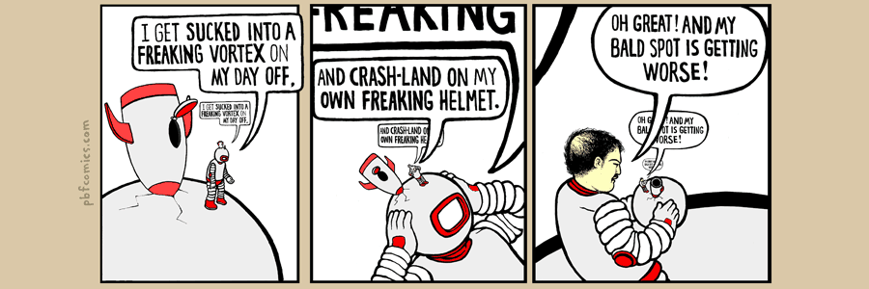

Slide 58
classes

Slide 59
anatomy of a class

Slide 60
anatomy of a class (1/2)
class ClassName {
VariableOneType variableOne;
...
FunctionOneReturnType functionOneName(...) { ... }
...
}
a class lets you bundle together data and functions
  a class may have any number of variables (fields)
    int foo; // objects of this class have an int called foo
  a class may have any number of functions (methods)
    int bar() { ... } // objects of class have function bar

Slide 61
anatomy of a class (2/2)
class Thing {
// instance variables
double x;
double y;
Color color;
double radius;
// instance methods
void draw() { ... }
...
}

Slide 62
dot

Slide 63
dot
the dot operator is used to access an object's variables and functions
Thing thing = new Thing();
thing.x = 3.0;
thing.y = 4.0;
thing.draw();

Slide 64
terminology

Slide 65
class vs. object (instance of a class)
a class is NOT the same thing as an object
  a class is "a blueprint for making objects"
  we can make an instance of a class (an object) using the new keyword
    this is called "instantiating the class"
    Thing thing = new Thing();

Slide 66
new and constructors

Slide 67
new
the new keyword create a new instance of a class
and calls its appropriate constructor
  int[] array = new int[5]; // { 0, 0, 0, 0, 0 }
  Color color = new Color(1.0, 0.0, 0.0); // (1.0, 0.0, 0.0)
  ☠️ you don't need new to create a new string
    String string = "strings are their own thing";
  ☠️ you don't need new to create a new array when using {} syntax
    int[] array = { 1, 2, 3 };
  ☠️ new doesn't actually return the object it created;
  it returns a reference to the object

Slide 68
constructors (1/2)
a constructor is called when an object is created
  if the class does not have a constructor, then the default constructor must be called, which takes no arguments and sets all variables to zero
    Color color = new Color(); // (0.0, 0.0, 0.0)

Slide 69
constructors (2/2)
a (non-default) constructor is never necessary, but is often convenient
Color color = new Color(1.0, 1.0, 1.0); // (r=1.0, g=1.0, b=1.0)
Color color = new Color(); // (0.0, 0.0, 0.0)
color.r = 1.0; // (1.0, 0.0, 0.0)
color.g = 1.0; // (1.0, 1.0, 0.0)
color.b = 1.0; // (1.0, 1.0, 1.0)

Slide 70
this
🐍 in Python, this is self

Slide 71
this
this is a reference to the instance of the class whose function we're inside of
  ✨ especially useful inside a constructor
class Color {
...
void shade() {
this.r /= 2;
this.g /= 2;
this.b /= 2;
}
Color(double r, double g, double b) { // constructor
this.r = r;
this.g = g;
this.b = b;
}
}

