Slide 1


🐝
🔥
🔥
🔥
🔥
🔥
🔥
🔥
🔥
🔥
🔥
🔥
🔥

Slide 2
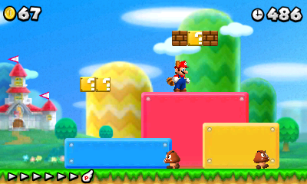
semi-solid platform
Directionally Solid Platforms

